Slide 2
Next week in school we will be learning about new ways we can take care of our mental health.

Slide 3
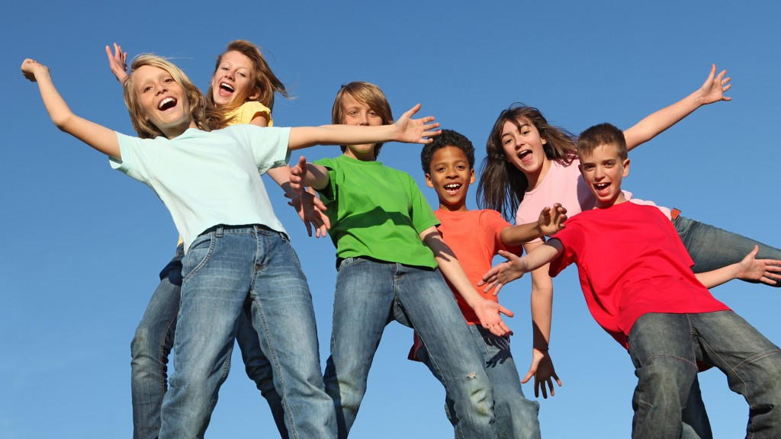
Mental Health is all about being good on the inside, in our emotions and how we feel. Sometimes, if we do not feel good on the inside, it can effect how we feel on the outside.
It is important to take care of ourselves by getting help to make ourselves feel better.

Slide 4
Ways we can help ourselves
You might think people do not care, but they do!
Sometimes carrying a big bag of worries around can make us feel tired and sad.
We can ask others to help us share our worried and help us find ways to feel better about things.
Here are some people who can help:
Parents, grandparents, sisters and brothers
Teachers or adults in school
FRIENDS
YOU!

Slide 5
You can help spread a bit of kindness to help those who are feeling sad, lonely, worried or frightened.

Slide 6
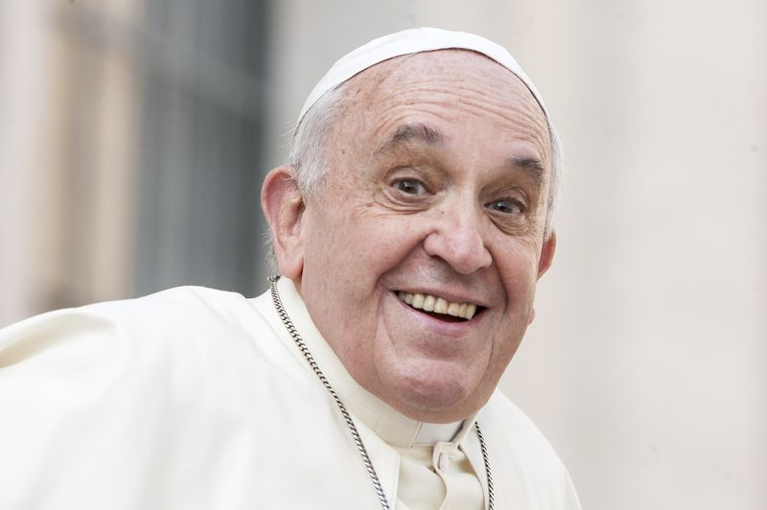
As Pope Francis says:
“Let us learn to live with kindness, to love everyone, even when they do not love us.”

Slide 7
Sometimes…
…children who do not feel good on the inside find it hard to tell others how they are feeling.
They can behave in ways that make it difficult for others to understand.
They can appear…

Slide 8
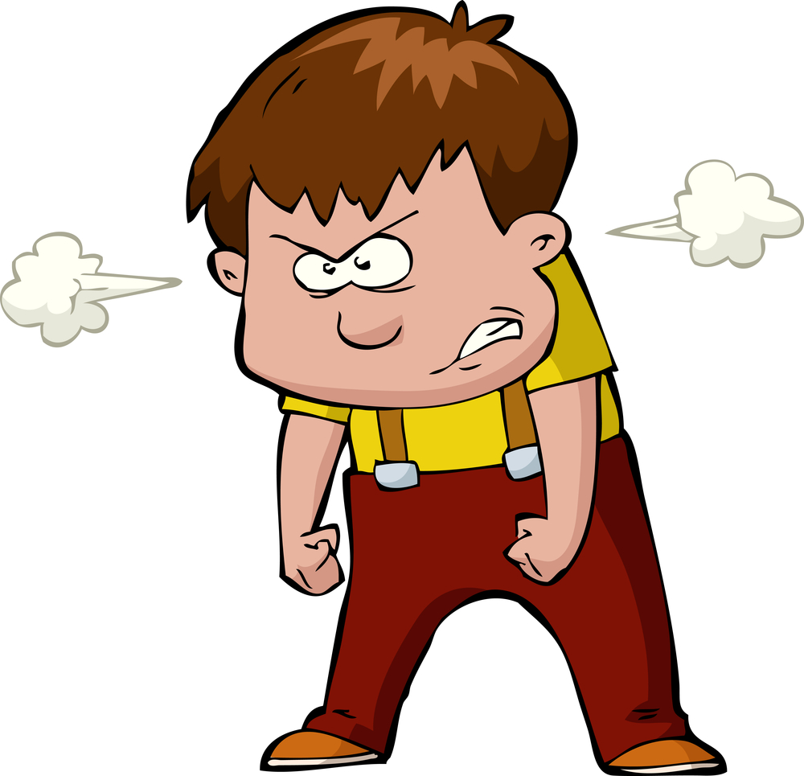
Angry

Slide 9
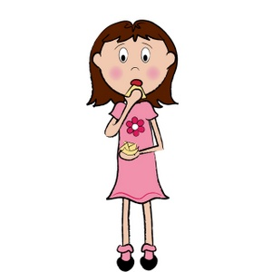
Quiet and nervous

Slide 10
Find it hard to concentrate and learn

Slide 11
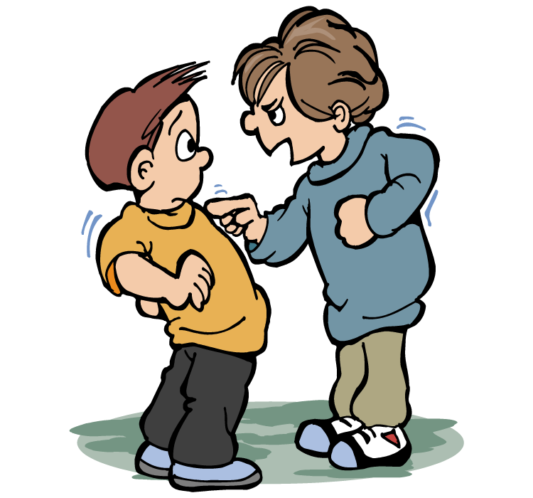
Find it hard to talk to others or to be a good friend

Slide 12
To help us think more about spreading a little kindness, we have a competition!
To enter, you will have to create your own superhero and show ways they can help spread kindness to those who don’t feel good on the inside.
The winner has a chance of winning cinema tickets for the new Lego Batman movie… for the entire class!

Slide 14
All you need is your imagination and a pencil.
Draw your own version of a Bat-sign and accompany it with your hero’s name and summary (what the superhero can do).
Try to make your superhero think about kind acts to help others.
Your teacher has other resources that will help you create your hero and think of ways he or she can spread kindness to others.

Slide 15
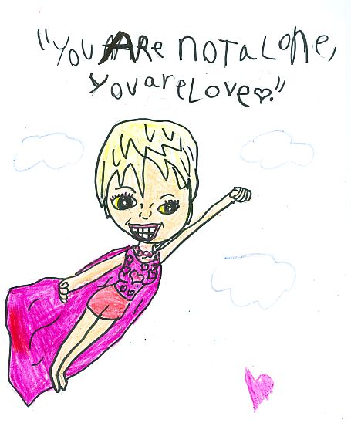
HAVE FUN and remember that each and everyone of us can help spread a little kindness next week, and every day of our lives to help ourselves and others feel better and healthier on the inside.
Spread your kindness superpowers!

