Slide 1
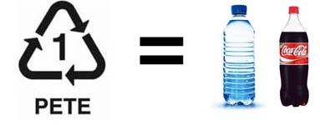
Plastic and Processes
clear, tough, and shatterproof. It provides a barrier to oxygen, water, and carbon dioxide PET's ability to contain carbon dioxide (carbonation) makes it ideal for use in carbonated soft drink bottles.
Polyethylene terephthalate

Slide 2
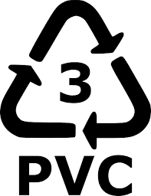
Plastic and Processes
Polyvinyl Chloride (PVC) is a major plastics material which finds widespread use in building, transport, packaging, electrical/electronic and healthcare applications. PVC is a very durable and long lasting construction material which can be used in a variety of applications, either rigid or flexible, white or black and a wide range of colours in between

Slide 3
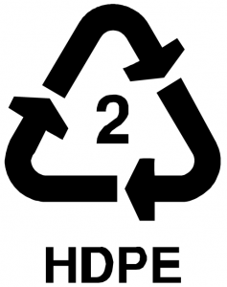
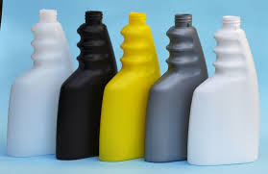
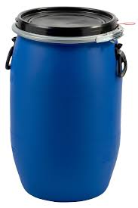
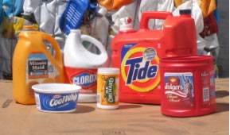
Plastic and Processes
=
Polyethylene (High Density)
Flexible, translucent/waxy, weatherproof, good low temperature toughness (to -60'C), easy to process by most methods, low cost, good chemical resistance.

Slide 4
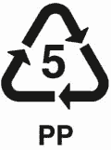
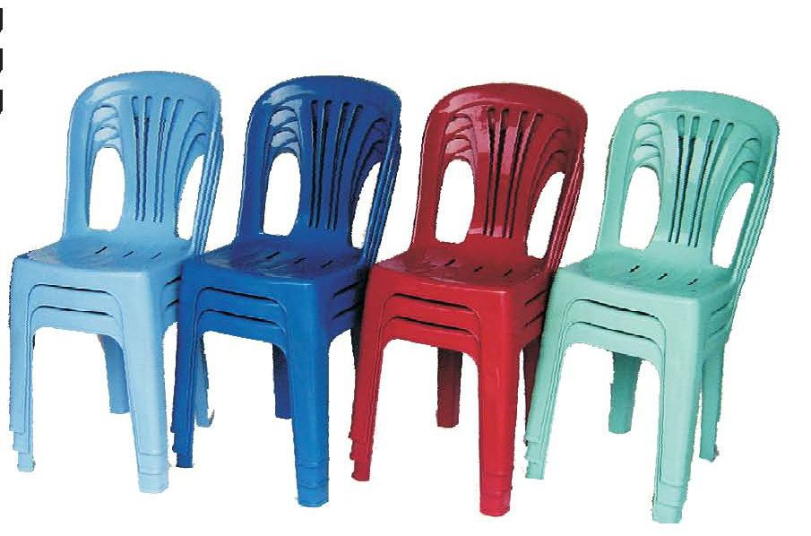
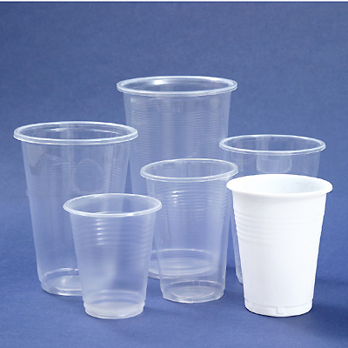
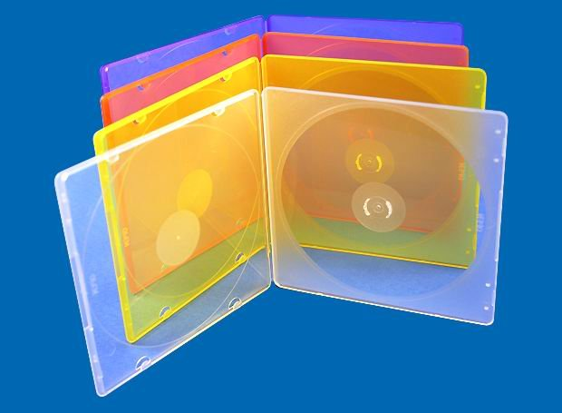
Plastic and Processes
=
Good chemical resistance
Tough
Good fatigue resistance
Integral hinge property
Cheap
Comes in a variety of colours
Good heat resistance
Translucent
adjective1.permitting light to pass through but diffusing it so that persons, objects, etc., on the opposite side are not clearly visible
Polypropylene

Slide 5
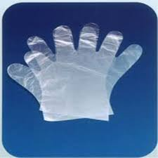
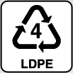
Plastic and Processes
=
Dry cleaning bags
Shopping bags
Plastic food wrap
flexible, and tough and is breakable.
Film for packaging is one of the largest markets for low density polyethylene. Low cost, ease of sealing and good product protection have helped to make film the largest polyethylene market
Polyethylene (low density)

Slide 6
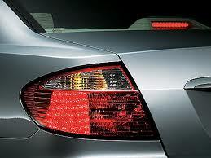
Plastic and Processes
Thermoplastic
PMMA (polymathic methacrylate) or ACRYLIC as its also known is both a thermoplastic and transparent plastic. Two of the most common brand names are Plexiglass and Lucite and it is also commonly known as acrylic glass, perspex or plexiglas.
It is often used as an alternative to glass and is preferred for many applications because of its moderate properties, easy handling, easy processing and low cost. However, acrylic is not recommended for use in structural applications because of its poor impact resistance.
• Disadvantages:
Poor solvent resistance
Possibility of stress cracking
Combustibility
Limited continuous service temperature of 93C and 200F
Inflexibility
PMMA (Polymethyl Methacrylate)
Acrylic plastics are available in three forms: flat sheets, elongated shapes (rods and tubes), and molding powder.

Slide 7
Plastic and Processes
Thermoplastics
It is a polymer that turns liquid when heated and returns to its solid state when cooled. Thermoplastics, like ABS, can be repeatedly re-melted and remoulded.
9
High-impact resistance with toughness and rigidity
Good electrical properties
3.Fairly good weather resistance and high gloss
4. Ease of forming by thermoplastic methods
5.Good chemical resistance
6.Lightweight
7.Very low moisture absorption
Disadvantages:
Poor solvent resistance
Low continuous service temperatures
Even thought ABS is a recyclable material it still has a considerable negative impact on the environment. The plastic starts as crude oil that must be drilled (an environmentally harmful process) for the raw materials to make the plastic.
Acrylonitrile Butadiene Styrene (ABS)

Slide 8
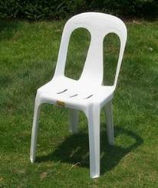
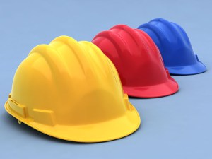
Plastic and Processes
Poor Product Applications:
Outdoor Furniture, because of it’s poor resistance to sunlight (UV rays).
Window Framings, because of ABS’s poor UV resistance and likeliness to discolour.
9
Common Product Applications:
Housing for Power Tools, Telephones, Computers and Medical Equipment, Ear Defenders and other Safety Equipment, Children’s Toys and Automotive Parts
Acrylonitrile Butadiene Styrene (ABS)

Slide 10
Plastic injection moulding
How plastic bottles are made
http://www.youtube.com/watch?v=ed7XJeXl3b4

