Slide 1
Materials and Manufacture (MM)
In this section you will learn about
LI: - the term Standard Components.
- identifying a standard component.
- adv/disadv of standard components
- knock down fittings
- rapid prototyping and production methods
1. STANDARD COMPONENTS

Slide 2
Introduce the term standard component.
The competitive nature of the manufacturing industry means that companies are constantly looking for ways to increase the speed at which they produce products.
Three of the most important ways companies can achieve this are by using;
standard components.
Knock down fittings
different production methods.
A standard component is usually an individual part or component, manufactured in thousands or millions, to the same specification (such as size, weight, material etc...). A good example is a steel bolt. Bolts are available in a vast range of standard sizes. However, each size is manufactured to an internationally accepted standard. For example, a M20 bolt. A typical steel M20 bolt will be a specific length, diameter, quality of steel, pitch of thread etc.

Slide 3
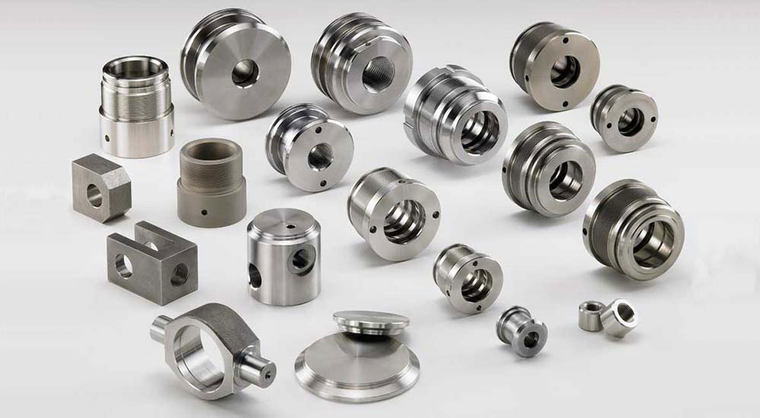
ADVANTAGES OF USING STANDARD COMPONENTS
1. Standard components can be manufactured in vast quantities, keeping costs down.
2. Standard components are supplied in standard sizes. Consequently, they are easy to order. Ordering of standard components is relatively straightforward, sizes / dimensions etc... are available in table or index form.
3. Buying directly from suppliers, over the counter, at hardware stores such as B & Q, is easier as standard components such as screws, bolts, nails and fixings are often displayed in order. This makes it easier to find the component the customer requires.
4. Safety / quality testing is easier when dealing with standard components. Often a number of standard components, from a batch will be tested. Faulty components can be withdrawn from sale, if detected.
5. Manufacturers of ‘complex’ products (computers TVs, etc....), usually assemble their products from standard components. This allows them to concentrate on the development of their specialised product, rather than having to design each individual component. This speeds up product development.
6. Setting up a mass production line is easier if standard components are used. It is easier to train staff / the workforce, as they are dealing with the same standard components, when assembling products.

Slide 4
b. Knock down fittings
PLASTIC CORNER BLOCK (FIXIT BLOCKS):
The corner block is pressed against the two pieces of material (normally wood based). Screws are used to fix the block into position. This type of joint is used to fit modern cabinets such as those found in a kitchen. It is a relatively strong joint although it has the advantage that it can be dismantled using a screwdriver
Knock-down fittings are those that can be put together easily, normally using only a screw driver, a drill, a mallet/hammer and other basic tools. They are temporary joints although many are used to permanently join together items such as cabinets and other pieces of furniture that are purchased in a flat pack.
RIGID JOINT: These are normally moulded in plastic which makes them strong. Screws pass through the four holes which hold the sides at each corner firmly together.

Slide 5
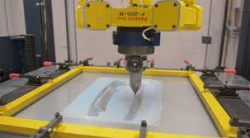
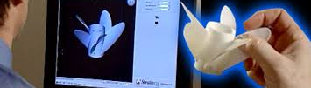
Rapid Prototyping
Rapid prototyping involves using a CNC machine to make a working model of a part directly from a CAD program. It can produce complicated 3D shapes, although the material used is often not what would be used in large-scale production. Rapid prototypes are normally used to evaluate a design, but they can be used for enclosures.
There are a range of different rapid-prototyping processes: typically they involve building up a product by depositing layer after layer of material. It often takes many hours, or even days, to produce a part. They are only suitable for making one-off products where cost is not an important factor.
BENEFITS OF RAPID PROTOTYPING
Allows the designer to make prototyping of components for a product without the need of expensive tooling.
Parts can be tested easily
Some RP Processes use materials such as ABS which can be used in the final product.
Using RP speeds up the design process.

Slide 6
c. Production methods
Production methods refers to how things are assembled. Manufactured and finished.
Not in terms of the process like injection mould, sand casting etc. that would be the production process...dont confuse the two.
There are 4 main production methods used in manufacturing:
one-off = one product at a time and each product is unique. This method needs highly skilled workers. This methods needs specialist machinery to create bespoke high demand products.
batch = a small number of identical products are made at one time. One batch is manufactured before the next batch is made. Highly skilled workers are required for this method.

Slide 7
Production methods
3. mass production = large volumes of identical products or components are manufactured by this method. The system is highly automated with a small number of workers. Not much skill is required.
4. Continuous flow manufacture = extremely high volumes are produced 24hours a day – 7 days a week. Highly automated with a small number of workers with very little manufacturing skills.

Slide 8
The Teams (Production method task)
 |  |  |  | Ben
 |  |  |  | Marc
 |  |  |  | Alexander
 |  |  |  | Ryan
 |  |  |  | Owen
 |  |  |  | Martyna
 |  |  |  | Irfan
 |  |  |  | Andrzej
 |  |  |  | Jade
 |  |  |  | Jonathan
 |  |  |  | Melissa
 |  |  |  | Declan
 |  |  |  | Cameron
 |  |  |  | Christopher
 |  |  |  | Patricia
 |  |  |  | Rhys
 |  |  |  | Declan L
 |  |  |  | Thomas Stephanie
 |  |  |  | Matthew
 |  |  |  | Emma
 |  |  |  | Jamie
 |  |  |  | Paul F
 |  |  |  | Aiden
 |  |  |  | Chloe
 |  |  |  | Matthew
 |  |  |  | Kieran
 |  |  |  | Francesca
 |  |  |  | Holly
 |  |  |  | Eve
 |  |  |  | Erin
 |  |  |  | Kieran W Paul C
 |  |  |  | Conor
 |  |  |  | Kieran
 |  |  |  | Ryan
 |  |  |  | Emma
Team Presentation task
In your separate teams choose a product
identify 2 standard components or knock down fittings used in the product
Highlight an area that could have been developed using a rapid prototyping method and why.
Decide what production method was used in the manufacture of your product.
How should this be presented.
An A1 poster with the product in the middle and the information surrounding it. A class presentation in teams.
A
B
C
D

Slide 9
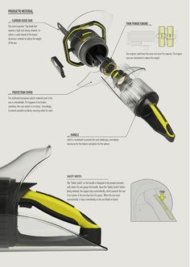
Exemplar poster
Rapid Prototype – the handle could have been rapid prototyped by using 3d printing – this would have been used in presenting concepts to the client
Standard components have been used in this product in the handle (20mm countersunk screw) the plug (three pronged connectors)……..
Production – this product was manufactured using batch production………

Slide 10
Materials and Manufacture (MM)
In this section you will learn about
LI: - hardwoods and softwoods
- manufactured woods
- properties and joints
- finishing techniques
- metal – ferrous and non ferrous
- metal processes – piercing and blanking, drop forging and forming
2. Timbers and metals

Slide 11
T I m b e r s (generic)
Timber
There are two types of timber, called hardwood and softwood. These names do not refer to the properties of the wood: some softwoods can be hard and some hardwoods can be soft. For example one of the weakest woods around is balsa wood, normally used for modelling…is a hardwood. There is a third type of wood called manufactured wood, which we will cover throughout your lessons.
Softwood
Softwoods come from coniferous trees which are evergreen, needle-leaved, cone-bearing trees, such as cedar, fir and pine.
Hardwood
Hardwoods come from broad-leaved, deciduous trees. The main hardwood timbers are ash, beech, birch, cherry, elm, iroko, mahogany, meranti, oak, obeche, sapele and teak.

Slide 12
H A R D W O O D BBB
Birch Beech & Balsa
Mooaan then
Hardwoods are often referred to as Solid Timbers
The benefits of using solid timbers (hardwoods)are;
• Quality of finish
• Aesthetics
• Durability
• Strength issues
• Recyclability
Typically hardwoods tend to be a lot more expensive, as during the farming process they take a lot longer to grow.

Slide 13
S O F T W O O D SCS
Scots Pine, Ceder & Spruce

Slide 14
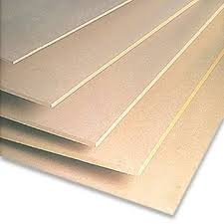
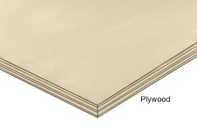
M a n u f a c t u r e d w o o d s MDF
Medium Density Fibre
Really cheap,
Can be cut into large sheets
Easy to work
What properties apply to all hardwoods = durable . Finish well,
What properties apply to all softwoods = durable . Finish well,
What properties apply to all manufactured woods = cheap

Slide 15
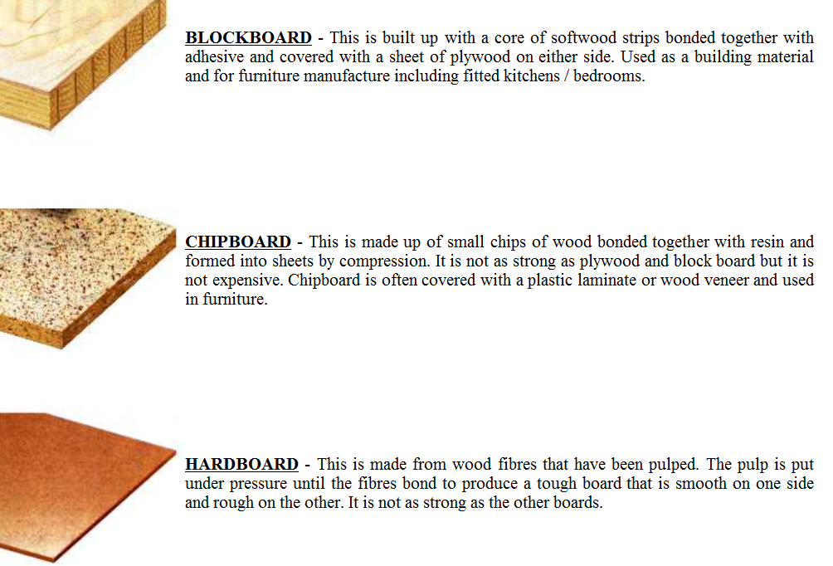
c. Manufactured woods

Slide 16
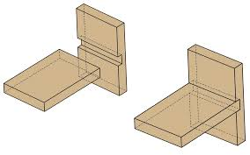
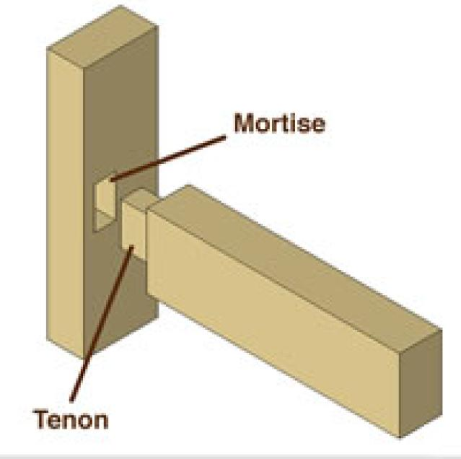
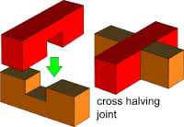
W o o d w o r k J o i n t s
Mortise and Tenon
Strong
Hidden joints
Difficult to make
Housing joint
Easy to make
Can be constructed from one part
Not very strong

Slide 17
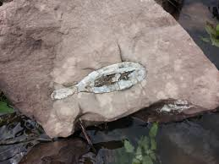
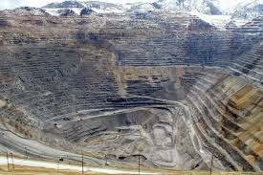
Metal
Metal ores and rocks are mined then processed to refine them into metals.
Some metals are mixed together such as brass (copper added with zinc) this is called an alloy.
All metals including alloys are classified into two groups
FERROUS AND NON FERROUS METALS

Slide 18
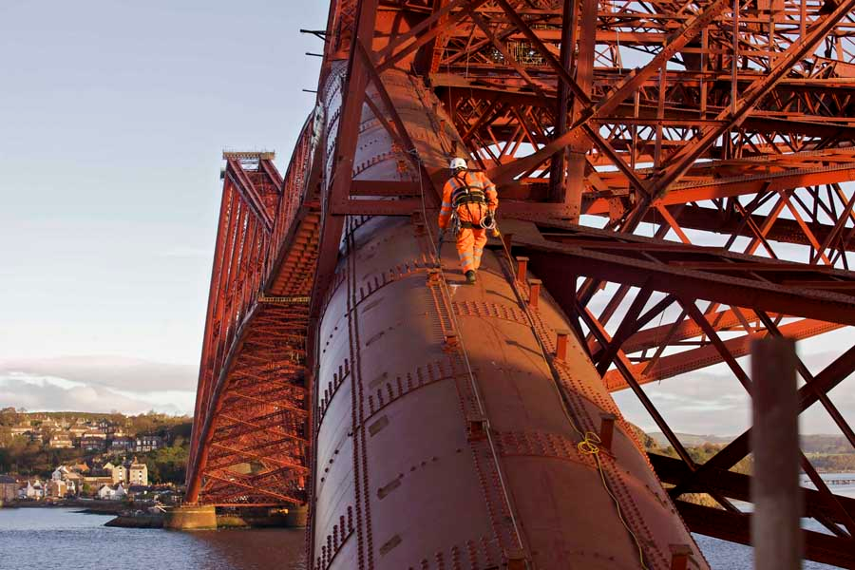
Forth Rail Bridge
Why is the forth rail bridge red ?
The bridge is made from steel, steel is a Ferrous metal which when in contact with the environment will rust
In 1890 the bridge was coated with RED OXIDE PAINT. This product protects ferrous metals from rust and corrosion . If the bridge was built today it may have been galvanised to protect it.,
The red oxide was mixed with forth bridge red paint in order to maintain the historical aesthetics of the bridge.

Slide 19
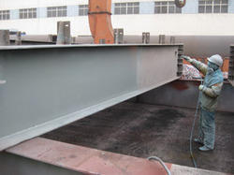
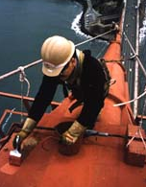
Golden gate bridge
What colour is the golden gate bridge ?
The Golden Gate Bridge has always been painted orange vermilion, deemed "International Orange.
the term Golden Gate refers to the Golden Gate Strait which is the entrance to the San Francisco Bay
paint protects the Bridge from the high salt content in the air which rusts and corrodes the steel components
In the 1980s, this paint system was replaced by a water-borne inorganic zinc primer and an acrylic topcoat

Slide 20
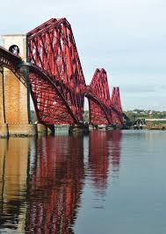
FERROUS (FERRUST) IMsSs
Iron, mild steel and stainless steel
A ferrous metal is a metal which contains iron. It is there for magnetic.
Iron reacts with oxygen on the surface of metal and creates a reaction called rust.
How can we avoid rust from happening ?
Apply a finish such as paint
Galvanised
Dip coating
Red oxide coating

Slide 21
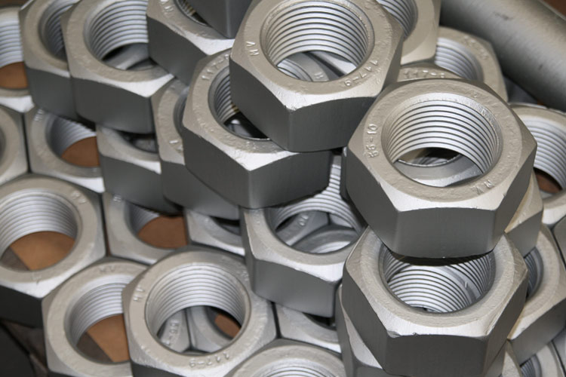
FERROUS finishes
Galvanised
https://www.youtube.com/watch?v=ZXvLLIjBMvo
Steel is usually coated. For example, the Golden Gate Bridge in San Francisco receives a new coat of rust resistant bronze paint every five years. This prevents rust damaging the structural integrity of the bridge. On smaller manufactured items zinc is used to coat steel and this is an effective measure against rust. This process is called galvanising.

Slide 22
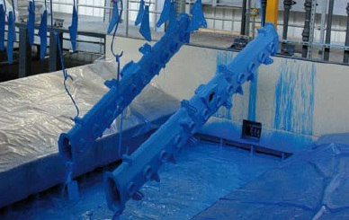
FERROUS finishes
Dip Coating
Dip coating is the precision controlled immersion and withdrawal of any substrate into a reservoir of liquid for the purpose of depositing a layer of material.

Slide 23
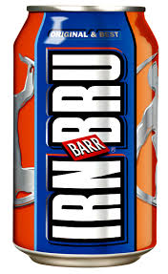
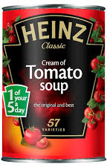
NON – FERROUS (NONFERRUST )ABC and Z
Aluminium, Brass, Copper AND Zinc
A ferrous metal is a metal which DOES NOT contains iron. It is there for NOT magnetic.
MOST NON ferrous metals are corrosion resistant. Which means they do not rust.
So why does cans rust sometimes if they are made from tin or aluminium?
Soup tins is not tin at all ….the are steel, and dipped in a tin coating .
Aluminium cans do not rust after several years the protective layer breaks down and corrodes (does not flake)

Slide 24
FERROUS AND NON FERROUS
ADVANATGES OF USING METAL
COME IN A RANGE OF COLOURS WITH THE COMBINATION OF PAINTING AND DIP COATING
HAVE A HYGNEIC AND STERILE APPEARANCE
EXCELLENT FOR CONDUCTING HEAT AND ELECTRICITY
SOME HAVE A GOOD STRENGTH TO WEIGHT RATIO (ALUMINIUM)
DISADVANTAGES
FERROUS METALS ARE PRONE TO RUST ADDING TIME AND COST TO MANUFACTURING
REQUIRES MAINTAINENECE TO PREVENT RUST
FINITE RESOURCE MEANING THAT ONCE ALL METALS HAVE BEEN MINED FROM THE EARTH THEY CANNOT BE REPLACED. THEREFORE METAL PRODUCTS SHOULD BE DESIGNED TO RECYLCE OR REUSE

Slide 25
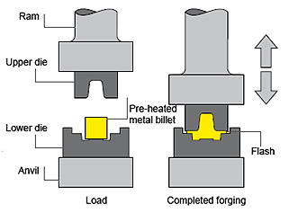
Metal process – drop forging
Drop forging is a metal shaping process in which a heated work piece is formed by rapid closing of a punch and die. Drop forging is also called impression die or closed die forging, or rot forging.
Benefits
It is a repeatable process
One piece construction
Good surface finish
How would you know something has been drop forged.
One piece construction
Quality of surface detail/finish
Draft angle / relief profile
DROP FORGING – CORROSION RESISTANT VIDEO
https://www.youtube.com/watch?v=WWXAnHXOfrw

Slide 26
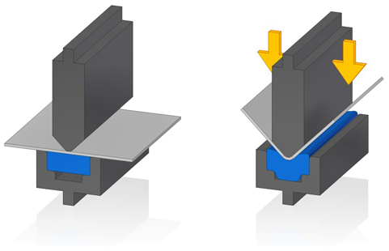
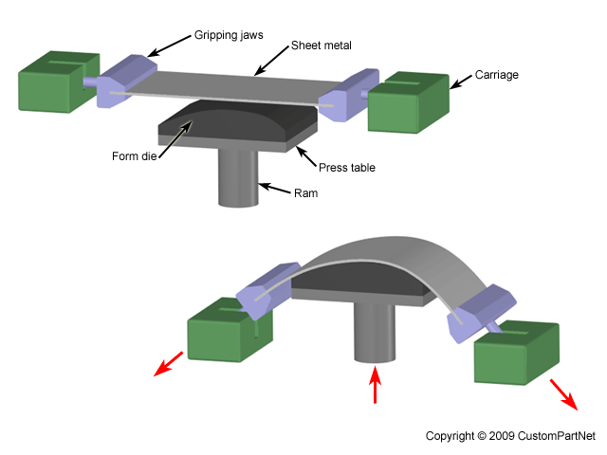
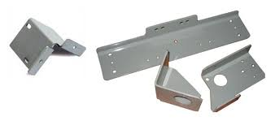
Metal process – press forming
press forming is a forming technology where a pressing force is applied to a material to deform it (by bending, stretching, etc.) to match the size and shape of the die, and the material then maintains that shape forever.
https://www.youtube.com/watch?v=jW9ksLb94vo

Slide 27
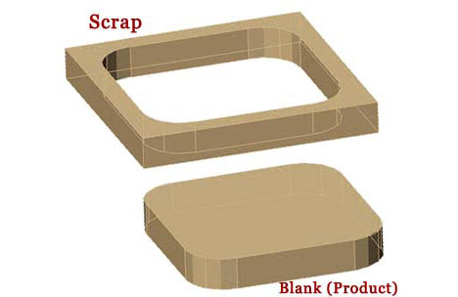
Metal process – piercing and blanking
Both blanking and piercing are essentially the same thing: A process whereby a particular shape is punched out of a sheet of metal, just like a cookie cutter and a sheet of dough. The difference is that with blanking the outside part is waste, whereas with piercing the inside part is waste--it's an is-the-glass-half-full-or-half-empty kind of thing.
Benefits or piercing and blanking
- Repeatability, accuracy & works well with a mass manufacture environment.
https://www.youtube.com/watch?v=RdeaLYIR3TE

