Slide 1
Lesson Title: PSHE/RE Lesson
LI: To think about what mental health ‘looks like’.
SC: To understand the impact that social media can have on our mental health, and that sometimes appearances can be deceiving!

Slide 2
STARTER
In pairs, try to answer the following question:
What is mental health, and why is it important?

Slide 3
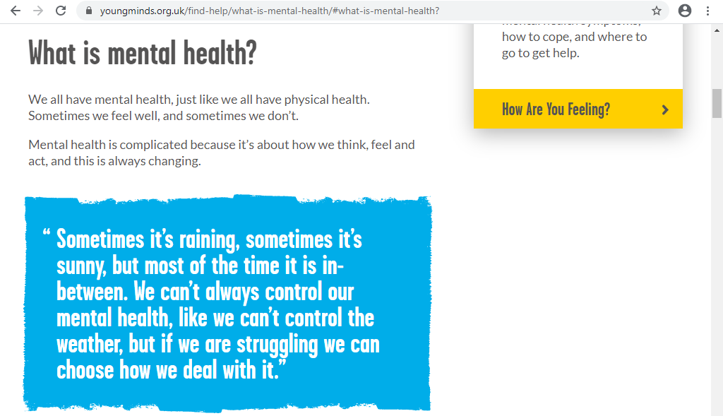

Slide 4
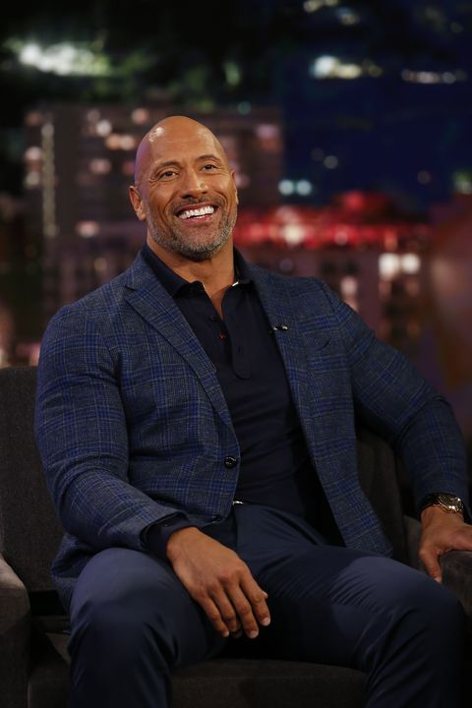
Notes:
Discuss who the above celebrities are and their similarities and differences – industry/gender/age/race etc.
Ask pupils which celebrity they think has had problems with their mental health? Why do they think that?
Reveal that all of them have spoken openly about their mental health issues.

Slide 5
Can you tell much about someone’s mental health by looking at a picture? Why/why not?
Notes:
Class discussion about what mental health ‘looks like’.

Slide 6
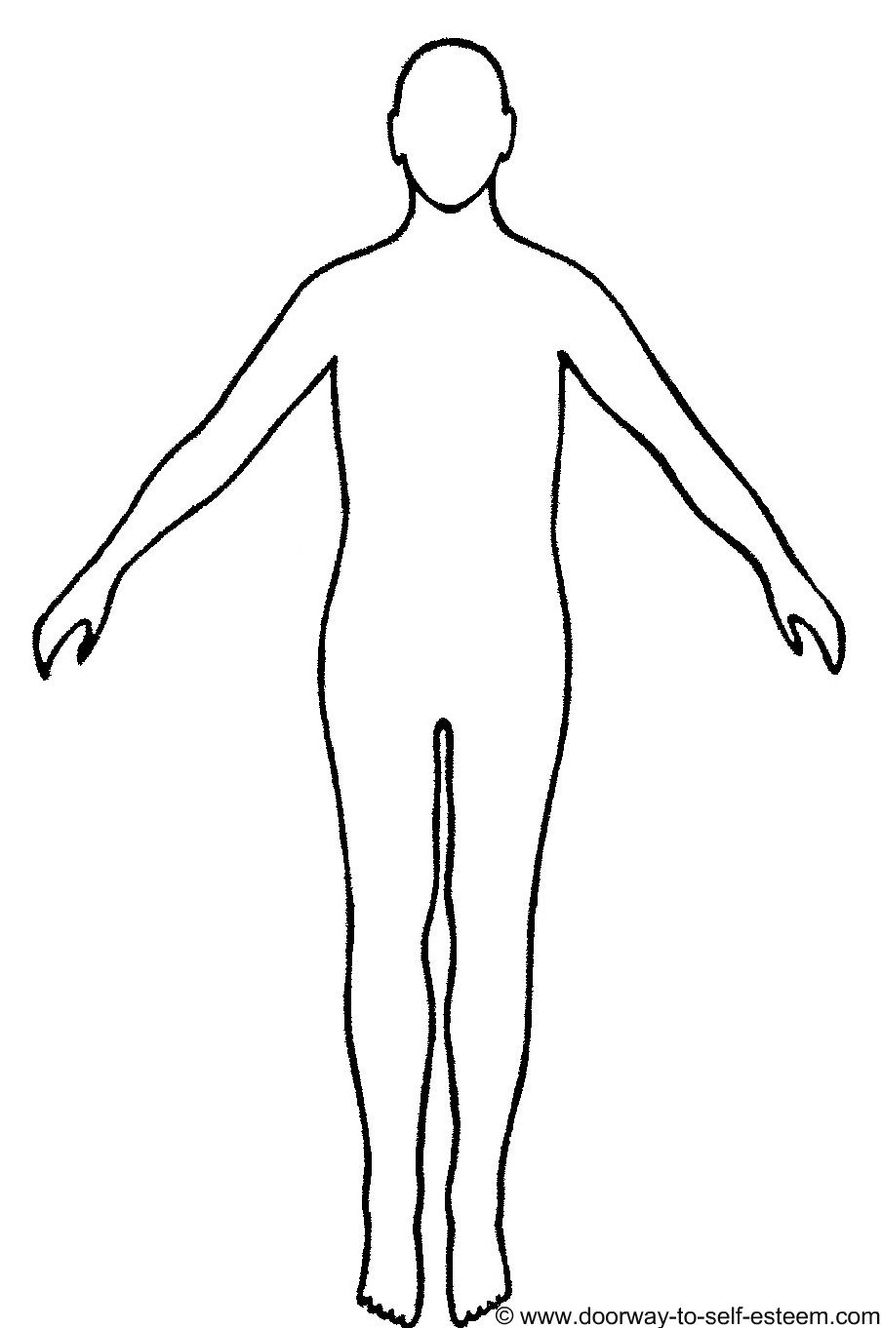
Task
In your jotters, copy the diagram and label how you think poor mental health affects your physical appearance.
Notes:
Ask them to feedback what they think poor mental health ‘looks like’.
Then go through each of the following social media posts and ask them if they think they have good/poor mental health, then show the mental health issues that each of them have.
None of these people have tried to hide their mental health issues, but not all posts on social media are as perfect as they seem!
It is also worth noting that women

Slide 7
Depression
Anxiety
PTSD

Slide 8
Anxiety
Low self-esteem

Slide 9
Feelings of helplessness and worthlessness

Slide 10
Body image
Low self-esteem
Eating disorders

Slide 11
Addiction and recovery

Slide 12
Podcast - how many people use social media to display the best parts of their lives, and feelings of inferiority and insecurity that can come with browsing.

Slide 13
Task
In pairs, discuss the following questions:
Is it possible to have a ‘healthy’ balance when it comes to the use of social media?
How might coming off social media temporarily impact your mental health? (positively and negatively)
Have you ever felt ‘not good enough’ after seeing someone’s social media posts? Why/why not?
Notes:
Give an opportunity for discussion before class feedback/discussion.

Slide 14
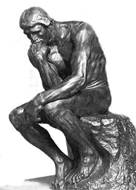
PLENARY
In your jotters, write a sentence to answer the following question:
In your opinion, what is the key ingredient to happiness?

