Slide 1
Rights Respecting School committee Come join our group!
What do we offer for our members?
The chance to be involved in raising awareness of your rights within the school.
The opportunity to shape our school community.
Why should you join?
If you think we should be doing more to raise awareness of your rights – join. Tell us!
Fantastic for CV building
Leadership opportunities
Who can join?
Any S1-S6 pupil!

Slide 2
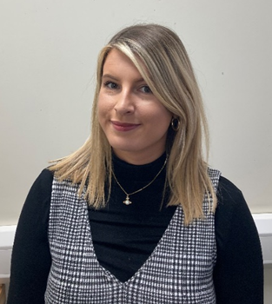
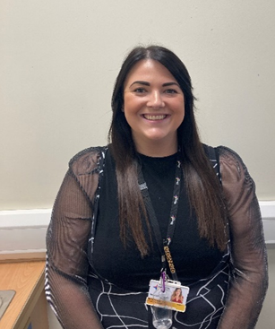
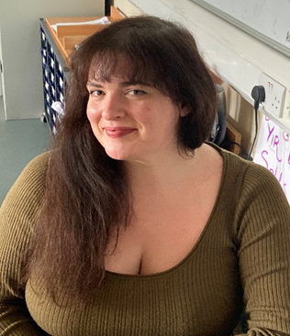
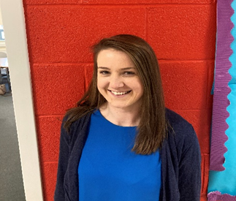
Staff responsible for each group
Monthly newsletter – Miss Milligan and Miss McQuade (Social Subjects)
Design group – Miss Hawson (Art & Design)
Mental health ambassadors – Mrs Hannah (Mod Lang)
What activities will we do?
Monthly newsletter – you will create/write and publish our monthly newsletter on issues you have chosen.
Design group – you will design the school logo for the RRS group and work on any design projects needed.
Mental health ambassadors – this team of pupils will work with staff to promote and improve the mental health of pupils. They will be available if you want to talk to someone.

Slide 3
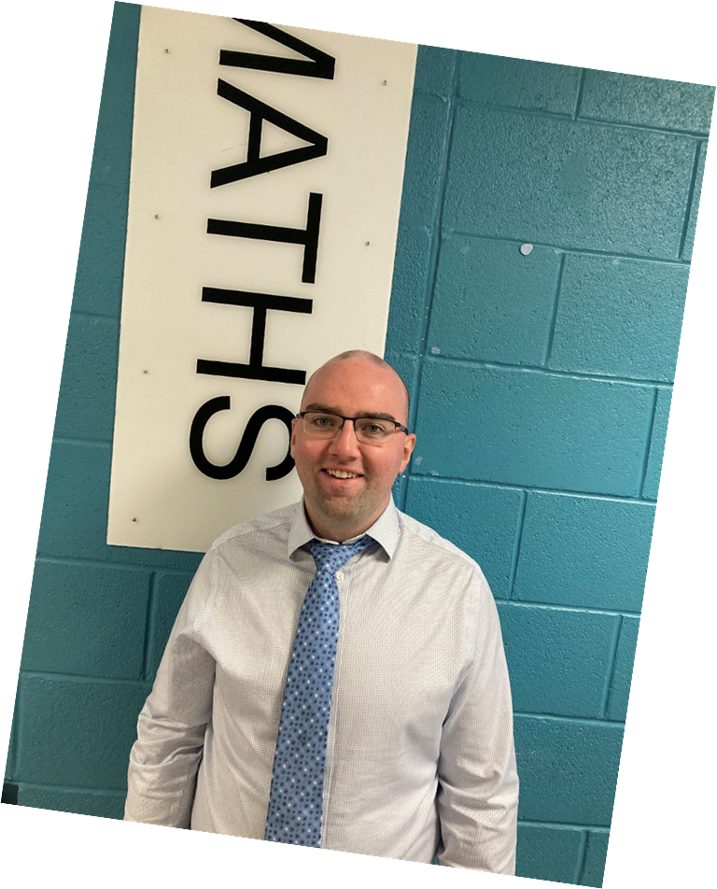
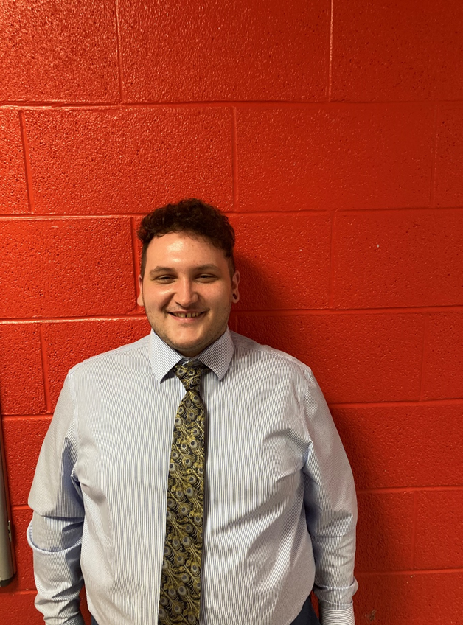
Senior school leader S4-S6
Mr Armour
Maths
Junior school leader
S1-S3
Mr O’Donnell
Mod Lang

Slide 4
When will we have our first meeting?
Thursday 5th November
Lunchtime 12:45
Dance Studio
You must BOOK in.
Contact any RRS teacher for this.
This is to accommodate social distancing.

Slide 5
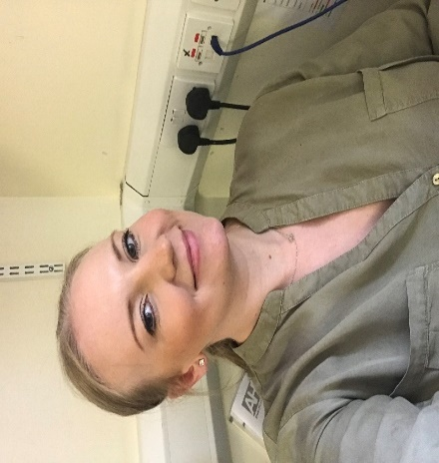
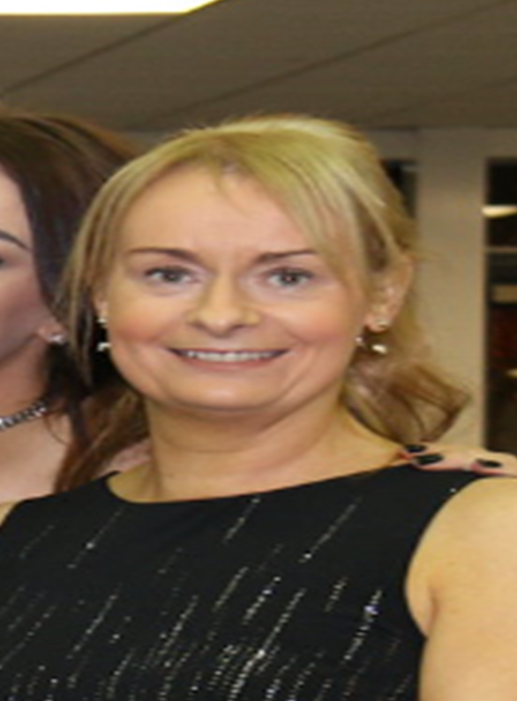
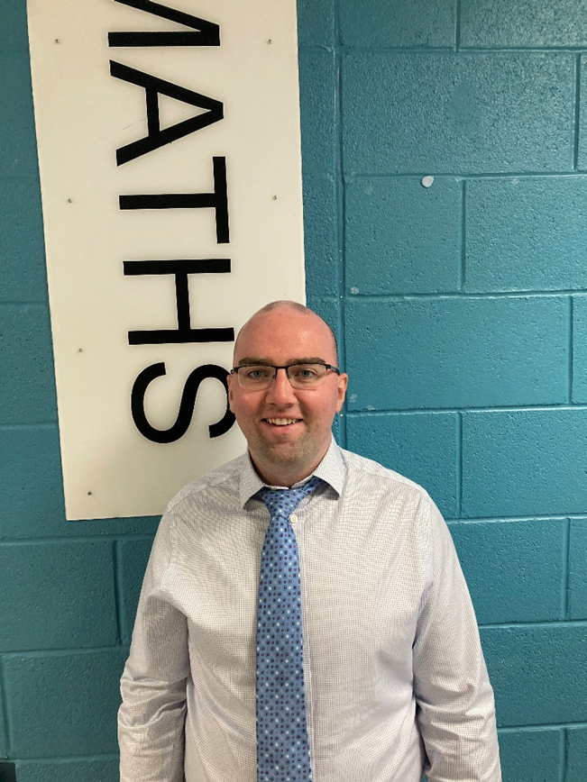
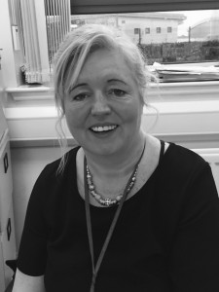
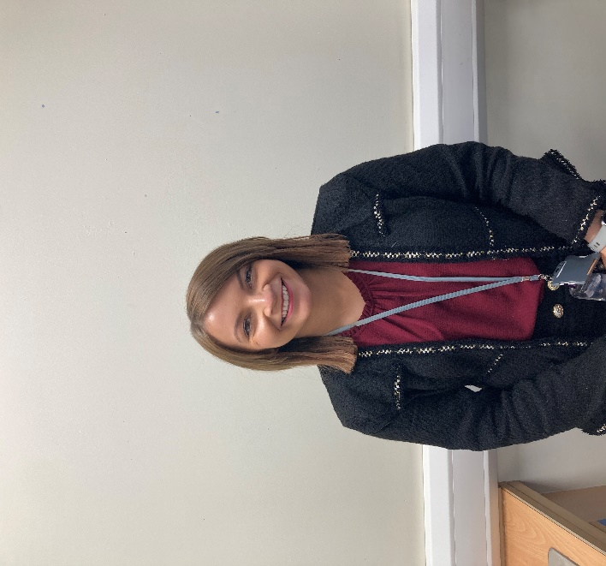
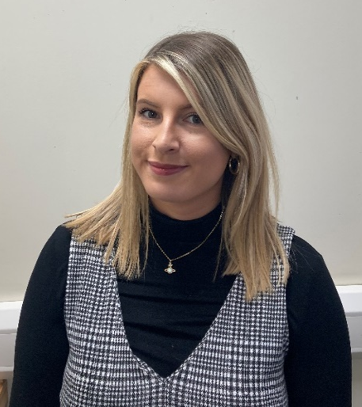
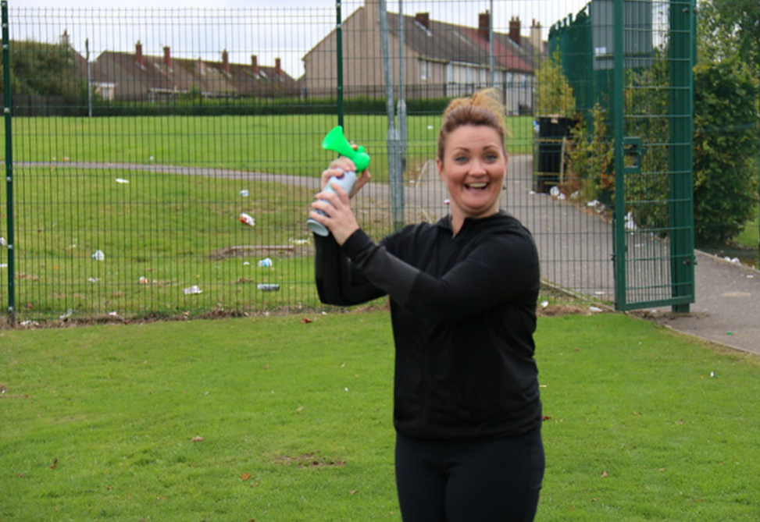
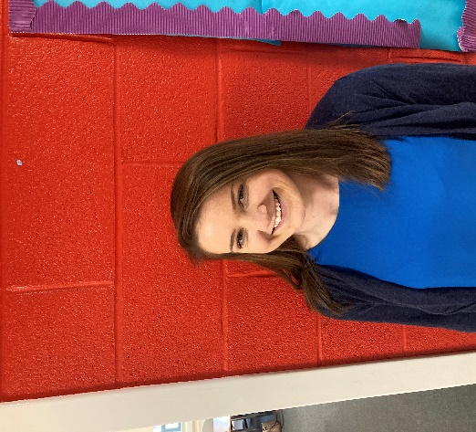
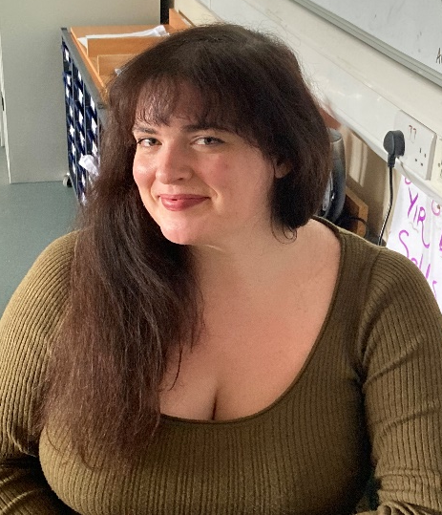
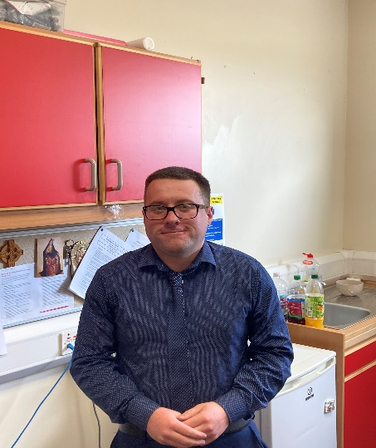
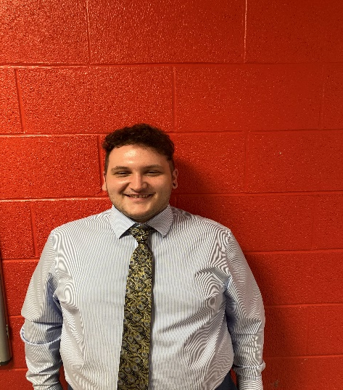
RRS Staff Committee 2020-2021
Mrs Lowry
RRS Leader
Ms Morrison
SMT
Mr Armour
Maths
Miss Veldon
Soc Sub (PTPS)
Miss Campbell
Social Subjects
Miss McQuade
Social Subjects
Miss Banks
PE (PTPS)
Mrs Hannah
Mod Language
Miss Milligan
Social Subjects
Miss Hawson
Art & Design
Mr Cassidy
RE (PT)
Mr O’Donnell
Mod Lang

