Slide 1
St. Andrew’s Primary Parent Council AGM
10th October 2016

Slide 2
Format of AGM
a report on the work of the Parent Council and its committee(s)
a report by the Head Teacher on the work of the school
selection of the new Parent Council
discussion of issues that members of the Parent Forum may wish to raise
approval of the accounts

Slide 3
Parental Involvement

Slide 4
Improvement Priorities 2015 – 2016
Raising Attainment in Literacy, Mathematics & Numeracy & Health & Wellbeing in line with Scottish Government and NLC pledge to challenge attainment.
Develop revised Planning for progressive coverage and Assessment of all Curricular areas while tackling bureaucracy.
Raising Achievement of all children.

Slide 5
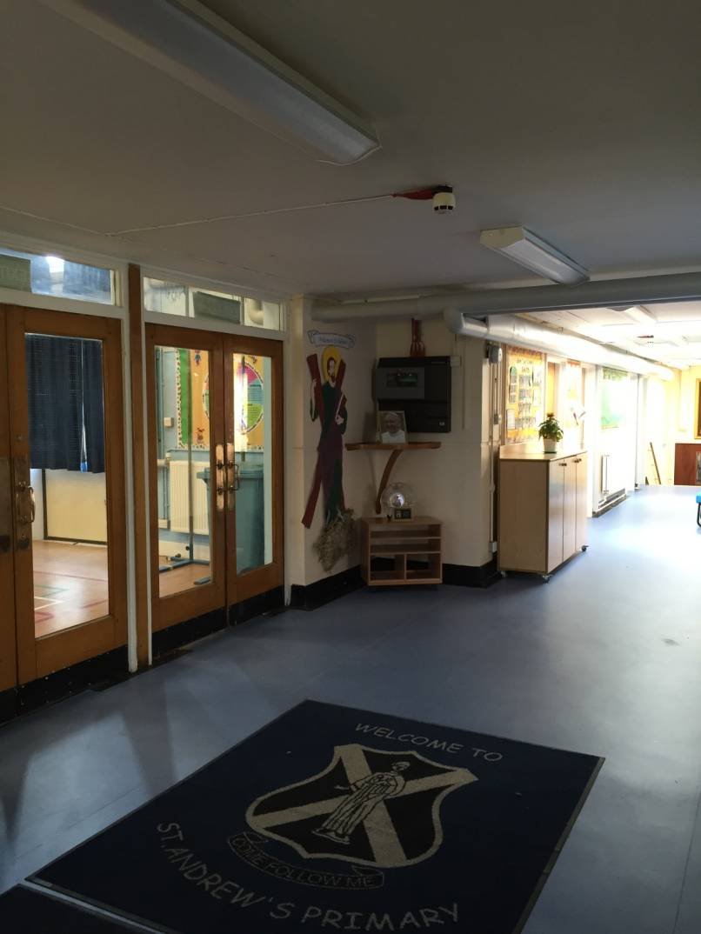
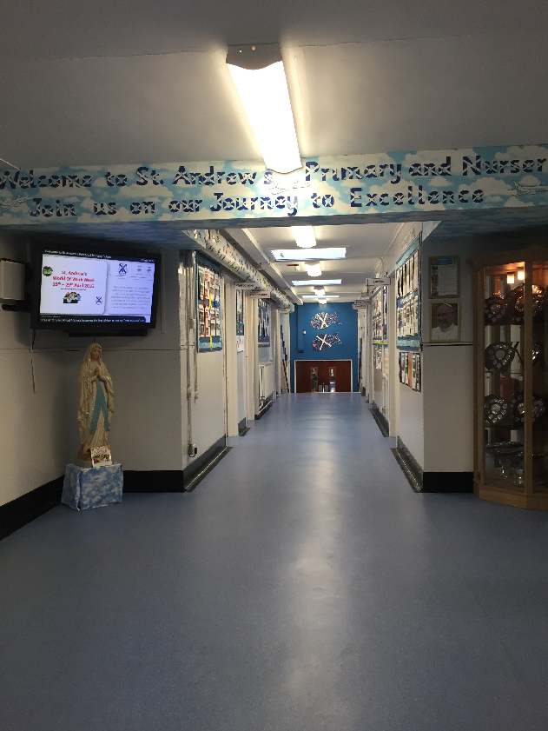
Main Foyer
Before
After

Slide 6
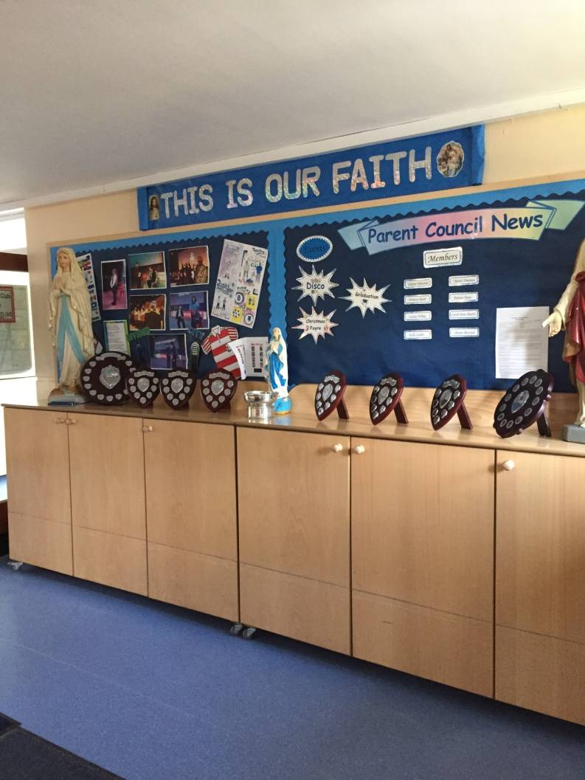
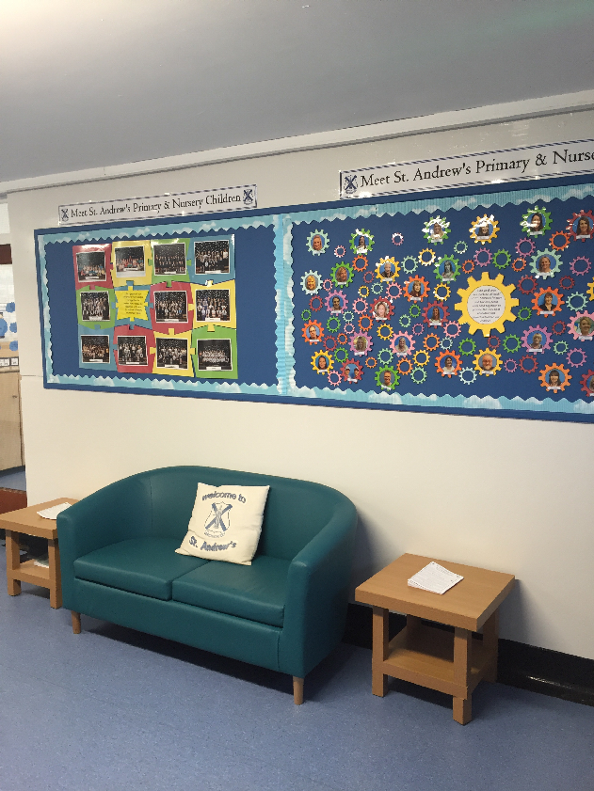
Main Foyer
Before
After

Slide 7
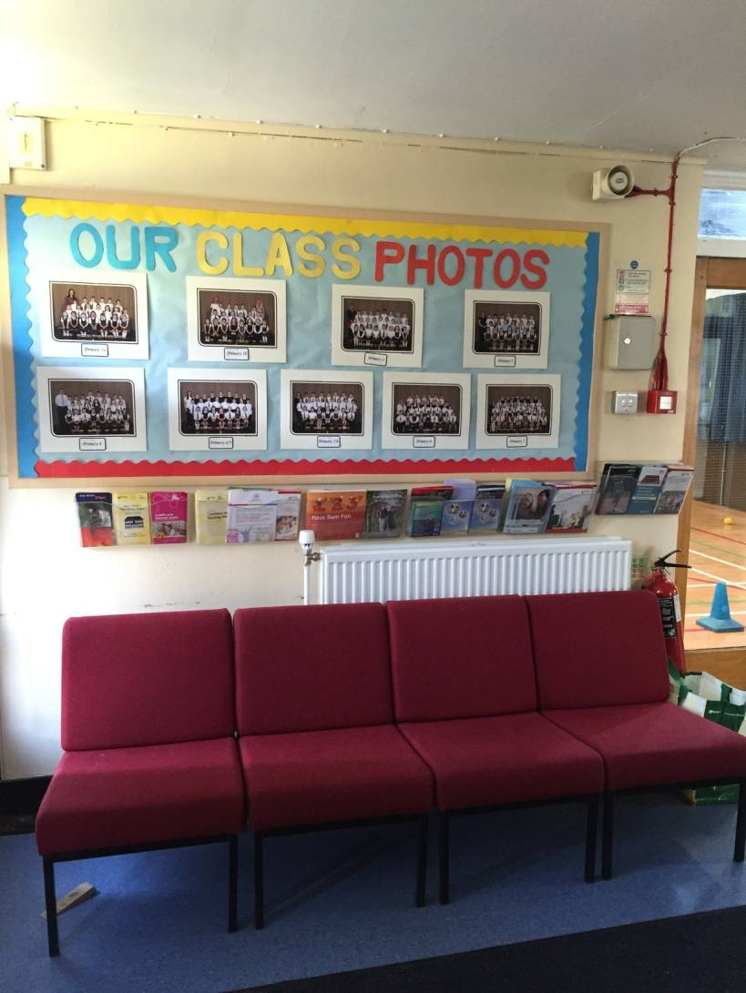
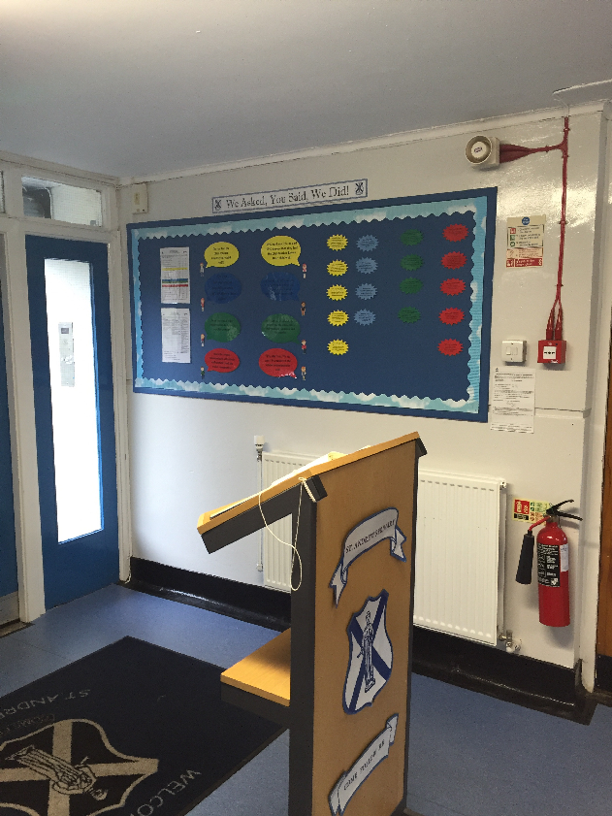
Main Foyer
Before
After

Slide 8
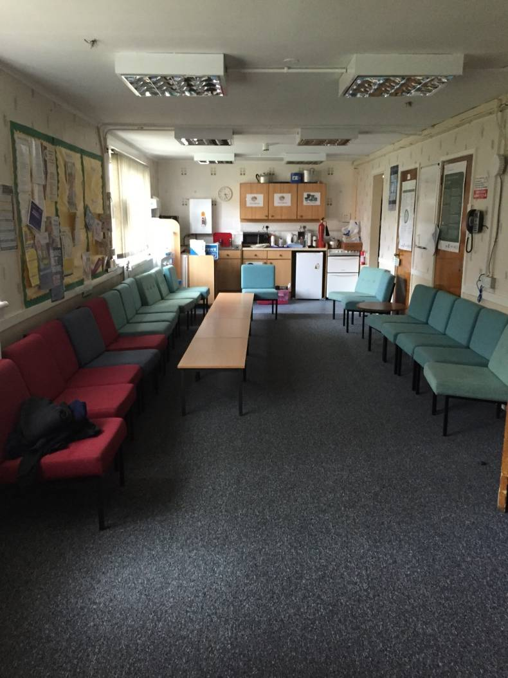
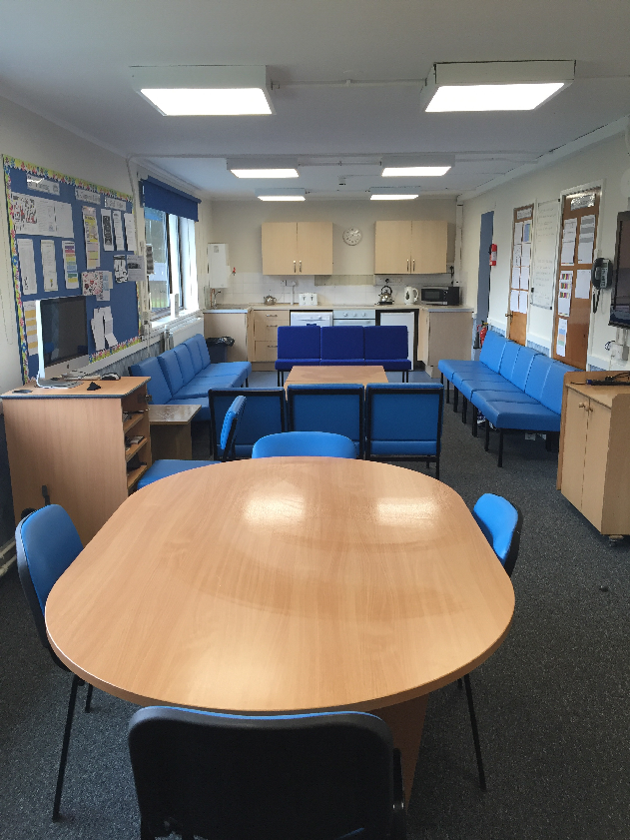
Staff Room
Before
After

Slide 9
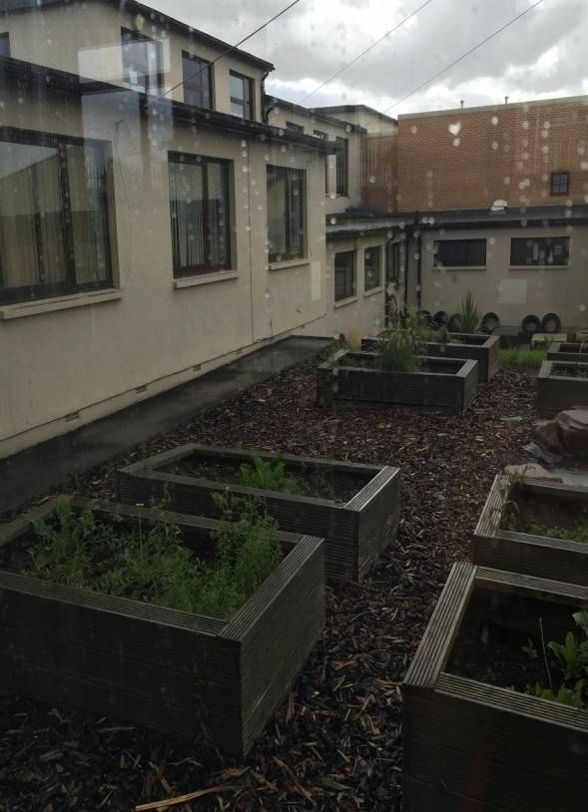
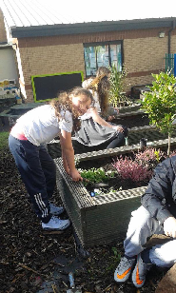
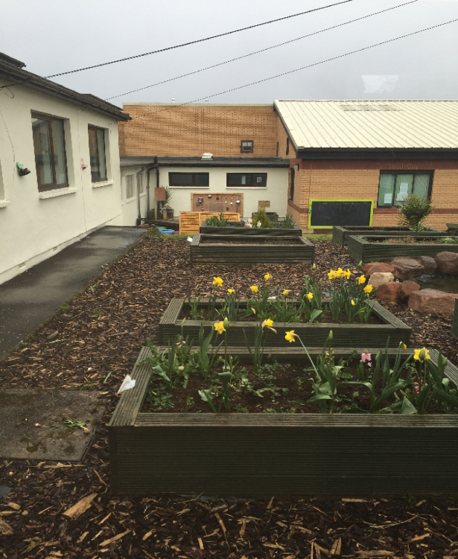
Our Garden
Before
During
After

Slide 10
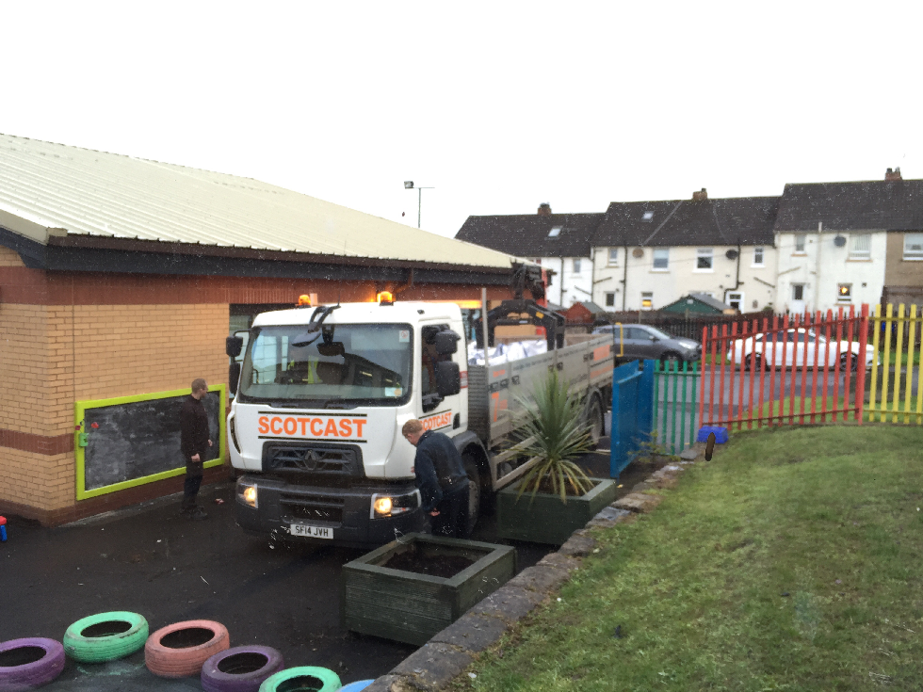
Our Garden
Parent & Community Involvement

Slide 11
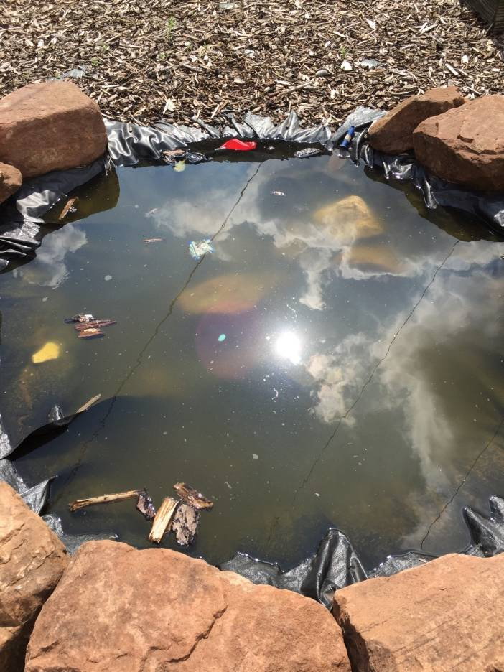
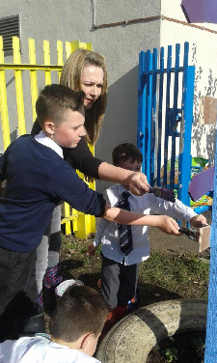
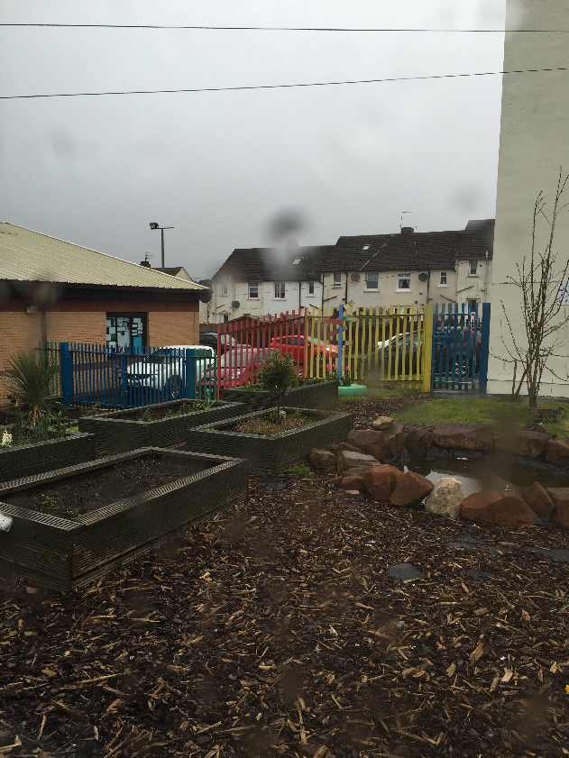
Our Garden
Before
During
After

Slide 12
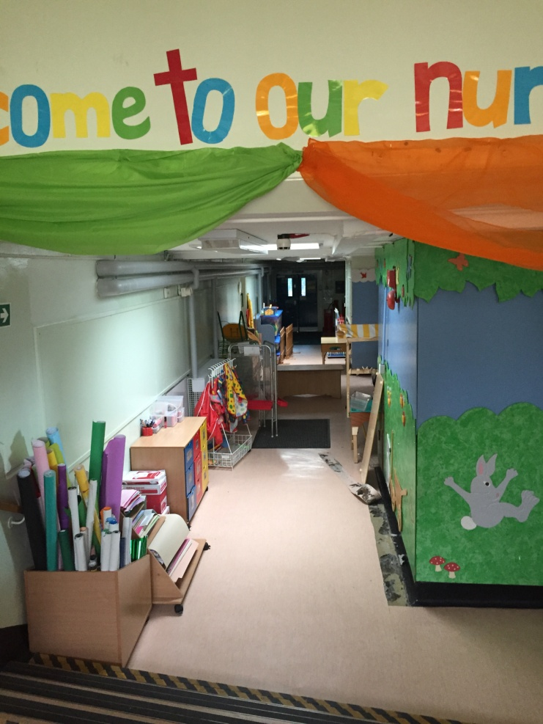
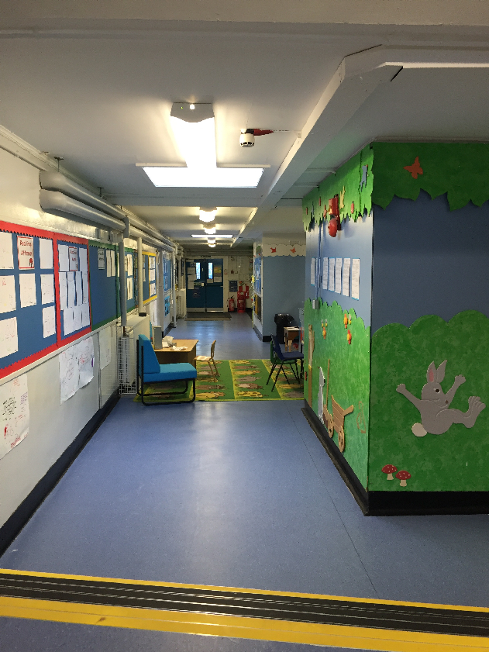
Our Nursery
Before
After

Slide 13
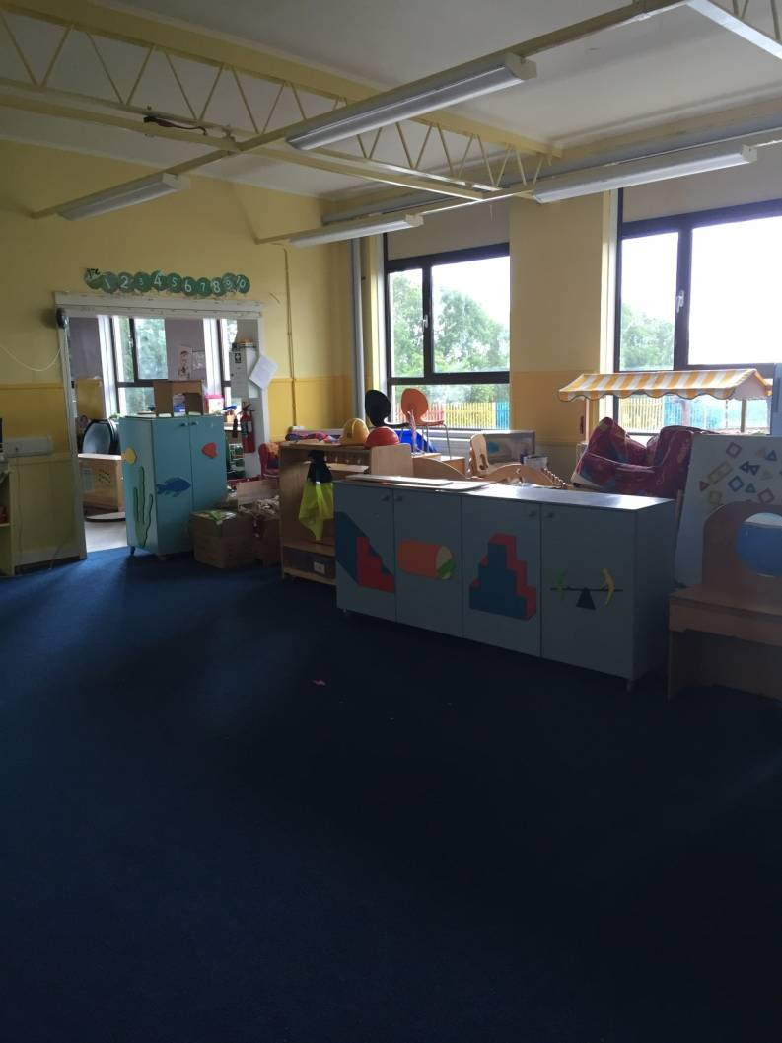
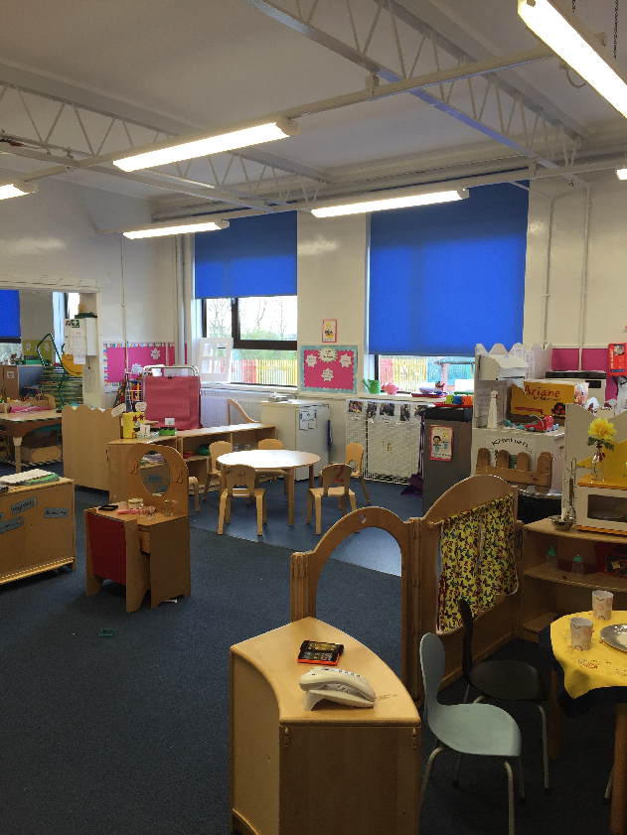
Our Nursery
Before
After

Slide 14
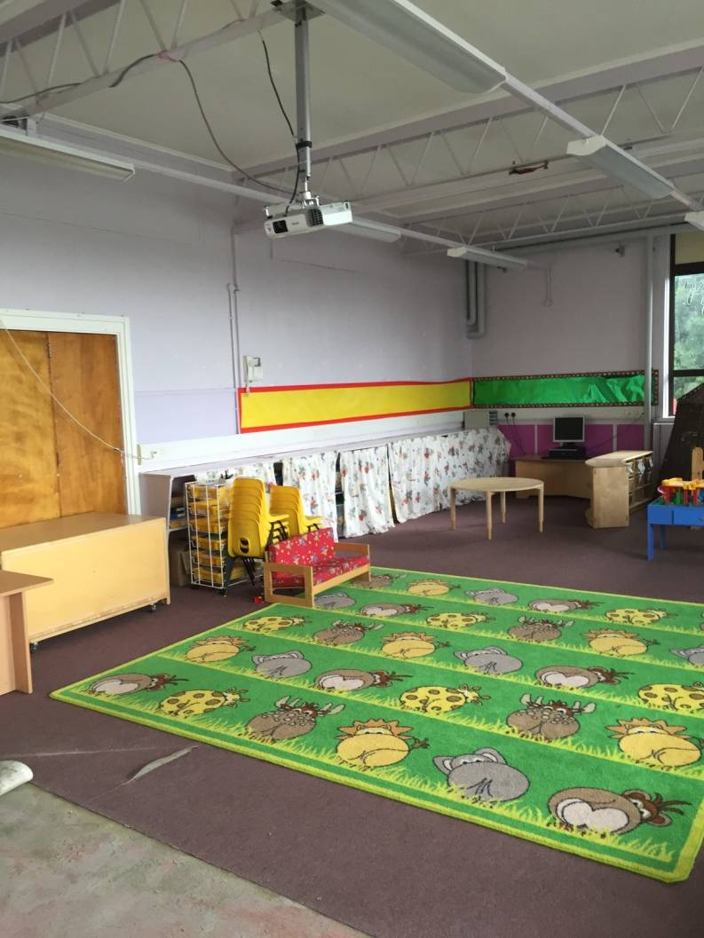
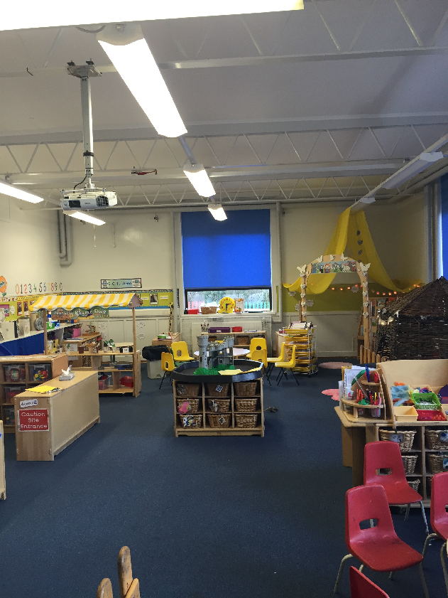
Our Nursery
Before
After

Slide 15
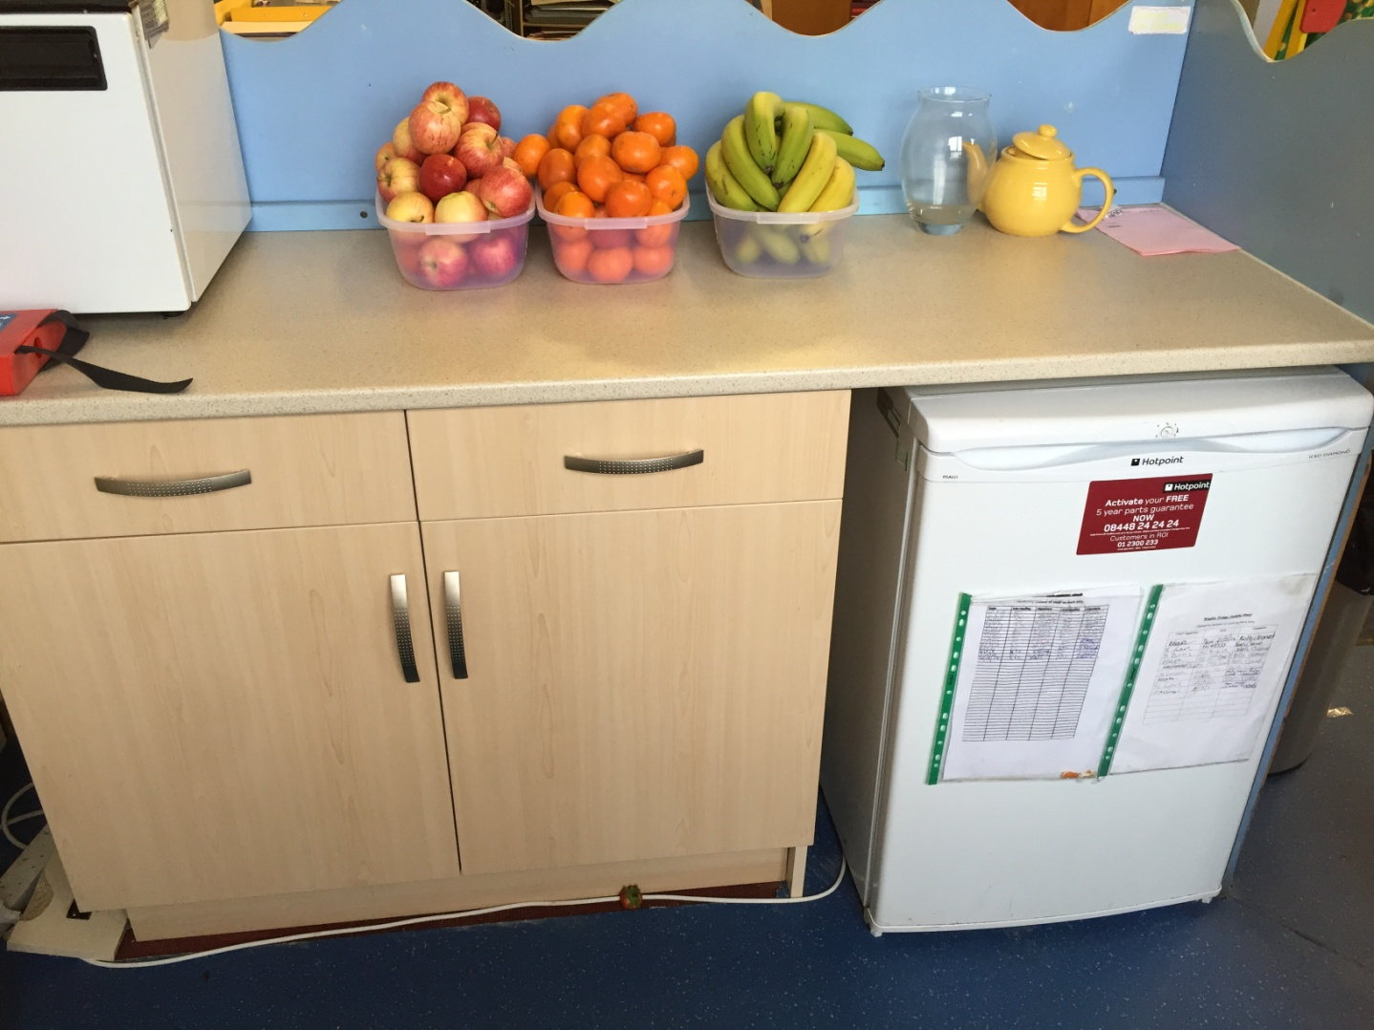
Our Nursery
New Fitted Kitchen

Slide 16
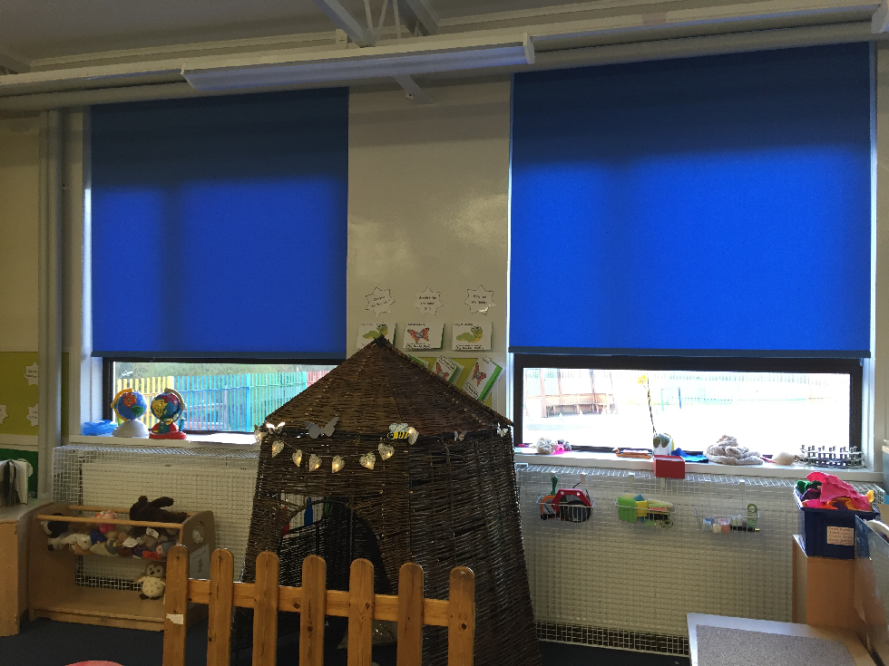
Our Nursery
New Blinds Fitted

Slide 17
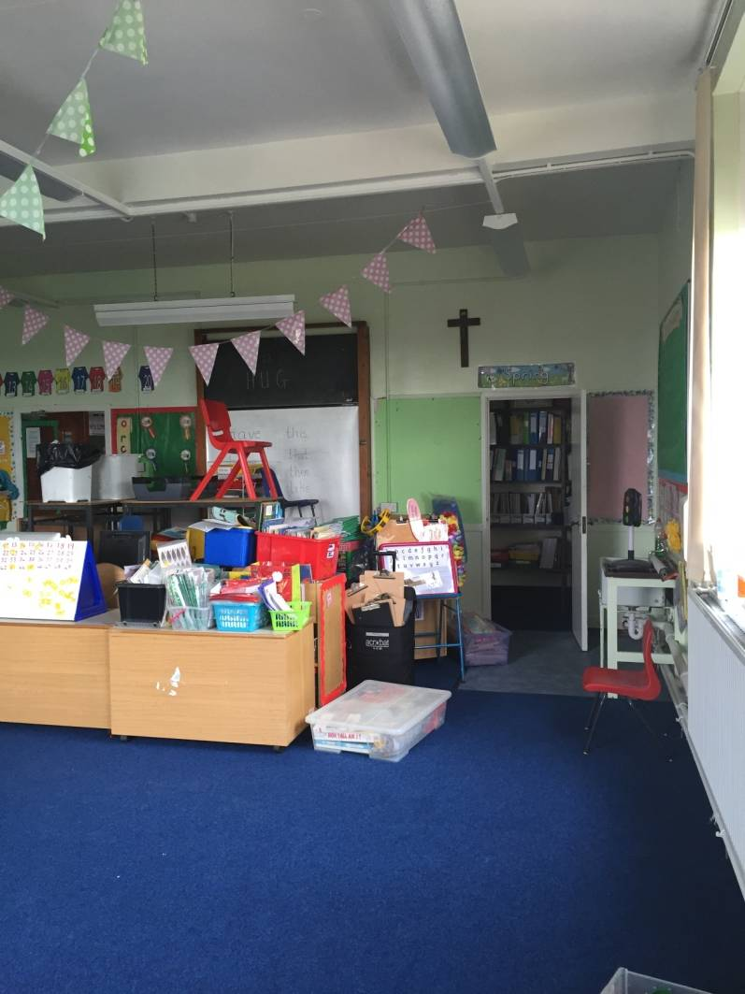
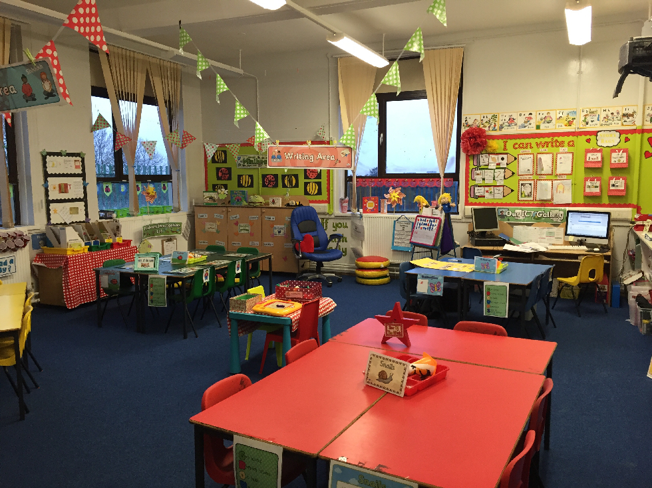
School Painted Inside
Before
After

Slide 18
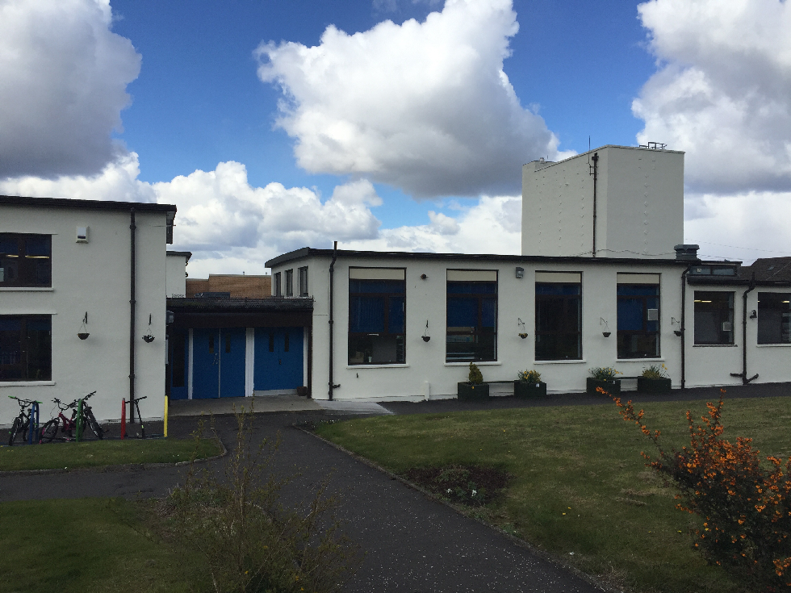
School Painted Outside

Slide 19
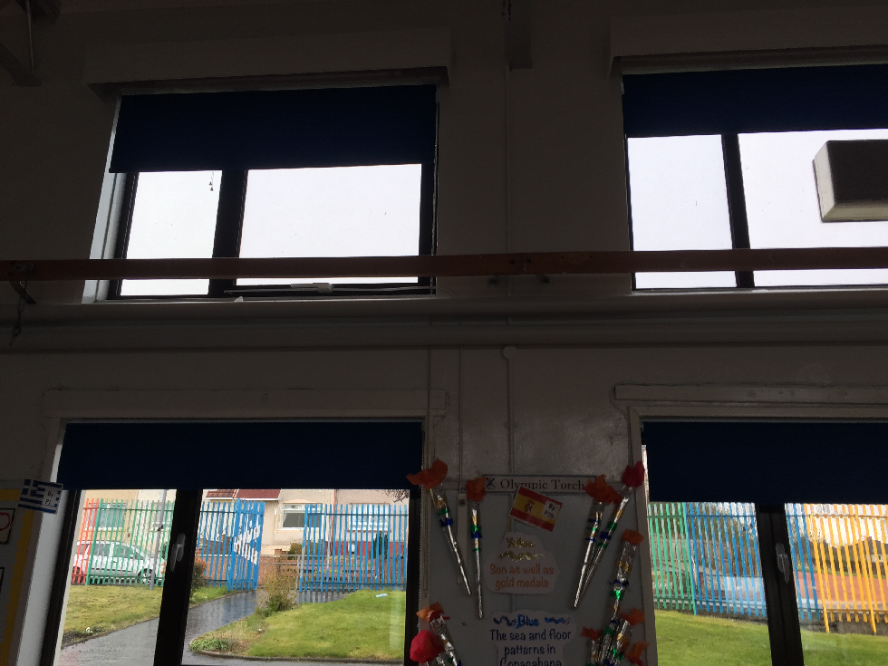
New Blinds

Slide 20
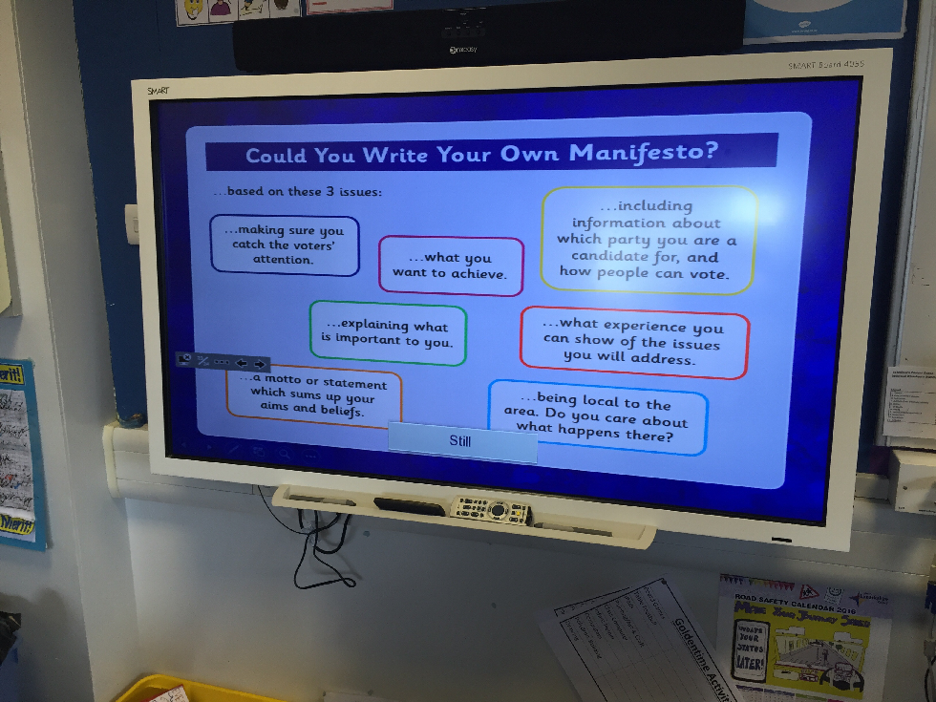
Smart Technology
Investment

Slide 21
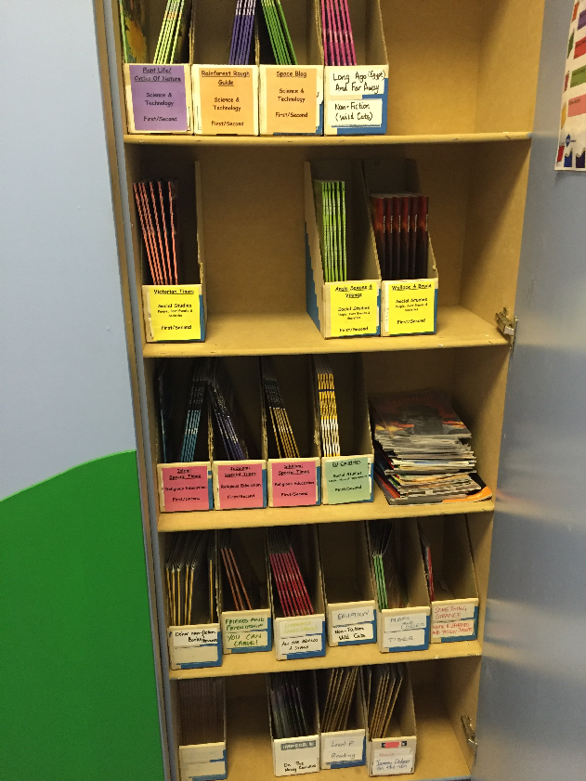
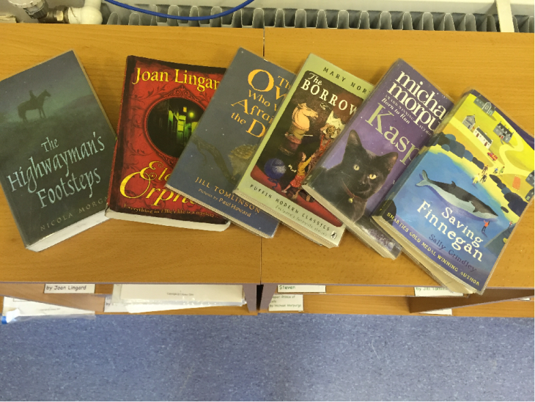
Non fiction & Novel Studies
Investment

Slide 22
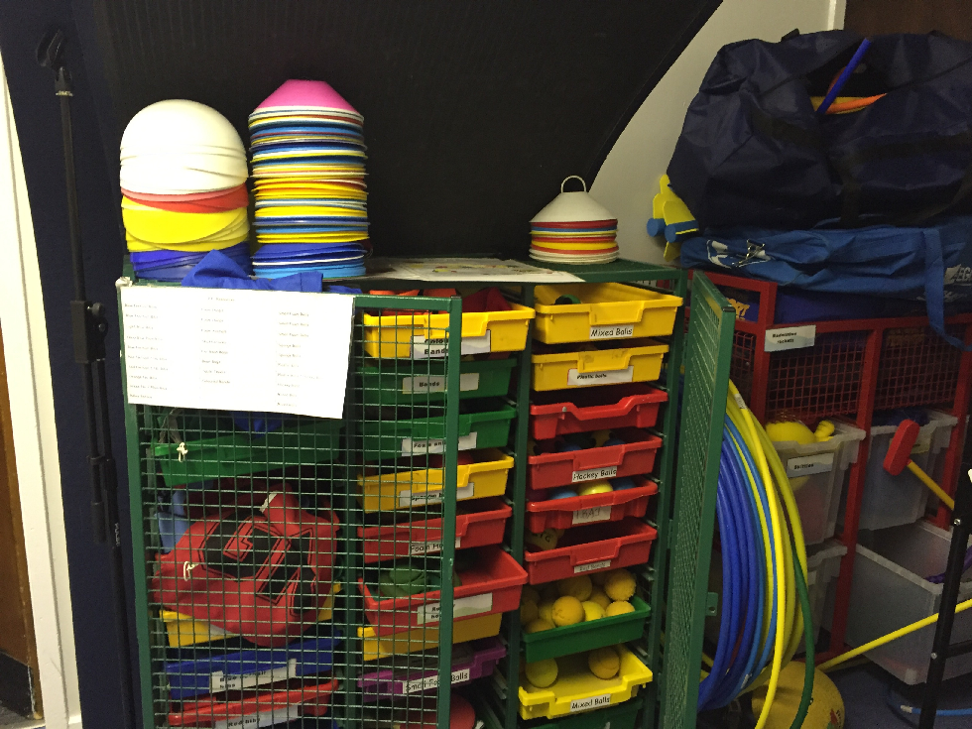
P.E Equipment
Investment

Slide 23
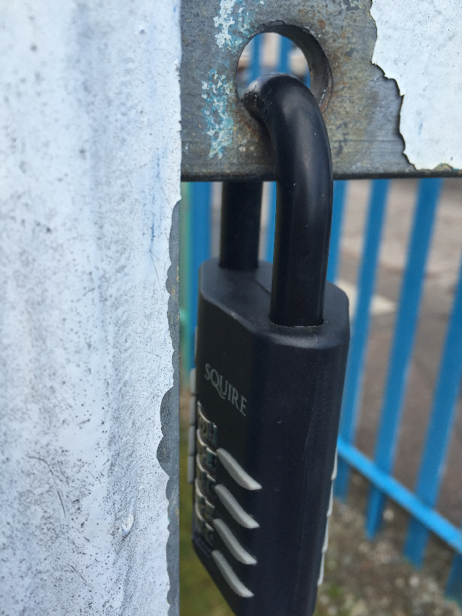
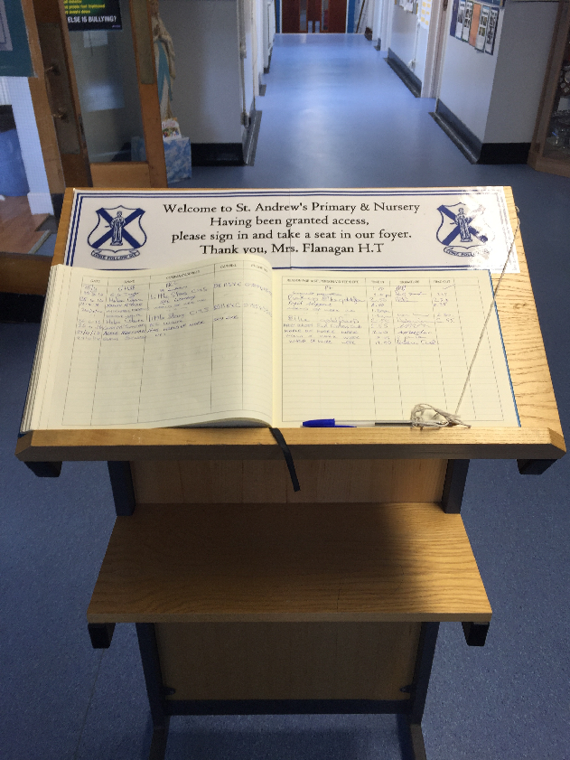
Security
Gate Lock Down
Secure Sign In

Slide 24
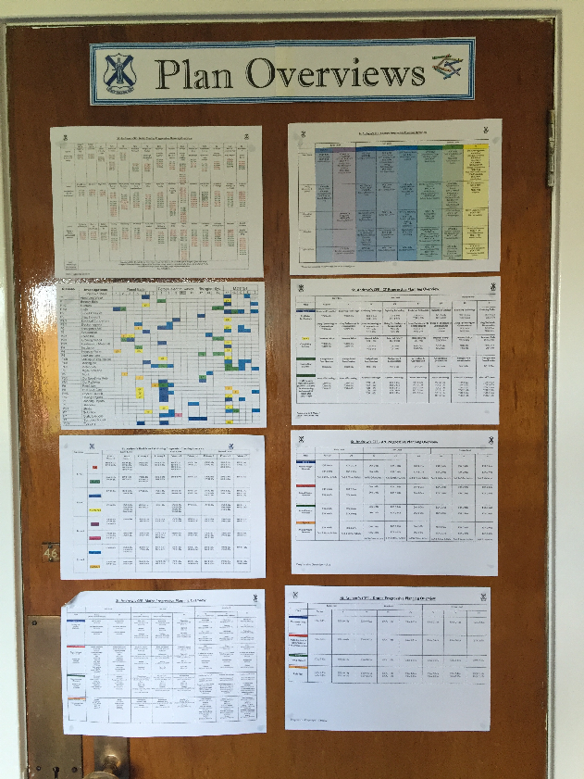
Curricular Planning
SIP

Slide 25
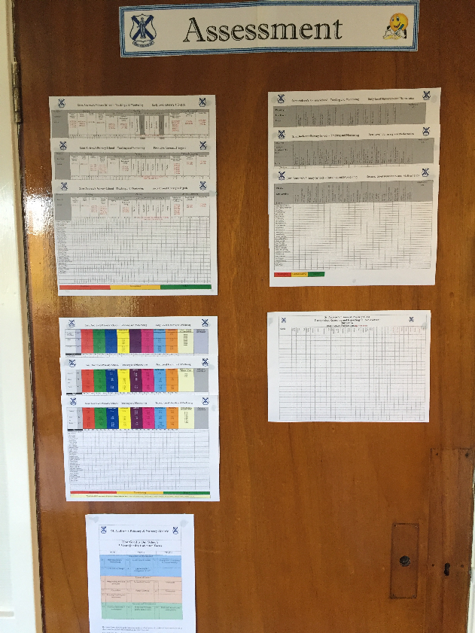
Tracking Attainment
SIP

Slide 26
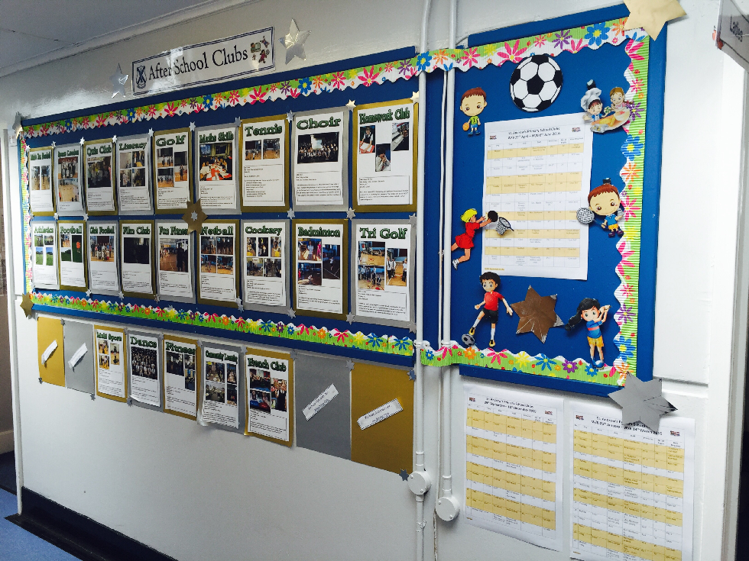
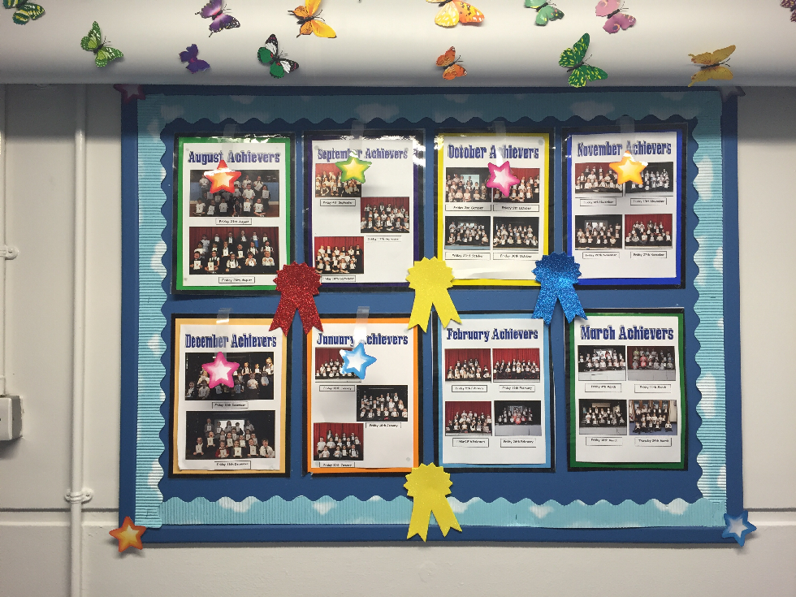
Raising Achievement
SIP

Slide 27
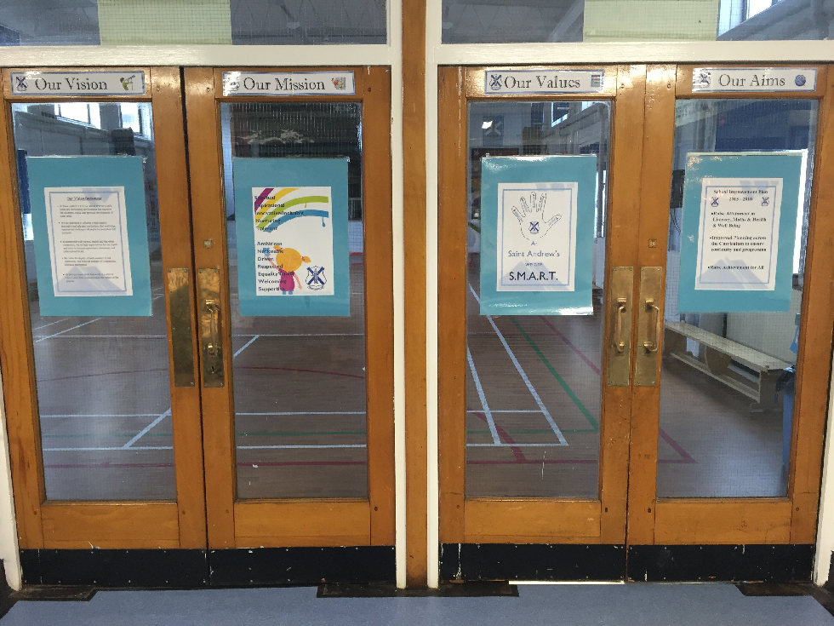
School Vision

Slide 28
Awards
Education Scotland Food For Thought Grant Awarded £3000

Slide 29
Improved Communication
Jotters Home, PLPs, Homework diaries, Reports, Termly overview home
Curriculum Evenings, Parents evenings Reports
Glow webpage, twitter, daily updates
Glow, Twitter, Homework diaries, Curriculum Evenings, Parent evenings,
monthly newsletters, termly curricular overviews, PLPs, jotters home

Slide 30
Daily Life Included
Sacraments, Mass preparation, Garden Week, Fairtrade Week, Lenten Charity Focus, Pupil council, Eco council, JRSO, Health Committee, World of Work Week, St. Andrew’s Day celebrations, Infant nativity, Senior Show, Chicks hatching projects, transitions, increased school trips for all classes, OSHL, Going for Gold Award, Olympic Sports day planning, Graduation planning, nursery shows, outdoor learning, active learning, competitions the list goes on...

Slide 31
Improvement Priorities 2016 – 2017
Increase pace of learning across Literacy, Maths & Health & Well Being to support government pledge to raise attainment via sharing of good practise in planning, self/peer/teacher assessment, monitoring and tracking.
Develop revised planning and progressive coverage and assessment of music using ABC music resource.
Improve attainment of maths for all learners by developing highly effective teaching approaches through staff training, revised resources and support for all learners to address the attainment gaps which have been identified.
Improve attainment in ICT through progressive skills programme of teaching and developing integrated digital learning.
Improve the physical health of children by increasing opportunities for physical activity and developing teachers capacity in health and wellbeing in particular ‘Better Movers and Thinkers’ programme and in food education.

Slide 32
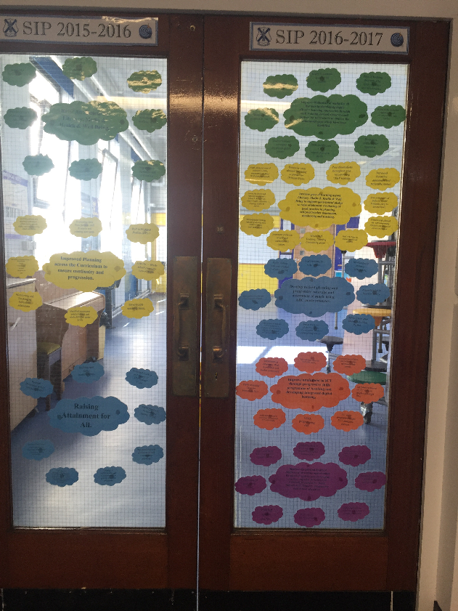
‘School Improvement Plan’ display

