Slide 1

S4 Assembly
Tuesday 29th September
2026

Slide 2

St Ambrose Afternoon Prayer
To us Christ is all!
If you have a wound to heal, he is the doctor;
If you are parched by fever, he is the spring;
If you are oppressed by injustice, he is justice;
If you are in need of help, he is strength;
If you fear death, he is life;
If you desire heaven, he is the way;
If you are in the darkness, he is light

Slide 3
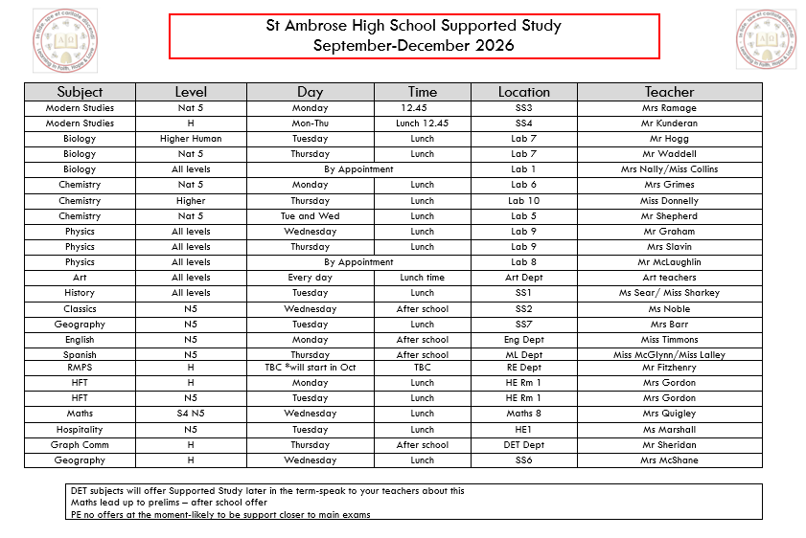
Supported Study

Slide 4
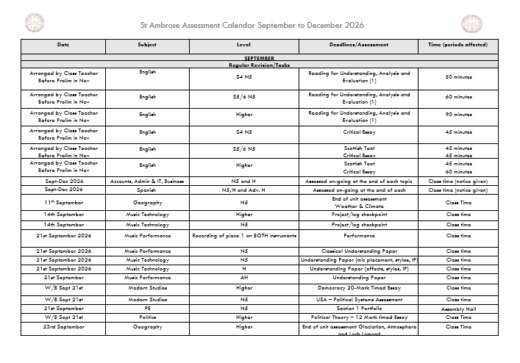

Slide 5

Why Study?
Significantly increases your opportunities when you leave school.
Builds confidence and self-esteem.
Effective studying is the only way to achieve your potential.
Reduces stress and anxiety.

Slide 6

SOME KEY TIPS FOR CREATING YOUR STUDY TIMETABLE:
BE REALISTIC- TRY NOT TO CRAM
THINK ABOUT YOUR ENVIRONMENT- STUDY SPACE
TRY TO PLAN 45 MINUTE SLOTS WITH 10 MINUTE BREAKS
ACCEPT THAT YOU MIGHT HAVE TO MAKE SMALL SACRIFICES
USE A STUDY METHOD THAT WORKS FOR YOU
USE A RANGE OF STUDY METHODS- HIGHLIGHTING; NOTE TAKING; FLASH-CARDS; MIND-MAPPING; PAST PAPERS; ONLINE RESOURCES
REMEMBER, YOU NEED BALANCE: EAT, SLEEP, REST AND EXERCISE WELL

Slide 7
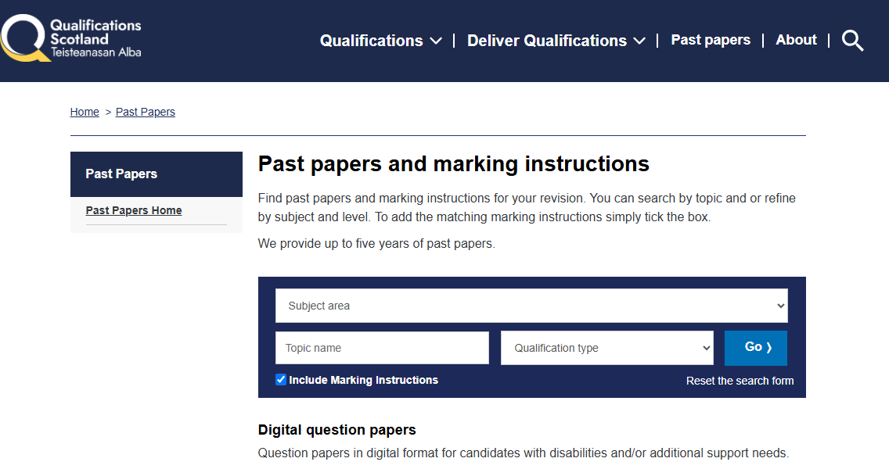
FOCUS ON: SQA PAST PAPERS
PAST PAPERS ARE PREVIOUS YEAR'S EXAM PAPERS FROM THE SUBJECTS THAT YOU ARE STUDYING
THEY ARE FREE TO ACCESS AND DOWNLOAD VIA THE SQA WEBSITE
THEY ARE ACCOMPANIED BY MARKING SCHEMES- THESE SHOW YOU THE ANSWERS AND WHAT THE SQA IS LOOKING FOR
THEY WILL ALLOW YOU TO MAXIMISE HOW MUCH INFORMATION YOU RETAIN
YOU CAN USE THEM TO UNDERSTAND HOW MUCH YOU NEED TO LEARN TO GET BETTER
THEY ARE PRACTICE AT THE REAL THING

Slide 8
SQA - NQ - Past papers and marking instructions
Download
You can download past papers free for any of the subjects you do
Try
You can try answering the past paper at home and checking your work using the marking scheme
Ask
You can ask your teachers for a bit of feedback and guidance on the past papers that you complete- they would be glad to help you

Slide 9


Slide 10
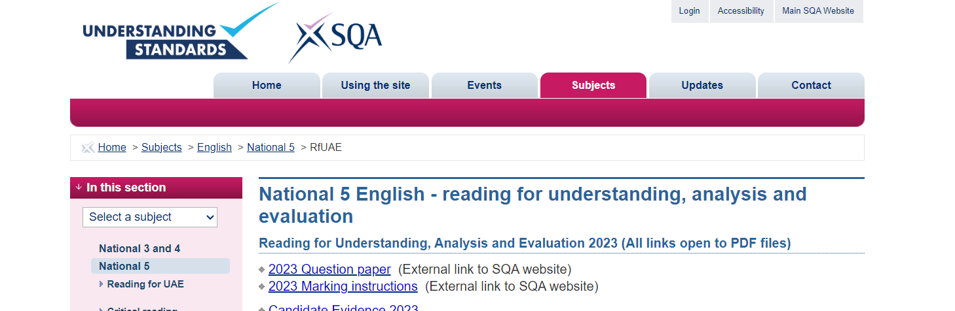
SQA UNDERSTANDING STANDARDS WEBSITE
SQA - Understanding Standards: Question paper
THIS SITE ALLOWS YOU TO SEE EXACTLY WHAT THE SQA ARE LOOKING FOR IN YOUR ANSWERS
THIS SITE ALLOWS YOU TO SEE EXAMPLES OF PUPIL'S WORK AND THE MARKS IT GOT
IT LETS YOU 'UNDERSTAND THE STANDARDS' REQUIRED FOR A PASS IN MOST OF YOUR SUBJECTS

Slide 11

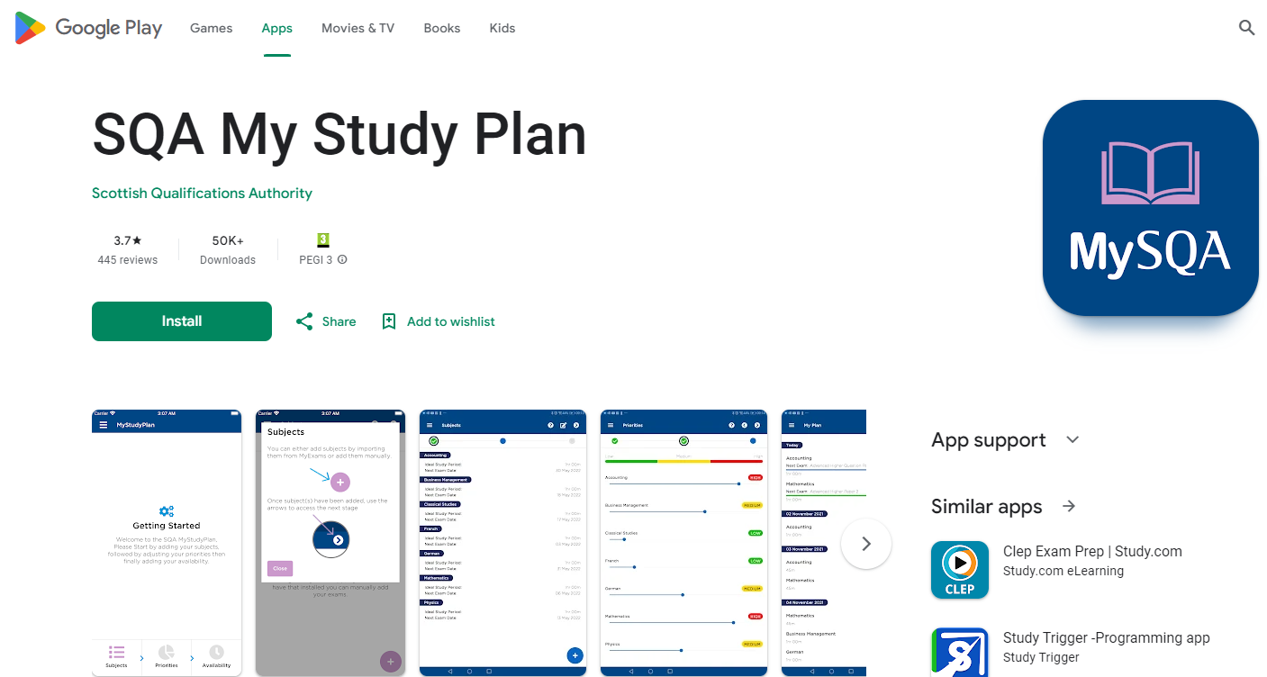
Supported Study

Slide 12
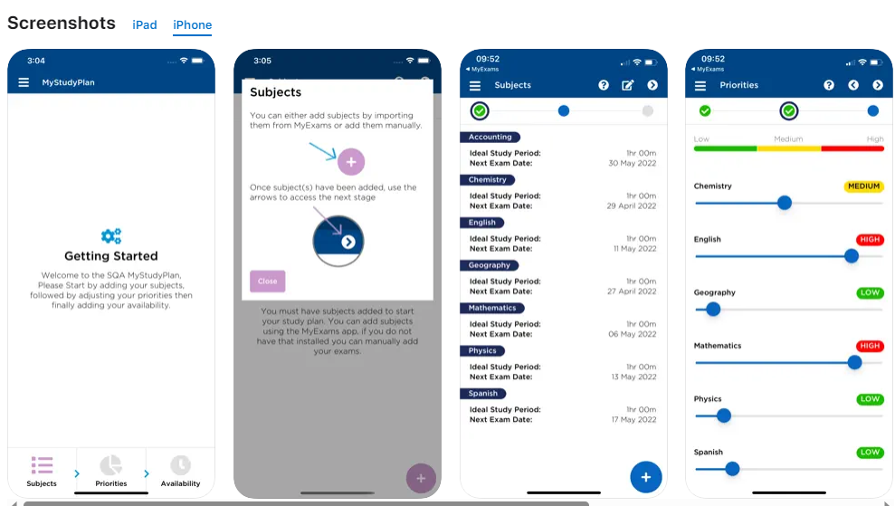

Slide 13
 | Monday | Tuesday | Wednesday | Thursday
4.30-5.00 | Arrive home Walk dog | Arrive home Walk dog | Arrive home Walk dog | Gymnastics
5.00-5.45 | Biology: cell structure | Maths: simultaneous equations | Maths: simultaneous equations | Gymnastics
5.45-6.30 | Dinner | Dinner | Dinner | Dinner
6.30-7.15 | Biology: cell structure | Geography: weather revision | Physics: Electricity | Maths: surds revision and practise
7.15-8.00 | Homework session/Back up study-English reading | Geography: weather revision | Physics: Electricity | Maths: surds revision and practise
8.00-8.45 | Football | Break-15 mins | Homework session /Back up study-RUAE past appear practise | Break-15 mins
 |  | Homework session/Back up study-RUAE past appear practise |  | Des Manufacture: Analysing a brief- data gathering and research
8.45-9.30 | Football/home | Spanish-vocabulary revision and writing topic practise | Break-15 mins | Des Manufacture: Analysing a brief- data gathering and research
9.30-10.15 | Reading/TV | Reading/TV | Reading/TV | Reading/TV
 | Friday |  | Saturday |  | Sunday
1.00-1.45 | Arrive home Walk dog | 9.30-10.15 | Homework | 12.00-12.45 | Mass
1.45-2.30 | Lunch/relax | 10.15-11.00 | Homework | 12.45-1.30 | Lunch
2.30-3.15 | Homework session/Back up study | 11.00-11.45 | Homework | 1.30-2.15 | Homework
3.15-4.00 | Homework session/Back up study | 11.45-12.30 | Homework | 2.15-3.30 | Spanish-vocabulary revision and writing topic practise
4.00-4.45 | Gym | 12.30- | Afternoon off | 3.30-4.15 | English-essay completion
4.45-5.30 | Gym |  |  | 4.15-5.00 | English-essay completion
5.30-6.15 | Gym |  |  | 5.00-5.30 | **Plan and organise for next week**
6.15-7.00 | Dinner |  |  | 5.30- | Gym
7.00 | Evening off |  |  |  | Gym /Evening off

Slide 14
ACHIEVE!
Achieve

Slide 15
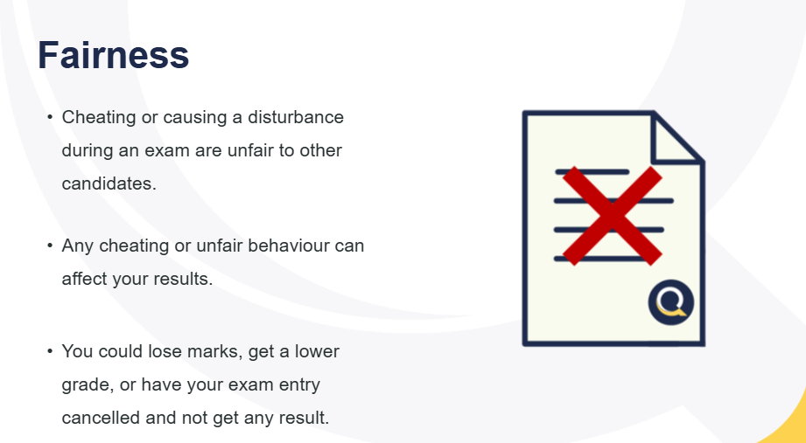
Qualifications Scotland Expectations and Malpractice

Slide 16
S4 Mentoring
Why you?
We have looked at your S3 data and will look at your S4 Tracking reports.
You may also have been recommended by Pupil Support or a teacher because:
You have lots of potential
You have already asked to be part of this programme
You might be concerned about at least one of your N5s
You might be revising, but it doesn't always show up in your work
You might be flying in your exams and coursework and we want you to secure your As and Bs in your N5s
Why not you?
We are waiting to see how you get on in your prelims
You might not need us yet
You might be already revising well and your teachers can see this in your work.

Slide 17

So What's Next?
S4 Tracking Report will be issued later this week
S4 Parents' Evening Thursday 22nd October
S4 Prelims start 23rd November-another assembly before then
59 days until the
prelims!!!

