Slide 1
Your
Exams
What you need to know about
National 5, Higher and
Advanced Higher exams
School edition

Slide 2


Qualifications Scotland took over from the Scottish Qualifications Authority on 1 February 2026. This does not change how you complete your qualifications. Teachers will tell you what you need to do and when. You will still see information with SQA branding on the Qualifications Scotland website. This will be changed to Qualifications Scotland as we update the website.

Slide 3

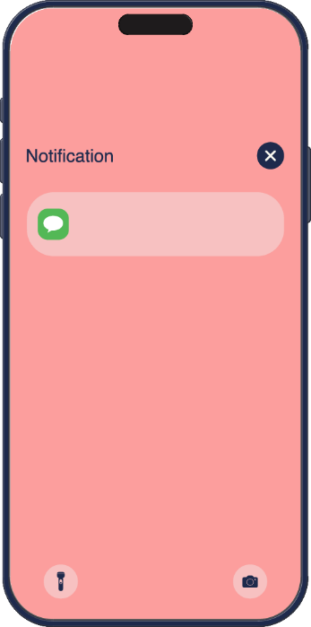



Important things you need to know
Tuesday, 4 August
08:00
Notification
The exams start on Wednesday 22 April and finish on Tuesday 2 June.
Your school will provide an estimated grade for each of your courses before the exams start.
You’ll receive your results by post on Tuesday 4 August. If you sign up to My Qualifications Scotland, you can get them by text, email or both.
Qualifications Scotland

Slide 4

Assessment Arrangements
Allow learners who are disabled or need additional support to use different ways to complete an exam
May vary by subject, level and learner
Include adapted question papers, changes to exam timings and where the exam is taken
Speak to your teacher for more information about assessment arrangements

Slide 5


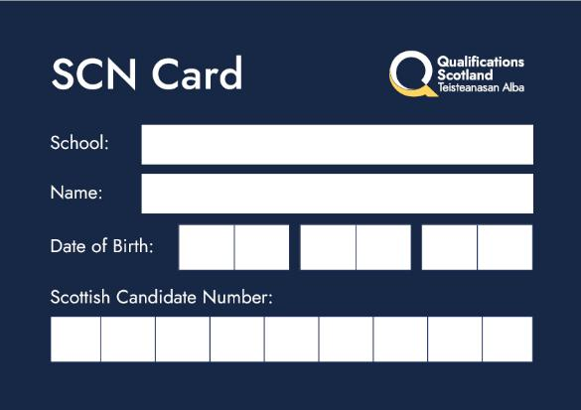
Preparing for your exams
Timetable
Make sure you have the latest version of the timetable. You can find it on the Qualifications Scotland website - just search for ‘timetable’.
Apps
Download the MyExams and MyStudyPlan apps to help you prepare. You’ll find them on the same page as the timetable.
Scottish Candidate Number
Make sure you know your Scottish Candidate Number (SCN). you’re Your teacher will tell you it and give you an SCN card to write your name, school name, date of birth and SCN.

Slide 6

On exam day
Make sure you arrive at least 10 minutes before your exam starts.
You’ll be given a desk or seat number for each exam – please remember this!
Don’t take any prohibited items to your desk or seat – these include mobile phones, electronic devices, any device that stores information or connect to the internet, extra information, pencil cases and calculator cases.
You can use a calculator or dictionary in some exams – please ask your teacher for more information.

Slide 7




Question papers and booklets
You’ll be given either a combined question paper and answer booklet, or a separate question paper and answer booklet
If you need extra paper, ask the invigilator
You must use a pen with black or blue ink to write your answers
You may not get marks if your writing is difficult to read or has poor spelling or punctuation

Slide 8

Remember
Take your time
Read the questions carefully
Answer the exact questions being asked
Double-check your answers if you finish early
Stay calm and do your best
1
2
3
4
5

Slide 9

Leaving the room
If you finish early or have done as much as you can, you can ask the invigilator for permission to leave.
Leave all exam materials on your desk for the invigilator to collect.
If you think you need to leave the exam room for any other reason, speak to the invigilator.

Slide 10


Fairness
Cheating or causing a disturbance during an exam are unfair to other candidates.
Any cheating or unfair behaviour can affect your results.
You could lose marks, get a lower grade, or have your exam entry cancelled and not get any result.

Slide 11





Extra information such as books, sketches, paper, anything written on your clothes or body, and notes or unauthorised information on your SCN card.
Mobile phones even if switched off.
Dictionaries, except for exams where dictionaries are allowed.
Prohibited
items
Calculators, except when allowed for the exam. If calculators are allowed, they must not have cases, covers or lids.
Electronic devices such as tablets, earbuds, smartwatches or any device that stores information or connects to the internet. This includes devices with AI software, such as smart glasses.
Pencil cases, including clear pencil cases.

Slide 12

Do
arrive at least 10 minutes before the exam starts.
bring the right equipment, including black or blue ink pens.
check that you don’t have any prohibited items with you at your seat or desk.
check you have been given the correct exam paper.
put your name, SCN and the name of your school on every piece of work.
write clearly.

Slide 13
Do
read all instructions and listen carefully for any announcements from the invigilator.
cross out any rough work.
stay in the room until the exam is finished. You can only leave early with permission from the invigilator.
wait for the invigilator to collect all of your exam papers before leaving the room.

Slide 14

Don’t
take any prohibited items to your seat or desk.
use any rude, abusive, offensive or discriminatory language or images in your answers.
get someone else to sit your exam for you or pretend to be someone else.
behave in a disruptive way or cause a disturbance.

Slide 15
Don’t
copy from anyone else.
share your work with anyone else.
share equipment with anyone else.
use gel pens, correction pens, tape or fluid.

Slide 16




If something unexpected happens
speak to your school as soon as possible
you may be able to use the Examination Exceptional Circumstances Consideration Service (EECCS)

Slide 17
Appeals
There will be a free appeals service – you can appeal directly or ask your school or college to do it for you.
More information about your results and appeals will be available by June 2026.

Slide 18


Visit qualifications.gov.scot to
Download a copy of Your Exams.
Stay up to date with information about your exams, the timetable and past papers.
Find out about support, including who you can speak to if you you’re feeling anxious.

Slide 19

Video

