Slide 1
S4 Assembly
Friday 16th February 2024

Slide 2
Together we pray…
In the name of the Father…
Lord teach me to look for you,
when I look show yourself to me.
Without your help, I will go through life blind to the many things you do for me.
With your help, I will be able to see you in other people, and in the ways you show how much you care and love me.
As I see you more and more,
may I grow in love of you.
Saint Ambrose, pray for us
In the name of the Father…

Slide 3
@ St Ambrose High School…
We believe it important you know this because we believe it:
Every single person in this school is made in
GOD’S IMAGE AND LIKENESS
That means every single person in this school has a God given right to be treated with DIGNITY & REPSECT!

Slide 4
What are our Vision & Values?
Vision – We are a community
Learning in Faith, Hope & Love
Our Values are:
FORTITUDE
AMBITION
INTEGRITY
TRUTH HOLINESS

Slide 5
School Uniform…
It is essential that uniforms are worn and that everyone looks part of St Ambrose
Why?
It means everyone is the same, so reduces bullying when it comes to clothes and fashion.
It is a security measure for all staff to recognise pupils of St Ambrose.
But, most importantly, it creates a pride in our school and our identity as pupils and ambassadors of our school.

Slide 6
School Uniform…
What can I wear?
What can’t I wear?
BLAZER – Non negotiable
White Shirt & Tie
Black Trousers/Skirt/Tartan Skirt (Appropriate Length)
Black jumper – No logo
Black trainers/shoes
Black outside jackets – Should not be worn in school
Outside Jackets
Hooded Jumpers/Zippers
Leggings/Jeans
Tracksuit Bottoms
Dress Tops
Gillet/Body Warmers
Shorts

Slide 7
More on Hoodies & Jackets
Blazers SHOULD be worn in school!
Jackets/Hoodies SHOULD NOT be worn in school!
Except for the end of the day pupils will not be permitted into or out of a classroom/working space with a jacket or hoodie on.
Staff will be present at the doors of classrooms at the start and end of each period to ensure this.

Slide 8
Attendance & Late coming…
You must come to school!
If you are off your parent/carer must inform the school office.
In the morning – as soon as you hear the first bell you should make your way to class.
You must go directly to class.
You must take the most direct route!

Slide 9
Late coming…
It is YOUR responsibility to attend class on time.
YOU MUST take the quickest route to your class.
Staff will be in corridors encouraging you to move quickly to class.
All late coming will be recorded on registers.
This will be followed up by pupil support.
If persistent late coming becomes a cause for concern, then sanctions will be employed – e.g. Detention.

Slide 10
Mobile Phones
In the first instance your teacher will request that you put away your mobile phone if it is being used in the classroom without permission.
In the second instance your teacher will direct you to place your mobile phone in the box at the front of the class/teacher’s desk. Your phone can then be collected when the bell goes at the end of the lesson.
In instances where you persistently use your mobile phone in the class the teacher will remove stage 2 and will collect phone from you and deliver it to the office. You will then collect your phone at the end of the day. Your teacher will inform you that this stage will be used instead of Stage 2 when the first warning is given.
Mobile phones are not permitted to be charged in any classroom.
Pupils are not permitted to use air pods in any classroom.
Photographs & Videos should NOT be taken in school!

Slide 11
If you’re going out for lunch… You are representing your school, as well as your family.
Please continue to be a RESPONSIBLE CITIZEN….
Respect the rules of the business/shop you are visiting. Eg follow one way systems and queues. Remember your manners – they don’t cost anything!
Put your litter in the bin!
On narrow footpaths, STEP ASIDE and let people members of the public past.
Be kind and show respect to any members of the public/local residents you meet… REMEMBER – you may be the only person they speak to today, so make it count.

Slide 12
Acceptable behaviour What is acceptable and what is not?
What’s acceptable?
What’s not?
Kindness
Compassion
Empathy
Respect
Forgiveness
Helpfulness
Doing things on the first request!
Any physical violence towards another person.
Any behaviour which calls the school into disrepute.
Pushing, shoving, tripping people up, filming people with or without consent, name calling, ‘play fighting’ etc etc…
Saying no to ANY member of staff!

Slide 13
Acceptable Language What is acceptable and what’s not?
What’s acceptable?
What’s not?
Kind words
Please & Thank you
Yes, sir / Yes, Miss
Swearing
Talking down to another member of the school community.
Slang – ‘ma bad etc.
If you say ‘It’s just a joke’, it’s probably not!

Slide 14
Warnings & Detentions
Warnings will be issued to pupils whose behaviour falls below an acceptable standard.
Should a pupil receive three warnings in a single period then a detention will be issued.
Pupils MUST attend their detention the following day.
Parents/carers will be informed of your detention.
Detentions are closely monitored by Pupil Support and DHTs.

Slide 15
What if I’m unwell?
If you are unwell during the course of the school day then it is important that you follow the correct procedures:
Report to the office who will issue you with a pink slip
Take your pink slip to your PS teacher. Your PS teacher will either sign it or send you back to class.
If you can’t find your PS teacher return to the office.
The school office will make contact with your parent/carer or emergency contact in order for you to be collected from school.

Slide 16
What are we all about?
A – Attendance
B – Behaviour
O – Organisation
U – Uniform
T - Timekeeping

Slide 17
Monday - 12.45pm - Exposition of the Blessed Sacrament
Tuesday - 1pm - Holy Mass
Wednesday - 8.35am - Holy Mass
Wednesday - 12.45pm - Exposition of the Blessed Sacrament
Thursday - 1pm - Holy Mass

Slide 18
SQA and Exams

Slide 19
PRELIM EXAMS-EVALUATION
How well did you do?
How prepared were you?
What would you do differently?
Do you know when supported study will take place this session-speak to your teachers now!
This Photo by Unknown author is licensed under CC BY-ND.

Slide 20
How will we support you?
Supported Study sessions and S4 assessment timetables/coursework deadlines will be coming to you shortly-make use of this.
S4 Mentor programme will be starting up by the end of February-we will let you know who will be invited to be part of this
Exam Stress Workshop
Talk to your teachers
This Photo by Unknown author is licensed under CC BY-NC-ND.

Slide 21
SOME INTERESTING STATS: 9 WEEKS OR 65 FULL DAYS OR 35 SCHOOL DAYS UNTIL SQA EXAMS BEGIN...
YOU CAN STUDY EFFECTIVELY IN THIS TIME
PLAN AND ORGANISE YOUR STUDYING USING A STUDY TIMETABLE
MAXIMISE THE IMPACT OF YOUR STUDYING BY USING PAST PAPERS

Slide 22
Why Study?
Significantly increases your opportunities when you leave school.
Builds confidence and self-esteem.
Effective studying is the only way to achieve your potential.
Reduces stress and anxiety.

Slide 23
SOME KEY TIPS FOR CREATING YOUR STUDY TIMETABLE:
BE REALISTIC- TRY NOT TO CRAM
THINK ABOUT YOUR ENVIRONMENT- STUDY SPACE
TRY TO PLAN 45 MINUTE SLOTS WITH 10 MINUTE BREAKS
ACCEPT THAT YOU MIGHT HAVE TO MAKE SMALL SACRIFICES
USE A STUDY METHOD THAT WORKS FOR YOU
USE A RANGE OF STUDY METHODS- HIGHLIGHTING; NOTE TAKING; FLASH-CARDS; MIND-MAPPING; PAST PAPERS; ONLINE RESOURCES
REMEMBER YOURE NOT A ROBOT- EAT, SLEEP, REST AND EXERCISE WELL

Slide 24
FOCUS ON: SQA PAST PAPERS
PAST PAPERS ARE PREVIOUS YEAR'S EXAM PAPERS FROM THE SUBJECTS THAT YOU ARE STUDYING
THEY ARE FREE TO ACCESS AND DOWNLOAD VIA THE SQA WEBSITE
THEY ARE ACCOMPANIED BY MARKING SCHEMES- THESE SHOW YOU THE ANSWERS AND WHAT THE SQA IS LOOKING FOR
THEY WILL ALLOW YOU TO MAXIMISE HOW MUCH INFORMATION YOU RETAIN
YOU CAN USE THEM TO UNDERSTAND HOW MUCH YOU NEED TO LEARN TO GET BETTER
THEY ARE PRACTICE AT THE REAL THING
This Photo by Unknown author is licensed under CC BY-NC.

Slide 25
SQA - NQ - Past papers and marking instructions
Download
You can download past papers free for any of the subjects you do
Try
You can try answering the past paper at home and checking your work using the marking scheme
Ask
You can ask your teachers for a bit of feedback and guidance on the past papers that you complete- they would be glad to help you

Slide 27
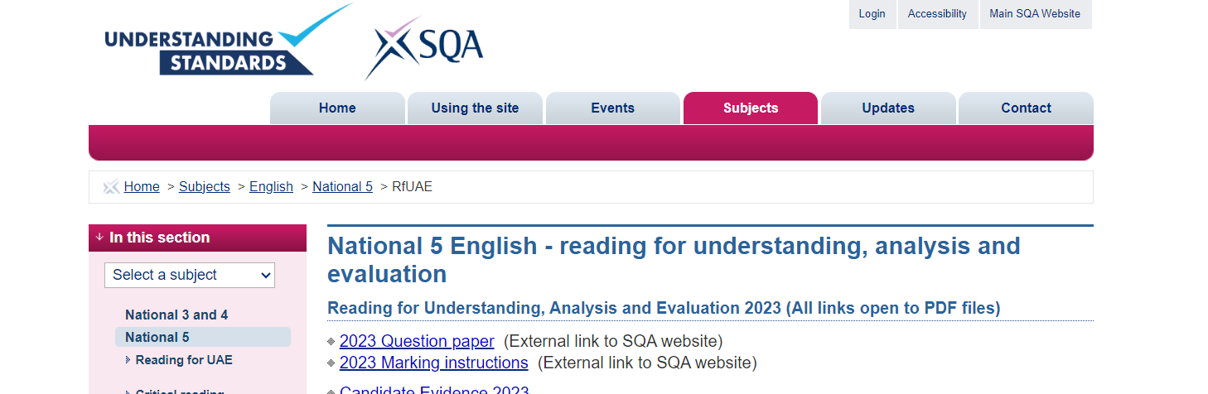
SQA UNDERSTANDING STANDARDS WEBSITE
SQA - Understanding Standards: Question paper
THIS SITE ALLOWS YOU TO SEE EXACTLY WHAT THE SQA ARE LOOKING FOR IN YOUR ANSWERS
THIS SITE ALLOWS YOU TO SEE EXAMPLES OF PUPIL'S WORK AND THE MARKS IT GOT
IT LETS YOU 'UNDERSTAND THE STANDARDS' REQUIRED FOR A PASS IN MOST OF YOUR SUBJECTS

Slide 28
SUPPORTED STUDY
YOUR TEACHERS' EXPERTISE IS CRUCIAL
TAKE THEM UP ON THEIR KIND OFFERS OF SUPPORTED STUDY
A SMALL SACRIFICE TO MAKE TO HELP YOU BE SUCCESSFUL

