Slide 1
S5&6 Assembly Thursday 14th December 2023
Preparing for your SQA Prelim Exams

Slide 2
Prayer of St Ambrose
Lord teach me to look for you.
When I look show yourself to me.
Without your help, I will go through life blind
to the many things you do for me.
With your help, I will be able to see you
in other people and in the ways you show
how much you care and love me.
As I see you more and more,
may I grow in love of you. Amen.

Slide 3
Your Prelim Exams 2024
You will be sitting your prelims from 10/1/24-26/1/24
You have been given today:
An individualised Prelim timetable
This shows your exam, the dates, times, locations and your seat numbers
The S5/6 Prelim Timetable for all S5/6 SQA Prelims
The SQA Your National Qualifications 2023 booklet

Slide 4
Some interesting statistics…
SQA Prelims
SQA Exams
Prelims start 10 January
26 days to go
Exams start 22nd April 24
18 weeks to go

Slide 5
Before your Exams
Timetable
ENSURE YOU KEEP YOUR TIMETABLE IN A SAFE PLACE
Past papers
Practice with old exam papers.
Use the marking instructions to check your answers.
SQA Apps
MyExams app - create a personal timetable, add notes, and add to other calendars.
MyStudyPlan app - organise your revision by creating a personal study plan.
Your Scottish Candidate number
Your Scottish Candidate Number (SCN) is your personal identification number.
Your SCN is used to record your achievements.
You need to write it on your exam answer booklet-we will tell you what your SCN is.
Check your school has the right name and address
Has your address changed?
Check your school have the correct details for you and your school will send to us.
You can check the personal details we hold by logging in to MySQA.

Slide 6
On Prelim Exam Day
Arriving for your exam
Make sure you know when and where your exam is taking place
Give yourself plenty of time to get there
Have your SCN with you
Be outside the exam room 10 minutes before the exam starts
If you're late, the teacher/invigilator in charge will tell you if you can sit the exam.
There is no study leave-you must stay in school for the entire day
Supplies
Make sure you have the necessary exam supplies, such as pens.
Bring a bottle of water to keep you hydrated and focused. Ask your teacher/lecturer if you're unsure what you need.

Slide 7
In the Exam Room
Your desk/seat
If your school allocates a specific desk for exams, make sure you know what desk number is yours.
Prohibited items
During the exam, you're only allowed to take items needed for the exam to your allocated seat. You're not allowed (unless an approved assessment arrangement is in place):
Electronic devices such as iPods, tablets, earpods, smartwatches or any device that stores information or can connect to the internet
Mobile phones
Extra information – books, sketches or paper, and anything written on your clothes or body
Pencil cases or calculator cases
Calculators (except when allowed)
Dictionaries (except when allowed)
Notes (except when allowed)
Check your bags and pockets to make sure you do not have any of these things with you - plan ahead and leave them in a safe place.
When specific items are allowed in an exam, you must make sure that they meet SQA regulations
YOU CANNOT LEAVE THE EXAM EARLY

Slide 8
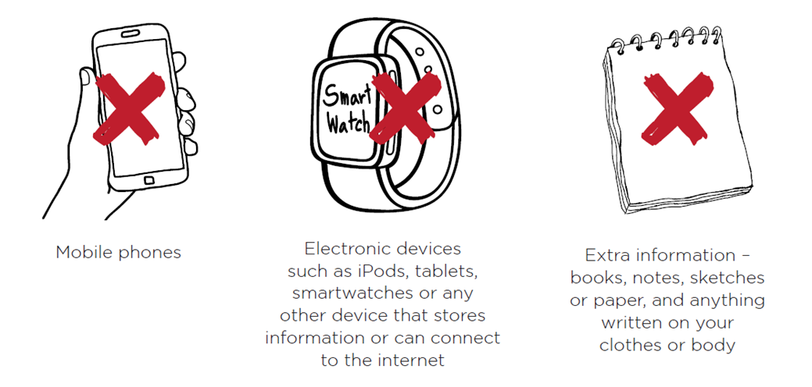
Prohibited items
Prohibited items are things that you must not have with you at your allocated seat or desk in the exam room, unless they have been approved by us as part of an assessment arrangement for the exam you are sitting.
Prohibited items include the following:

Slide 9
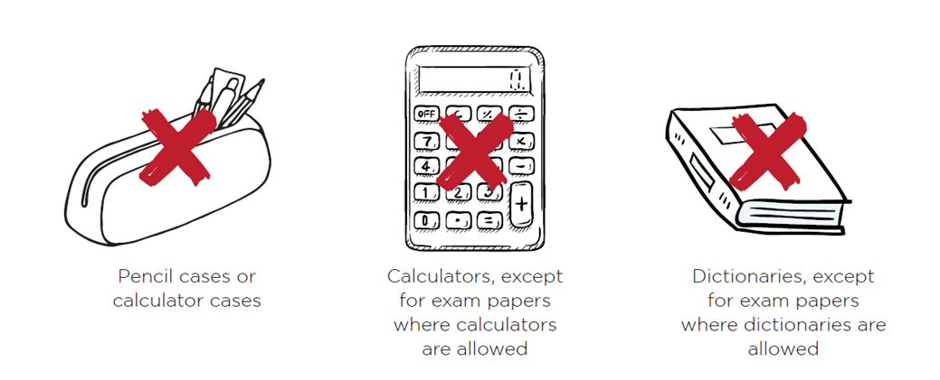

Slide 10
So, to recap....
Before you go to your seat in the exam room, check your bags and pockets carefully to make sure you do not have these things with you.
You must not take any prohibited items to your seat. You should plan ahead and leave them in a safe place.
When specific items are allowed in an exam, you must make sure that they meet SQA regulations. Your teacher or lecturer will be able to give you more information.
You must make sure that the items do not give you access to information that you are not allowed to have in the exam.
You are not allowed to share any equipment during an exam.

Slide 11
In the Exam Room (2)
Invigilators
Invigilators supervise the exam and make sure the rules are followed. Follow any instructions given by the invigilator and ask them for help if you feel unwell or upset.
Leaving the exam room
You must stay in the exam room until the end of the exam unless you are unwell
Before you leave, you must give the invigilator all your exam papers, including any answer booklets, extra sheets, question papers and data booklets. You could lose all marks for the paper concerned if you don’t give your exam papers to the invigilator before leaving the exam room.

Slide 12
Conduct and Fairness
Everyone should have a fair chance to do their best during exams.
Cheating and causing a disturbance during an exam are unfair to other candidates.
Examples of cheating and unfair behaviour (candidate malpractice) include the following:
Having prohibited items with you at your seat in the exam room
Pretending to be someone else or getting someone else to take an exam for you
Disruptive behaviour in the exam room
Using rude, abusive, offensive or discriminatory language or images
Copying from another person
Collusion — working with other candidates on an individual task that must be your own work
Plagiarism – failing to reference sources properly or presenting someone else’s work as your own

Slide 13
PLEASE BE AWARE!!
Any cheating or unfair behaviour can have serious consequences for your results and your future.
This could include losing marks, getting a lower grade or having your qualification cancelled.
IT CAN ALSO AFFECT YOUR OTHER EXAMS.

Slide 15
AND LASTLY....
All your teachers here at St Ambrose wish you all the best with this!
We know it is hard
We have all been there (many times over)
We have all had triumphs and disappointments in exams
This is only one small part of who you are and who you will be!
Good luck and God Bless!

