Slide 1
S4 Assembly Tuesday 12th September 2023
Organising your study

Slide 2
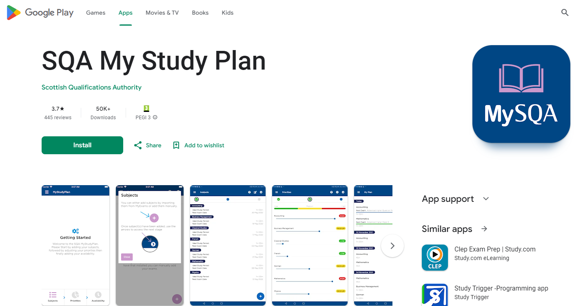
Supported Study

Slide 3
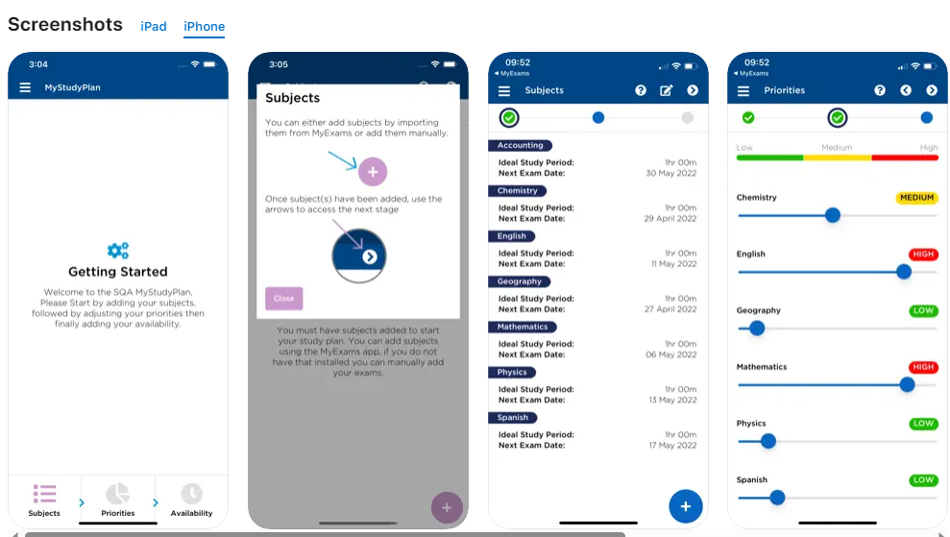

Slide 4
 | Monday | Tuesday | Wednesday | Thursday
4.30-5.00 | Arrive home Walk dog | Arrive home Walk dog | Arrive home Walk dog | Gymnastics
5.00-5.45 | Biology: cell structure | Maths: simultaneous equations | Maths: simultaneous equations | Gymnastics
5.45-6.30 | Dinner | Dinner | Dinner | Dinner
6.30-7.15 | Biology: cell structure | Geography: weather revision | Physics: Electricity | Maths: surds revision and practise
7.15-8.00 | Homework session/Back up study-English reading | Geography: weather revision | Physics: Electricity | Maths: surds revision and practise
8.00-8.45 | Football | Break-15 mins | Homework session /Back up study-RUAE past appear practise | Break-15 mins
 |  | Homework session/Back up study-RUAE past appear practise |  | Des Manufacture: Analysing a brief- data gathering and research
8.45-9.30 | Football/home | Spanish-vocabulary revision and writing topic practise | Break-15 mins | Des Manufacture: Analysing a brief- data gathering and research
9.30-10.15 | Reading/TV | Reading/TV | Reading/TV | Reading/TV
 | Friday |  | Saturday |  | Sunday
1.00-1.45 | Arrive home Walk dog | 9.30-10.15 | Homework | 12.00-12.45 | Mass
1.45-2.30 | Lunch/relax | 10.15-11.00 | Homework | 12.45-1.30 | Lunch
2.30-3.15 | Homework session/Back up study | 11.00-11.45 | Homework | 1.30-2.15 | Homework
3.15-4.00 | Homework session/Back up study | 11.45-12.30 | Homework | 2.15-3.30 | Spanish-vocabulary revision and writing topic practise
4.00-4.45 | Gym | 12.30- | Afternoon off | 3.30-4.15 | English-essay completion
4.45-5.30 | Gym |  |  | 4.15-5.00 | English-essay completion
5.30-6.15 | Gym |  |  | 5.00-5.30 | **Plan and organise for next week**
6.15-7.00 | Dinner |  |  | 5.30- | Gym
7.00 | Evening off |  |  |  | Gym /Evening off

Slide 5
Supported Study

Slide 6
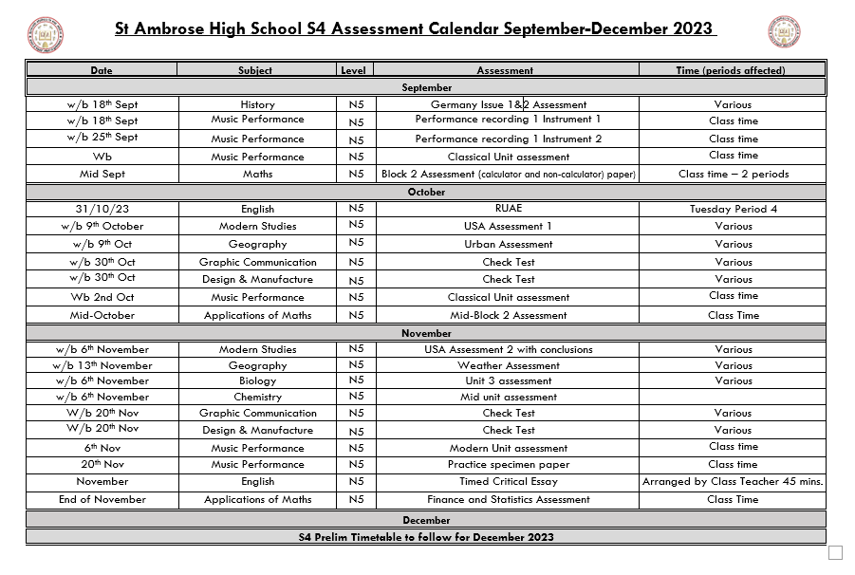

Slide 7
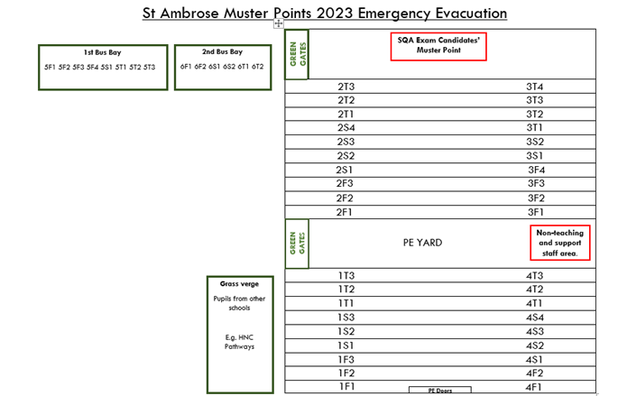
Emergency Evacuation Practise

