Slide 1
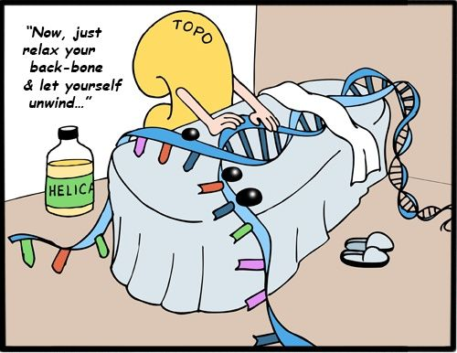
Structure & Replication of DNA
Unit 1 - Key Area 2
Part 2: Replication of DNA

Slide 2
Learning Intentions
To name the requirements of DNA replication.
Explain why DNA replication is described as being semi-conservative.
Describe the process of DNA replication.
Explain the role of enzymes and primers during DNA replication.
Notes:
3 periods including time for extended answer question (to revise for homework)

Slide 3
DNA is a unique molecule because it can make exact copies of itself. This is called DNA replication.
Introducing DNA replication
It occurs when cells makes copies of their chromosomes (DNA) prior to cell division.
It ensures the new cells have the same genetic information as the original cell.
DNA replication is a complex process involving many enzymes.

Slide 4
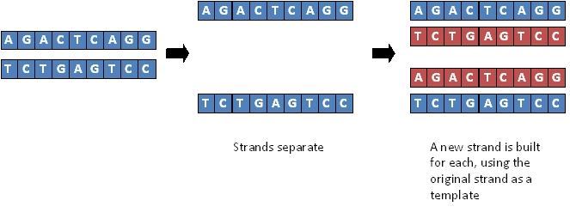
DNA replication - The basic idea
Daughter DNA molecules - each is an exact copy of the original parent DNA
Parent DNA molecule
(bases only shown)
Strands separate
A new strand is built for each daughter DNA molecule using the original strand as a template
Use highlighters to colour each strand add labels to your diagram

Slide 5
Copied DNA
Semi-conservative replication
Daughter DNA molecule
Daughter DNA molecule
Original DNA

Slide 6
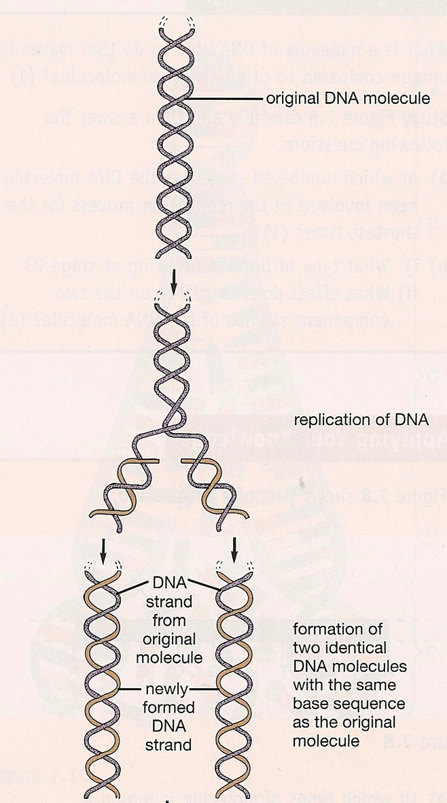
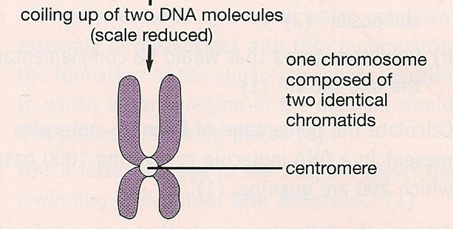
Semi-conservative replication
Replication results in two new DNA ‘daughter’ molecules.
It is said to be SEMI-CONSERVATIVE because each new ‘daughter’ DNA molecule receives one strand of the original parent molecule and one new strand of DNA.

Slide 7
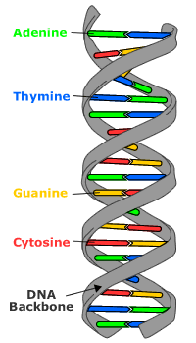
5. Sugar- phosphate bonds form
(DNA polymerase controls this)
6. Daughter DNA molecules form
DNA replication
- The basic steps
4. Weak hydrogen bonds form between bases
2. Hydrogen bonds break and DNA ‘unzips’
3. Free nucleotides find complementary bases
1. Parent DNA unwinds
Note – this gives the basic stages but not the correct orientation for both strands as it is too difficult to do just now.

Slide 8
DNA replication: Jumbled up basic stages
Free DNA nucleotides join complimentary pairs on open strand.
Strong chemical bond forms (sugar-phosphate) between both nucleotides
- controlled by enzyme called DNA POLYMERASE.
Newly formed daughter DNA (identical to original) begins to wind into double helix.
Weak hydrogen bonds between bases break (‘unzips’) causing the 2 strands to separate.
Weak hydrogen bonds reform between base pairs.
DNA double helix unwinds.
Notes:
Pupils unjumble the statements and add them to their handout.
10 copies printed

Slide 9
DNA replication: Basic Stages
DNA replication is complete in 6 stages:
DNA double helix unwinds.
2. Weak hydrogen bonds between bases break (‘unzips’) causing the 2 strands to separate.
3. Free DNA nucleotides join complimentary pairs on open strand.
4. Weak hydrogen bonds reform between base pairs.
5. Strong chemical bond forms (sugar-phosphate) between both nucleotides
- controlled by enzyme called DNA POLYMERASE.
6. Newly formed daughter DNA (identical to original) begins to wind into double helix.

Slide 10
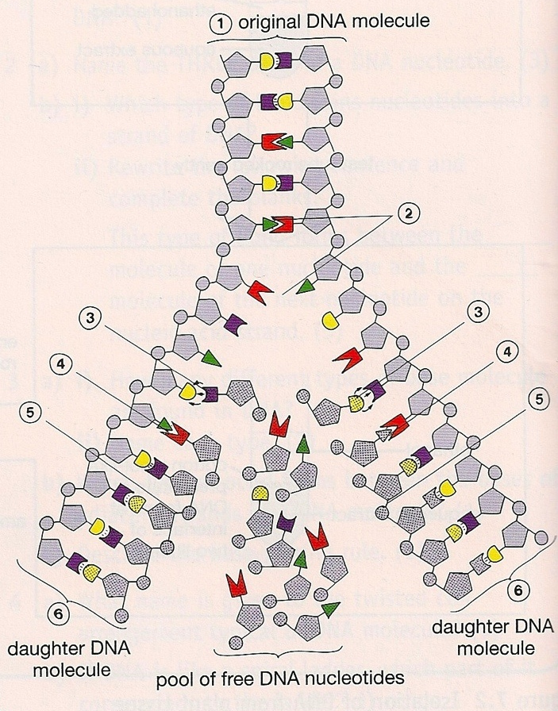
What is needed for replication?
DNA replication can only take place if the nucleus contains:
DNA (acts as template for new molecule)
Supply of DNA nucleotides
Appropriate enzymes
Supply of ATP
Primers

Slide 11
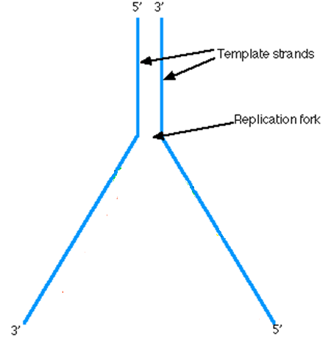
However – there is a problem….
Remember, the new nucleotides can only add on easily to the 3’ end of a DNA parent strand…
The section of DNA that is to be replicated unwinds and unzips creating a y-shaped replication fork.
3
This is perfect for this strand ☺
But not so easy for this strand :{
3
5
5
3
The important thing to remember is that DNA can only build in the direction 5’ – 3’ . This means that nucleotides can only be added to the 3’ end of the strand to be replicated by the enzyme DNA polymerase.
Notes:
Through some quirk of evolution, DNA polymerase is only able to add nucleotides to the 3' (sugar) end of a growing chain of DNA.

Slide 12
Enzyme control of DNA replication
DNA replication is a complex process involving many enzymes.
The enzyme DNA polymerase controls the formation of the sugar-phosphate bonds when making the new strand.

Slide 13
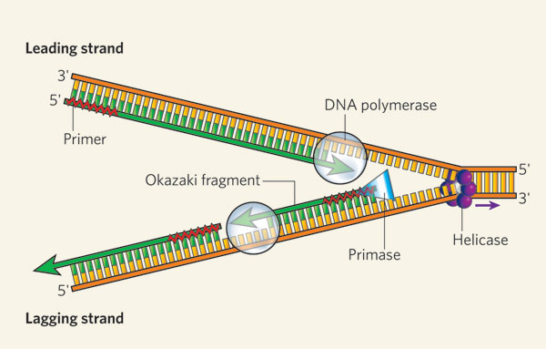
1. DNA replication
Refer to the diagrams on page 29/30 of the textbook as we go through the stages
The DNA molecule unwinds and the weak hydrogen bonds between base pairs break allowing the two strands to separate (‘unzip’). (This process in controlled by the enzyme helicase). The bases become exposed at a Y- shaped ‘replication fork’.
replication fork
- where hydrogen bonds are broken and bases become exposed.
Notes:
Copy next 5 slides and provide as an ‘info pack’ for each group.
Go through slides while referring to diagrams in pupil booklet. Show video clip then allow pupils 20-25 minutes to make notes/complete handout using info packs and textbook.
Have copies of diagrams from the textbook available for pupils to stick in.

Slide 14
2. DNA replication
The enzyme that controls the joining of new nucleotides to create a new chain is called DNA polymerase.
This enzyme can only add nucleotides to an existing chain so a short sequence of complementary nucleotides - formed at the 3’ end of the parent chain to be duplicated - is put in place. This short chain is called a primer. (This process is controlled by the enzyme primase).
Notes:
Primer - short string of nucleotides usually 10 base pairs (in most cases of natural DNA replication, the primer for DNA synthesis and replication is a short strand of RNA.

Slide 15
3. DNA replication
Individual free nucleotides become aligned with their complementary partners (by following the base pairing rule A with T, G with C). DNA polymerase adds the complementary DNA nucleotides to the DNA strand.
The new complementary strand of DNA starts forming from the 3’ end of the primer and forms a continuous strand towards the replication fork.
This is called the leading strand.
Leading strand
3’

Slide 16
5’ end of DNA strand
Leading strand of replicated DNA
DNA polymerase enzyme
Direction of replication
3’ end of DNA strand
Start of complementary strand of replicated DNA
Replication of the leading strand of DNA
Primer

Slide 17
After the hydrogen bonds break, the DNA unzips.
A DNA primer (a short stretch of complementary DNA) attaches to the start of the piece of DNA being copied.
DNA polymerase the attaches free nucleotides to the 3’ end of the primer.
This continuous process till leading strand is copied.

Slide 18
The Leading Strand
http://www.nobel.se/medicine/educational/dna/a/replication/replication_ani.html

Slide 19
4. DNA replication
DNA polymerase can only add nucleotides to the 3’ end of a growing strand so on the opposite parent strand the new complementary strand grows in the opposite direction to the leading strand. This is known as the lagging strand.
The lagging strand is produced in fragments with each fragment started at the 3’ end of a primer.
Each fragment requires a primer to initiate its production.
fragment
lagging strand
primer

Slide 20
5. DNA replication
Once the DNA fragments are created they are joined together to form a complementary strand by an enzyme called ligase.
Ligase enzyme joins strands together

Slide 21
Replication of the lagging strand of DNA
3’ end of DNA strand
Primer
DNA polymerase
Ligase
5’ end of DNA strand

Slide 22
DNA polymerase can only add onto the 3’ end of a primer. So for the other strand:
Many primers attach along the strand.
These are extended by the DNA polymerase.
The fragments are then joined by the enzyme ligase
This is a discontinuous process creating the lagging strand.

Slide 23
The Lagging Strand
http://www.nobel.se/medicine/educational/dna/a/replication/lagging_ani.html
www.davidgalloway.co.uk/repli2s.swf

Slide 24
Summary: The stages of DNA replication
DNA replication is an enzyme controlled reaction which requires ATP.
The DNA molecule unwinds and the weak hydrogen bonds between the base pairs break (‘unzips’) allowing the two strands to separate and form two template strands. The point of separation is called the replication fork.
A primer molecule is required to attach at the end of the lead template strand in order for the DNA polymerase enzyme to initiate the production of a new strand of DNA.
Individual free nucleotides become aligned with their complementary partners on the template strands (remember A with T, C with G). DNA polymerase adds complementary DNA nucleotides to the DNA strand.
New nucleotides can only be added to the 3’ end of a DNA chain. The DNA polymerase enzyme joins the nucleotides to form the phosphate-sugar backbone of the new strand.
The leading strand is formed as one continuous strand working towards the replication fork.
The lagging strand is formed in fragments (discontinuous) working away from the replication fork. Each fragment requires a primer to initiate its production. The fragments are joined together to form a complete complementary strand by the enzyme ligase.
Notes:
Print for each group and add to pupil info pack.

Slide 25
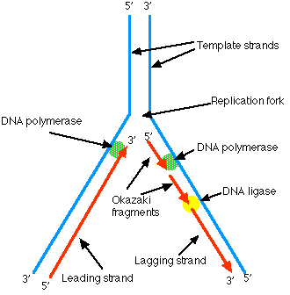
DNA replication - a summary
http://highered.mcgraw-hill.com/sites/9834092339/student_view0/chapter14/dna_replication.html (2:38)
https://www.youtube.com/watch?v=TNKWgcFPHqw (3:28)
Watch the video clip
Notes:
Excellent video clip

Slide 26
DNA replication - Overview
https://www.yourgenome.org/sites/default/files/downloads/video/dna-replication/dna-replication-720p.mp4

Slide 27
Formation of the leading strand of DNA
The enzyme DNA polymerase controls the sugar-phosphate bonding between nucleotides on the new DNA strand. This enzyme will only add nucleotides to a pre-existing chain.
A primer is needed to initiate DNA replication.
A primer is a short strand of complementary nucleotides formed at the 3’ end of the parental DNA strand.
DNA replication on this strand is continuous and forms the leading strand of the replicated DNA.
Notes:
Print for each group and add to pupil info pack.

Slide 28
Formation of the lagging strand of DNA
DNA polymerase can only add nucleotides to the free 3’ end of a growing strand.
Therefore the DNA on the parental strand that has the 5’ end exposed is replicated in fragments, each starting at the 3’ end of a primer.
As the replicated strand is discontinuous, the enzyme LIGASE joins the fragments together.
The strand formed is called the lagging strand of replicated DNA.
Notes:
Print for each group and add to pupil info pack.
Each fragment must be primed as before to enable the DNA polymerase to bind individual nucleotides together.
Once replication of a fragment is complete, the primer is replaced with DNA.
When a long chromosome e.g. from a mammalian cell is being replicated, many replication forks operate simultaneously to ensure speedy copying of the lengthy DNA molecule – see figure 2.23 in textbook page 31

Slide 29
What does this diagram not show?
Diagram does not show the primers
3’ end of the parental DNA strand
UNZIPPING POINT
3’
This leading strand
can build continuously in the correct direction 5’-3’ TOWARDS the unzipping point
5’
5’
This is the parent strand opening like a zip
3’
5’
3’
This lagging strand
can only be built 5’-3’ AWAY from the unzipping point so must be built in sections which are ‘glued’ together by ligase.
DNA Polymerase
3’
Ligase
5’
5’ end of the parental DNA strand
Notes:
Print copy for pupils.
Important note
LAGGING STRAND: ALTHOUGH “BUILDING” IS MOVING AWAY FROM THE FORK, THE OVERALL REPLICATION IS MOVING TOWARDS FORK.
Diagram does not show the primer.

Slide 30
Your Turn…..
Collect a DNA replication info pack
Produce a summary of the process in your notes using the information available – DNA info pack; textbook; stick in diagrams etc.

Slide 31
Key terms: In a sentence!
Term | In a sentence….
Replication fork | Where hydrogen bonds are broken between the two strands of DNA and bases become exposed.
DNA polymerase | DNA polymerase adds nucleotides to the new DNA strand
Primer | a short strand of complementary nucleotides formed at the 3’ end of the parental DNA strand.
Leading strand | this strand builds continuously (in the correct direction 5’ – 3’) towards the unzipping point
Lagging strand | this strand is formed in fragments i.e. discontinuously, away from the replication fork
Ligase | Ligase joins together fragments of DNA which form the lagging strand

Slide 32
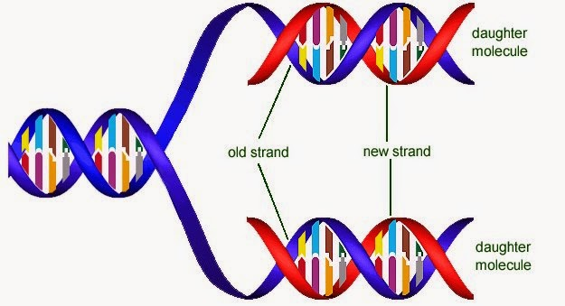
Importance of DNA Replication
Once the two identical daughter DNA strands form, they coil up and become identical chromatids (held together by a centromere).
Following DNA replication (and before cell division) the cells DNA content is at its maximum.
DNA replication ensures that new cells have the same genetic information and a complete copy of the genome. The chromosome complement is therefore maintained.
If DNA failed to replicate itself, mitosis and meiosis would be unable to take place.
DNA is therefore essential for life to exist.

Slide 33
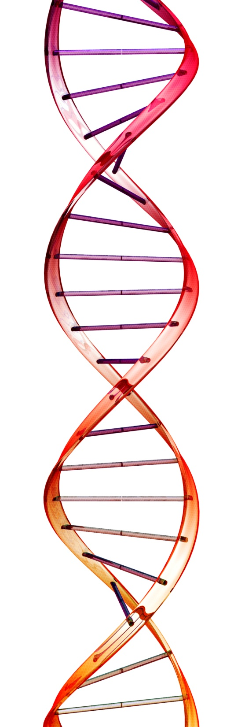
Now try the following questions…
Textbook Page 31 Qu 1-3
Finished?
Describe DNA replication on the leading strand and lagging strand using the following key terms, but without notes!
Parental strand orientation, DNA Polymerase, Ligase, primer, replication fork, nucleotides, continuous and discontinuous

Slide 34
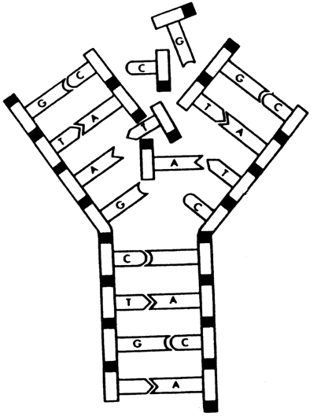
Test your knowledge and Understanding...
Where in the cell does this process take place?
Name components A, B and C.
Name base 1 and 2.
Name another substance not shown in the diagram that is required for DNA replication.
DNA replication is said to be semi-conservative. Explain why.
nucleotide
A
nucleus
1 = Guanine
2 = thymine
phosphate
ATP/DNA polymerase/primers/ligase
1
B
C
deoxyribose sugar
Because each daughter DNA molecule produced consists of 1 original DNA strand and 1 new DNA strand
2
The diagram shows the process of DNA replication
Notes:
34

Slide 35
Crash Course Video clip (12:58)
Watch this video clip (in class or at home) to revise key area 2.
Crash course: DNA structure and replication

Slide 36
Homework
Past paper Questions.
Revise for the following extended answer question:
Describe the structure and replication of a molecule of DNA. (10 marks)
Notes:
Model paper 3

