Slide 1
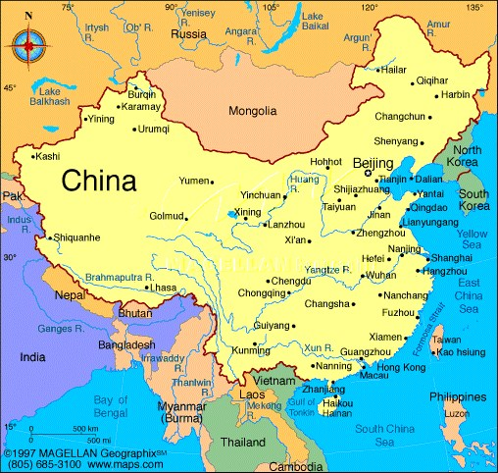
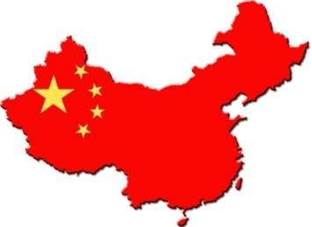
China: Why Study it?
Take down the heading and learning intention.
L.I I can explain the reasons why we should study China.

Slide 2
Starter
How many things do you already know about China?

Slide 3
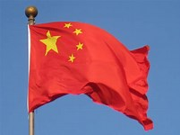
An Introduction to China
One in five of the people in the world (1.3 billion) live in China, making China the most populated country on Earth. However, it is only the 4th largest country in the world.
China is an important country. China produces huge amounts of gas, coal and oil for other countries in the world to use. Much of the world’s manufactured (made) goods such as toys and electronic equipment are made in China. China is also an important country as it has nuclear weapons and a powerful army.
The capital city of China is Beijing.

Slide 4
1. Explain two reasons why China is an important country. (4)
Remember from 1st year, we use Point, Explain in Modern Studies.
Make a Point (1)
Explain your Point. (1)
Use the writing frame:
China is an important country because _______________________________. (1)
This means that _________________________________________________. (1)
Another reason China is an important country is because ________________. (1)
This means that _________________________________________________. (1)

Slide 5
Watch and take notes:
https://www.youtube.com/watch?v=2IqdV5EfByg (10:19 mins)

Slide 6
Questions
2.“China is the most populated and largest country in the world.”
Leila Strachan
Give one reason to support the view of Leila Strachan.
Use the writing frame
One reason to SUPPORT the view of Leila Strachan is when she
says”__________________________. “
This can be seen in the source which shows ________________________________.

Slide 7
UK |  | China
64 million | Population | 1.35 billion
81 years | Life expectancy | 75 years
4 per 1,000 | Infant death rate | 10 per 1,000
99% | Literacy rate | 95%
£26,500 | Average income per person | £ 7,590
5.4% | Unemployment | 6.1%

Slide 8
“People in the United Kingdom have a higher life expectancy than those in China. There is a higher percentage of unemployment and poverty in China than the UK. The literacy rate for both countries is exactly the same. Children in the UK are less likely to die as infants than those in China.” Kasey Ryan
Using only the information in the table in your jotter, write down one statement that is made by Kasey Ryan which is exaggerated. Explain the reason for your choice.
Use the writing frame
Kasey Ryan is exaggerating when she says “________________ __________________________.”
I know this because the table shows _______________________________ _______________.

Slide 9
How has China changed?
China is a country which is changing fast. Sixty years ago most Chinese people lived in the country following an agricultural (or farming) way of life that had not changed for centuries. Today, however, around half of Chinese people live in cities and millions more Chinese are expected to migrate there in the next 20 years. The most populated city in China is Shanghai where there are 24m people.

Slide 10
How has China changed?
Many of the Chinese people who left the countryside have done so in order to find better paid work in the new industries in the cities. Although about 50% of Chinese people still work in agriculture, the rest work in factories or in the service sector (for the government, in shops, etc.). In the cities, wages are much higher than the country. The average income in the countryside is about £200 per month. In the cities income is about four times higher at £800 per month. A small number of Chinese people are rich or very rich although the number of rich people is growing.
Question
For what reason are people moving from the countryside to the cities?
Remember to use Point, Explain in your answer. (PE)

Slide 11
Percentage (%) of Chinese in Different Income Groups
80
70
60
40
20
(%)
10
20
Question
What conclusion can be drawn about income levels in China?
0
£0-£2000
£2,000-£4,000
£4000 or more
Income per year
Use the writing frame
One conclusion that can be drawn is _______________________________________________. I know this because the source shows _____________________________________________.

Slide 12
Extension Task
Create a fact file in your jotter about China.
You should include
The flag/outline of the map
The capital
Key facts or statistics
Why you think it’s important to study life in China.

Slide 13
Plenary
Tell a partner 3 reasons why we are looking at China in Modern Studies.

