Slide 1
St Ambrose High School S2-S3 Moving into the Final Year of the Broad General Education
Thursday 24th January 2019
Notes:
Format of this evening is that there will be a short presentation from me about the format and structures of the Subject Decision programme for our young people. Thereafter, there is an opportunity for you to go into the Social Area and there are a range of people who will assist you.
We have some departments represented tonight where staff are on had to help you with queries and advice about subjects and potential pathways for pupils.
To assist departments, we also have current pupils in S6 who are curriculum and school leaders who can tell you about their experiences regarding the choices they have made and the pathways this has led to for them.
We also have a group of former pupils who are all currently in first year at university and will also help to offer support and advice about their pathways to careers and study.
We also link with a number of outside industries and we have a representative from Bosch who can again offer advice and direction.
Skills Development Scotland staff are her to help offer further clarity about careers and the work which is already underway for the pupils in S2
and our school librarian is on hand to offer support as she plays a big role in the careers support and information literacy of our pupils.

Slide 2
Curriculum from Junior to Senior Phase: a coherent curriculum from 3-18
Junior Phase
A broad general education
well planned experiences and outcomes
all the curriculum areas
understanding of the world and Scotland’s place in it.
Senior Phase
provides opportunities for qualifications
other planned opportunities for developing the four capacities.
Opportunities :
for developing skills for learning, skills for life and skills for work
to achieve to the highest levels they can through appropriate personal support and challenge
to move into positive and sustained destinations beyond school.

Slide 3
National Qualifications
National 3
National 4
National 5
Higher (National 6)
Advanced Higher (National 7)

Slide 4
National Qualifications : Assessment and Certification
Other levels of Certification
Assessments for Courses and Units
Notional 160 hours
Pupils will be involved in assignments,
case studies, practical activities and
question papers
NATIONAL 4 courses will be assessed
internally
NATIONAL 5s will involve external assessment
usually an exam.
Nationals 1, 2, 3
National 6 (THE HIGHER)
AH
All of which provide good progression to and from National 4 and National 5

Slide 5
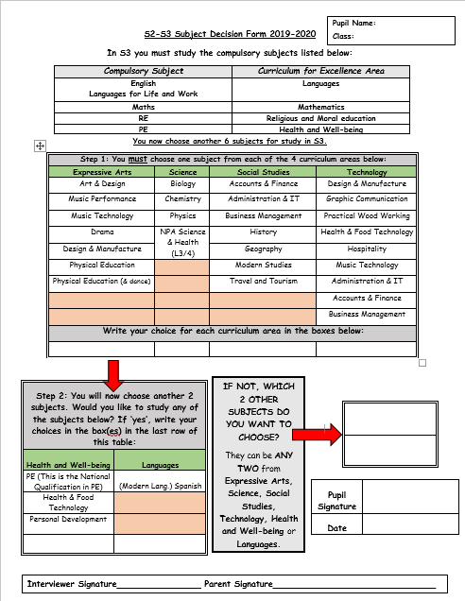
Curriculum Structure S2-3 This is the Subject Decisions form which our pupils were issued at an assembly this week.
Notes:
This Curriculum Structure will allow pupils to study 8 subjects in 3rd year to complete the BGE, but with a view to dropping one subject in S4 to study 7 Nationals.

Slide 6
So what does each section within the Subject Decision form mean?
Compulsory Subject | Curriculum for Excellence Area
English Languages for Life and Work | Languages
Maths | Mathematics
RE | Religious and Moral Education
PE | Health and Well-being

Slide 7
Step 1-First 4 Choices
Step 1: You must choose one subject from each of the 4 curriculum areas below:
Expressive Arts | Science | Social Studies | Technology
Art & Design | Biology | Accounts & Finance | Design & Manufacture
Music Performance | Chemistry | Administration & IT | Graphic Communication
Music Technology | Physics | Business Management | Practical Wood Working
Drama | NPA Science & Health | History | Health & Food Technology
Design & Manufacture |  | Geography | Hospitality
Physical Education |  | Modern Studies | Music Technology
Physical Education (& dance) |  | Travel and Tourism | Administration & IT
 |  |  | Accounts & Finance
 |  |  | Business Management
Write your choice for each curriculum area in the boxes below:
Notes:
In Step 1, pupils choose one subject area in each column as above.

Slide 8
Step 2-Next 2 Subject Choices
IF NOT,WHICH 2 OTHER SUBJECTS DO YOU WANT TO CHOOSE?
They can be ANY TWO from Expressive Arts, Science, Social Studies, Technology, Health and Well-being or Languages.
.
Step 2: You will now choose another 2 subjects. Would you like to study any of the subjects below? If ‘yes’, write your choices in the box(es) in the last row of this table:
Health and Well-being | Languages
PE (This is the National Qualification in PE) | (Modern Lang.) Spanish
Health & Food Technology
Personal Development
Choice 5 (you could choose two from this column to make up choices 5 and 6) | Choice 6
Choice 5
Choice 6
Notes:
You the move to Step 2 where you can choose from the Health and Well-being curricular area or Languages. If you do not choose from these areas, you can go back to the box in the previous slide and choose another two from Expressive Arts, Sciences, Social Subjects and Technologies.

Slide 9
Supporting Pupils on their Learning Journey
Personal Support
Careers input/Glasgow Caledonian University careers day
Subject specialists in classes
One-to-one interviews with Pupil Support staff
S3 support
Notes:
We have a very thorough and planned programme of personal support which is designed to prepare and inform our young people to undertake this next important step in their learning journey.
The key driver of this support is our Personal Support programme. In the last few months your sons and daughters have been working with their teachers, their Pupil Support teacher and others such as myself, the Librarian and the Careers Service to help them to consider their next learning journey steps and to make informed choices.
The Personal Support programme involves our young people considering their individual skills and qualities, exploring different careers and career paths and looking at the range of subjects which are on offer. Subject specialists will also be providing their classes with information about their individual subjects and will be able to answer any subject-specific questions which pupils may have on an ongoing basis.

Slide 10
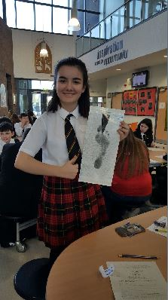
Personal Support-ongoing
Tracking Reports: January 2019 and May 2019
Subject Decisions meeting 24th January 2019
Glasgow Caledonian University Mentors 25th January 2019
S2 Reporting Evening – Thursday 7th March 2019
Information Leaflet-already issued to pupils today
Subject Decisions Booklet- to be published online and will be discussed with pupils in Personal Support
Research and discussion
Notes:
Of course, in addition to all the work done in Personal Support, there is a whole programme of events designed to support the home-school partnership as our young people undertake this important step in their learning journey.
During the Subject Decisions programme, pupils have received information leaflets and booklets are online which will help to inform them about the Subject Decisions process and the subjects which they will be able to choose. We would actively encourage both pupils and parents to supplement this with their own research on subjects using sites such as the SQA, My World of Work and Plan It Plus so that they can be as informed as possible about what the different subjects involve and how these help to support particular career paths. This is especially important for subjects which pupils may choose which they have not studied before such as Personal Development or Accounting.

Slide 11
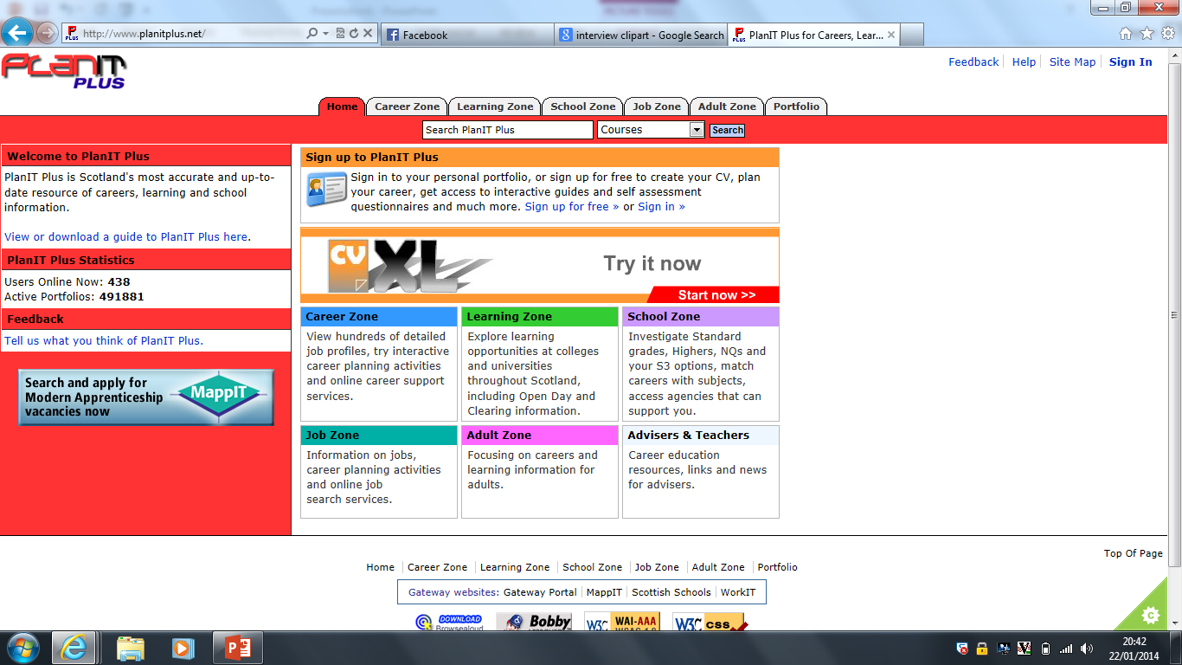
Notes:
Part of the personal support through Personal Support involves using the Plan It Plus resources online. Your son or daughter will be able to use this resource to research subjects, careers and qualifications. It is a resource which can be used at home with the username and password set up in school and really does provide an excellent opportunity for parents to be involved in researching and discussing future careers and learning.

Slide 12
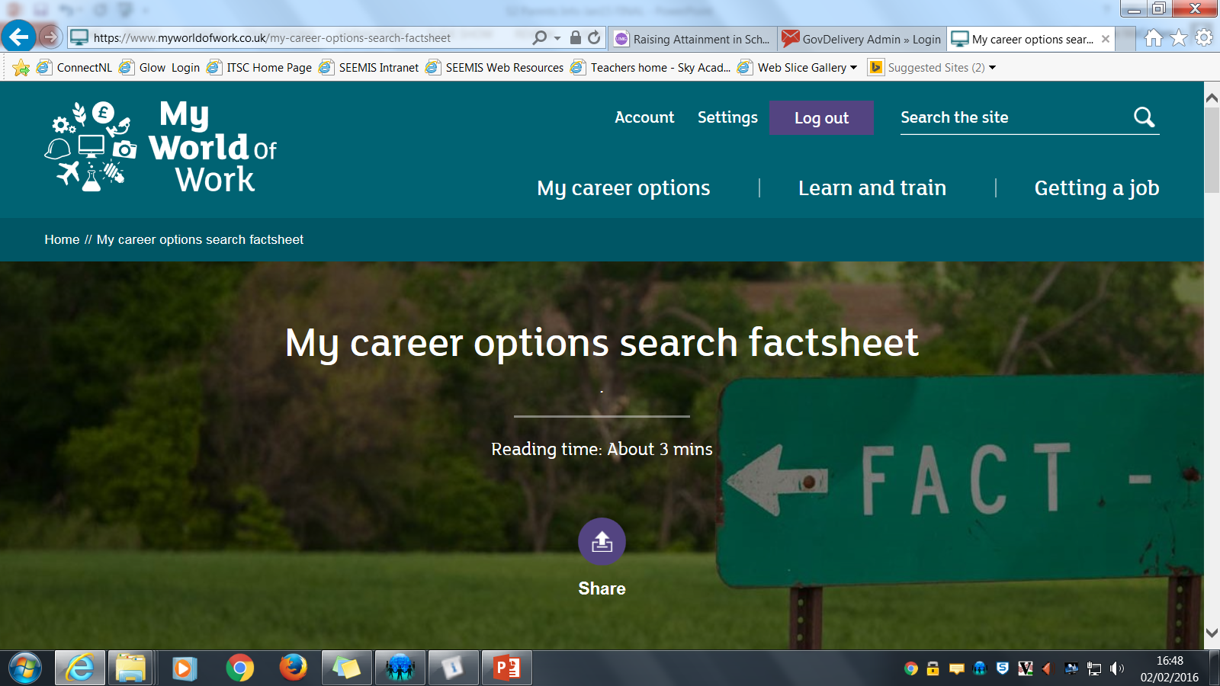
Notes:
Another resource which provides excellent materials to use at home is the My World of Work website. This provides information and advice for young people and parents in all areas of subject decisions, careers and jobs. There is an excellent section which allows young people to assess their strengths and it even allows them to collect 150 Young Scot points when they take the quiz! Very worthwhile for those who save their points to claim prizes from the Young Scot website at the end of each term!

Slide 13
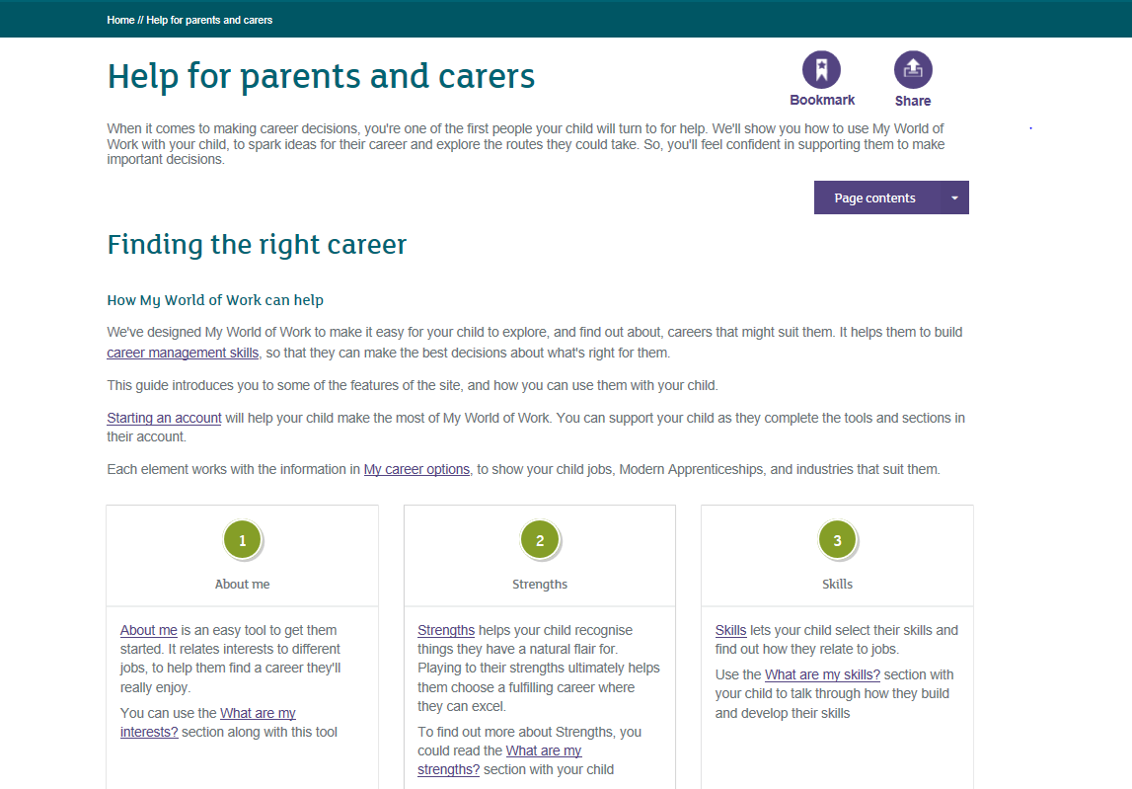

Slide 14
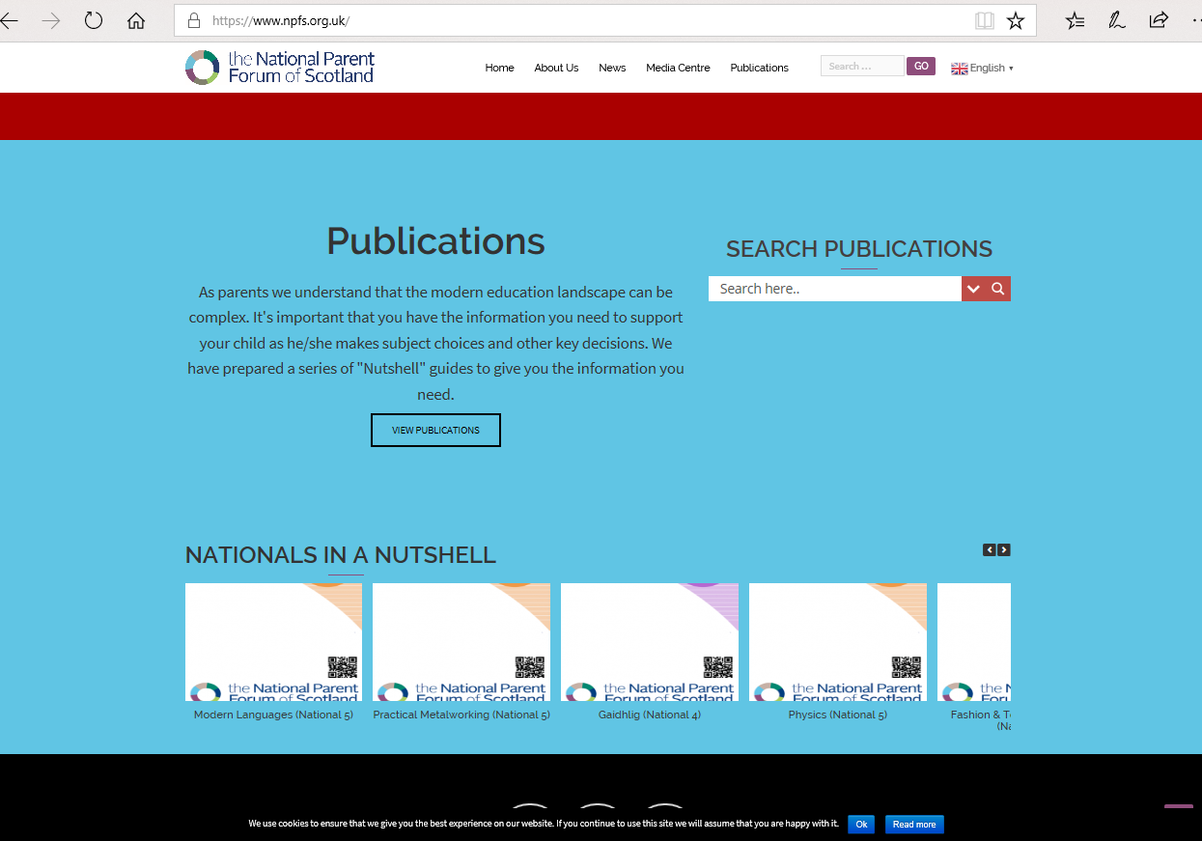
Notes:
To help inform parents and young people further, we often refer you to the National Parent Forum of Scotland and in this there is really helpful information about the National Qualifications and what format these programmes take. This is a really worthwhile exercise to undertake with your sons and daughters together as you begin to see the framework for subjects and the demands and challenges these pose.

Slide 15
Curriculum for Excellence - Junior Phase
There is a period of transition from June through to November of S3 when course work can relate to BGE Benchmarks before National Qualifications start.
S3 Tracking Reports will refer to progress in benchmarks in each subject studied by pupils- these begin to chime with outcomes at National levels
Reporting meeting in the Spring term of S3 will provide an insight into progress towards the national qualifications
Notes:
So in staying true to the CFE in the Junior Phase, in S3 there is a period of transition from Aug –Nov when course work relates to the experiences and outcomes before national qualifications start.
The S3 Tracking report will refer to the progress with these benchmarks and the parents evening in S3 in the spring will be able to give an insight into your son or daughter’s progress into national qualifications.

Slide 16
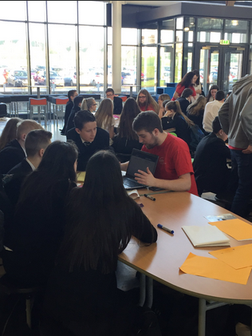
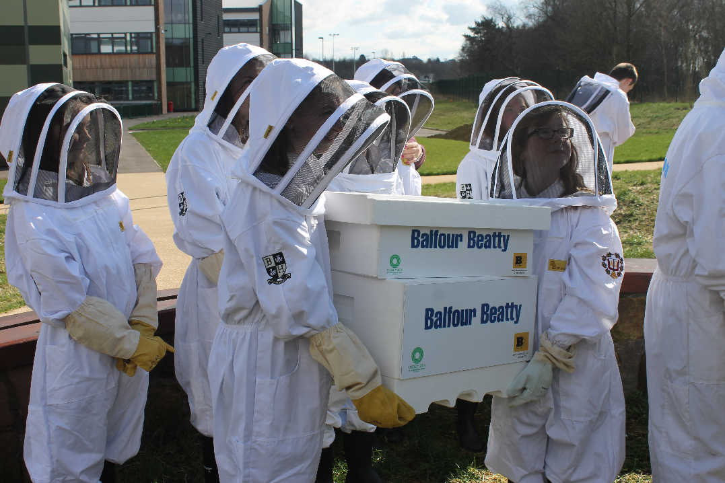
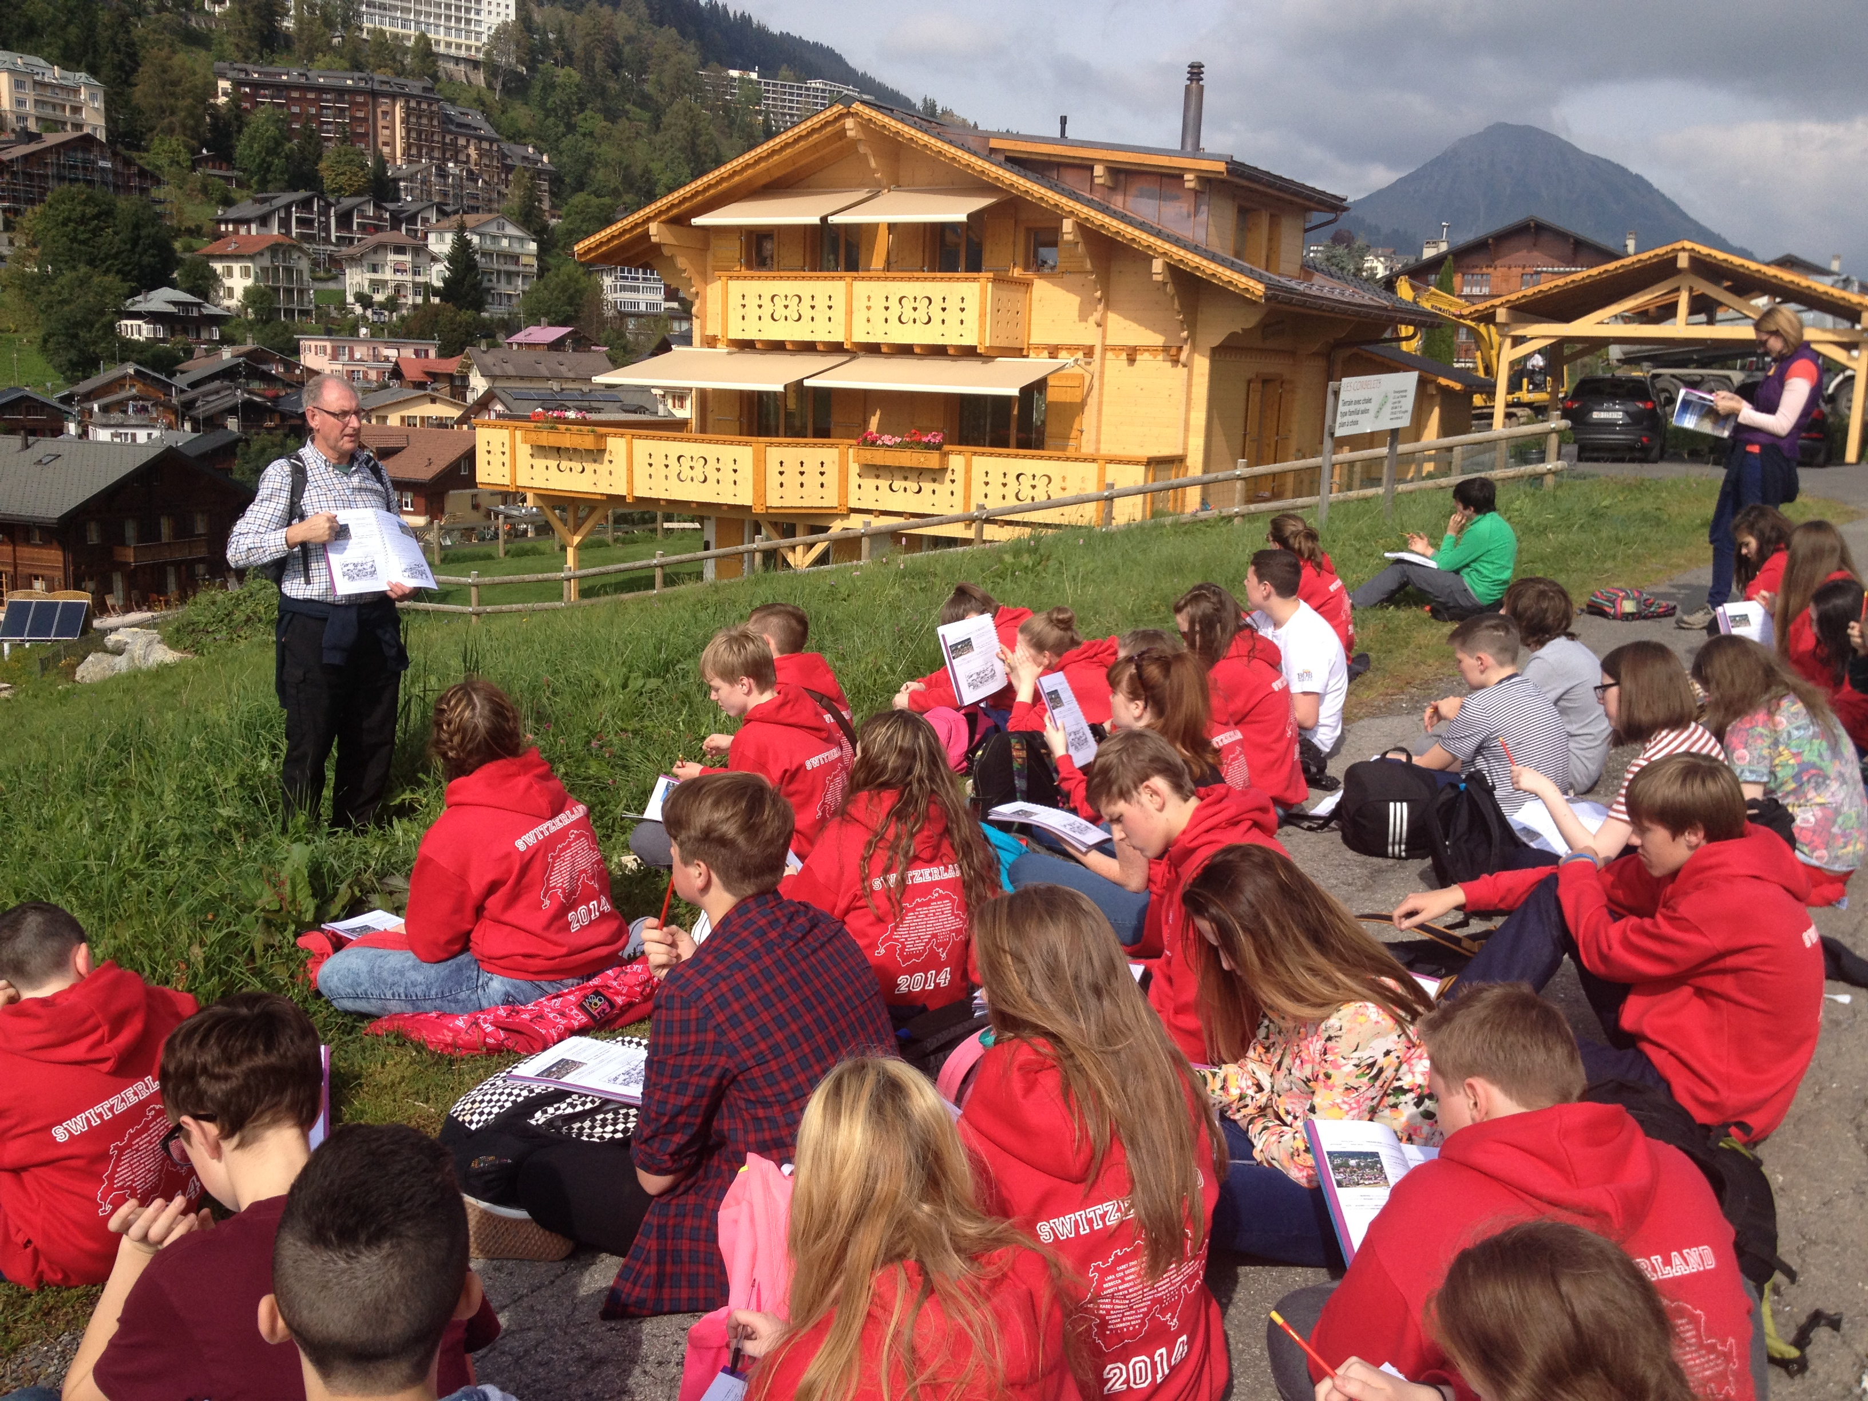
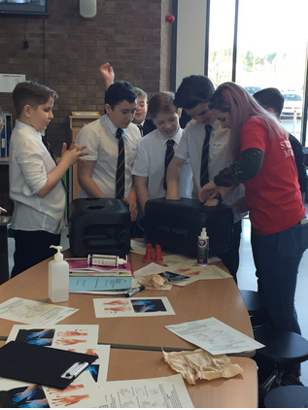
Our Pupils

Slide 17
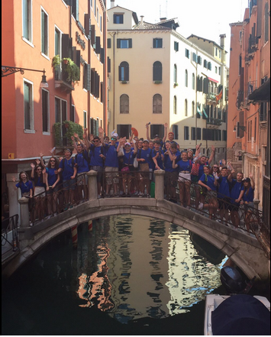
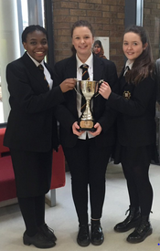
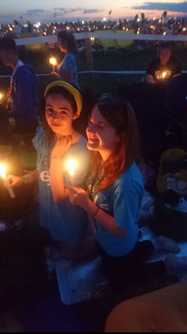
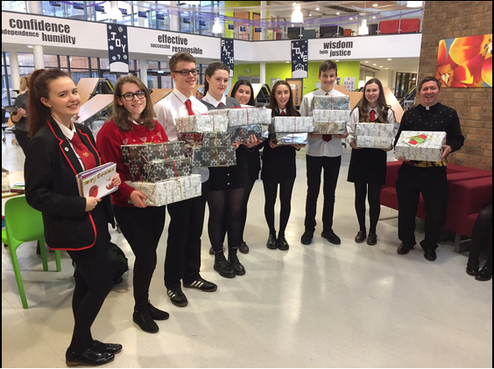
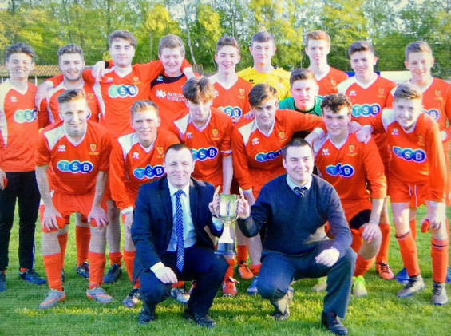
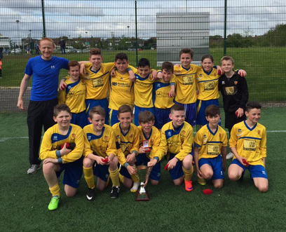
Our Pupils

Slide 18
Questions and Evaluation
Notes:
Thank you for coming this evening and now could I invite you to go into our Social Area and talk to our pupils, staff and links who can offer you further support and advice.

