Slide 1
Summer Holiday Budgeting

Slide 2
Learning Intention
Click file, save as, download a copy to complete this activity.
We are learning to plan for an event whilst sticking to a budget.
Success Criteria
•Use the internet to research costs.​
•Select cost effective options.​
•Calculate the total budget.​

Slide 3
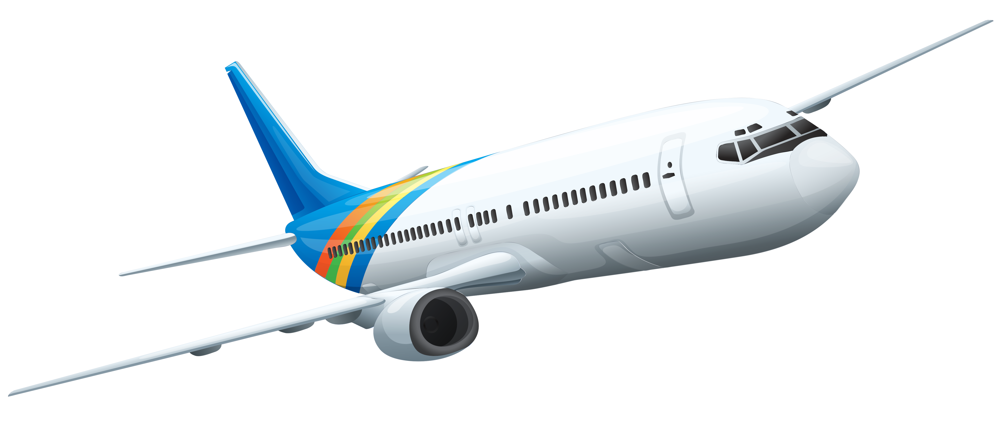
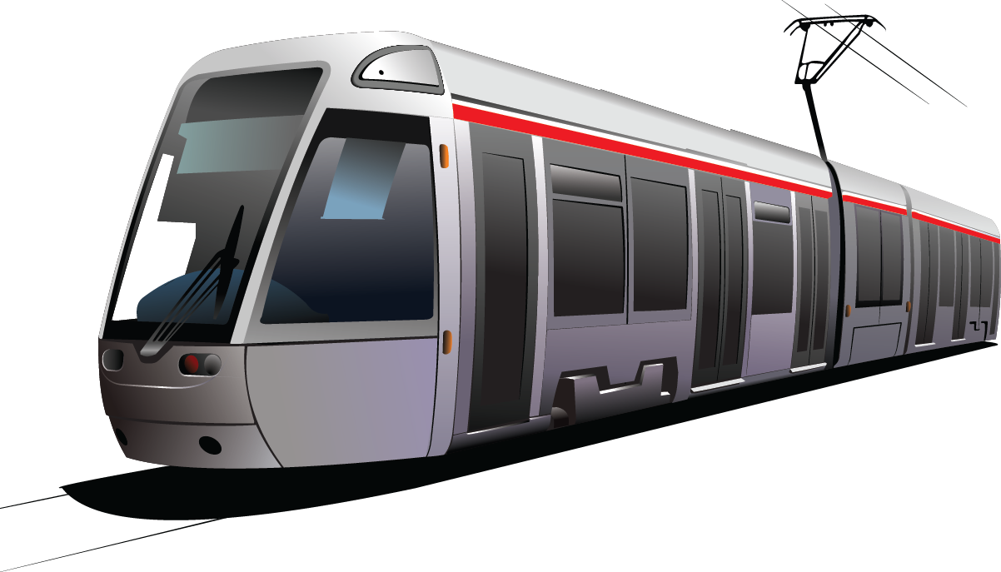
Introduction
Your task today is to plan and budget for a summer holiday.
You can choose the location, method of travel and activities you do whilst you are there.
This has to be a holiday for a family and the budget you will be given is for the whole family, not per person. You can decide how many people will be in the family, but it must include at least one adult and one child.
Use the internet to research the cost of travel, accommodation and activities.
Are there any additional expenses you need to budget for – for example new clothes, sun cream, spending money.
You can use the table on the next slide to help you plan.
This Photo by Unknown Author is licensed under CC BY-NC
This Photo by Unknown Author is licensed under CC BY-NC

Slide 4
Click file, save as, download a copy to complete this activity.
Summer Holiday Budgeting
Your total budget for your holiday is £4000. This must include all expenses and spending money. Use the table below to help plan your perfect summer holiday.
My Perfect Summer Holiday
 | Cost | Details
Travel
Accommodation
Activities
Clothes and Shoes
Food and Drinks
Additional Items eg sun cream
Spending Money
Total Cost

Slide 5
Summer Holiday Budgeting
Have a look at this table. The person who has planned this holiday has gone seriously over budget. Could you suggest any changes to help reduce their costs?
There are some suggestions on the next slide.
My Perfect Summer Holiday
 | Cost | Details
Travel | £5836 | 2 weeks All Inclusive in Benalmadena flying from Glasgow on 1st July
Accommodation |  | Hotel Bali Benalmadena
Activities | £90 | Family ticket to Aqualand
Clothes and Shoes | £2000 | Shopping in Designer stores
Food and Drinks | £100 | All inclusive, so only need to buy lunch at the water park
Additional Items eg sun cream | £50 | Sun cream, toiletries and pool inflatables
Spending Money | £1000 | For souvenirs and days out
Total Cost | £9096

Slide 6
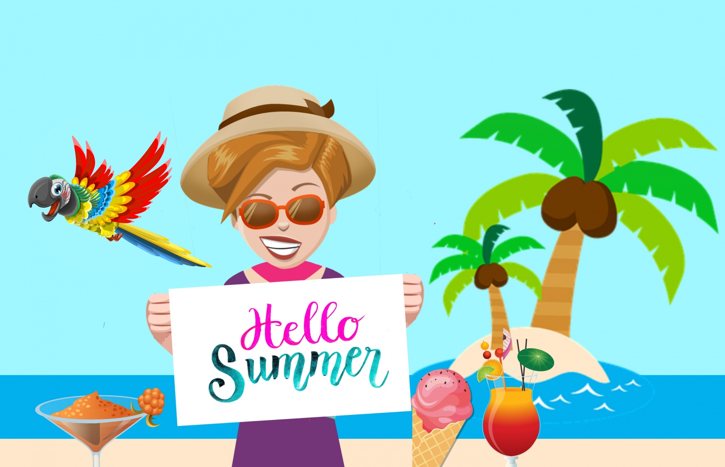
Holiday Budgeting
Here are some ways to reduce the cost of this holiday:
Perhaps they could go for one week instead of two.
Look at different dates – prices change on a daily basis.
Check out the price to fly from a different airport but remember to add any additional travel costs.
Perhaps they could go self catering and cook their own meals – remember to add extra money for food and drinks.
Shop around to find cheaper options for clothing and additional items.
If it’s still too expensive, think about cutting out the trip to the water park or going to a cheaper hotel or location.

Slide 7
Holiday Budgeting
Budgeting often means you have to change or cut out some things from your plans.
When you have completed planning your holiday, make a presentation, showing your choices and detailing any changes you had to make to stay within budget.
Decide how you will present your findings back to your class.
Here are some ideas of how you may choose to present it:
Sway
PowerPoint
Poster
Excel
Make a Video
Story Board
Write a Report

Slide 8
Self Assessment
We will know if we have been successful if we can:
•Use the internet to research costs.​
•Select cost effective options.​
•Calculate the total budget.​
I need more help
I am getting there
I can do this

Slide 9
Share your learning
We love to see you all taking part in our lessons. Remember to share your learning with us on Twitter.
@NLDigitalSchool
#NLVirtualClassroom

Slide 10
Images sourced from flaticon

