Slide 1
Sharing My Opinion

Slide 2
Learning Intention
We are learning to express and share our opinion with others.
Success Criteria
Select a video or online game that I would recommend to others.
Decide who I’d recommend the game to (my audience).
Make a suitable set of notes with engaging information about the game.
Justify the personal opinions expressed in the review.
Plan and rehearse my review before I ‘present’ it in my chosen format.

Slide 3
Introduction
You are going to become a Games Reviewer for the day.
Think about your favourite or the best game that you play online…
Why is it so good?
Why should others be playing it too?

Slide 4
Click on each video below to watch the different steps in writing a review
Task
When you review anything, you need to know it really well so that what you write is true
and can be justified, that way, others can rely on the information you give.
Any good review should be planned well and have certain key elements included. The video lessons below will take you through putting your review together. Watch them and start to prepare your review as you do. You have probably written a few book reviews in school, so think about what you have learned from your teachers too.
Part 1 - What is a review?
Part 2 – How to write a review
Part 3 – Planning your review
Part 4 – Writing your review

Slide 5
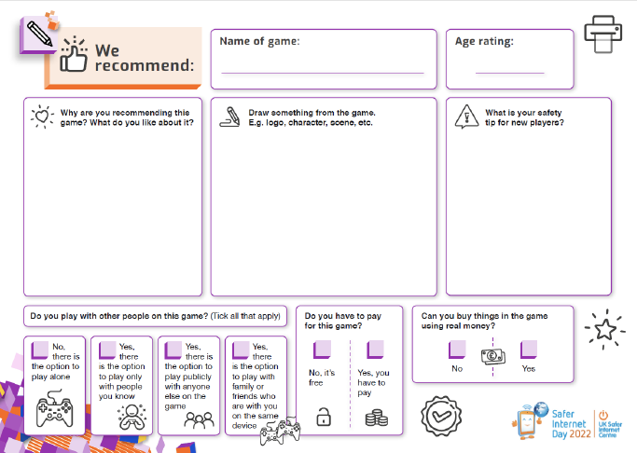
Task
By now you probably have some of the information you are going to make notes on and will have decided how to organise your notes in a way that suits you.
If not, continue to make notes and plan what you want to include until you are happy.
Express your opinion but do it responsibly - don’t use any unnecessary bias.
Be sure to have played the game properly and know all about it.
Don’t look at other reviews before you write yours. Be original!
If you use a scoring scale, give each number in the scale a meaning.
Don’t fully explain the game – mention a couple main points about style and story behind the game but then get on to your opinion.
Click here for further ideas on info to include

Slide 6
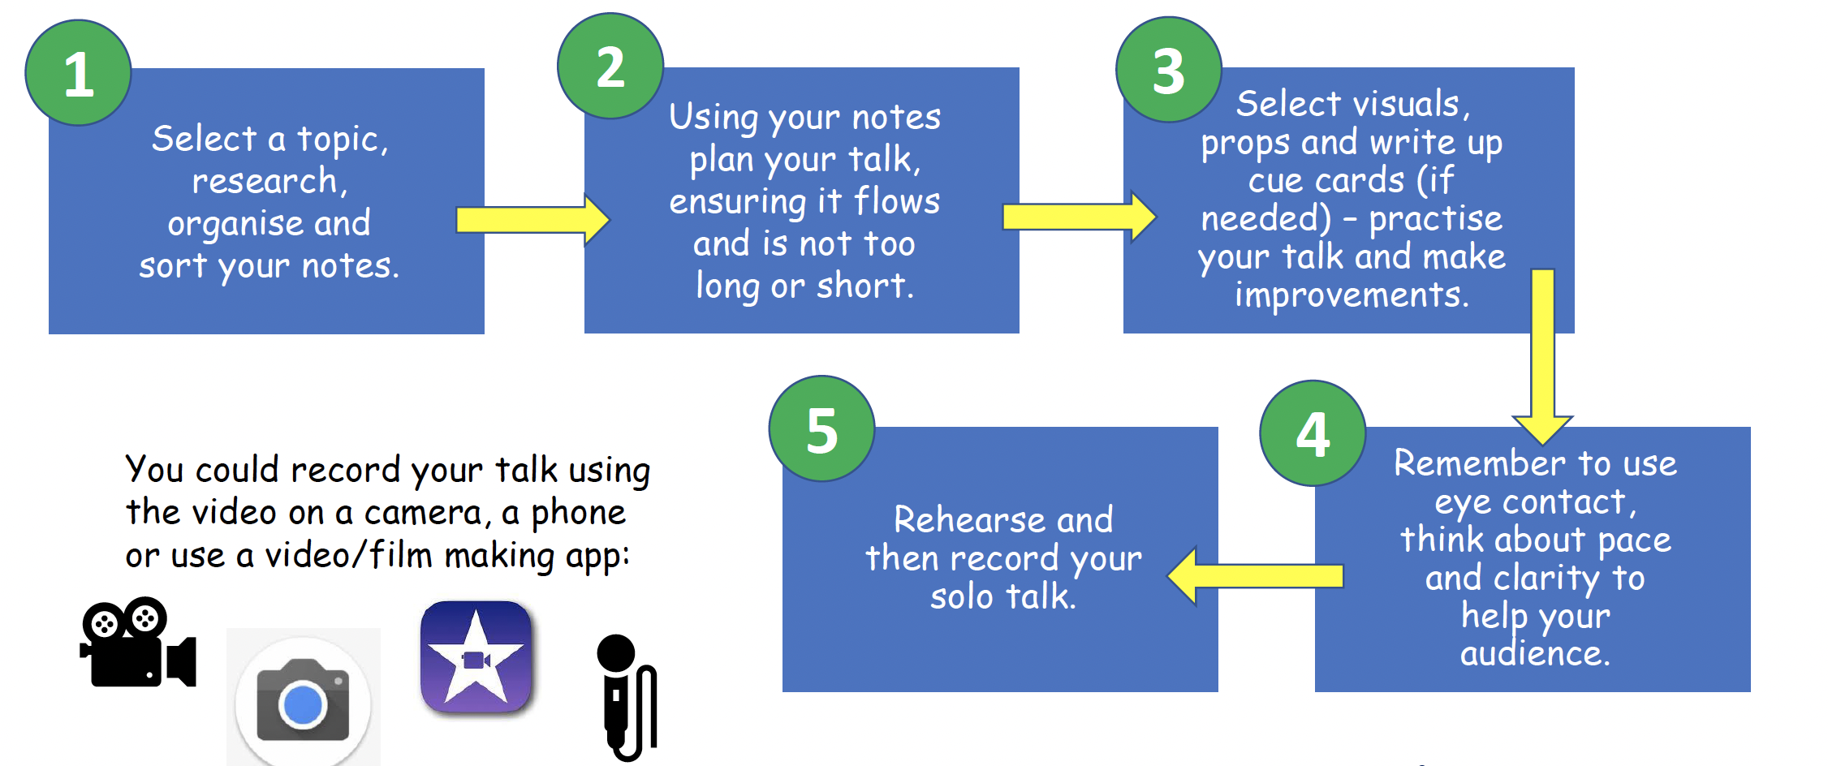
Top Tips
Now that all your information and content is in place you need to prepare to share your review.
You are going to ‘present’ your game review as a solo talk, or maybe you would like to do it in a ‘podcast’ setting and discuss the game with other members of your class at the same time?
No matter what you decide, it will be useful to think about top tips for making your talk interesting and engaging for your audience.
Click here for top tips for a top talk

Slide 7
Self Assessment
Time to reflect on our lesson’s success criteria and think about how you found today’s learning…
Select a video or online game that I would recommend to others.
Decide who I’d recommend the game to (my audience).
Make a suitable set of notes with engaging information about the game.
Justify the personal opinions expressed in the review.
Plan and rehearse my review before I ‘present’ it in my chosen format.
I need more help
I am getting there
I can do this

Slide 8
Share your learning
We love to see you all taking part in our lessons. Remember to share your learning with us on Twitter.
@NLDigitalSchool
#NLVirtualClassroom

Slide 9
Exemplar Template
These are only some ideas of what you could include in your review. Can you think of any other information you could include about the game that would interest your audience?
Back to task

Slide 10
1. Select a topic and research, organise and sort your notes.
2. Using your notes, plan your talk, ensuring it flows and is not too long or short.
3. Select visuals, props and write up cue cards (if needed) – practise your talk and make improvements
4. Remember to use eye contact, think about your pace and clarity to help your audience.
5. Rehearse and then record your solo talk.
Top Tips for a Top Talk
You could use digital tools to record your talk using the video on an ipad or device. Or using a film making app;
Back to task
Icons from flaticon

Slide 11
Images sourced from flaticon

