Slide 1
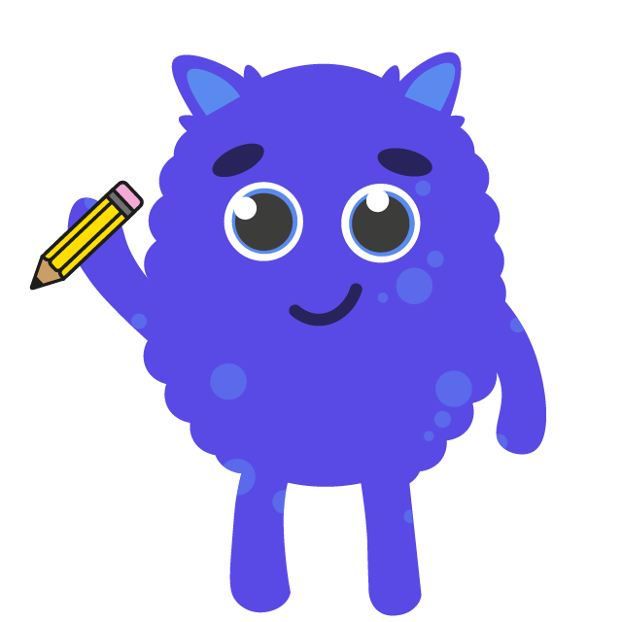
Talking About Being Safe Online

Slide 2
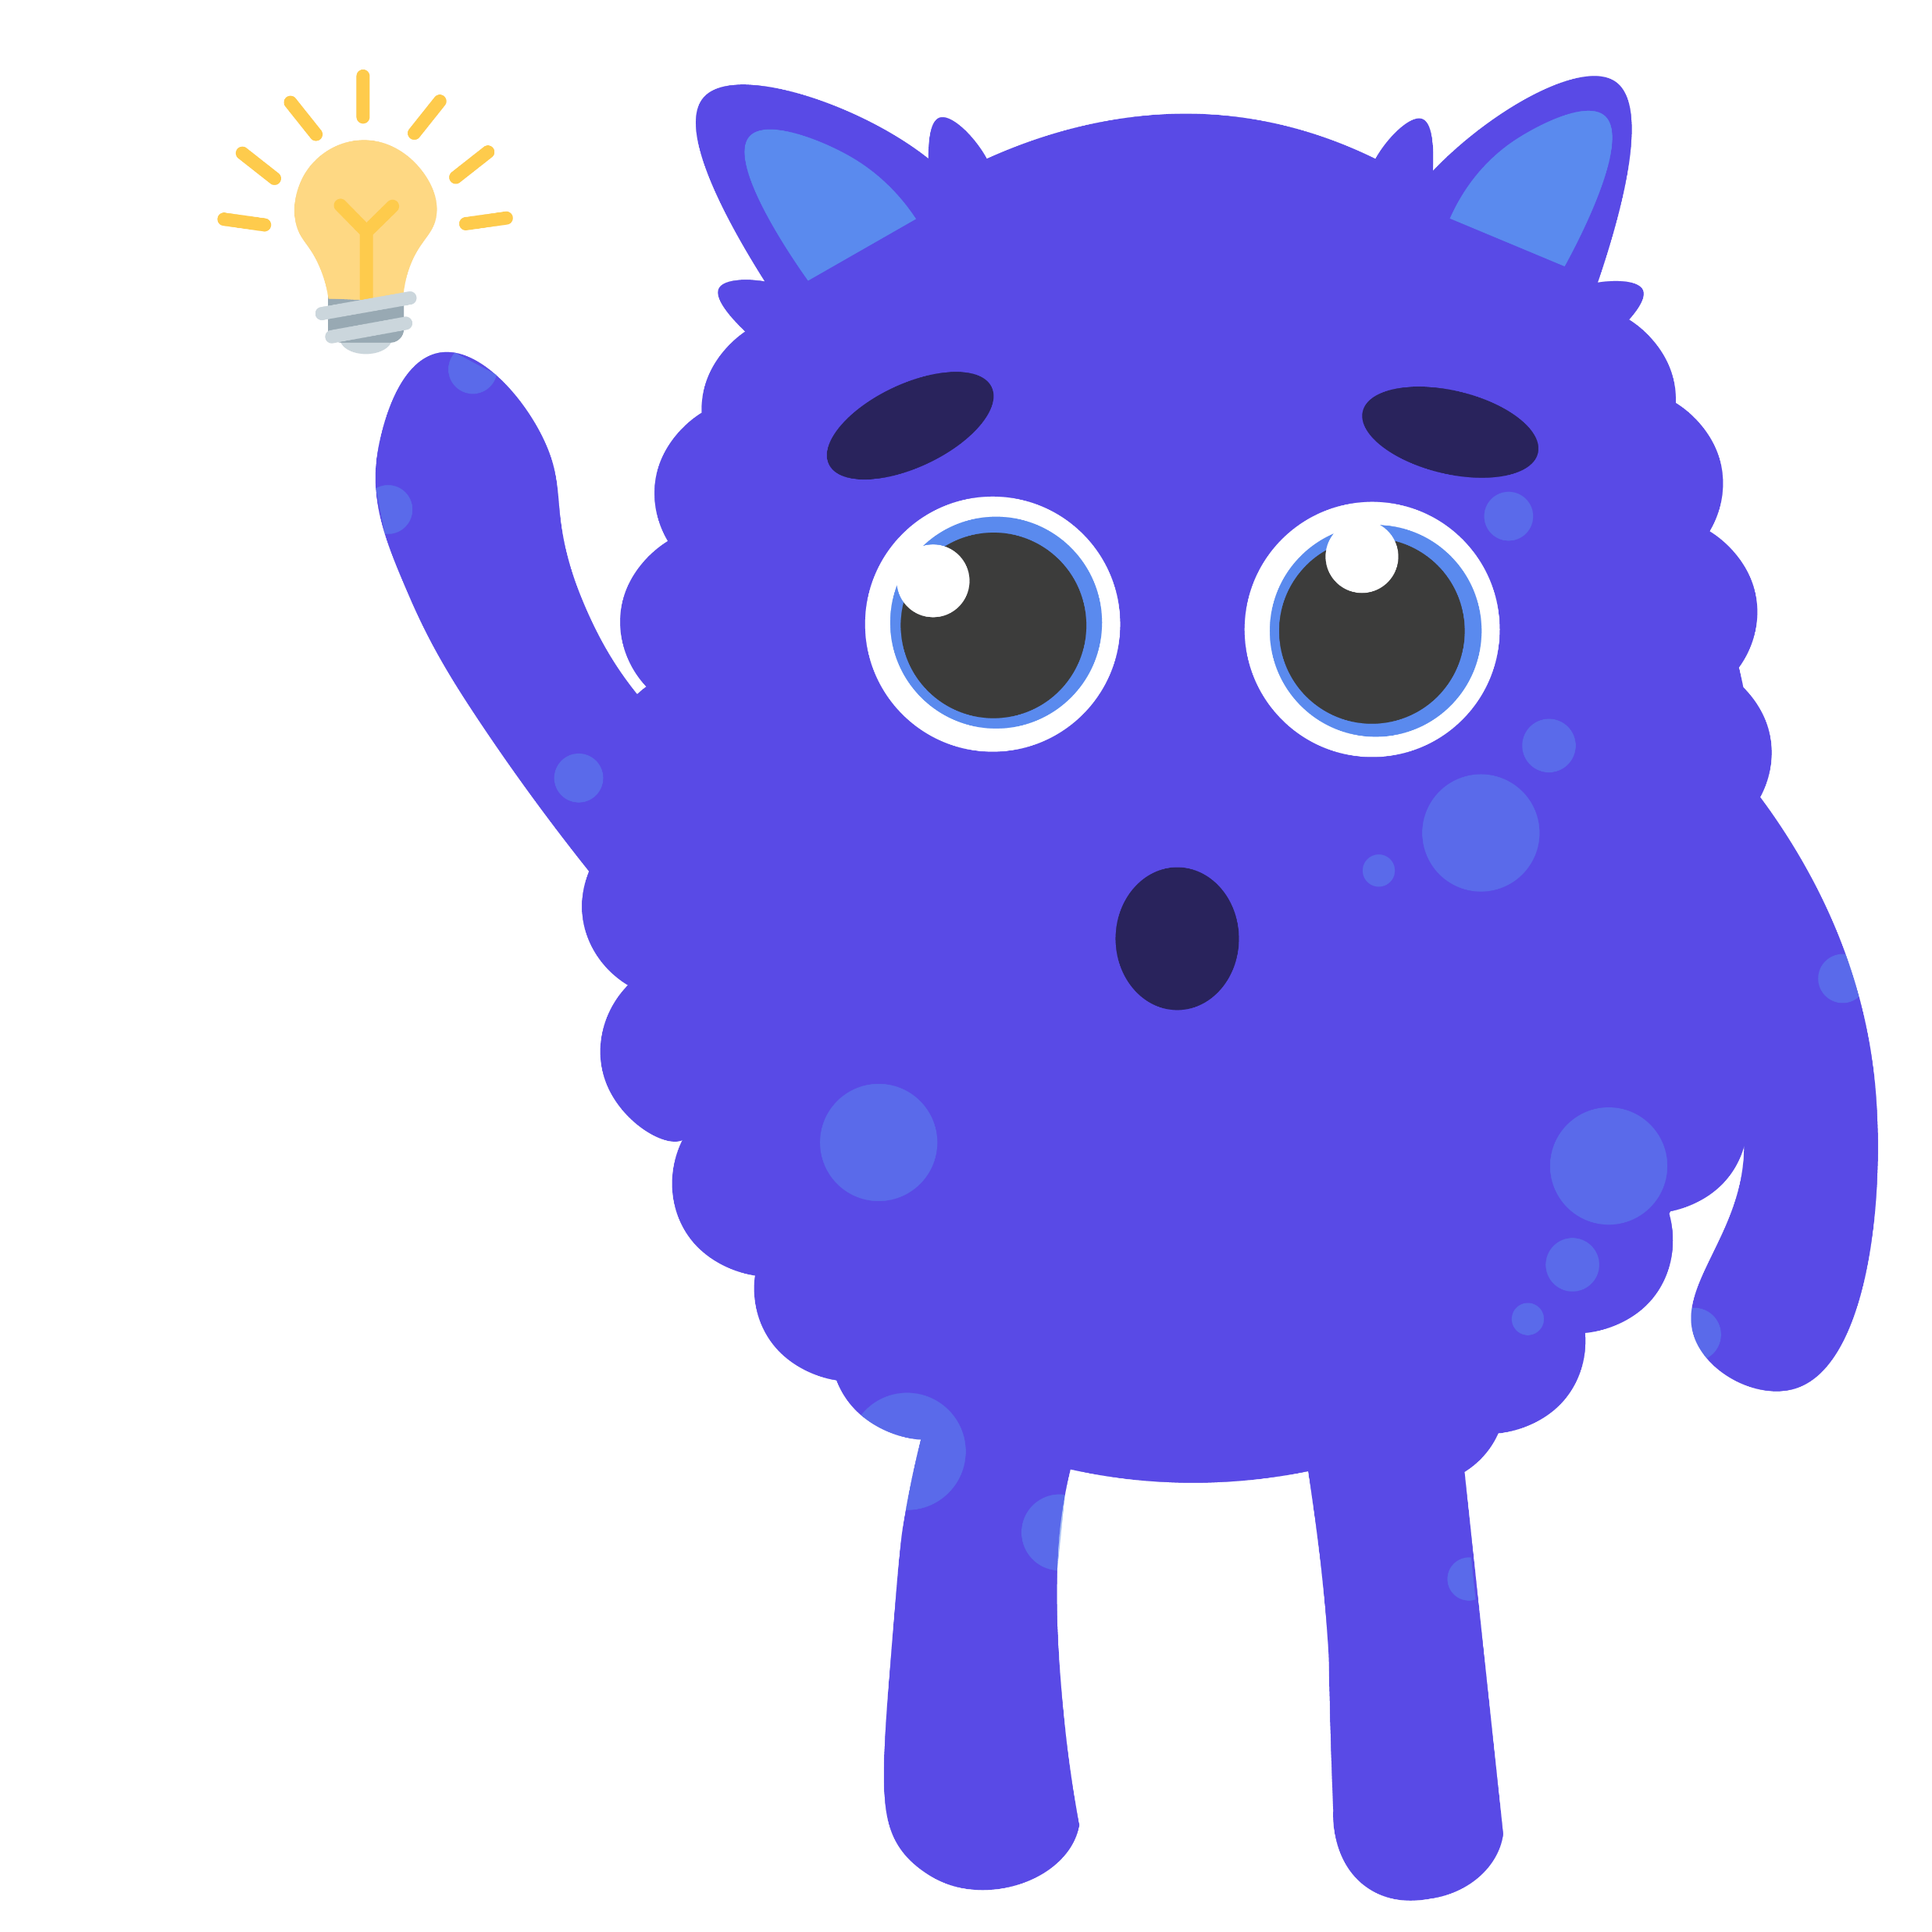
Learning Intention
We are learning to share what we know and talk to others about being safe online.
Success Criteria
Create a paper fortune teller following a set of instructions.
Use my knowledge (and reliable sources) to select appropriate questions or topics about online safety to discuss.
Use the fortune teller correctly to select a topic or question for discussion.
Listen to and respect others when they talk.

Slide 3
Introduction
It’s good to talk to your family, friends and others about the internet and life online – what you do, see and hear online, how you feel about being online and what to do if you are unsure about anything online.
Using the internet can be great fun but it requires responsibility and know how to use it safely.
This Photo by Unknown Author is licensed under CC BY

Slide 4
Task
To help you start a conversation about internet use with your classmates or family, you are going to make a paper fortune teller. You may have made one of these before, but if not, a template and full instructions are all there for you.
Click here for how to make a basic fortune teller.
Once you have made your fortune teller, you will need to ‘decorate’ it - add some information and ideas:
Write the names or draw the logos of four of your favourite apps/games on the four, square flaps on the outside of the fortune teller,
Number the inside triangles 1-8,
On the underside of each of the triangle flaps that can be raised, write a question or conversation topic relating to life online.
This Photo by Unknown Author is licensed under CC BY-SA

Slide 5
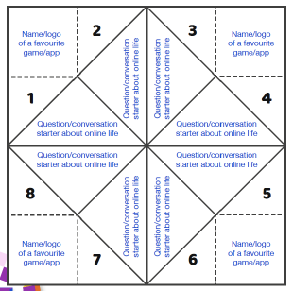
Task
How your fortune teller should be filled in
Think carefully about what you want to ask or discuss with your classmates.
You could focus on online safety messages you know, ask general questions about life online, be more specific about your favourite app/game or test your friend’s knowledge.
Check out these websites for ideas to discuss if you need to.

Slide 6
Task
To use the fortune teller:
The ‘chooser’ picks one of the four apps/games and the ‘teller’ opens and closes the fortune teller once for every letter that spells out that name. For example, Minecraft has 9 letters so would mean 9 moves.
Then the ‘chooser’ picks a number from inside the fortune teller and the ‘teller’ opens and closes the fortune teller again – the number of moves equals the number the ‘chooser’ picked.
The ‘chooser’ picks another number and this time, the ‘teller’ lifts the flap for that number to reveal the question or topic underneath.
Now it’s time to get talking – try to get everyone involved in sharing thoughts, ideas and facts.
Click here to get an idea of a fortune teller in action
This Photo by Unknown Author is licensed under CC BY-SA

Slide 7
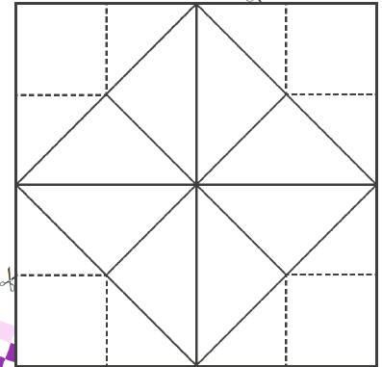
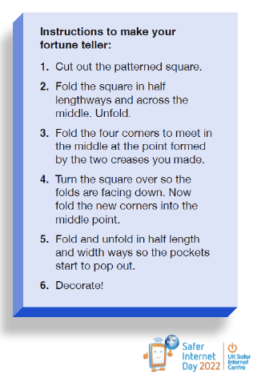
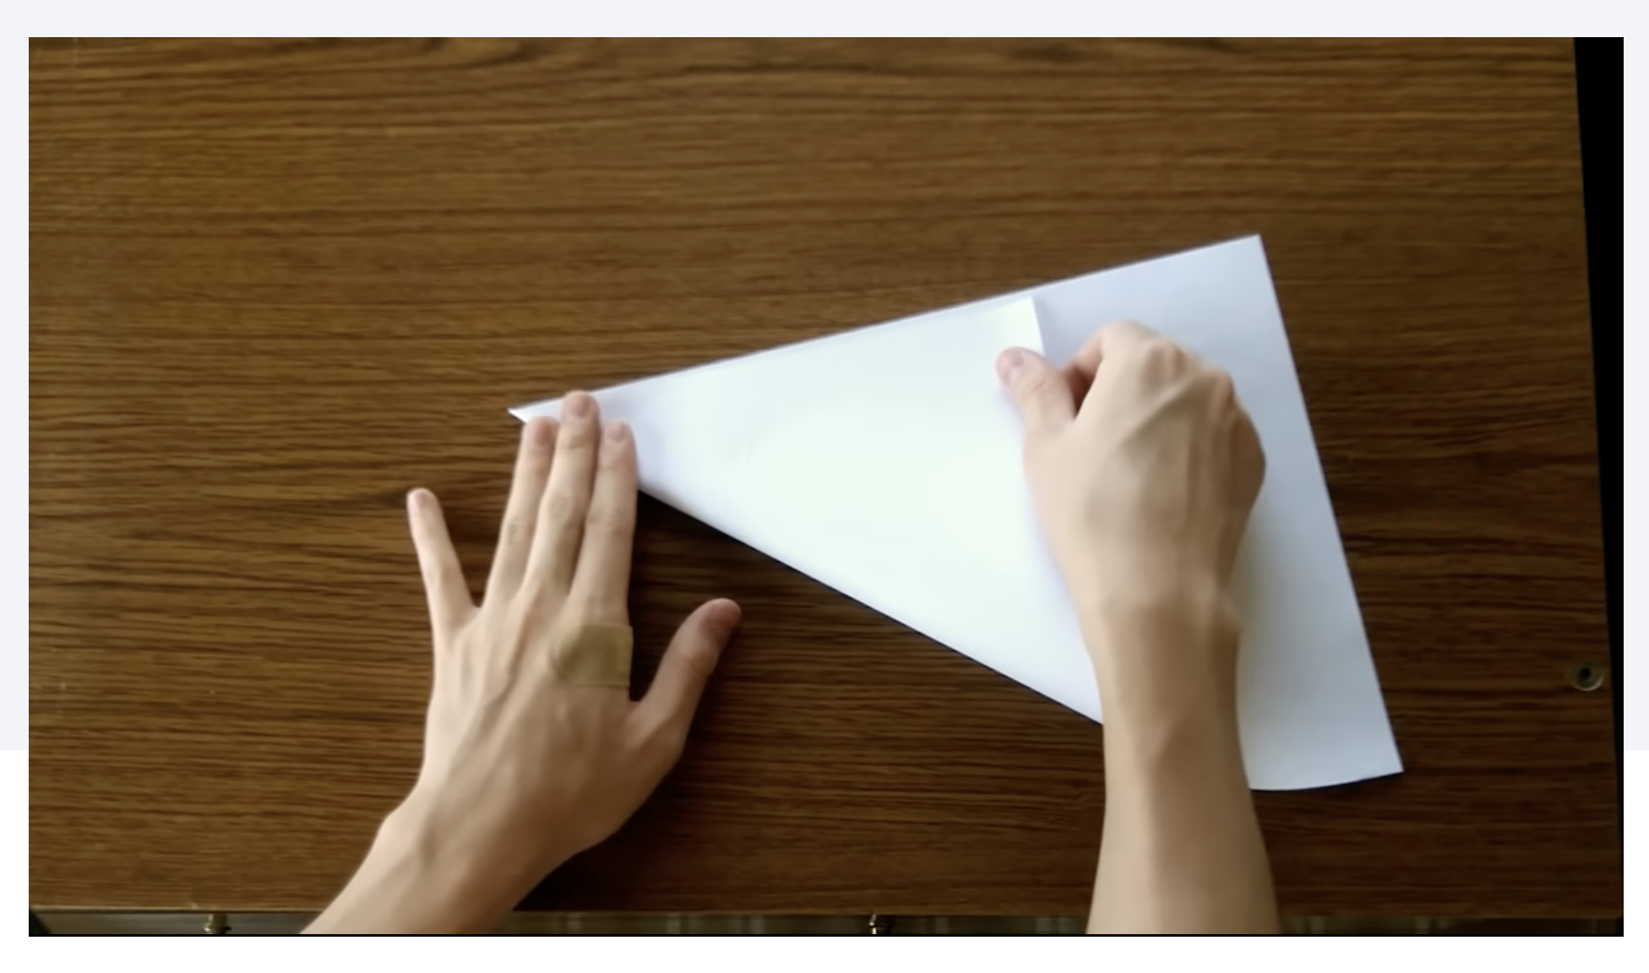
Template
You can use an A4 sheet of paper to make a square for your fortune teller.
Watch below to find out how:
To download and print off a template, click the icon below and follow the instructions on the sheet.

Slide 8
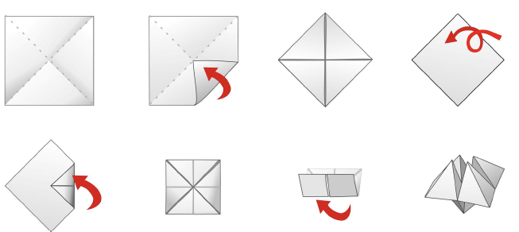
Template
1.
How to get your square:
Turn the folded square over
2.
How to fold to make your fortune teller:
Fold in each corner to meet the middle
Fold this new square in half with the triangle sections should be on the inside

Slide 9
Self Assessment
Time to reflect on our lesson’s success criteria and think about how you found today’s learning…
Create a paper fortune teller following a set of instructions.
Use my knowledge (and reliable sources) to select appropriate questions or topics about online safety to discuss.
Use the fortune teller correctly to select a topic or question for discussion.
Listen to and respect others when they talk.
I need more help
I am getting there
I can do this

Slide 10
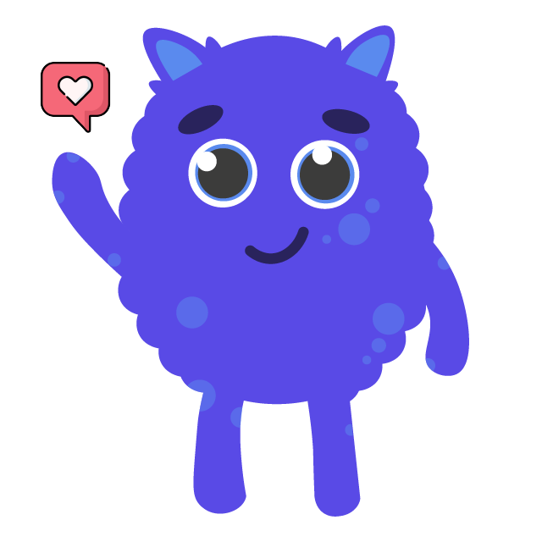
Share your learning
We love to see you all taking part in our lessons. Remember to share your learning with us on Twitter.
@NLDigitalSchool
#NLVirtualClassroom

Slide 11
Images sourced from flaticon

