Slide 1
Digital Spelling Strategies

Slide 2
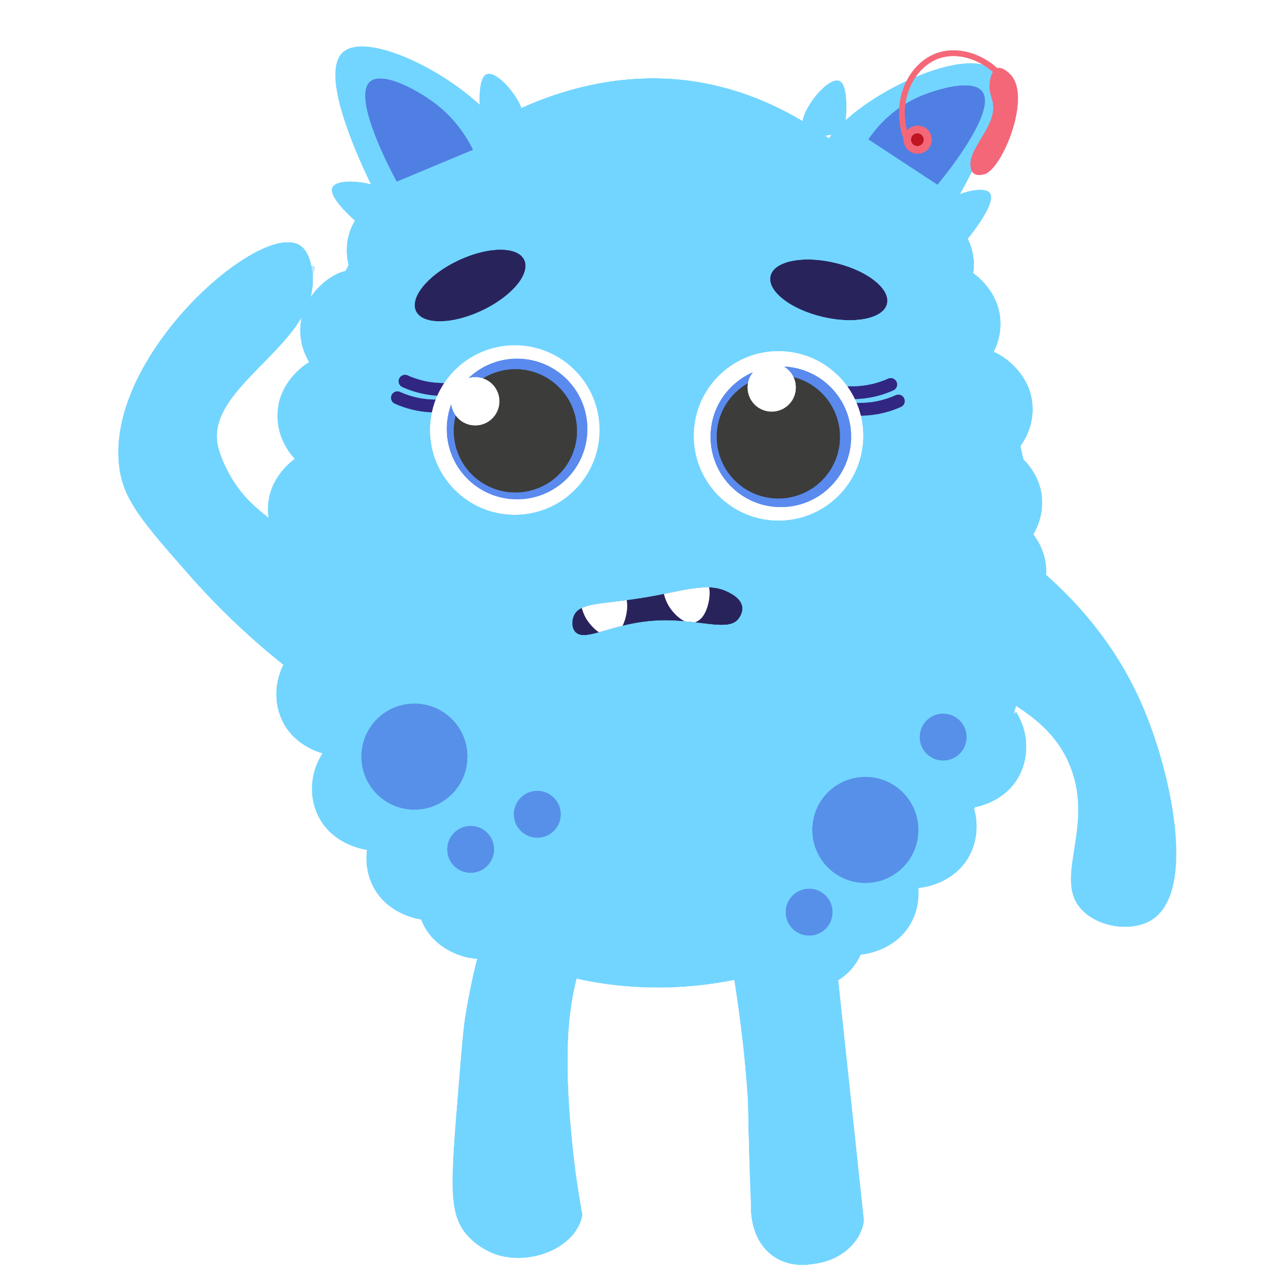
Teacher Information
Spelling Resources:
When giving learners a spelling task, ensure you have given them a word list as the spelling resources are designed to be used for a range of word lists.
Slideshow/ Edit Mode
When navigating through the PowerPoint, some slides will require you to be in “edit mode” rather than slideshow mode. Exit slideshow mode to interact with the resources.
Deleting Slides
Some of the slides may not be relevant to your learners. You can delete these and tailor the learning to your class. To do so, right click the slide on the left hand side and select “delete slide”.
Duplicating Slides
You may want to give your learners more space to complete their task or provide them with more templates. To do this, right click the slide and select “duplicate slide”.

Slide 3
Learning Intention
We are learning to use strategies to spell common words.
Success Criteria
Match each word with a strategy.
Use digital tools to support my learning.
Create digital content to demonstrate my learning.

Slide 4
Introduction
Did you find the answers?
We are going to identify the best strategy to help spell our words. Each slide shows one of the six strategies. Use the examples on each slide to help you sort the words.

Slide 5
Phonics
We use the phonics strategy when we can sound out the whole word. Type your phonics words in the boxes then tap and drag the sound buttons to show each phoneme.
mouse

Slide 6
Syllabification
We use the syllabification strategy to break up words into smaller chunks.
Type your words in the boxes and use the insert line function.
yesterday
1
2
3
Drag the cursor to create the line.

Slide 7
Did you find the answers?
Compound Words
You can use ctrl+C then ctrl+V to copy and paste your text boxes.
We use the compound words strategy when a word is made up of two smaller words.
Insert two joined text boxes and type in your words.
foot
ball
1
2
Drag the cursor to create the text box.

Slide 8
Word Within a Word
We use the word within a word strategy when we can see a familiar word inside a larger word.
Type your words here and highlight the word within a word.
interesting
1
2
to stop.

Slide 9
Mnemonic
We use the mnemonic strategy when we need a memory aid to help us with spelling.
Type your words here and record the mnemonic you create.
1
only
2
3
Record/stop Finish

Slide 10
Analogy
We use the analogy strategy when we know the spelling of a word that is similar to the one we are learning about.
Type your words in the top row, then list words you know with similar spellings.
1
Click on the table
word | all
analogy | ball
 | fall
 | call
 | small
2

Slide 11
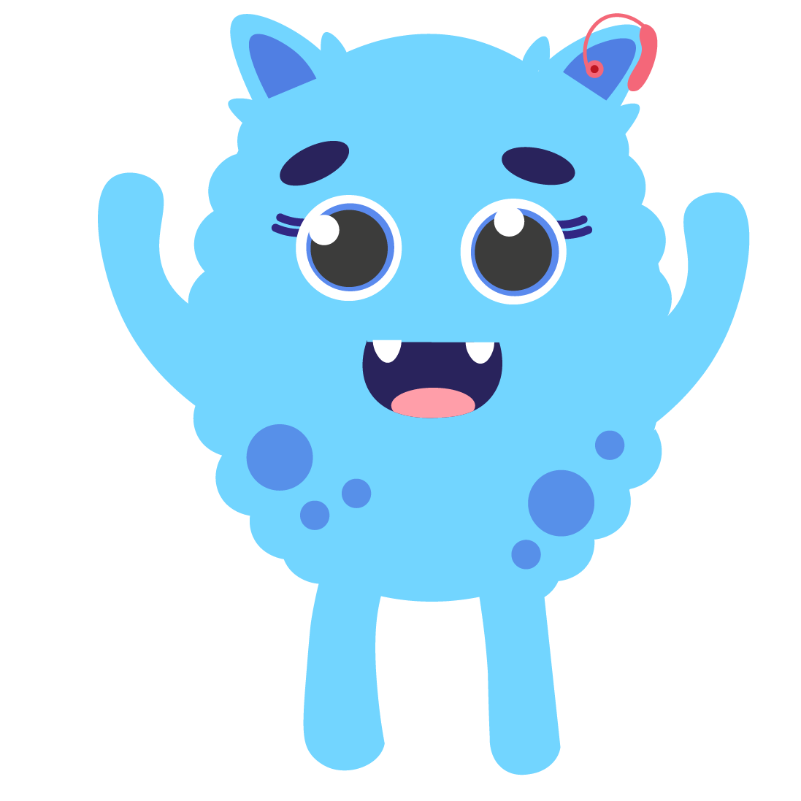
Self Assessment
We will know if we have been successful if we can:
Match each word with a strategy.
Use digital tools to support my learning.
Create digital content to demonstrate my learning.
I need more help
I am getting there
I can do this

Slide 12
Share your learning
We love to see you all taking part in our lessons. Remember to share your learning with us on Twitter.
@NLDigitalSchool
#NLVirtualClassroom

Slide 13
Images sourced from flaticon

