Slide 1
Arrays

Slide 2
Learning Intention
We are learning to multiply using arrays.
Success Criteria
Recognise multiplication as repeated addition.
Recall multiplication facts. ​

Slide 3
Introduction
We will be learning to multiplication calculations using arrays.
Arrays help us split objects into different groups and multiply them, making it a lot easier and quicker than counting each item individually!
In this resource, you will make arrays to help answer multiplication calculations.

Slide 4
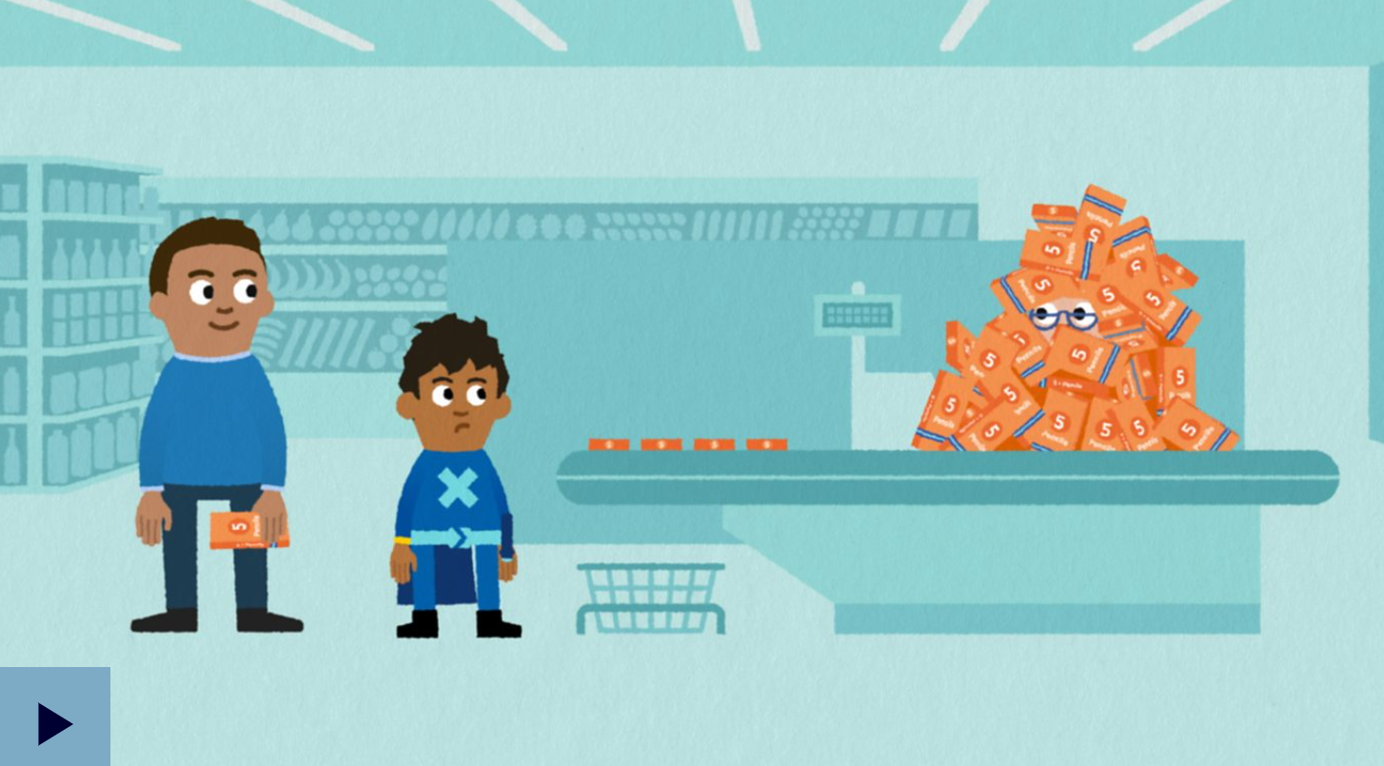
Let’s Learn
Visit the website to further your learning about arrays.

Slide 5
Arrays Example
Arrays | Calculation
 | 5 x 6 = 30 6 x 5 = 30

Slide 6
Arrays
Arrays | Calculation
 | Insert your calculations here

Slide 7
Self-Assessment
We will know if we have been successful if we can
Recognise multiplication as repeated addition.
Recall multiplication facts.
I need more help
I am getting there
I can do this

Slide 8
Share your learning
We love to see you all taking part in our lessons. Remember to share your learning with us on Twitter.
@NLDigitalSchool
#NLVirtualClassroom

Slide 9
Images sourced from flaticon

