Slide 1
Place Value Mats

Slide 2
Learning Intention
We are learning to develop our knowledge of place value
Success Criteria
Organise dienes into correct place value column
Represent whole numbers to 10000
Explain the link between digit, place and value

Slide 3
Introduction
Use this resource as a digital place value mat. Sort the Dienes materials into the correct columns to create a visual representation of the number.
Please ensure this resource has been downloaded beforehand.

Slide 4
Place Value Mats
EXAMPLE
95
TENS | ONES
Drag the tens and ones to the correct column to make your number.

Slide 5
Place Value Mats
Insert your own number here
TENS | ONES
Drag the tens and ones to the correct column to make your number.

Slide 6
Place Value Mats
EXAMPLE
467
HUNDREDS | TENS | ONES
Drag the hundreds, tens and ones to the correct column to make your number.

Slide 7
Place Value Mats
Insert your own number here
HUNDREDS | TENS | ONES
Drag the hundreds, tens and ones to the correct column to make your number.

Slide 8
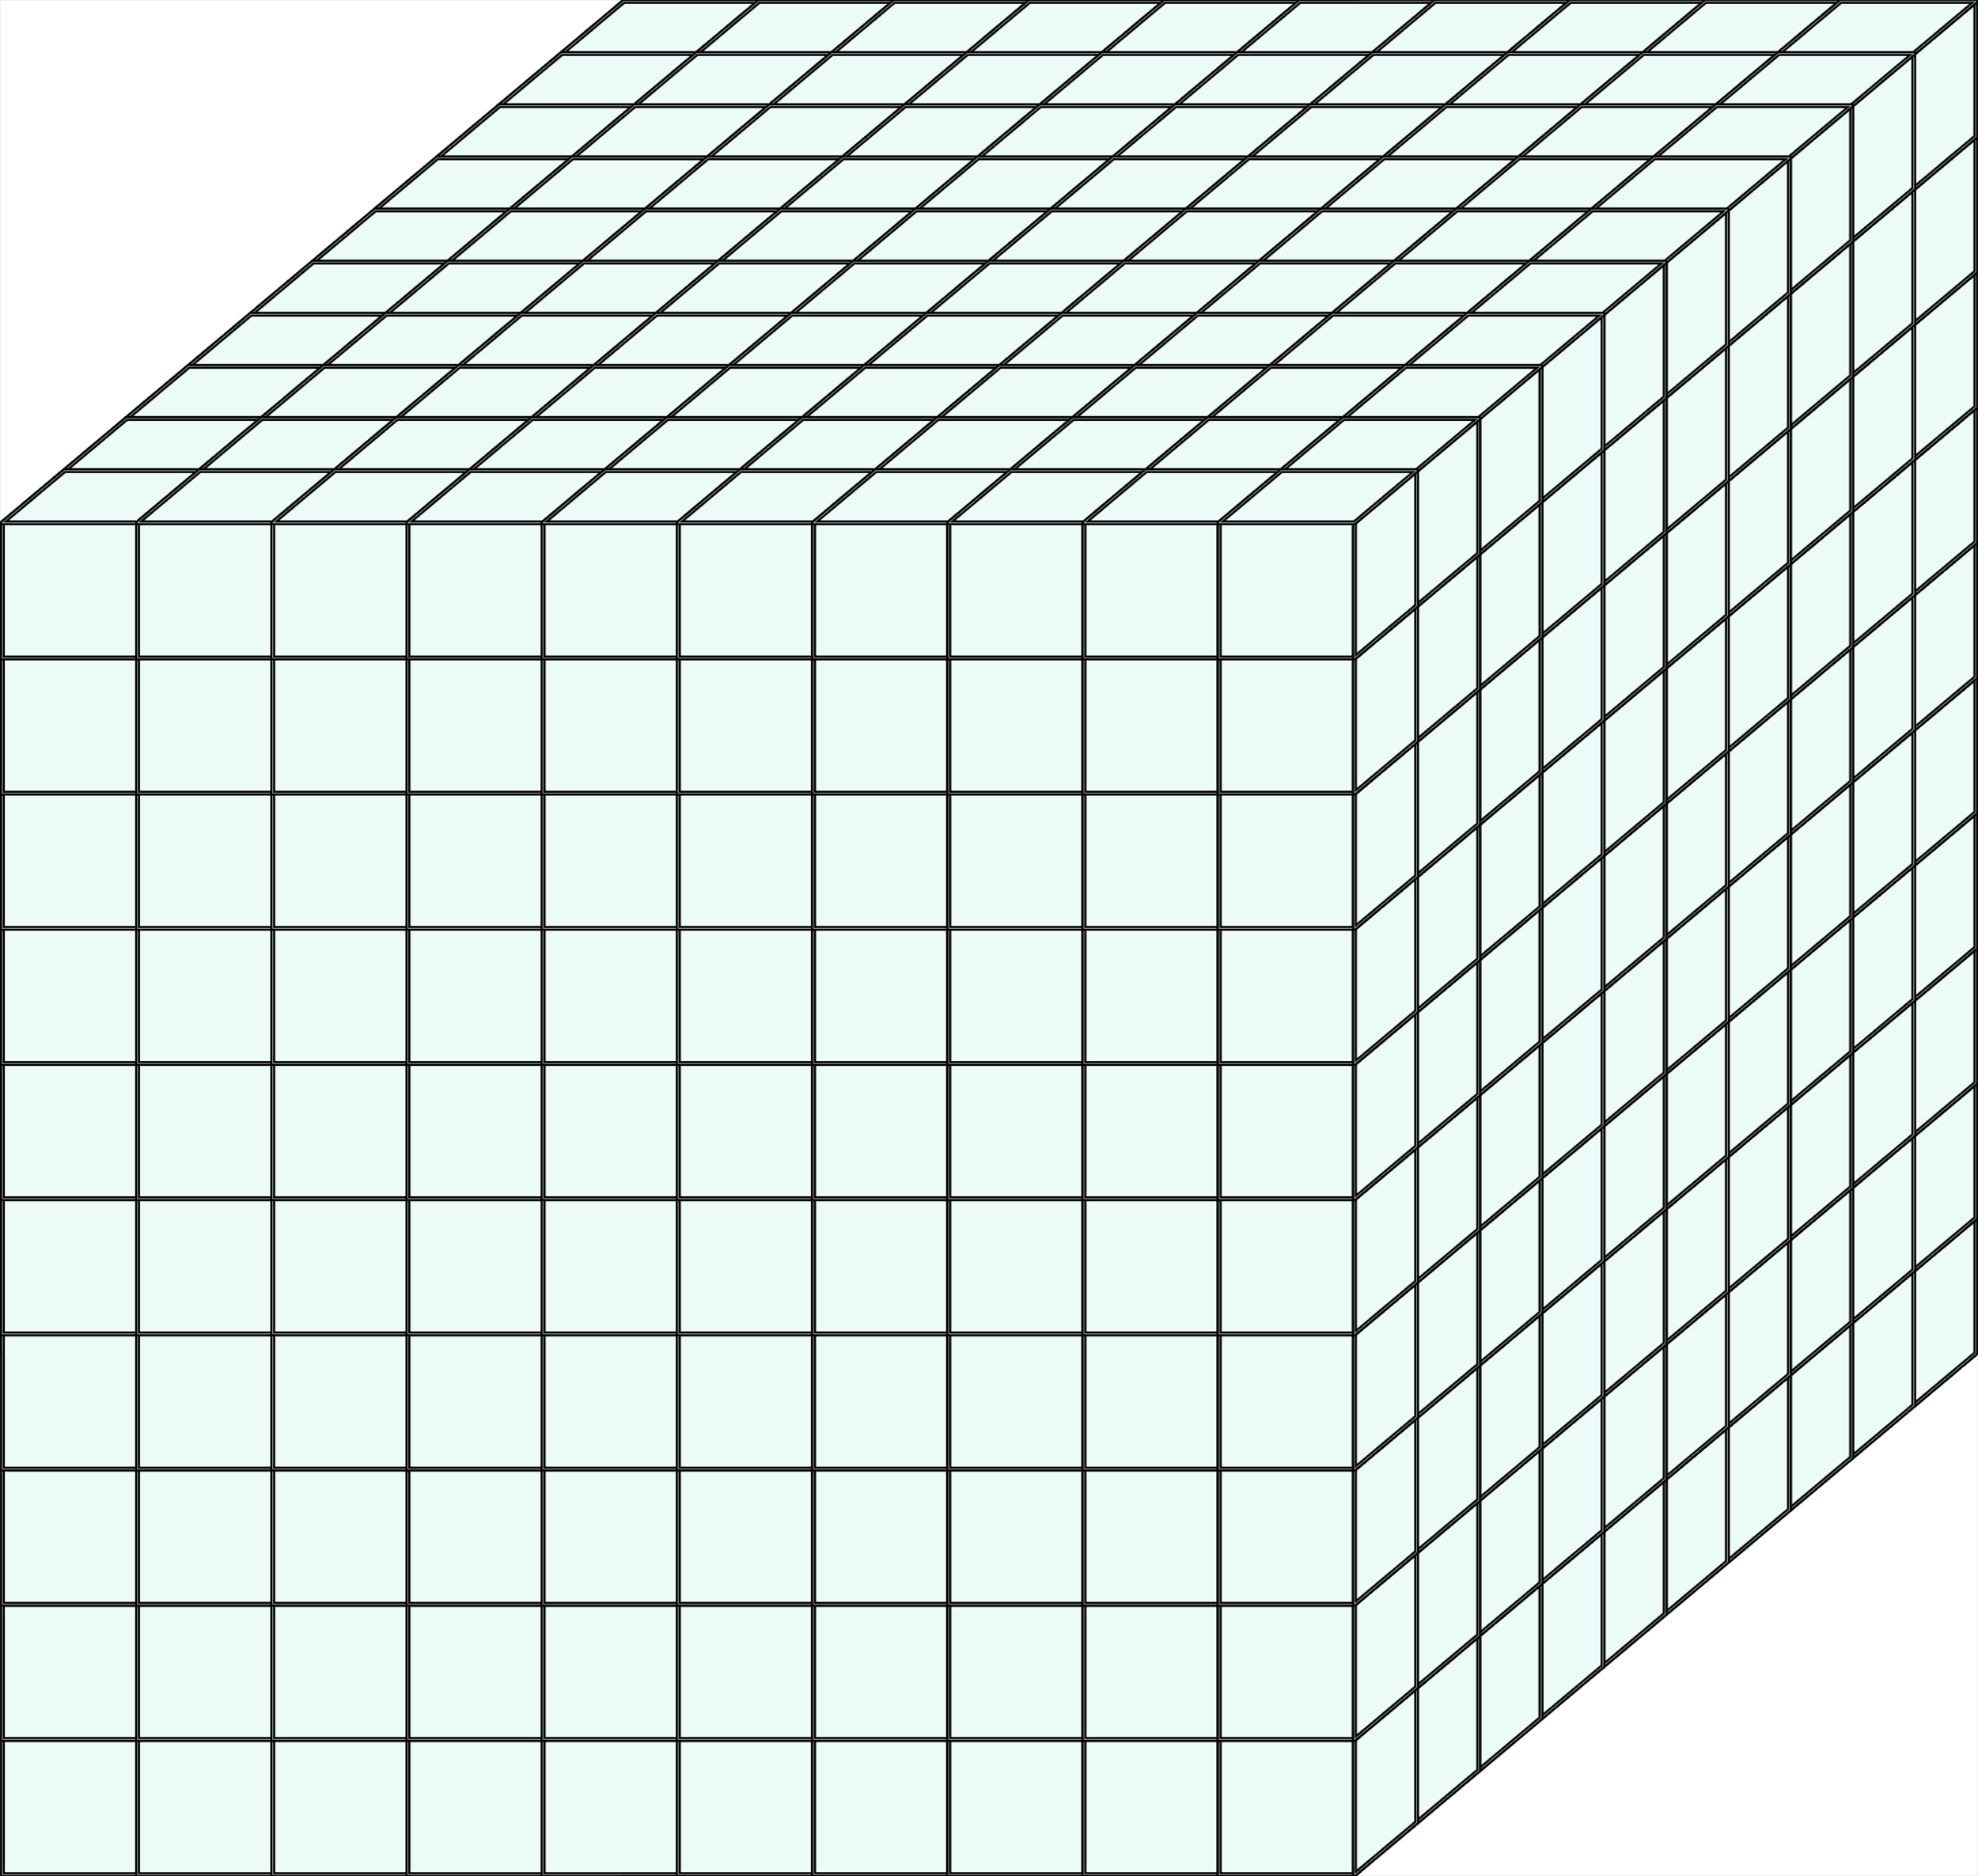
Place Value Mats
EXAMPLE
2345
THOUSANDS | HUNDREDS | TENS | ONES
Drag the thousands, hundreds, tens and ones to the correct column to make your number.

Slide 9
Place Value Mats
Insert your own number here
THOUSANDS | HUNDREDS | TENS | ONES
Drag the thousands, hundreds, tens and ones to the correct column to make your number.

Slide 10
Self-Assessment
We will know if we have been successful if we can:
Organise dienes into correct place value column
Represent whole numbers to 10000
Explain the link between digit, place and value
I need more help
I am getting there
I can do this

Slide 11
Share your learning
We love to see you all taking part in our lessons. Remember to share your learning with us on Twitter.
@NLDigitalSchool
#NLVirtualClassroom

Slide 12
Images sourced from flaticon

