Slide 1
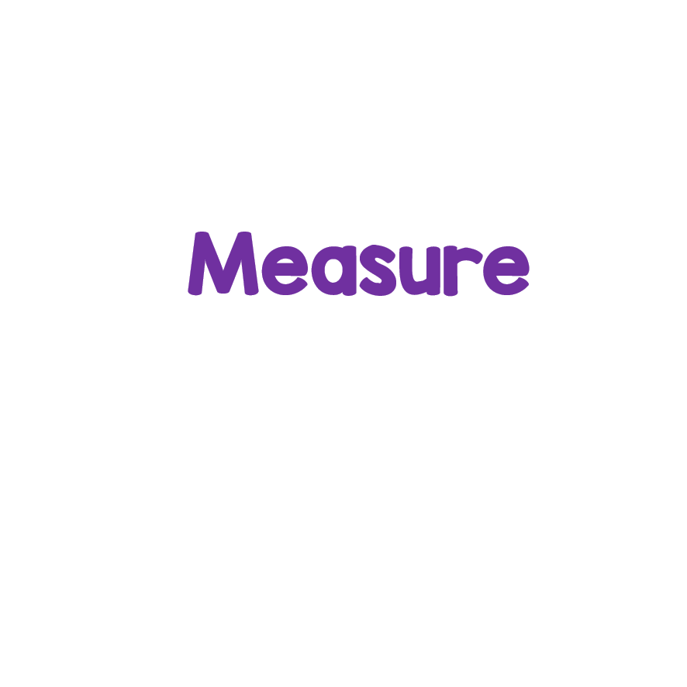
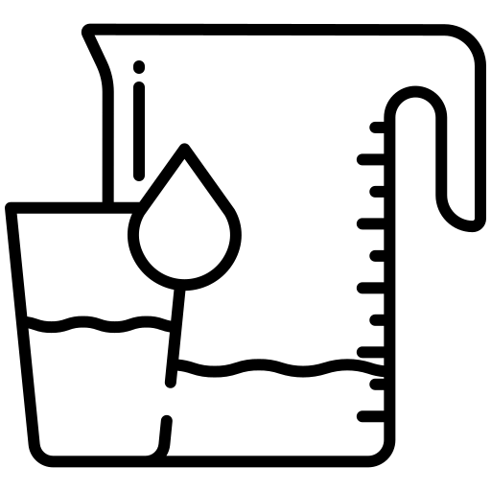
Volume-reading scales

Slide 2
Learning at home tips
Submit your work
Take breaks
Send your work to your teacher through Teams. Remember, you can take a photo of your work too!
Take some time to do things you enjoy or find relaxing! Try to take regular screen breaks too!
Take notes
Be prepared
Use OneNote, Microsoft Word, your jotter or a piece of paper to take notes about any new or important information.
Make sure you have everything you need to learn. Paper, a pencil and digital device will always come in handy!

Slide 3
We are learning to accurately read measurements of volume using millilitres and litres.

Slide 4
We will know if we have been successful if we can
Read a variety of scales.
Measure volume using knowledge of multiples of 10 and 100.
Make simple conversions between litres and millilitres.

Slide 5
Introduction
Volume is the amount of liquid that is in a container.
We can measure volume using measuring jugs and measuring cylinders.
We measure volume using millilitres (ml) and litres (l).
Why do you think it is important to learn about volume?

Slide 6
Prior knowledge
Complete the activity to show what you already know about volume.
Click here to type something you already know.
Click here to type something you already know.
Click here to type something you already know.
Click here to type something you already know.
Click file, save as, download a copy to complete this activity digitally. Or, you can copy and complete it on a piece of paper.

Slide 7
Key words
Here are some key words associated with measuring volume. Can you read them?
Remember you can use immersive reader if you are finding it tricky.
Volume
Capacity
The amount of liquid in a container.
1
2
The amount of liquid a container can hold when full.
Measure
3
4
Liquid
To find out how much of something there is.
Something that is runny and not solid.
You can right click on a slide to open it in Immersive Reader!

Slide 8
Starter task
Have a look for different bottles of liquid in your house.
Can you sort them in order from the least to most amount of liquid?

Slide 9
Measuring in millilitres (ml)
When we are measuring in millilitres, sometimes the scales can go up in increments (jumps) of 10 or 100.
Have a look at the measuring cylinder opposite.
The volume of the blue liquid is 100ml.
500ml
400ml
300ml
200ml
100ml

Slide 10
Measuring in litres (ml)
Image from flat icon
This time, the measuring cylinder is going up in litres.
The volume of the green liquid is 2l.
5l
4l
3l
2l
1l

Slide 11
Measuring in litres (ml)
Sometimes, we need to use decimal numbers to measure a liquid.
There are 1000ml in 1l.
That means there are 500ml in half a litre.
Have a look at the pink liquid.
The volume of the pink liquid is 1 and a half litres which is the same as 1500ml.
5l
4l
3l
2l
1l

Slide 12
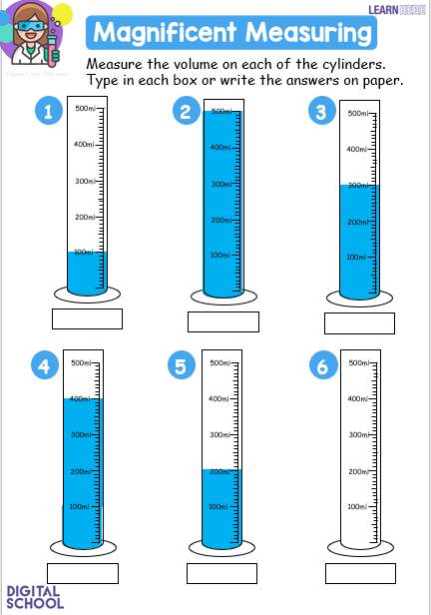
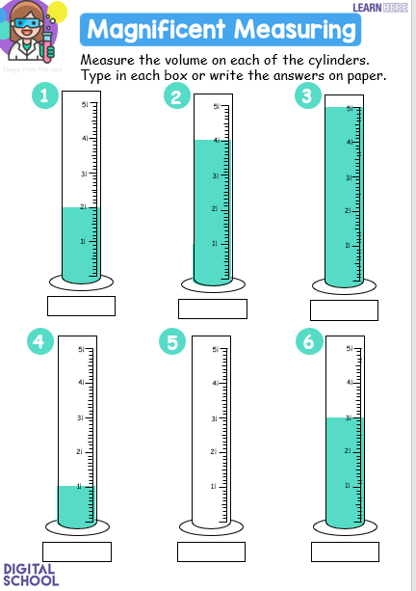
Activity
You will now practise measuring liquids using different scales.
Click the picture to go to your activity. Remember, you can check back here if you get stuck!

Slide 13
Plenary Pyramid. Fill in the pyramid to reflect on your learning today.
Something I want to know…
Something new I learned…
Something new I learned…
Something I already knew…
Something I already knew…
Something I already knew…
Click file, save as, download a copy to complete this activity digitally. Or, you can copy and complete it on a piece of paper.

Slide 14
Self assessment
We will know if we have been successful if we can
Read a variety of scales.
Measure volume using knowledge of multiples of 10 and 100.
Make simple conversions between litres and millilitres.
I need more help
I am getting there
I can do this

