Slide 1
Multiplication Squares

Slide 2
Learning Intention
We are learning to apply strategies to determine multiplication facts.
Success Criteria
Identify number patterns.
Count up using repeated addition.
Create a multiplication square.

Slide 3
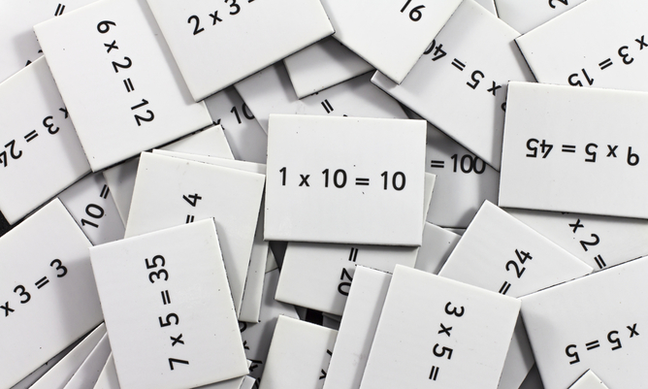
Introduction
Click file, save as, download a copy to complete this activity.
We will be learning to use a multiplication square to help identify patterns in multiplication. Watch this video to recap your times tables.
This Photo by Unknown Author is licensed under CC BY-ND

Slide 4
Multiplication Square Editable
To randomly generate a number, view in slideshow mode.
X | 0 | 1 | 2 | 3 | 4 | 5 | 6 | 7 | 8 | 9 | 10
0
1
2
3
4
5
6
7
8
9
10

Press esc to fill in the table.

Slide 5
Multiplication Square Answers
View this slide in slideshow mode.
X | 0 | 1 | 2 | 3 | 4 | 5 | 6 | 7 | 8 | 9 | 10
0 | 0 | 0 | 0 | 0 | 0 | 0 | 0 | 0 | 0 | 0 | 0
1 | 0 | 1 | 2 | 3 | 4 | 5 | 6 | 7 | 8 | 9 | 10
2 | 0 | 2 | 4 | 6 | 8 | 10 | 12 | 14 | 16 | 18 | 20
3 | 0 | 3 | 6 | 9 | 12 | 15 | 18 | 21 | 24 | 27 | 30
4 | 0 | 4 | 8 | 12 | 16 | 20 | 24 | 28 | 32 | 36 | 40
5 | 0 | 5 | 10 | 15 | 20 | 25 | 30 | 35 | 40 | 45 | 50
6 | 0 | 6 | 12 | 18 | 24 | 30 | 36 | 42 | 48 | 54 | 60
7 | 0 | 7 | 14 | 21 | 28 | 35 | 42 | 49 | 56 | 63 | 70
8 | 0 | 8 | 16 | 24 | 32 | 40 | 48 | 56 | 64 | 72 | 80
9 | 0 | 9 | 18 | 27 | 36 | 45 | 54 | 63 | 72 | 81 | 90
10 | 0 | 10 | 20 | 30 | 40 | 50 | 60 | 70 | 80 | 90 | 100
Click here to reveal the answers.

Slide 6
Self Assessment
We will know if we have been successful if we can
Identify number patterns.
Count up using repeated addition.
Create a multiplication square.
I need more help
I am getting there
I can do this

Slide 7
Share your learning
We love to see you all taking part in our lessons. Remember to share your learning with us on Twitter.
@NLDigitalSchool
#NLVirtualClassroom

Slide 8
Images sourced from flaticon

