Slide 1
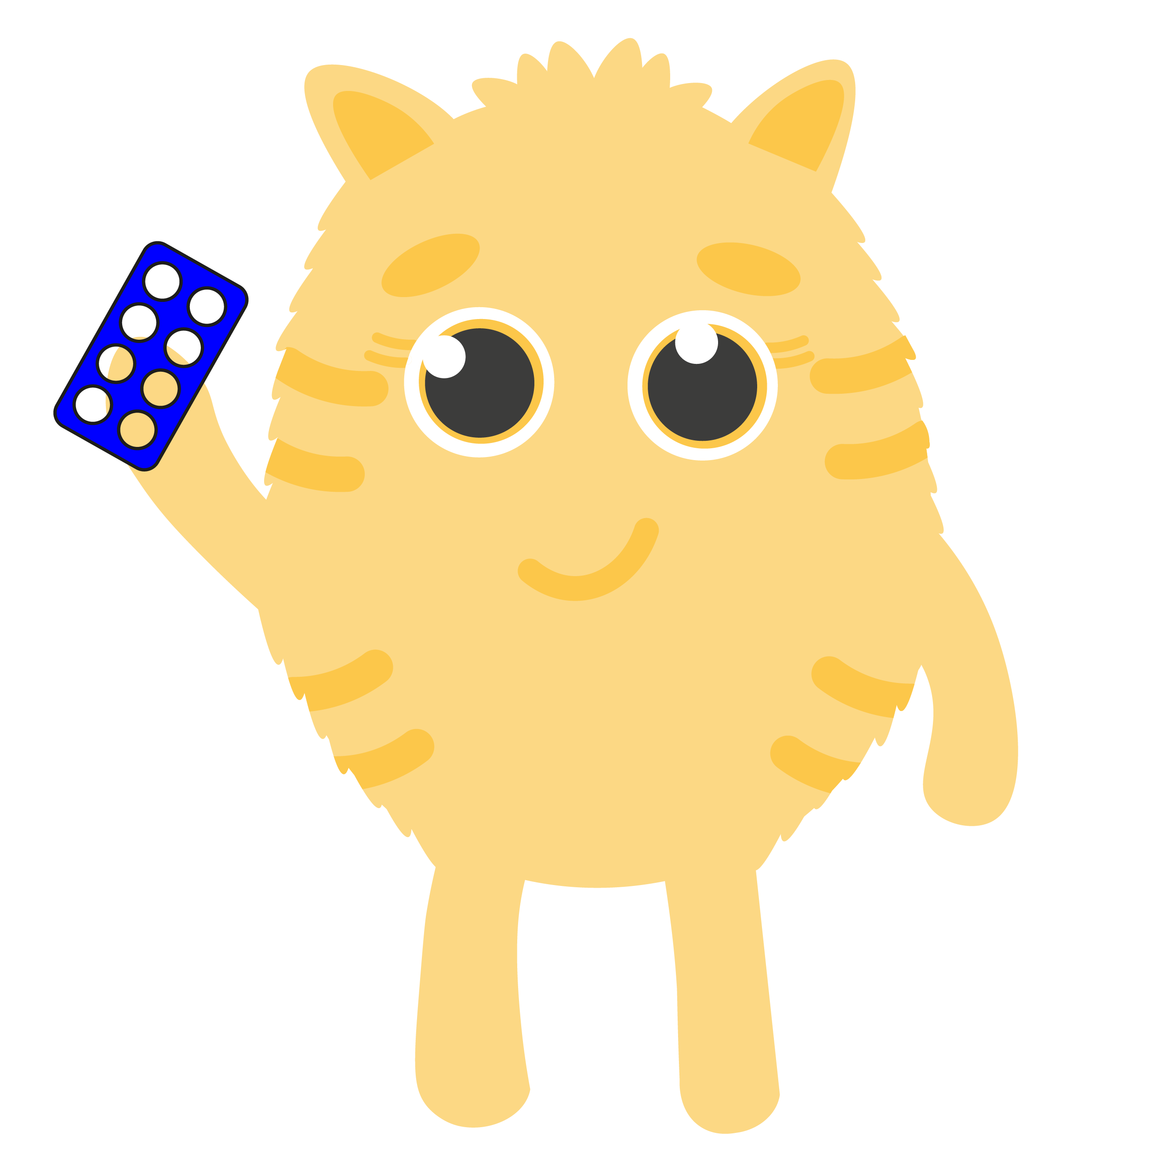
Hundred Squares

Slide 2
Learning Intention
We are learning to use mental maths strategies to build problem solving and reasoning skills.
Success Criteria
Explain my reasoning behind number calculations.
Mentally solve computation problems.

Slide 3
Introduction
Click file, save as, download a copy to complete this activity.
We will be learning to solve numeracy calculations mentally and explain how we came to our answers.
Use this resource to help you explain your ideas.

Slide 4
Multiples
1 | 2 | 3 | 4 | 5 | 6 | 7 | 8 | 9 | 10
11 | 12 | 13 | 14 | 15 | 16 | 17 | 18 | 19 | 20
21 | 22 | 23 | 24 | 25 | 26 | 27 | 28 | 29 | 30
31 | 32 | 33 | 34 | 35 | 36 | 37 | 38 | 39 | 40
41 | 42 | 43 | 44 | 45 | 46 | 47 | 48 | 49 | 50
51 | 52 | 53 | 54 | 55 | 56 | 57 | 58 | 59 | 60
61 | 62 | 63 | 64 | 65 | 66 | 67 | 68 | 69 | 70
71 | 72 | 73 | 74 | 75 | 76 | 77 | 78 | 79 | 80
81 | 82 | 83 | 84 | 85 | 86 | 87 | 88 | 89 | 90
91 | 92 | 93 | 94 | 95 | 96 | 97 | 98 | 99 | 100
Drag the coloured block below to cover all numbers that are multiples of the…


Slide 5
Self-Assessment
We will know if we have been successful if we can:
Explain my reasoning behind number calculations.
Mentally solve computation problems.
I need more help
I am getting there
I can do this

Slide 6
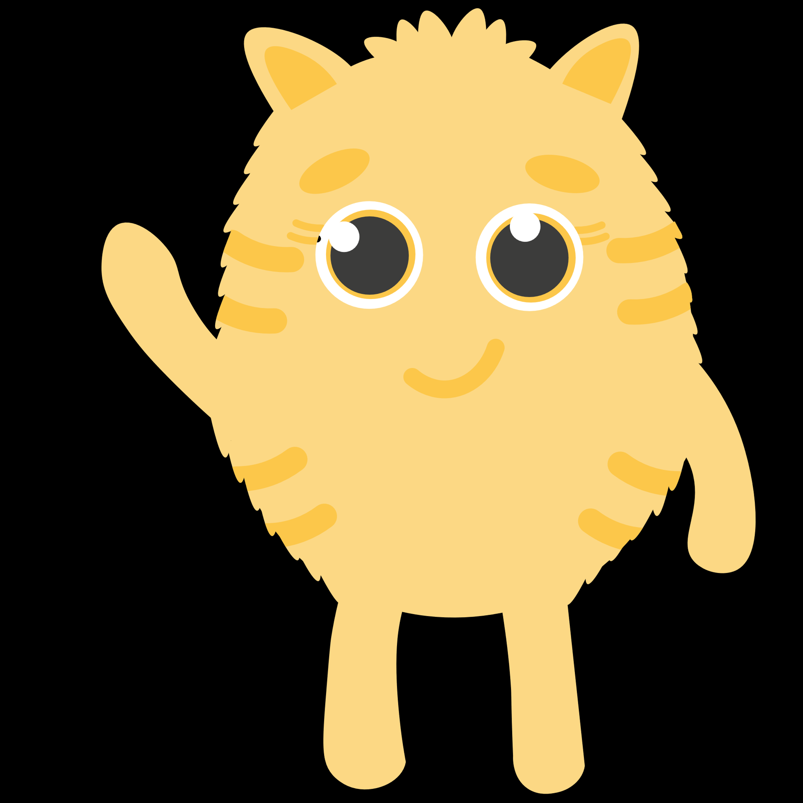
Share your learning
We love to see you all taking part in our lessons. Remember to share your learning with us on Twitter.
@NLDigitalSchool
#NLVirtualClassroom

Slide 7
Images sourced from flaticon

