Slide 1
1
Room on the Broom

Slide 2
Learning at home tips
Submit your work
Take breaks
Send your work to your teacher through Teams. Remember, you can take a photo of your work too!
Take some time to do things you enjoy or find relaxing! Try to take regular screen breaks too!
Take notes
Be prepared
Use OneNote, Microsoft Word, your jotter or a piece of paper to take notes about any new or important information.
Make sure you have everything you need to learn. Paper, a pencil and digital device will always come in handy!

Slide 3
We are learning to listen and respond to stories.
Notes:
can show my understanding of what I listen to or watch by responding to and asking different kinds of questions. LIT 1-07a

Slide 4
We will know if we have been successful if we can
Listen carefully, pause and rewind to find information.
Consider our own opinions.
Use full sentences in our answers.
Complete a book review.

Slide 5
Introduction
We will be learning about Scots language this week.
The Scots language is an important part of our heritage and culture, appearing in songs, stories and poems, as well as daily in our communities.
These activities are inspired by Education Scotland.

Slide 6
Room on the Broom
We will be learning about the Scots language by watching and responding to Room on the Broom in Scots.
There are also plenty of fun websites that you can check out on the library in the Virtual Classroom.

Slide 7
Thought Cloud
To get us started, have a think about what you already know about the Scots language. Can you fill in the clouds with what you already know?
Click here to type something you already know.
Click here to type something you already know.
Click here to type something you already know.
Click here to type something you already know.
Click file, save as, download a copy to complete this activity digitally. Or, you can copy and complete it on a piece of paper.

Slide 8
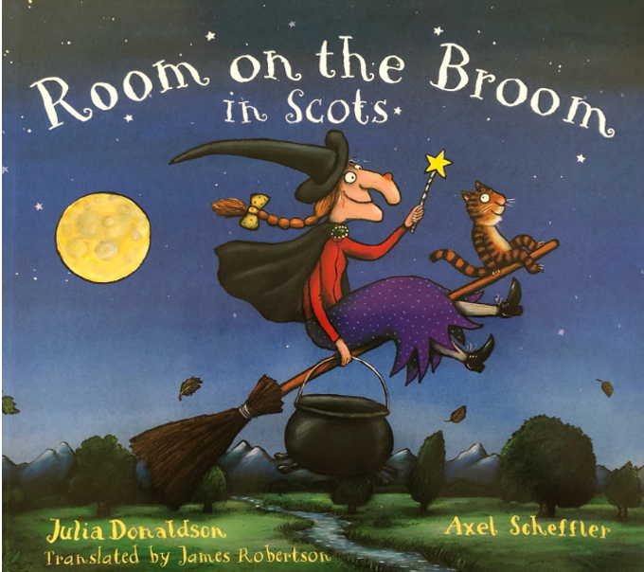
Room on the Broom
Click the link on the right to watch a reading of ‘Room on the Brom in Scots’ by Julia Donaldson.

Slide 9
Comprehension Questions
Can you answer the questions? Remember you can re-watch the story.
1
Is the witch in the story a typical witch? Why/why not?
2
Which animals go on the witch’s broom?
3
Did you enjoy the story?

Slide 10
Comprehension Questions
Can you answer the questions? Remember you can re-watch the story.
4
What was your favourite part of the story?
5
Is this story similar or different to any other Julia Donaldson stories you have read?
6
Can you think of an alternative ending for the story?

Slide 11
Comprehension Questions
Can you answer the questions? Remember you can re-watch the story.
7
What did you think was the most exciting part of the story?
8
Was there a problem in the story? How was it resolved?
9
Who would you recommend this story to and why?

Slide 12
Book Review
Now that you have answered the questions, you can complete a book review!
Book Title
Click insert, online pictures then type ‘Room on the Broom’ to insert a picture of your favourite character.
Personality
Favourite character
This book made me feel…
Star rating
Click here to type
Click here to type
Click here to type
Author
Click here to type
Fiction or non-fiction
Click here to type
Setting
Physical appearance
Drag and drop the stars to give a star rating
Click here to type
Click here to type
How I feel about this character and why
Click here to type
Click file, save as, download a copy to complete this activity digitally. Or, you can copy and complete it on a piece of paper.

Slide 13
Self assessment
We will know if we have been successful if we can
Listen carefully, pause and rewind to find information.
Consider our own opinions.
Use full sentences in our answers.
Complete a book review.
I need more help
I am getting there
I can do this

