Slide 1


Phonemes
Week 7
‘tch’

Slide 2




Learning Intention
We are learning to spell our phoneme words.
Success Criteria
Read and spell ‘tch’ phoneme words.
Use digital tools to support my learning.
Create digital content to demonstrate my learning.

Slide 3





Task 1- Highlighting
We are going to identify the ‘tch’ phoneme in words.
Read the phoneme story on the next slide and highlight the ‘tch’ words.
1
Click to stop highlighting.
First, click on the draw icon at the top
2
Next , click on the highlighter pen​

Slide 4

Highlighting
It was Halloween, and Ben was dressed up as a witch. He wore a green wig which made him itchy. He took off the wig to scratch his head and left it on the kitchen table.
Dasher tugged at the edge of the wig and pulled it down onto his head. He tried to pull it off with his teeth. Ben and Belle laughed so much when they saw him.
“What a twitchy witch!” said Ben.

Slide 5






Answers
It was Halloween, and Ben was dressed up as a witch. He wore a green wig which made him itchy. He took off the wig to scratch his head and left it on the kitchen table.
Dasher tugged at the edge of the wig and pulled it down onto his head. He tried to pull it off with his teeth. Ben and Belle laughed so much when they saw him.
“What a twitchy witch!” said Ben.

Slide 6




Task 2 – Recording Sound
We are going to read our ‘tch’ words and record our voice.
1
First, click on the and icons at the top.​
2
Next , click on the and buttons.​
3
Finally, click and read. To stop, click then .

Slide 7
Recording Sound
1
match
2
ditch
3
patch
4
witch
5
stitch

Slide 8
Recording Sound
6
catch
7
hatch
8
snatch
9
scratch
10
kitchen

Slide 9

Answers
1
match
2
ditch
3
patch
4
witch
5
stitch

Slide 10
Answers
6
catch
7
hatch
8
snatch
9
scratch
10
kitchen

Slide 11
Task 3 Drag and Drop
We are going to use the word maker to make our ‘tch’ words.
1
First, read your word from the word list.
2
Next , drag and drop the sounds onto the workspace.
3
Finally, check your spelling using the word list.

Slide 12
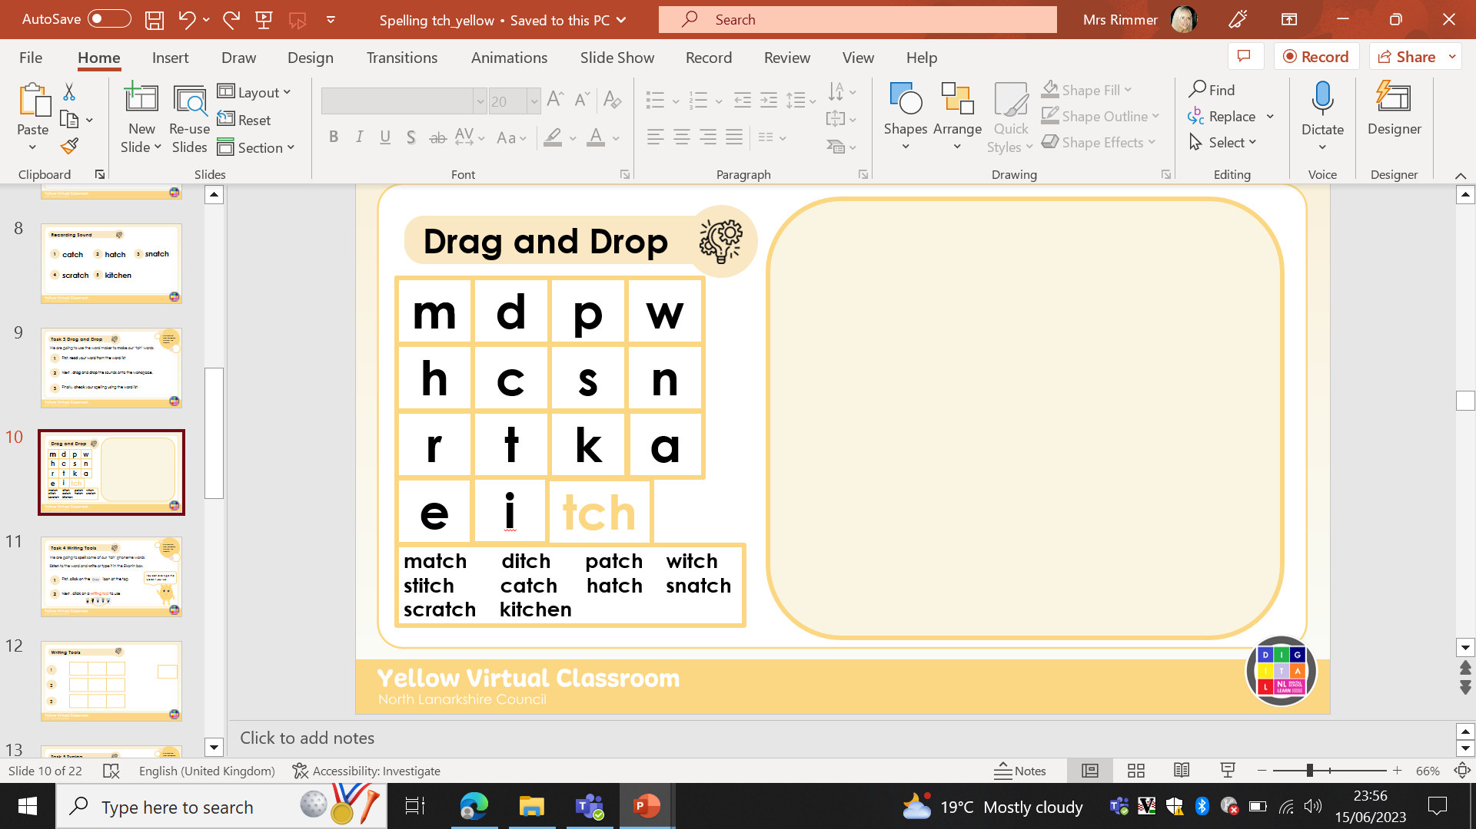
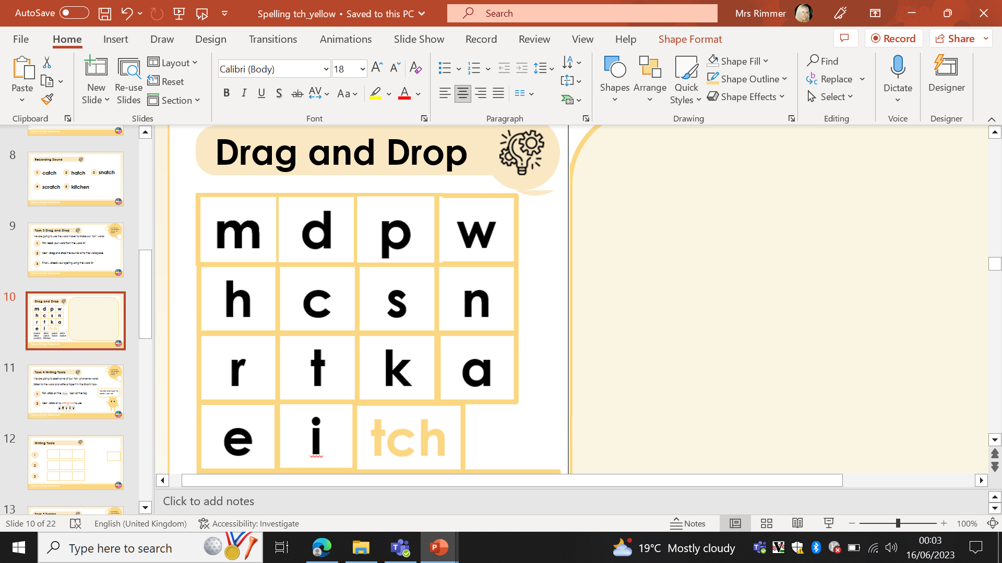
Drag and Drop

Slide 13


Task 4 Writing Tools
We are going to spell some of our ‘tch’ phoneme words.
Listen to the word and write or type it in the Elkonin box.
1
You can also type the words if you like!
First, click on the icon at the top.
2
Next , click on a writing tool to use.

Slide 14
Writing Tools
1
2
3

Slide 15
Writing Tools
4
5
6

Slide 16
Writing Tools
7
8
9

Slide 17
Writing Tools
10
You can check your answers
on the next few slides.

Slide 18
Answers
m
a
tch
1
2
d
i
tch
3
p
a
tch

Slide 19
Writing Tools
w
i
tch
4
5
s
t
i
tch
6
c
a
tch

Slide 20
Writing Tools
h
a
tch
7
8
s
n
a
tch
9
s
r
a
tch

Slide 21
Writing Tools
10
k
i
tch
e
n
You can check your
answers on the next slides.

Slide 22
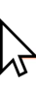

Task 5 Typing
We are going to use our phoneme words in sentences.​
​
Listen to the sentence and type it in the text box.
1
First, click on the text box you are working on.
2
Next , type the words using your keyboard.

Slide 23
Writing Tools
1
2
3

Slide 24
Writing Tools
1
The witch had an itch she had to scratch.
2
There is a mouse in the kitchen we have to catch.
3
I need to stich my sleeve and add a patch.

Slide 25



Task 6- Dictation
We are going to create our own sentences using our phoneme words.​
​
Choose a word from your list and use dictate to say a sentence for it.
1
Click again to stop recording.
First, click on the text box.
2
Next , click and to start recording.

Slide 26




match ditch patch witch stitch catch hatch snatch scratch kitchen
Dictate
1
2
3

Slide 27



match ditch patch witch stitch catch hatch snatch scratch kitchen
Dictate
4
5
6

Slide 28



match ditch patch witch stitch catch hatch snatch scratch kitchen
Dictate
7
8
9

Slide 29

match ditch patch witch stitch catch hatch snatch scratch kitchen
Dictate
10

Slide 30

Self Assessment
I will know I have been successful if I can:
Read and spell ‘tch’ phoneme words.​
Use digital tools to support my learning.​
Create digital content to demonstrate my learning.
I need more help
I am getting there
I can do this

Slide 31



Images sourced from flaticon

