Slide 1
Stage 2 - Week 3

Slide 2
Learning Intention
We are learning to use sounds to create words.
Success Criteria
•Identify phonemes.
•Blend the sounds together.
•Read the word.

Slide 3
Introduction
Make sure you are viewing this resource in slideshow mode
We are going to practise blending sounds together to read words.
First, let’s revise some of our sounds.
th
wh
oa
ck
oy
ee
oo
ng
x
v
qu
sh
ai
w
ch
Tap to start

Slide 4
Identify
Make sure you are viewing this resource in slideshow mode
Say each sound when the arrow lights up.
qu
i
t
Tap to start

Slide 5
Blend
Make sure you are viewing this resource in slideshow mode
Now, blend with the dinosaur as it moves along.
qu
i
t
Tap to start

Slide 6
Read
Make sure you are viewing this resource in slideshow mode
Click to reveal the word!
qu
i
t
This Photo by Unknown Author is licensed under CC BY-NC

Slide 7
Identify
Make sure you are viewing this resource in slideshow mode
Say each sound when the arrow lights up.
f
l
i
ck
Tap to start

Slide 8
Blend
Make sure you are viewing this resource in slideshow mode
Now, blend with the dinosaur as it moves along.
f
l
i
ck
Tap to start

Slide 9
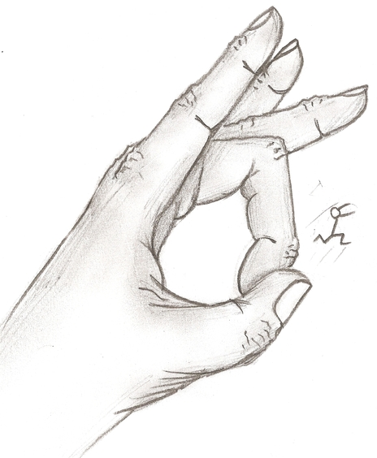
Read
Make sure you are viewing this resource in slideshow mode
Click to reveal the word!
f
l
i
ck
This Photo by Unknown Author is licensed under CC BY-SA-NC

Slide 10
Identify
Make sure you are viewing this resource in slideshow mode
Say each sound when the arrow lights up.
r
oy
a
l
Tap to start

Slide 11
Blend
Make sure you are viewing this resource in slideshow mode
Now, blend with the dinosaur as it moves along.
r
oy
a
l
Tap to start

Slide 12
Read
Make sure you are viewing this resource in slideshow mode
Click to reveal the word!
r
oy
a
l

Slide 13
Identify
Make sure you are viewing this resource in slideshow mode
Say each sound when the arrow lights up.
b
r
ai
n
Tap to start

Slide 14
Blend
Make sure you are viewing this resource in slideshow mode
Now, blend with the dinosaur as it moves along.
b
r
ai
n
Tap to start

Slide 15
Read
Make sure you are viewing this resource in slideshow mode
Click to reveal the word!
b
r
ai
n

Slide 16
Identify
Make sure you are viewing this resource in slideshow mode
Say each sound when the arrow lights up.
b
oa
t
Tap to start

Slide 17
Blend
Make sure you are viewing this resource in slideshow mode
Now, blend with the dinosaur as it moves along.
b
oa
t
Tap to start

Slide 18
Read
Make sure you are viewing this resource in slideshow mode
Click to reveal the word!
b
oa
t
This Photo by Unknown Author is licensed under CC BY-NC

Slide 19
Identify
Make sure you are viewing this resource in slideshow mode
Say each sound when the arrow lights up.
ch
ai
r
Tap to start

Slide 20
Blend
Make sure you are viewing this resource in slideshow mode
Now, blend with the dinosaur as it moves along.
ch
ai
r
Tap to start

Slide 21
Read
Make sure you are viewing this resource in slideshow mode
Click to reveal the word!
ch
ai
r

Slide 22
Identify
Make sure you are viewing this resource in slideshow mode
Say each sound when the arrow lights up.
r
oa
d
Tap to start

Slide 23
Blend
Make sure you are viewing this resource in slideshow mode
Tap to start
Now, blend with the dinosaur as it moves along.
r
oa
d

Slide 24
Read
Make sure you are viewing this resource in slideshow mode
Click to reveal the word!
r
oa
d
This Photo by Unknown Author is licensed under CC BY-SA

Slide 25
Practise
Use these codes to practise more on Educandy.
Phoneme | Code
ck | 25db7
ai | 25da4
oy | 25e25
oa | 25de2
qu | 25e29
Scan or click to start.

Slide 26
Self Assessment
We will know if we have been successful if we can
•Identify phonemes.
•Blend the sounds together.
•Read the word.
I need more help
I am getting there
I can do this

Slide 27
Share your learning
We love to see you all taking part in our lessons. Remember to share your learning with us on Twitter.
@NLDigitalSchool
#NLVirtualClassroom

Slide 28
Images sourced from flaticon

