Slide 1
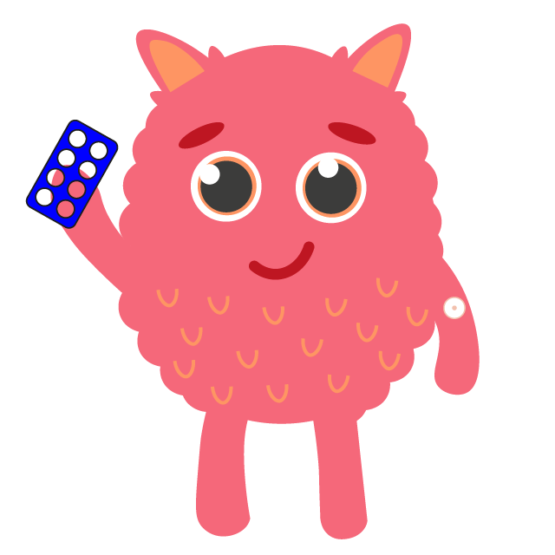
I Spy
-Numbers
‘1’

Slide 2
Learning Intention
We are learning to identify representations of numbers
Success Criteria
•Identify number one.​
•Identify the pictures that match the number.
•Say the number.
•Make the number.

Slide 3
Make sure you are viewing this resource in slideshow mode.
Highlight function
We are going to use the highlight tool in Powerpoint to complete the next task
1
First, click on the ‘draw’ icon at the top
2
Next , click on the highlighter pen icon at the top
3
Now, it’s time to identify our numbers

Slide 4
Make sure you are viewing this resource in edit Powerpoint mode.
I Spy - Numbers
Identify and highlight all the number ones you can find

Slide 5
Answer reveal
Make sure you are viewing this resource in edit Powerpoint mode.
I Spy - Numbers
Identify and highlight all the number ones you can find

Slide 6
Let’s Watch
Watch the number songs below to further your learning.

Slide 7
Challenge Task
1
Use these math manipulatives to practice making today’s number.
Unifix Cubes
Coloured Counters
Ten Frame

Slide 8
Self Assessment
We will know if we have been successful if we can
•Identify number one.​
•Identify the pictures that match the number.
•Say the number.
•Make the number.
I need more help
I am getting there
I can do this

Slide 9
Share your learning
We love to see you all taking part in our lessons. Remember to share your learning with us on Twitter.
@NLDigitalSchool
#NLVirtualClassroom

Slide 10
Images sourced from flaticon

