Slide 1
Week 5-7 Blending

Slide 2
Learning Intention
We are learning to use sounds to create words.
Success Criteria
•Identify initial sounds.​
•Blend the sounds together.
•Say the word.

Slide 3
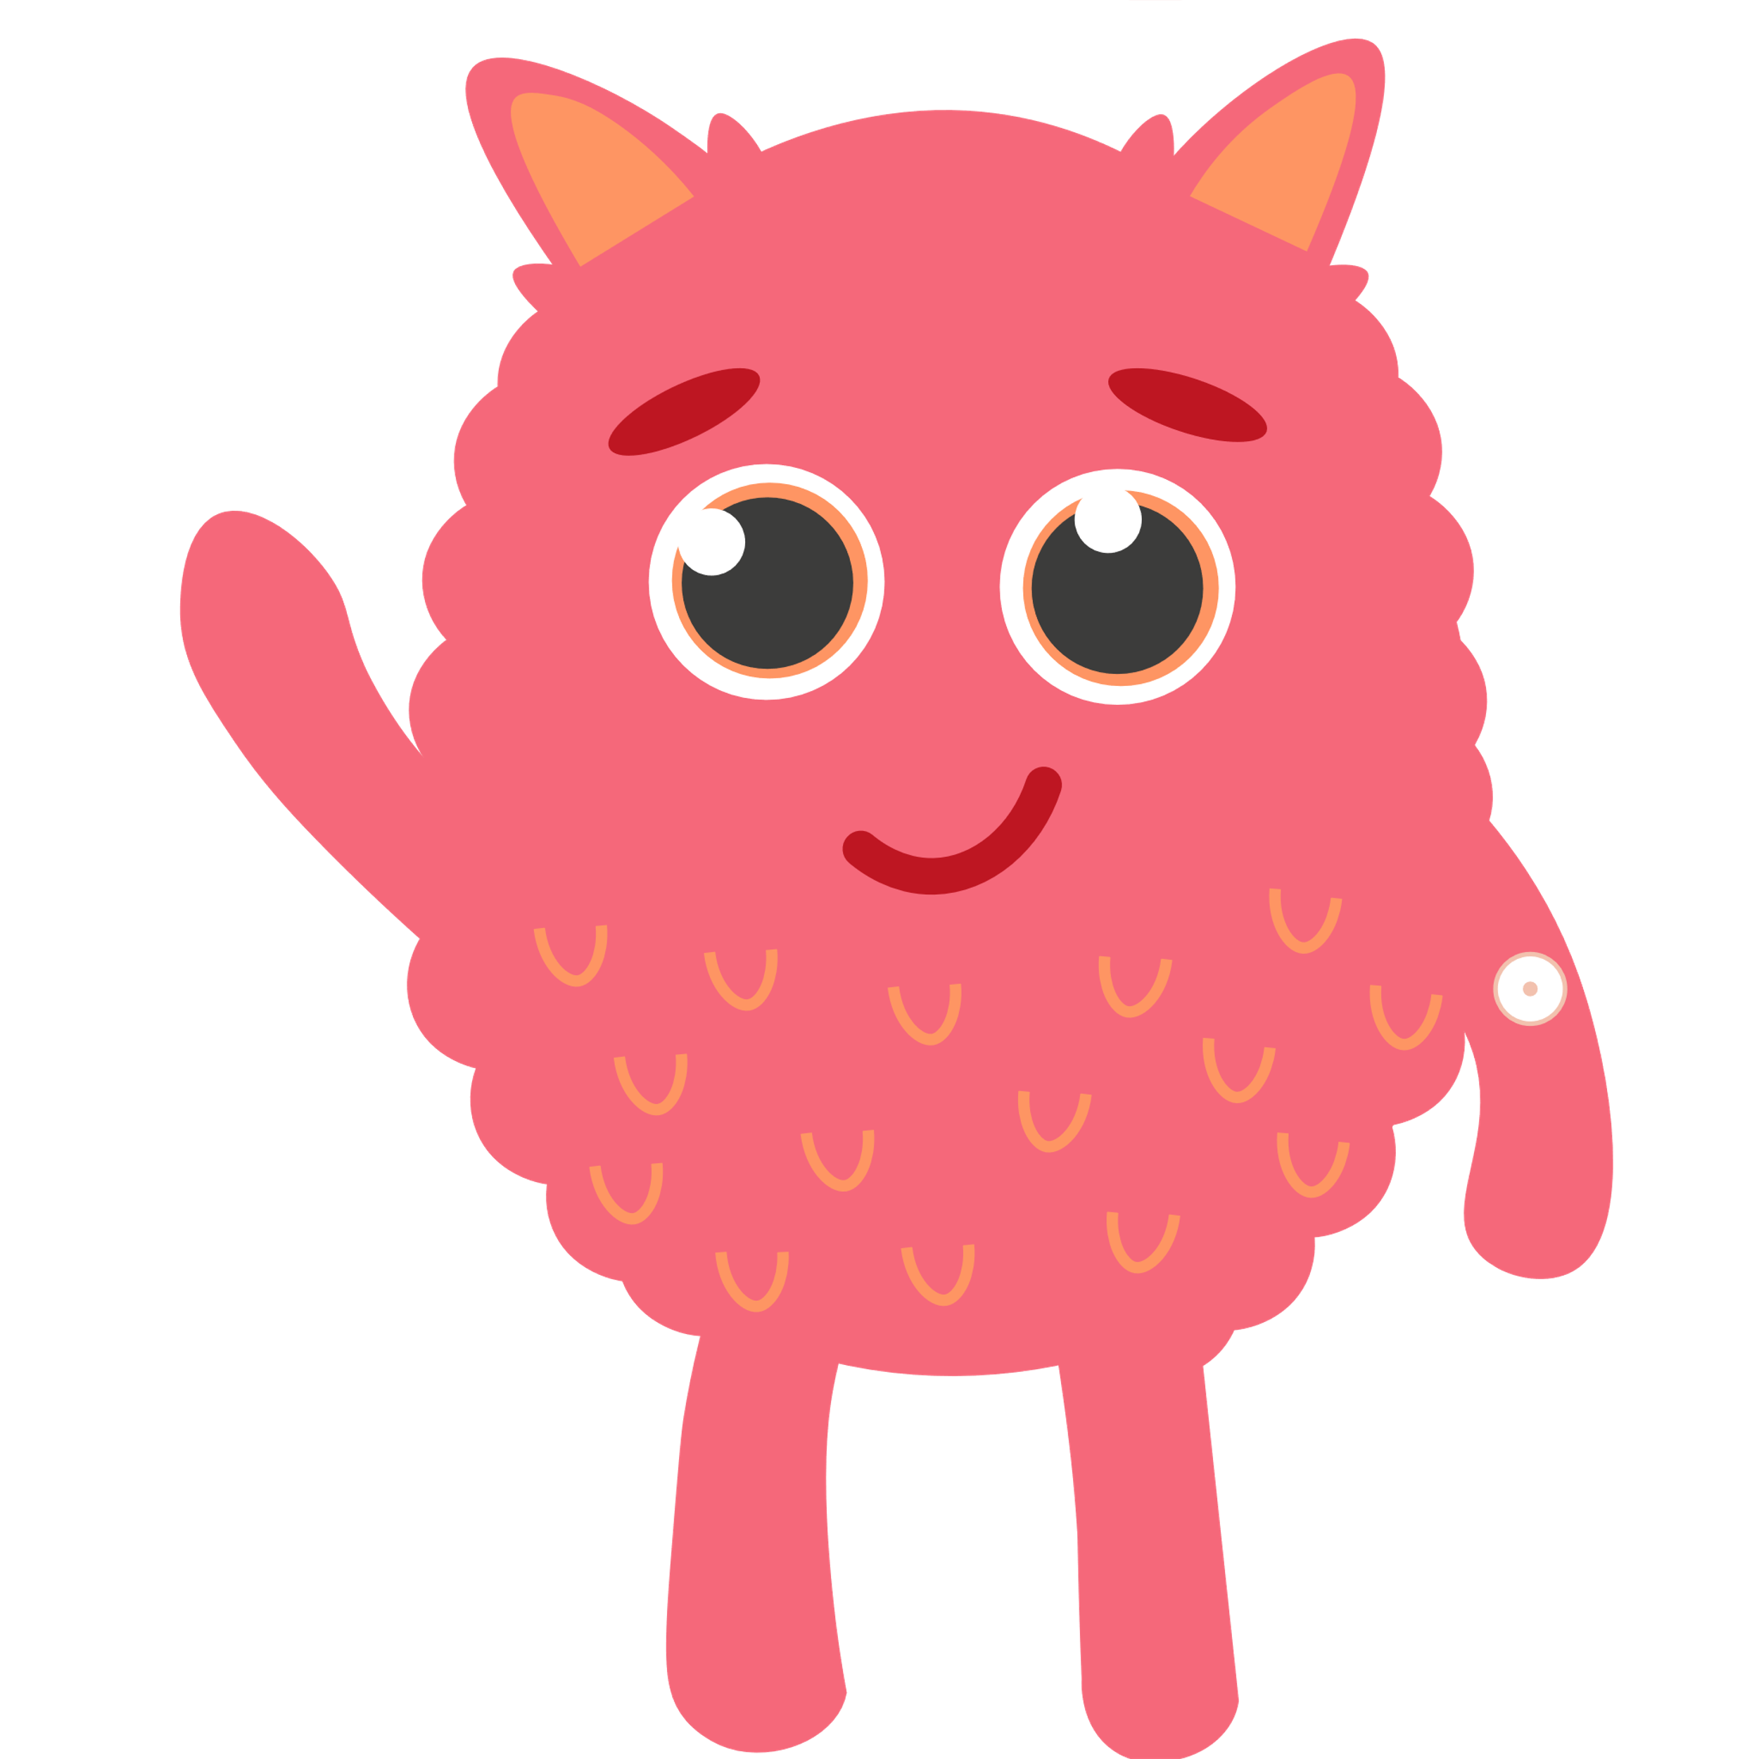
Make sure you are viewing this resource in slideshow mode.
Introduction
We are going to practise blending sounds together to read words.
First, let’s revise some of our sounds.
p
t
s
i
n
a
Click to show sounds.

Slide 4
Make sure you are viewing this resource in slideshow mode.
Task
Say each sound when the arrow lights up.
s
a
t
Click when ready.

Slide 5
Make sure you are viewing this resource in slideshow mode.
Task
Now, blend with the dinosaur as it moves along.
s
a
t
Click when ready.

Slide 6
Make sure you are viewing this resource in slideshow mode.
Task
Click to reveal the word!
s
a
t
This Photo by Unknown Author is licensed under CC BY-NC-ND

Slide 7
Make sure you are viewing this resource in slideshow mode.
Task
Say each sound when the arrow lights up.
t
a
p
Click when ready.

Slide 8
Make sure you are viewing this resource in slideshow mode.
Task
Now, blend with the dinosaur as it moves along.
t
a
p
Click when ready.

Slide 9
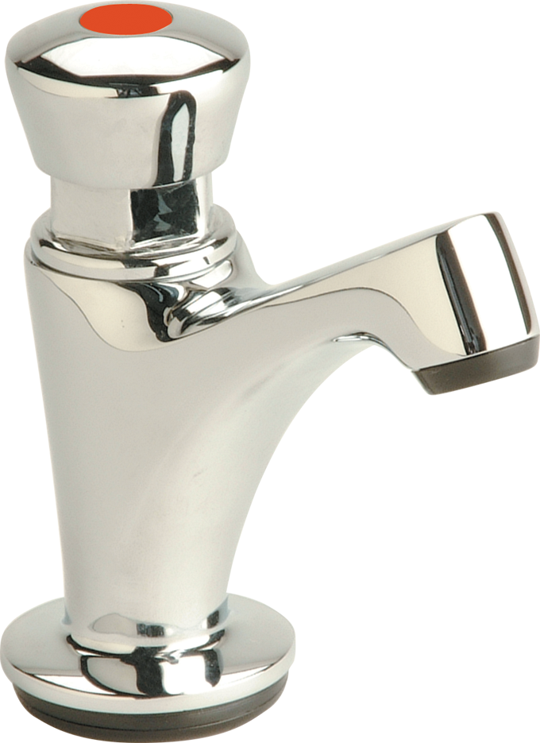
Make sure you are viewing this resource in slideshow mode.
Task
Click to reveal the word!
t
a
p
This Photo by Unknown Author is licensed under CC BY-NC

Slide 10
Make sure you are viewing this resource in slideshow mode.
Task
Say each sound when the arrow lights up.
p
i
n
Click when ready.

Slide 11
Make sure you are viewing this resource in slideshow mode.
Task
Now, blend with the dinosaur as it moves along.
p
i
n
Click when ready.

Slide 12
Make sure you are viewing this resource in slideshow mode.
Task
Click to reveal the word!
p
i
n

Slide 13
Make sure you are viewing this resource in slideshow mode.
Task
Say each sound when the arrow lights up.
p
a
n
Click when ready.

Slide 14
Make sure you are viewing this resource in slideshow mode.
Task
Now, blend with the dinosaur as it moves along.
p
a
n
Click when ready.

Slide 15
Make sure you are viewing this resource in slideshow mode.
Task
Click to reveal the word!
p
a
n

Slide 16
Make sure you are viewing this resource in slideshow mode.
Task
Say each sound when the arrow lights up.
t
i
n
Click when ready.

Slide 17
Make sure you are viewing this resource in slideshow mode.
Task
Now, blend with the dinosaur as it moves along.
t
i
n
Click when ready.

Slide 18
Make sure you are viewing this resource in slideshow mode.
Task
Click to reveal the word!
t
i
n

Slide 19
Make sure you are viewing this resource in slideshow mode.
Task
Say each sound when the arrow lights up.
n
a
p
Click when ready.

Slide 20
Make sure you are viewing this resource in slideshow mode.
Task
Now, blend with the dinosaur as it moves along.
n
a
p
Click when ready.

Slide 21
Make sure you are viewing this resource in slideshow mode.
Task
Click to reveal the word!
n
a
p
This Photo by Unknown Author is licensed under CC BY

Slide 22
Challenge
Can you drag the word to match the picture?
nap
tin
pan
sat
pin
tap
This Photo by Unknown Author is licensed under CC BY
This Photo by Unknown Author is licensed under CC BY-NC-ND
This Photo by Unknown Author is licensed under CC BY-NC

Slide 23
Self Assessment
We will know if we have been successful if we can
•Identify initial sounds.​
•Blend the sounds together.
•Say the word.
I need more help
I am getting there
I can do this

Slide 24
Share your learning
We love to see you all taking part in our lessons. Remember to share your learning with us on Twitter.
@NLDigitalSchool
#NLVirtualClassroom

Slide 25
Images sourced from flaticon

