Slide 1
Media- Invent a Character

Slide 2
Learning Intention
We are learning to invent a character.
Success Criteria
•Create a character.​
•Name the character.​
•Say how they would fit in with the film.​

Slide 3
Introduction
We will be learning about character development.
We will start by looking at characters that already exist in some really well-known films.
​
Have a think about characters that already exist and how you think the creator produced their idea.

Slide 4
Let’s Watch
Select a trailer you want to watch.
Think about a character that could be added to the story throughout.
Turning Red
Encanto
Luca

Slide 5
Discussion
Which character from Encanto is being described here?
Doesn’t have a magical gift
Brave
Kind
Wears glasses
Has a big family
Likes to sing
Notes:
Mirabel

Slide 6
Task 1 - Drawing
Draw a picture of your own character to add to a film. This can be from the trailer you watched or your favourite film.

Slide 7
Task 2 - Dictate
Use the dictate function to describe your character.
Click inside the box before you speak.
What is their name?
What do they look like?
What do they like to do?
What does their house look like?
Do they have any pets?
What do they like to eat?

Slide 8
Challenge - Photos
Create your character from different materials e.g. leaves, twigs, playdoh. Take a picture of your character and insert it into the box.

Slide 9
Self Assessment
We will know if we have been successful if we can
•Create a character.​
•Name the character.​
•Say how they would fit in with the film.
I need more help
I am getting there
I can do this

Slide 10
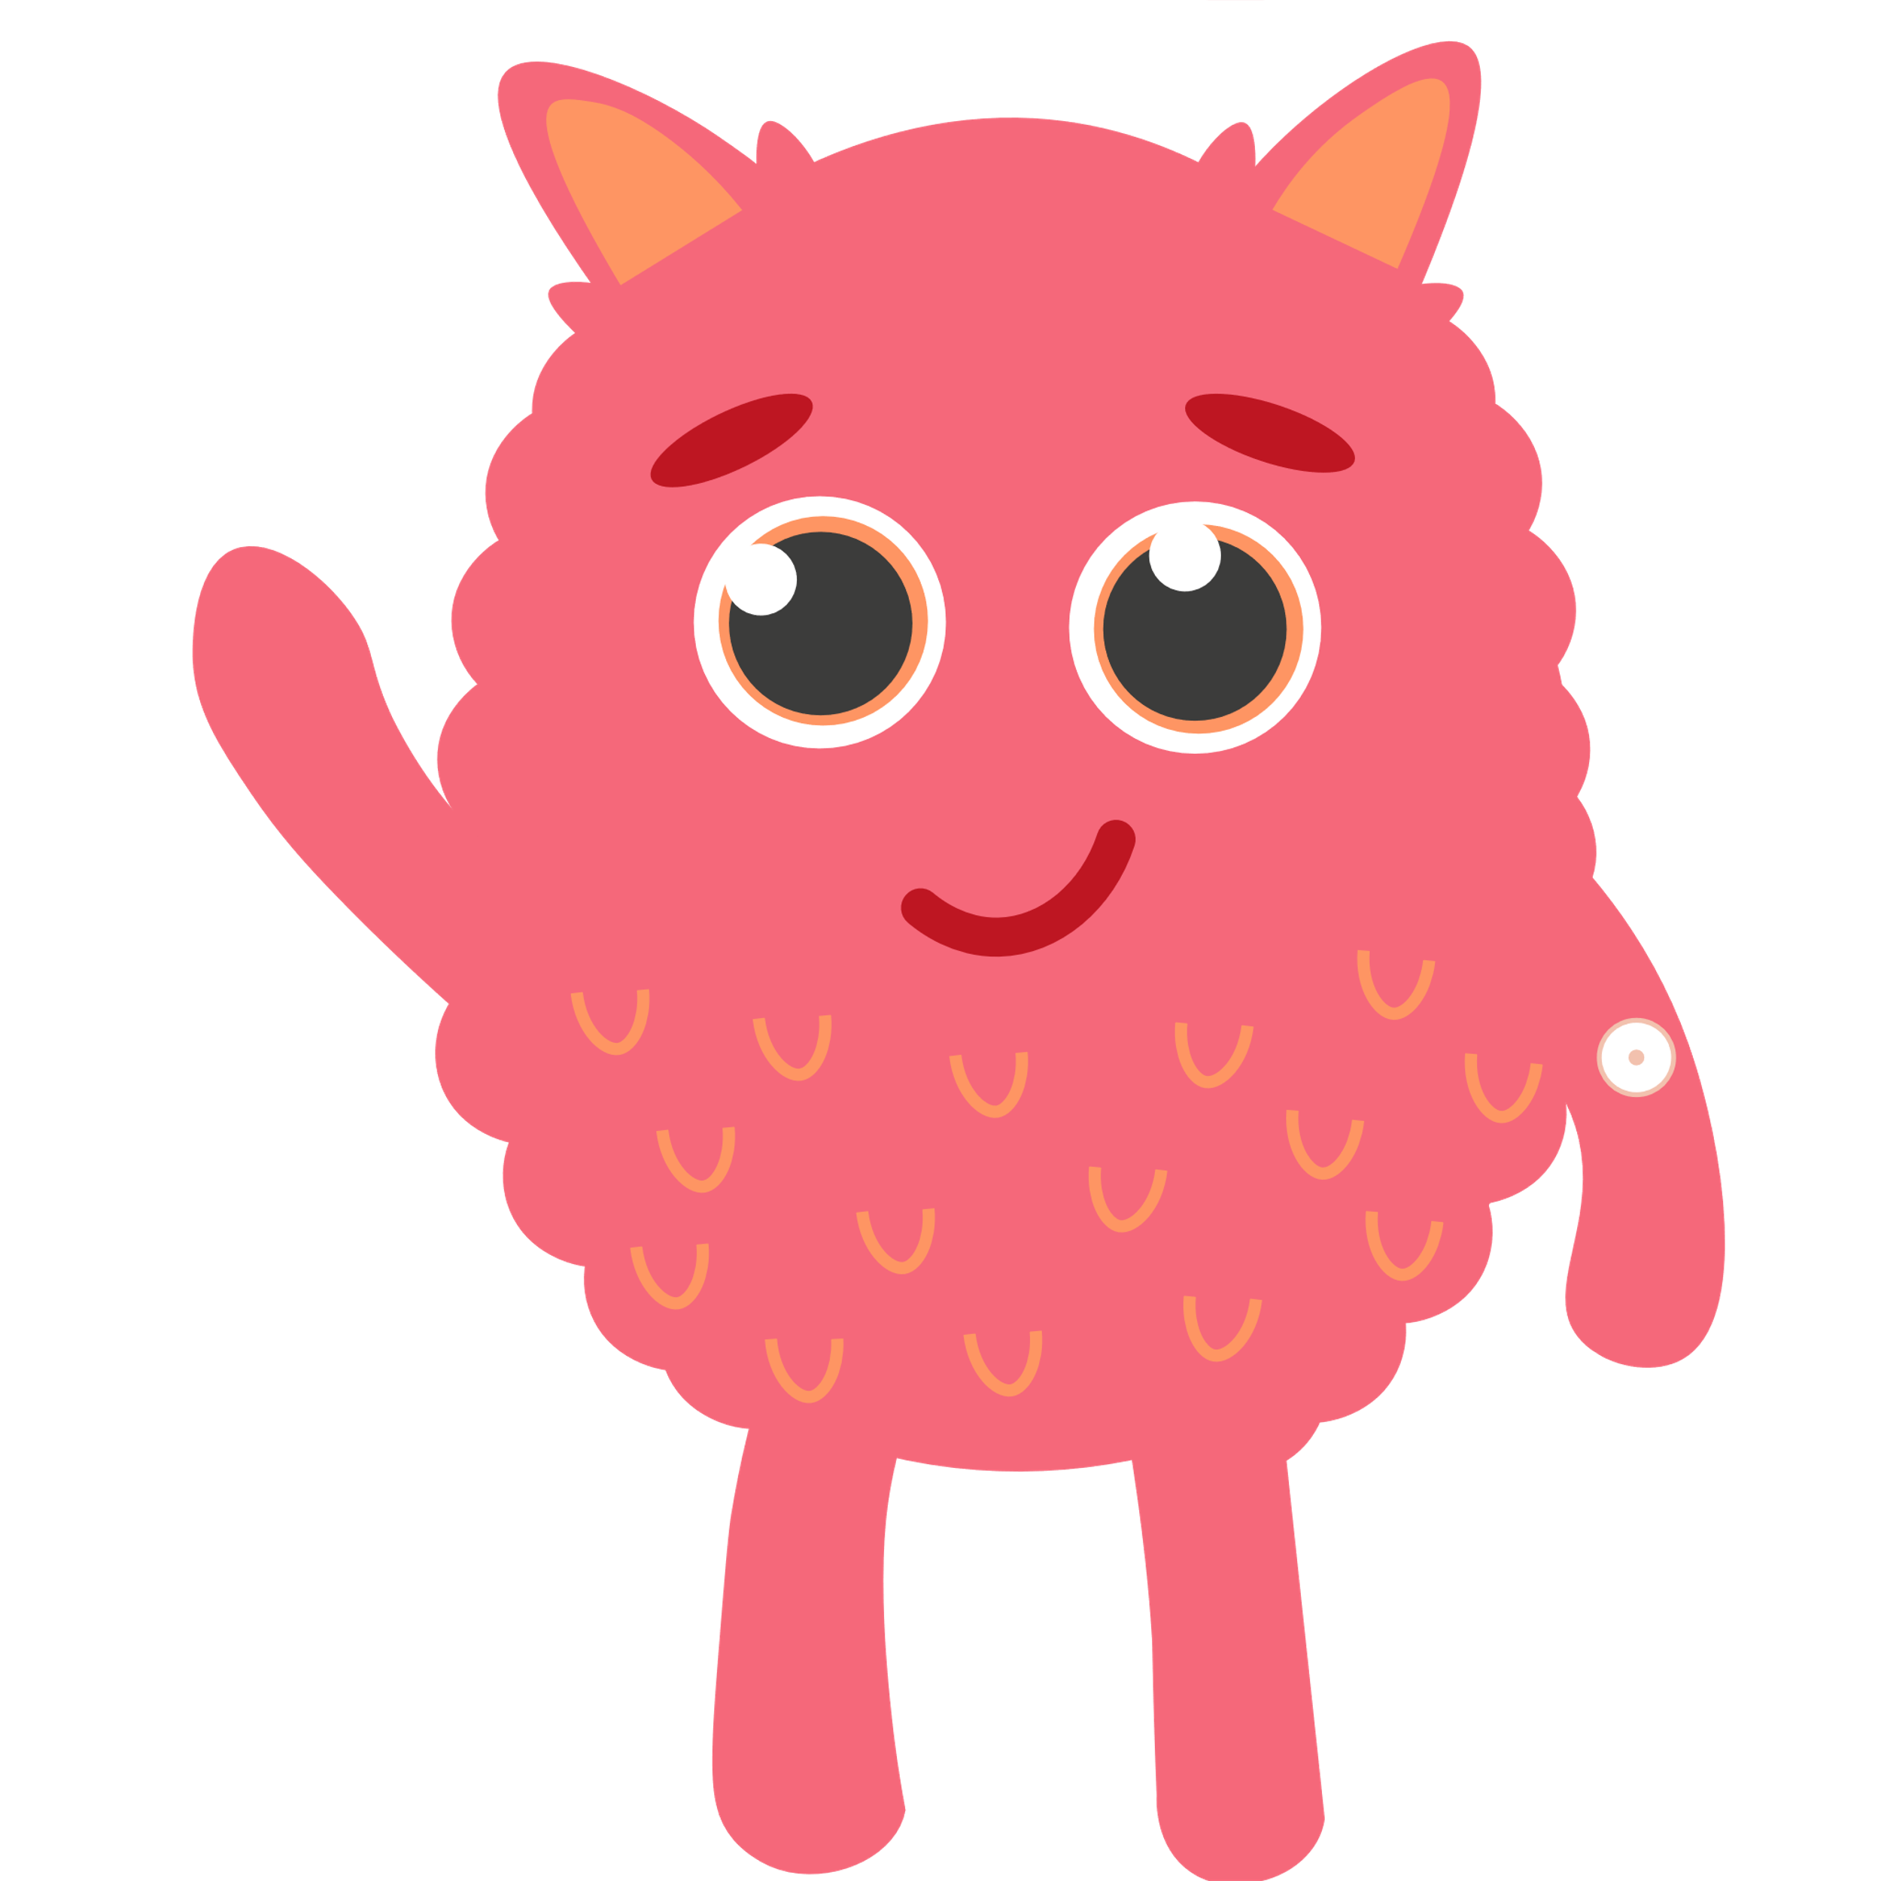
Share your learning
We love to see you all taking part in our lessons. Remember to share your learning with us on Twitter.
@NLDigitalSchool
#NLVirtualClassroom

Slide 11
Images sourced from flaticon

