Slide 1
Meet the Teacher
Miss Martin
Primary 6
August 2020

Slide 2
Welcome back!
It is an absolute joy to be back with your children for another year and we have made an amazing start after lockdown. You all know me fairly well by now and hopefully know I am always available to talk about your children. It would be really beneficial if you could make sure you have access to Microsoft Teams and Twitter this year as these are the preferred methods for sharing information and photos/videos for our council. There is a lot to do after the strange start to 2020 but my children and I are excited to make up lost time and support each other in the year ahead. Our class is like a family and we look out for each other and encourage each other at all times. Your children are so respectful and hard-working, a credit to you all and I am blessed to be able to spend another year shaping their futures. Thank you for your support as parents and I look forward to speaking to you all again throughout the year.
Kindest Wishes,
Miss Martin

Slide 3
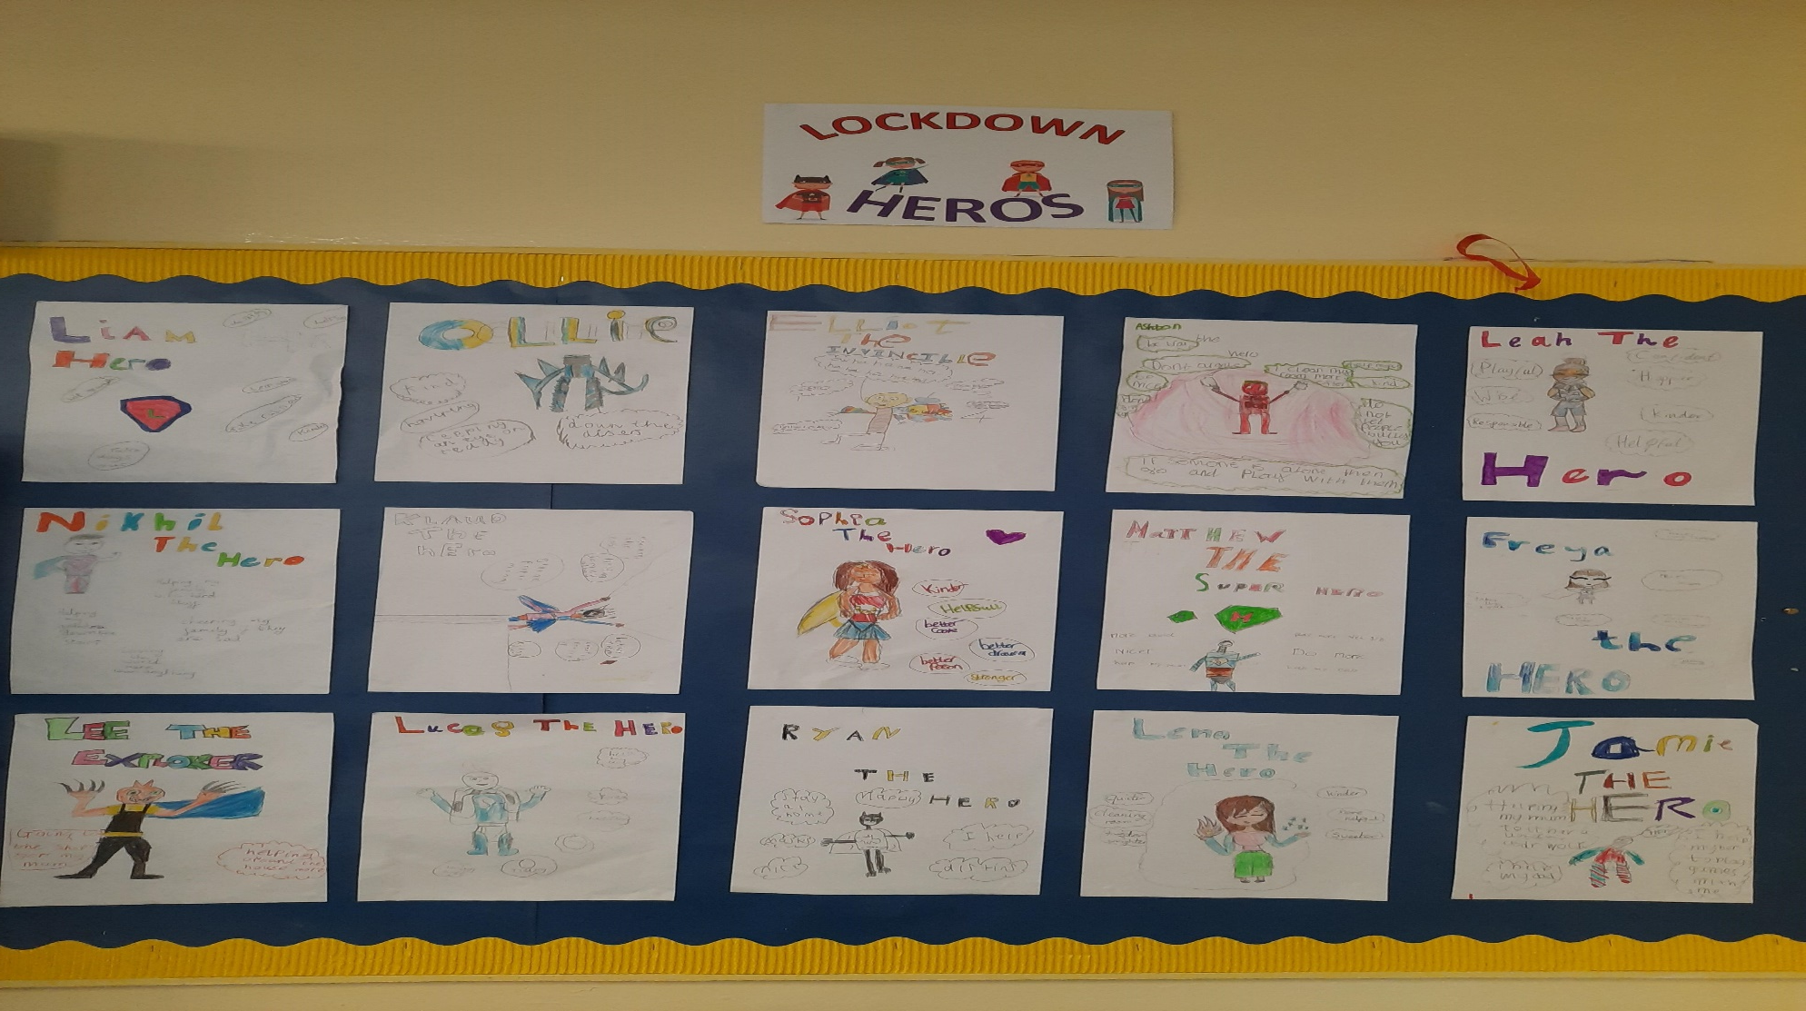
Lockdown Heroes We have all been heroes in our own way throughout 2020. We wanted to celebrate that together.

Slide 4
Raven Charcoal Drawings

Slide 5
Fashion from the 1550’s Mary Queen of Scots

Slide 6
The Feast of the Passover Storyboard

Slide 7
Mary Queen of Scots Timeline

