Slide 1
Welcome to : Primary 5
Year 2020-2021

Slide 2
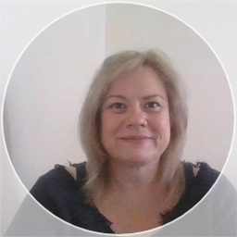
Hi, I’m Mrs Craig
This year I am delighted to be teaching Primary 5.
Most of you know me already as I have been a teacher at St. Mary’s for 10 years.
I am really looking forward to teaching a new stage this year and am excited by the topics we will be learning about. My big focus at the start of this year is Health and Wellbeing. Our timetable may change at short notice to meet the needs of your children.
An overview of our homework this year will be posted on the school webpage along with downloadable versions of our termly Focus for Learning https://blogs.glowscotland.org.uk/nl/smpc/ with supporting resources available on Teams. We have been practising using it in class but if you would like a paper copy just let me know by giving the office a call.
I will post pictures weekly on our school Twitter @stmarysseafar, as this is North Lanarkshire’s preferred Social media platform. Please like and share our tweets ☺

Slide 3
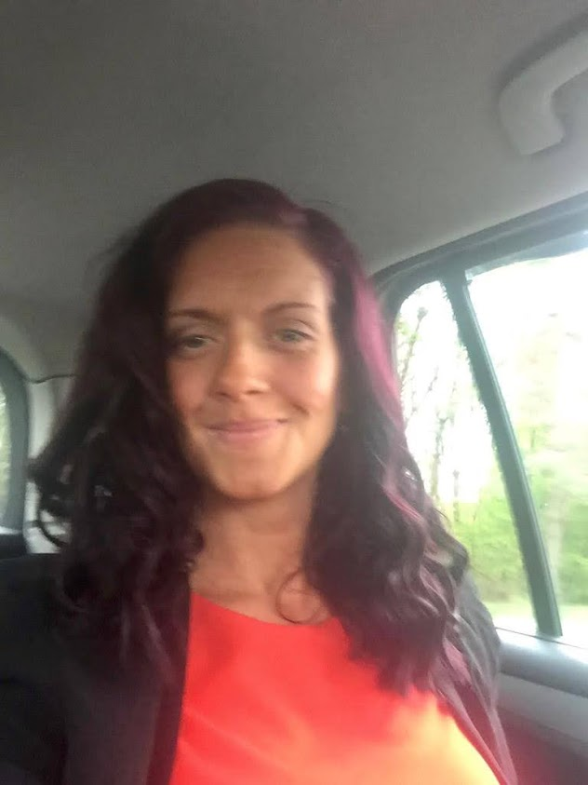
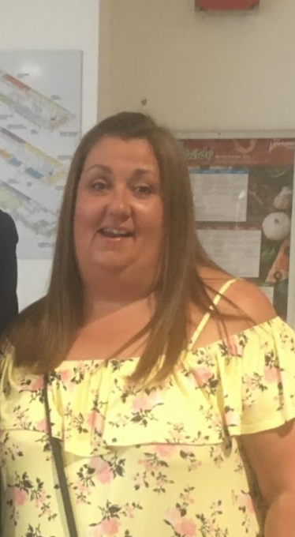
In St. Mary’s we often have other adults supporting in our classroom and this year your child might see the following people in our class.
Miss Beattie Mrs Fulton

Slide 4
Our topics this year are;
The Ancient Egyptians
Glasgow
Scottish Democracy
Lifestyle and culture comparison – Japan
Our STEM (Science, Technology, Engineering and Maths) topics will be;
Buoyancy
Electrical circuits and symbols
Lifecycles of plants and animals
Renewable energy
Micro-organisms; composting
Fertilizer- uses and limitations

Slide 5
Focus for Learning
August-October 2020
Primary 5
Language
Our Writing will be focussed on personal/imaginative and instructional pieces this term.
We will link it to our Science investigations and ‘Egyptians’ topic in some instances.
We are reading Michael Morpurgo’s ‘Cool’ as our class reader and ‘Frankenkids’ as a modelling block this term.
We will also be completing comprehension activities linked to short texts.
We will focus on inference and decoding skills along with finding the main ideas of a text.
Our focus for Talking and Listening will be:
Taking turns to listen and speak
Listening to texts that are read aloud and
responding to questions linked to the text;
including the main idea and purpose.

Slide 6
Numeracy and Maths
Our focus for this term is revision:
Rounding and estimating answers by rounding
Place value using 3 digits and beyond with focus on zero as a place holder
Number sequences
Addition and subtraction revision
Multiplication and division revision
Egyptian hieroglyphs numerals in relation to our topic and the history of numbers. Learning 1 to 20
Patterns and relationships
The children will be learning to :
Complete calculations using zero as a placeholder where there are no hundreds, tens or units but there are thousands.
Arrange numbers up to 9,999 in ascending and descending order
Represent, partition and describe 3 digit numbers and beyond.
Continue number patterns and sequences and explain rules for number sequences.
Multiply and divide using known facts.

Slide 7
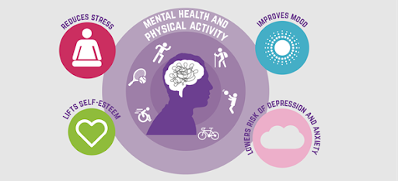
Health and Wellbeing
Our focus for this term is: Being Safe and Healthy
The children will be learning :
How good cleanliness and hygiene routines are important at all times.
How to maintain good hygiene when handling food.
How being active on a daily basis contributes to different aspects of our health.
Physical Education
This term we will be focusing on Fitness, exercise for good mental health, and athletics.
The children will be learning:
To recognise the long term benefits of exercise, both indoors and outdoors
How to communicate effectively as a team
Running and jumping techniques.
P.E. days are not currently set as we are required to do it outdoors. Gym kits are not needed, however, for the children who wear skirts or pinafores having a pair of shorts in their school bag would be beneficial.

Slide 8
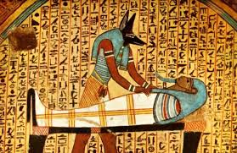
Cross Curricular
Our topic this term is: The Egyptians
Through the context of ‘The Egyptians’ we will be learning about the impact the Egyptians had on technological development around the world
We will learn about the signs and artefacts which remain to tell us about the Egyptian’s lifestyles and traditions
We will be learning about the Egyptian Gods and their symbols.
We will be learning about the process of mummification
We will be learning about the River Nile
We will be exploring hieroglyphics and making our own papyrus.
We will also be taking part in some science and technology investigations. So far we have investigated Buoyancy, Viscosity and Endothermic Reactions—also known as Dancing Raisins, Glitter Brains and Ice cream machines.
We will be exploring Music through the theme of Mama Mia!

Slide 9
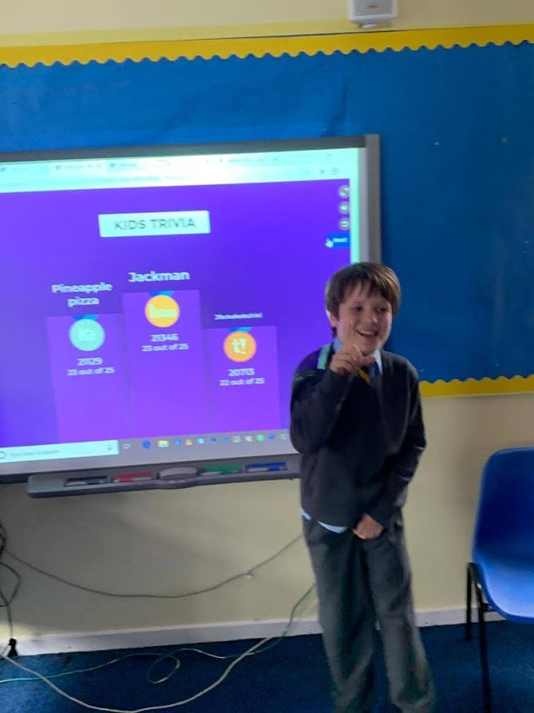
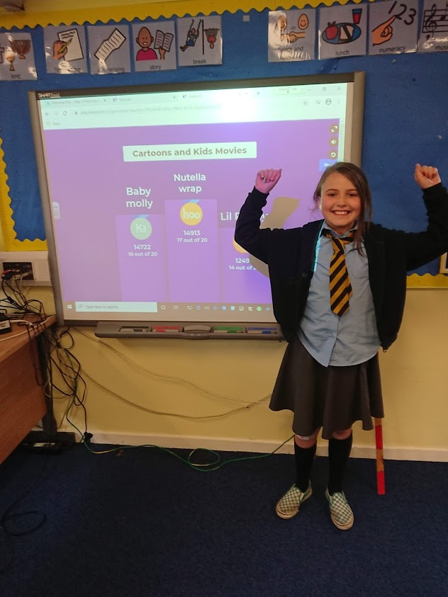
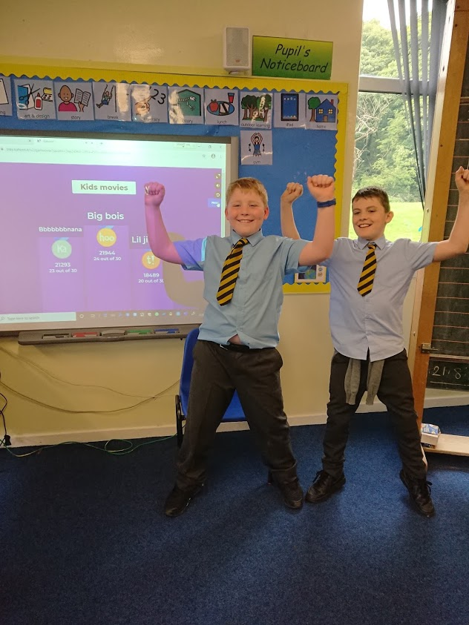
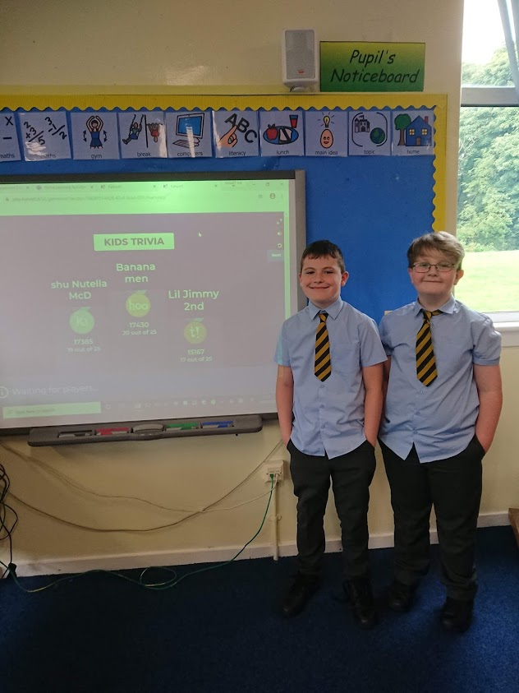
Unfortunately this year we aren’t able to welcome you into class so here is a wee snapshot of what we have been up to so far…
TOP QUIZZING
Team Cayla and Ola were Victorious too, but we didn’t get a photo, sorry!

Slide 10
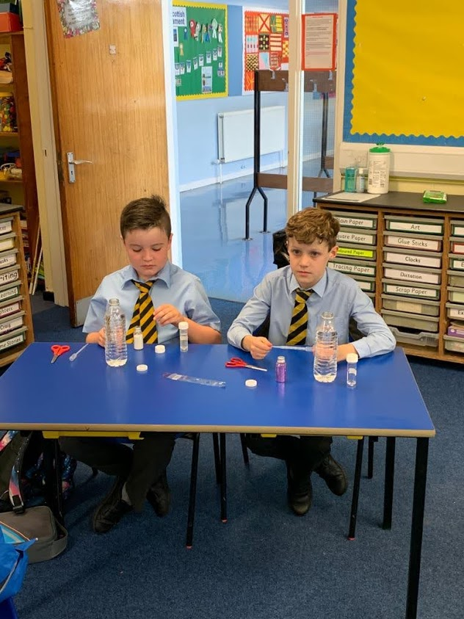
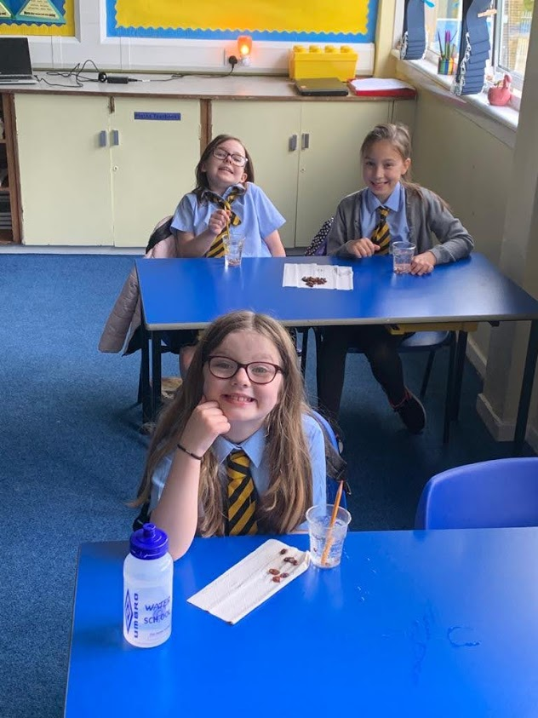
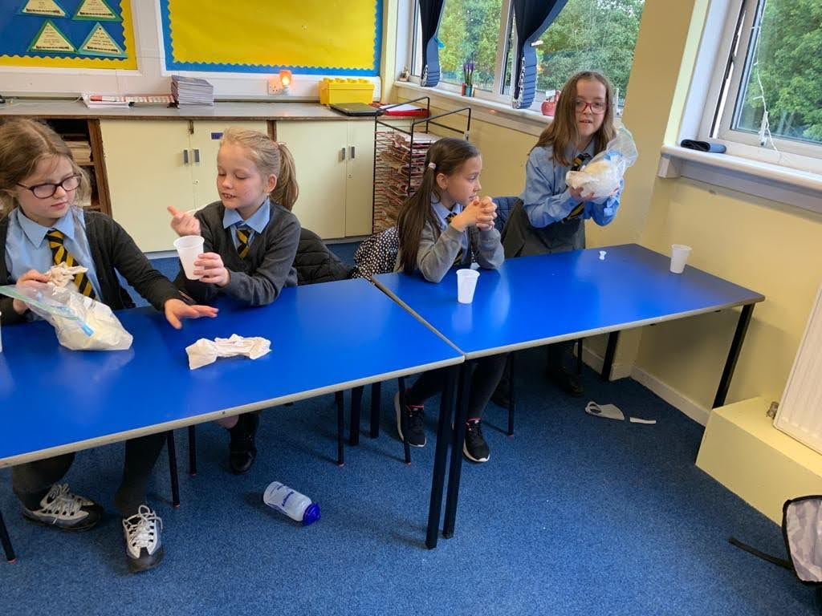
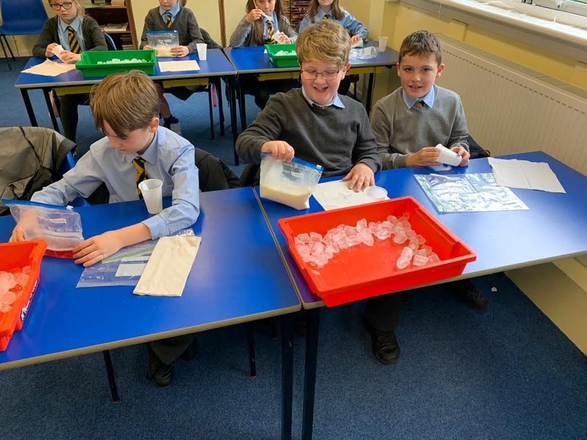
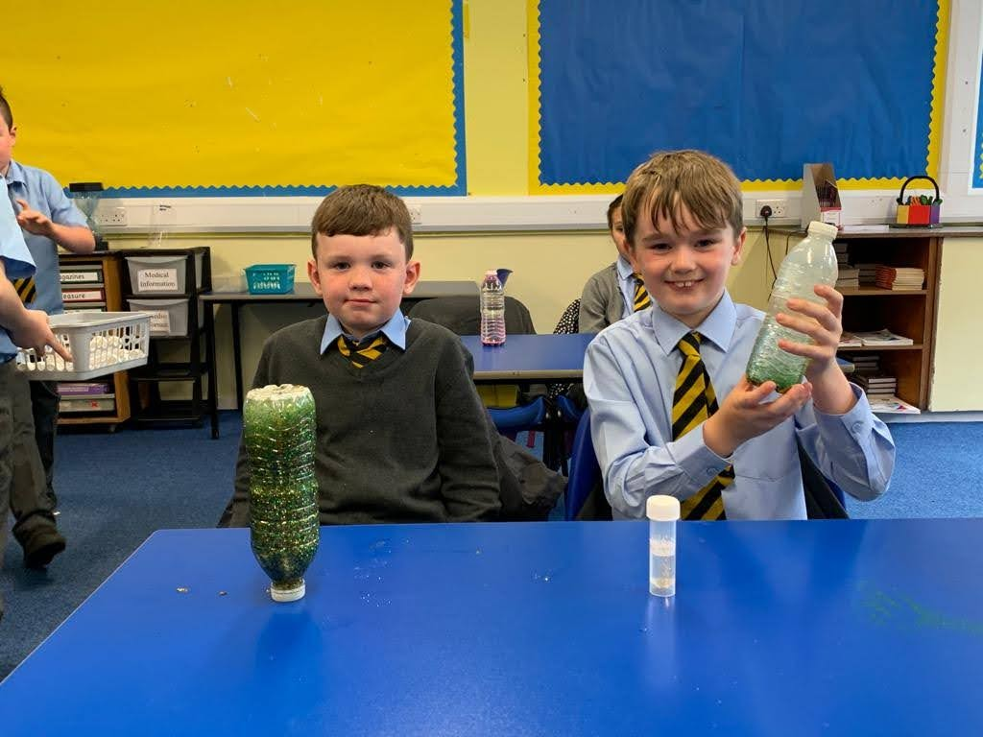

Slide 11
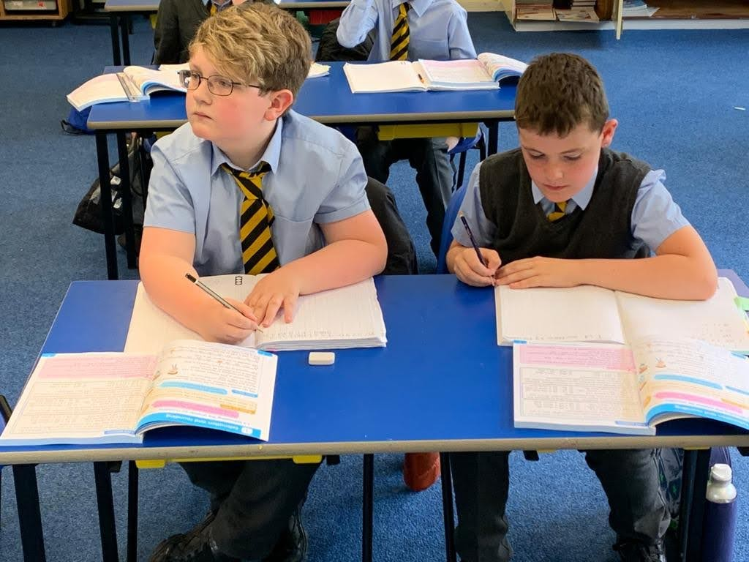
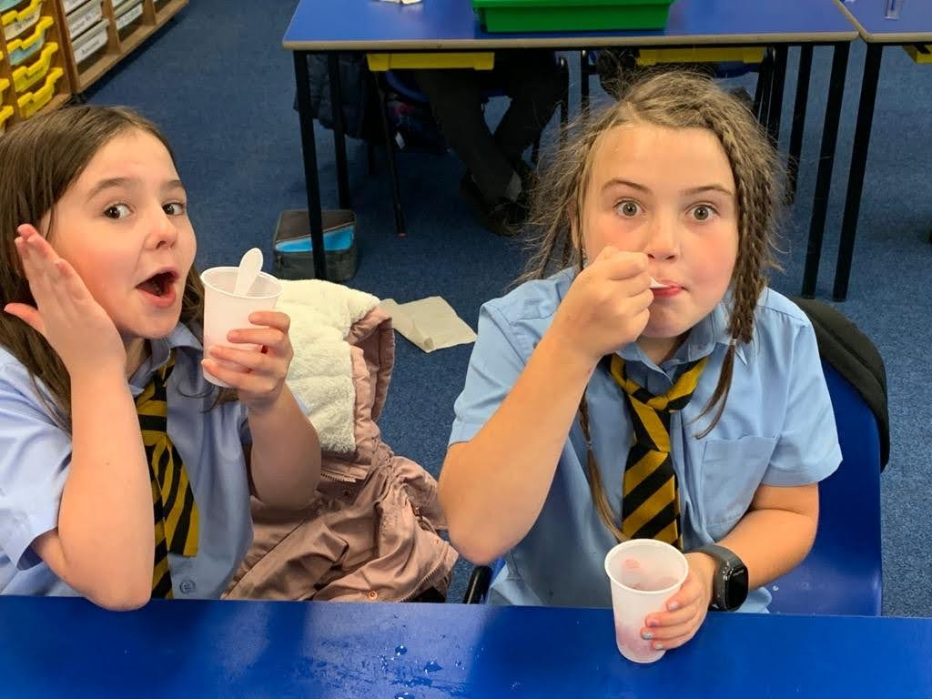
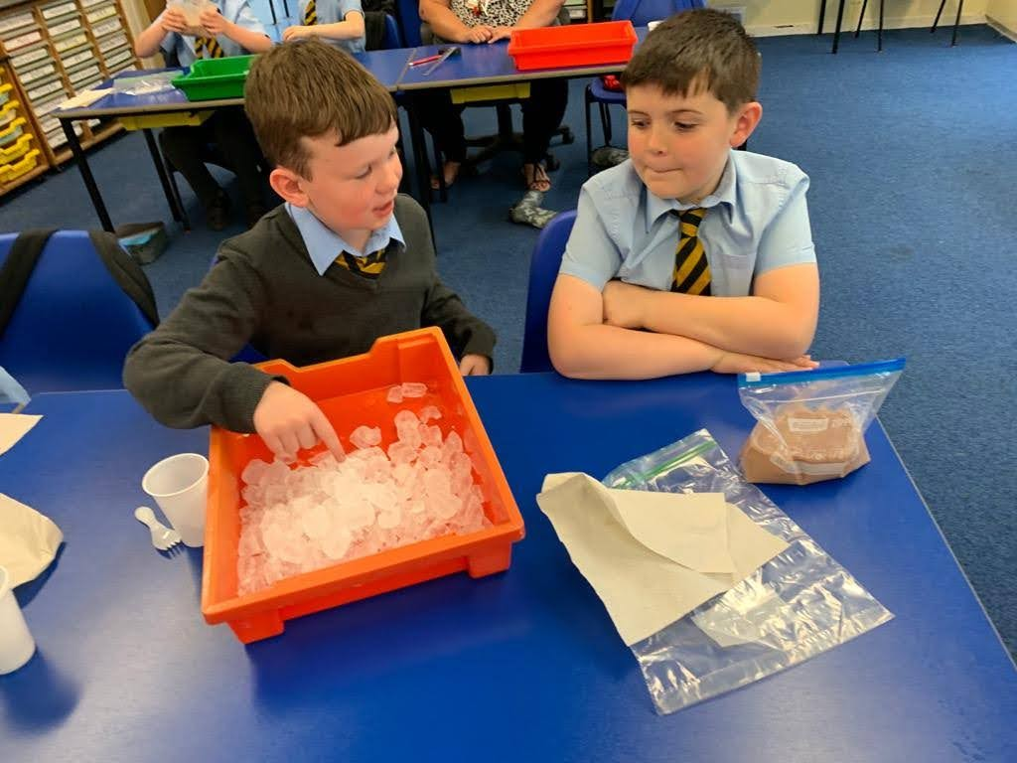
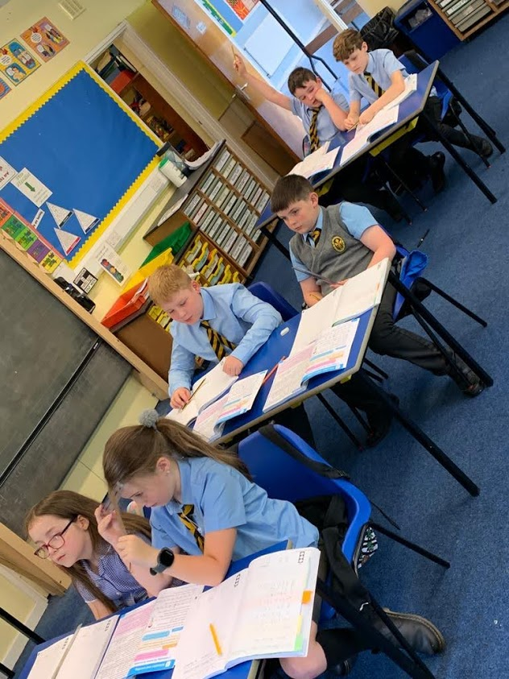
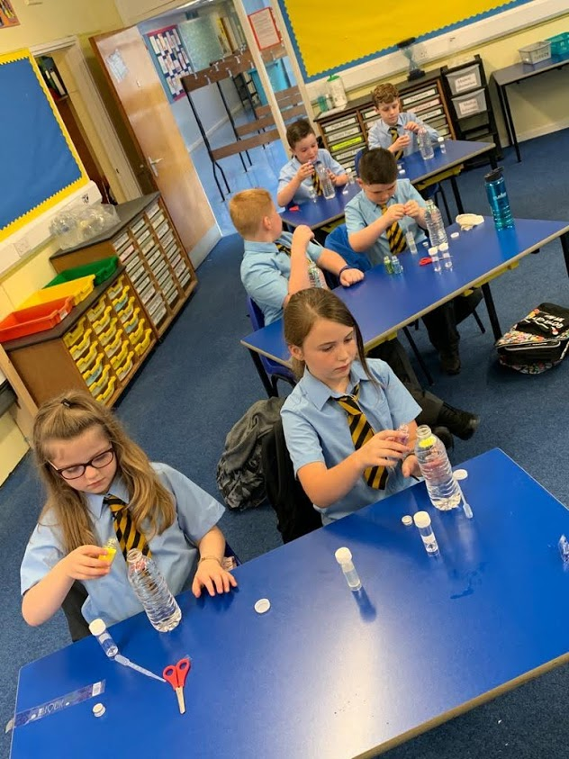
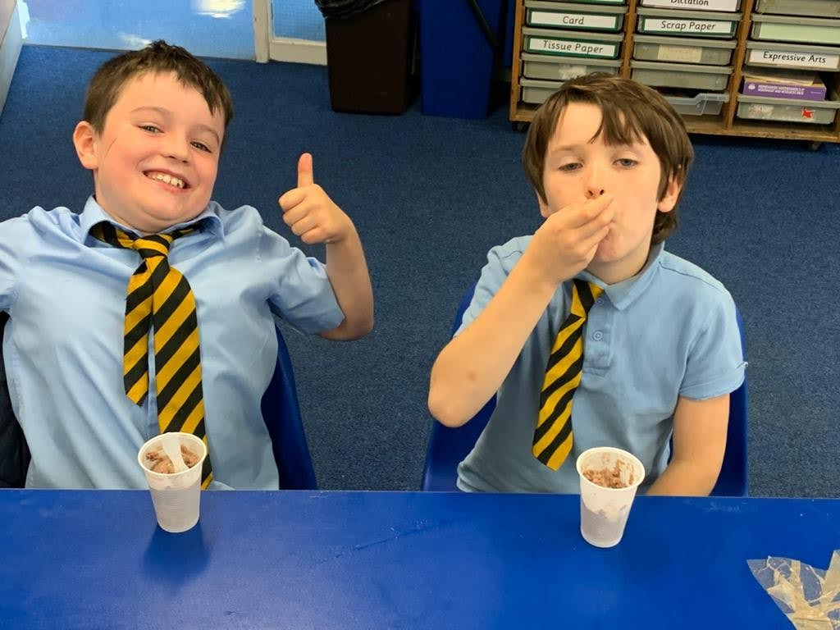

Slide 12
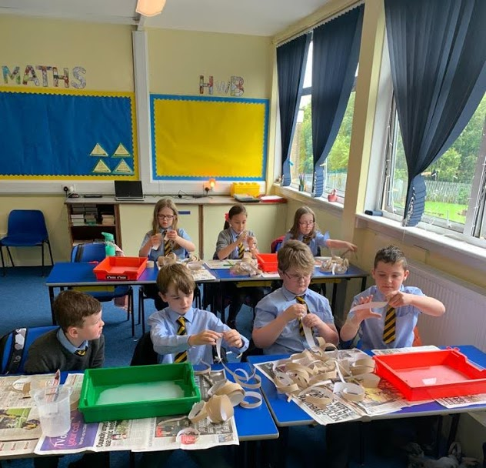
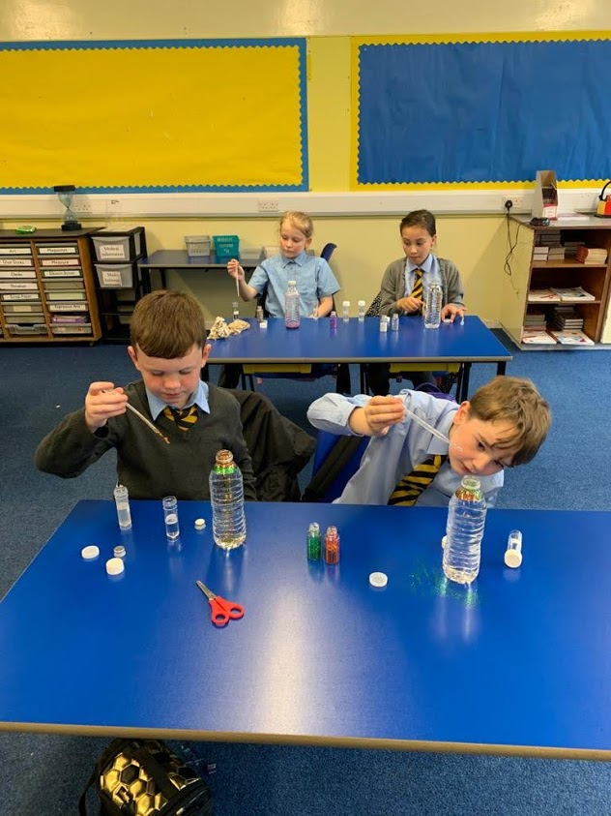
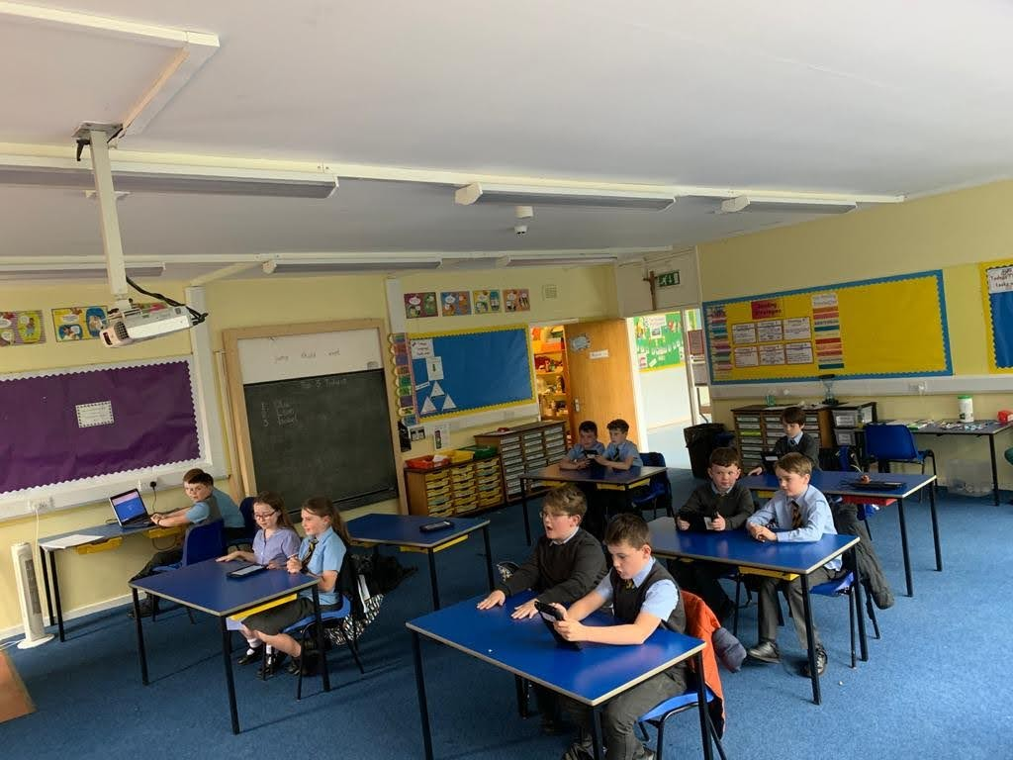
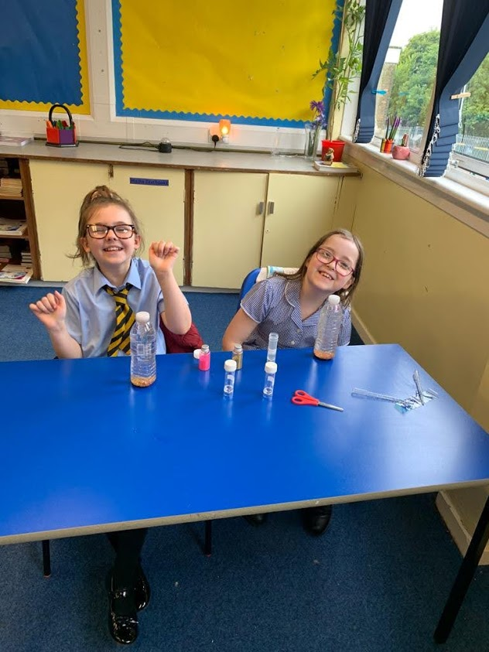
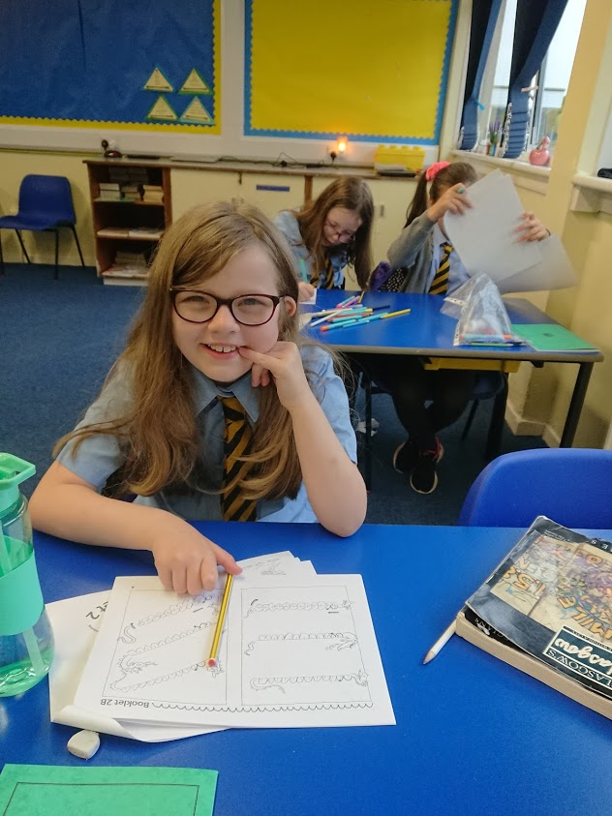
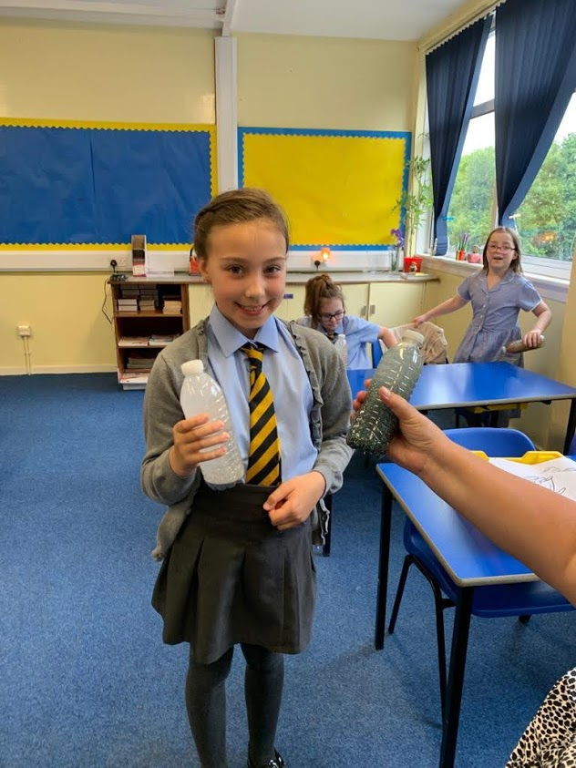
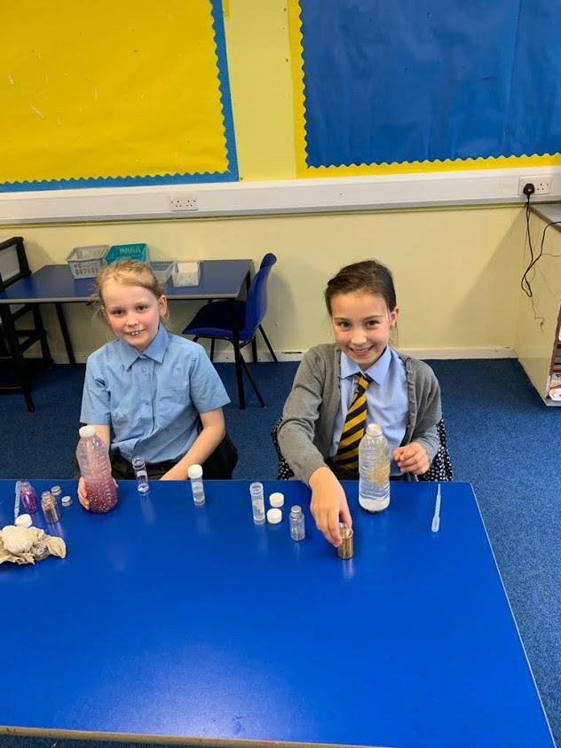
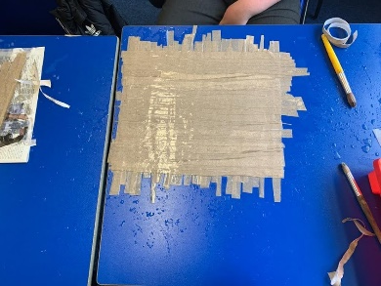

Slide 13
