Slide 1
Have you downloaded Groupcall Xpressions yet?
This is a new mobile communications app for parents, schools & nurseries

Slide 2
Information can include
free messages sent by the nursery delivered directly to the app
attendance messages
nursery closure
records of achievement
a wide variety of information

Slide 3
To sign up for the service
search & download the app “Groupcall Xpressions”.
ensure nursery has up to date mobile telephone number & email address. For security reasons you will need to provide these details to log into the Groupcall app. If you have not already returned your Annual Data form please do so
Open the app and enter your email address and mobile phone number, which must match the information held by the nursery.
The app will text a security code to your mobile phone, enter this code and then press log in.
You will then have the option to set up a password and or pin number

Slide 4
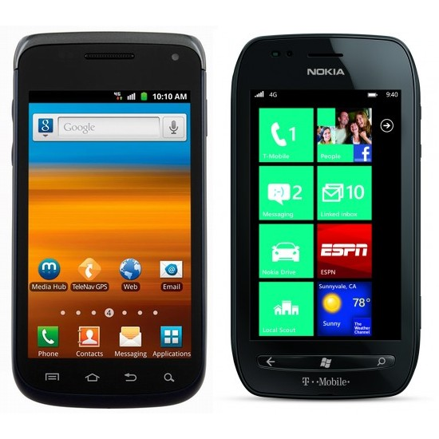
This service is available for Shotts Family Learning Centre
Download it free today
This Photo by Unknown Author is licensed under CC BY-SA

