Slide 1
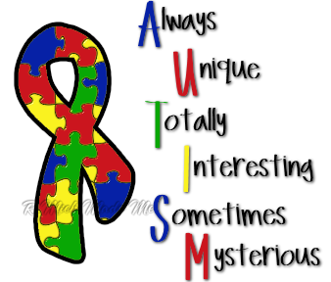
Autism Awareness Week From the 14th – 18th of March is Autism Awareness Week. Shotts Family Learning Centre would like to invite your child to take part in onesie Wednesday (16th March), by coming to nursery wearing their favourite onesie. If anyone would like more information about Autism you can visit the National Autistic Society website http://www.autism.org.uk/ or speak to Gemma Kelly Speech and Language Therapist.

