Slide 1

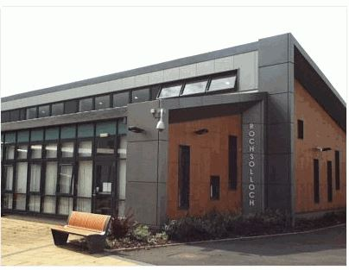
Rochsolloch Primary School
P1 Induction: Information for Parents and Carers
June 2025

Slide 2
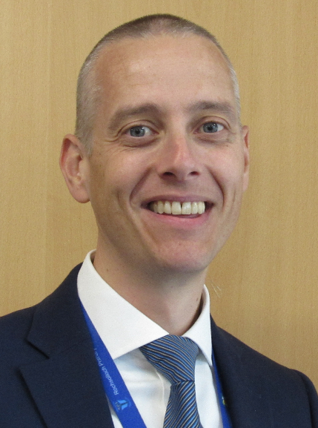
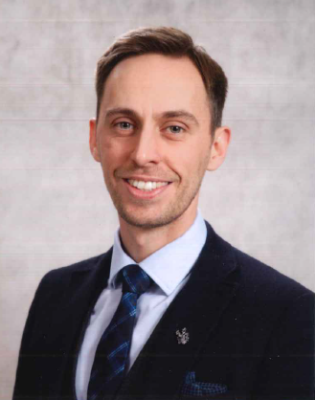
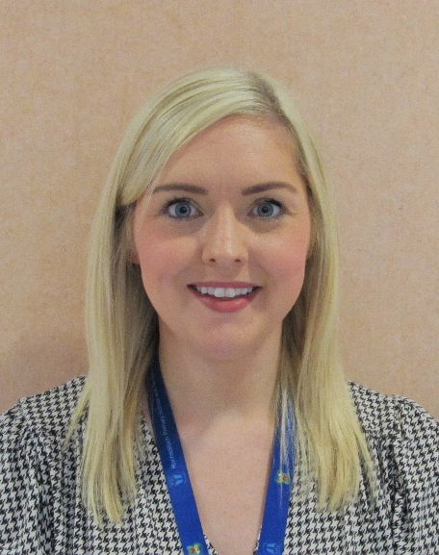
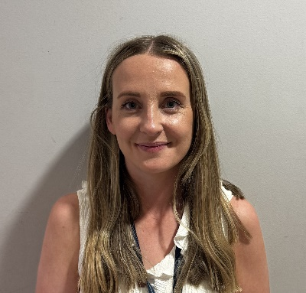
Senior Leadership Team
Lindsay Torley
Principal Teacher/
Depute Head Teacher
Mark Wilson
Head Teacher
Lisa Colquhoun
Principal Teacher
Jamie Innes
Depute Head Teacher
Notes:
Mark

Slide 3
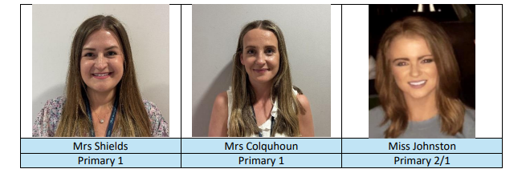
Primary 1 Teaching Team
Notes:
Mark

Slide 4
Everyone Achieves Their Potential
Respect Achievement Happiness
Aims:
Provide the highest quality learning and teaching that gives all learners the knowledge, skills and attitudes to fulfil their potential.
Provide relevant and varied opportunities for wider achievement.
Provide a happy and secure environment where children’s wellbeing is at the centre of all we do.
Notes:
Mark

Slide 5


Breakfast Club, Breaktimes, and School Lunches
Breakfast Club is available from 8.15am with Mrs White.
Children have 15 minutes for playtime and 45 minutes for lunchtime each day.
For children having a school dinner, the teacher will share the menu in the morning and the children will order their lunch.
Our cafeteria is cashless and you can add money to your child’s account online via Parents Portal.
If your child has food allergies, you will need to complete a form alongside your GP before our catering staff are able to offer your child lunch.
Children can drink water in class throughout the day.
Please do not send your child to school with any nut products or fizzy drinks.
Breakfast club and school dinners are free for all P1 pupils.
Notes:
Jamie

Slide 6
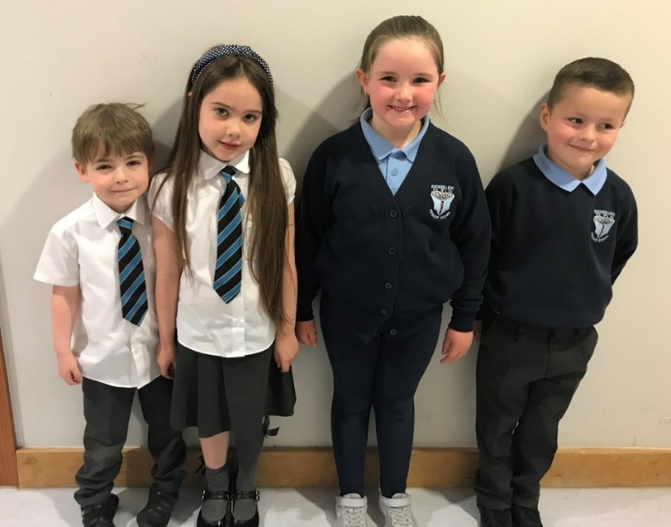
School Uniform
Our school uniform can be purchased online or in store from Scotcrest.
Our children can wear shirts and ties to school, or sweatshirts and polo shirts. In the nicer weather, many of our children wear summer dresses too.
In a recent addition, tartan dresses and skirts are also available.
On gym days, children can come to school dressed in their PE kit (shorts/joggers/leggings and a t-shirt). For outdoor PE, children should wear comfortable clothing which is suitable for the weather. It is important to us that our children feel comfortable and ready to learn.
Notes:
Jamie

Slide 7
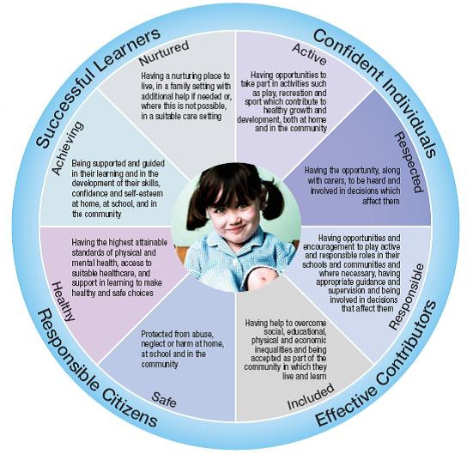

Getting it Right for Every Child (GIRFEC)
Notes:
Mark/Lindsay

Slide 8
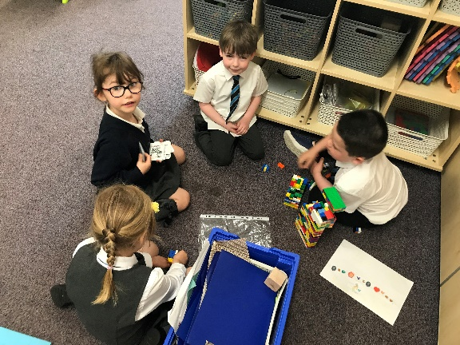
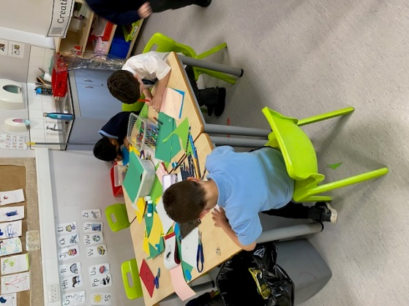
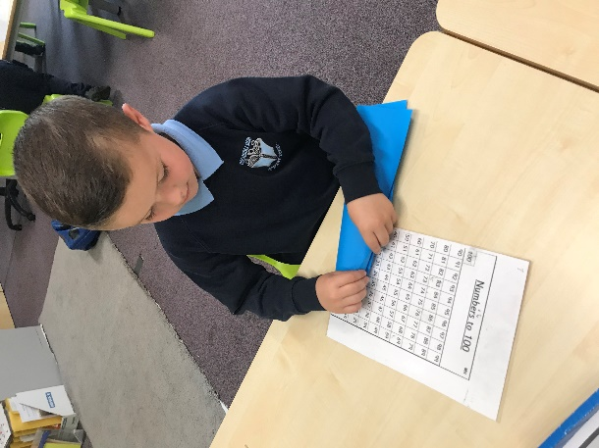
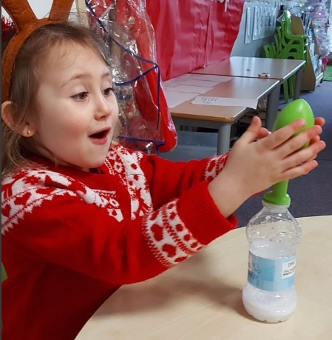
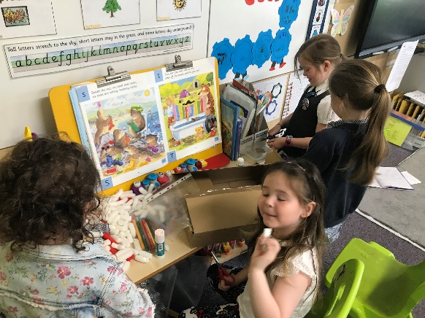
Learning Through Play
We are proud to offer learning experiences for our P1 pupils which are centred around play.
Learning Through Play Sway
Notes:
Lindsay

Slide 9
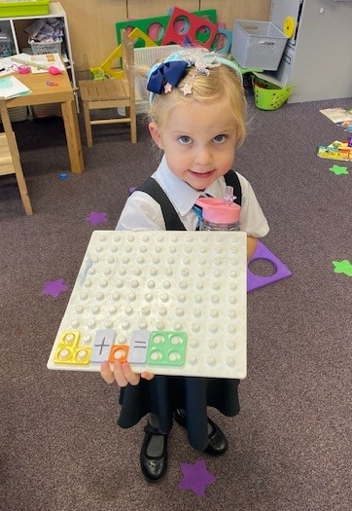
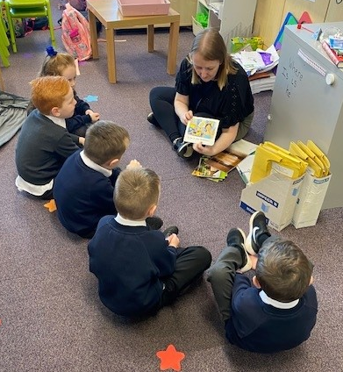
Curricular Workshops
This year, we will be hosting optional workshops to allow you to find out more about how your child is learning at school and how you can support them at home with their Literacy and Numeracy.
Dates for these workshops will be shared with you when they are finalised.
Notes:
Lindsay

Slide 10

Homework
Homework will be given out on a monthly basis, starting from September. In September your child will be given a pack with everything they will need. From then, a monthly grid will be issued which will direct them to the activities they should complete.
  Literacy – Reading/Phonics/Common Words
  Numeracy
Our homework offer is optional to allow families to balance school life with their other family commitments. Homework will direct you to activities which will support your child with the learning they are doing in class.
Notes:
Lindsay

Slide 11



Keeping in Touch
Xpressions App
Parents Portal
X (Formerly Twitter) @Rochsolloch_Pr
School Website
Rochsolloch Primary YouTube
Newsletters
Progress Meetings
Formal Written Report
Parent Council
Call our office on 01236 794880
Notes:
Mark

Slide 12

Helping Your Child Prepare for August
Supporting your child in developing his/her independence can make a big difference to their early school experience.
Teach them how to put on jumpers, shoes, jackets etc.
Encourage them to use the toilet/wash their hands independently.
Labels on clothes, bags, shoes etc. – these often go missing!
Recognisable ribbon or key ring on school jacket.
Encourage your child to look after their property.
  If you wish to support your child further with their learning of Literacy and Numeracy skills, there are some simple ideas available on the File Store of our website.
Notes:
Jamie

Slide 13
Day 1 and Day 2
On day 1, our P1 children will arrive at school for 9.30am at the front door.
On day 2, our children will arrive via the playground gate for 9.00am.
We will send you an e-mail reminder of the arrangements on the 12th August ahead of the 14th of August start-date.
Bus Travel
To find out if your child is eligible for the school bus, click here to visit the NLC website.
Aim High! Give it your best try!
Notes:
Jamie

