Slide 1
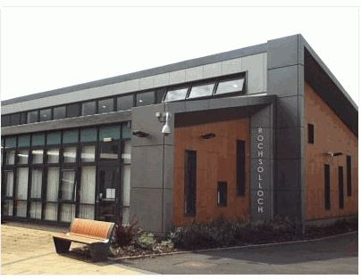
Rochsolloch Primary School
P1 Induction: Information for Parents and Carers
June 2024

Slide 2
Everyone Achieves Their Potential
Respect Achievement Happiness
Aims:
Provide the highest quality learning and teaching that gives all learners the knowledge, skills and attitudes to fulfil their potential.
Provide relevant and varied opportunities for wider achievement.
Provide a happy and secure environment where children’s wellbeing is at the centre of all we do.
Notes:
Mark

Slide 3
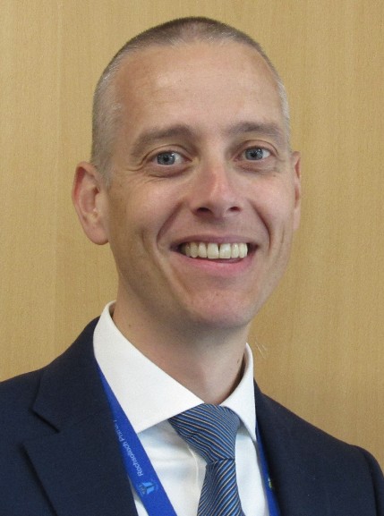
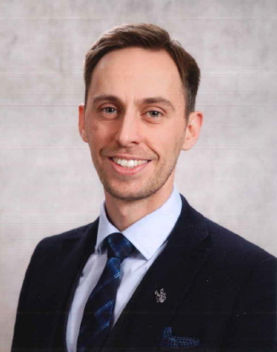
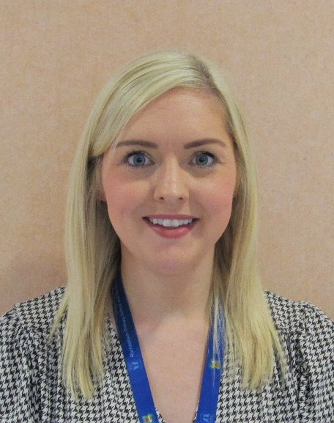
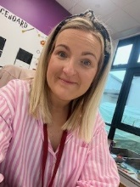
Senior Leadership Team
Lindsay Torley
Principal Teacher/
Depute Head Teacher
Mark Wilson
Head Teacher
Nicolle Murray
Principal Teacher
Jamie Innes
Depute Head Teacher
Notes:
Mark

Slide 4
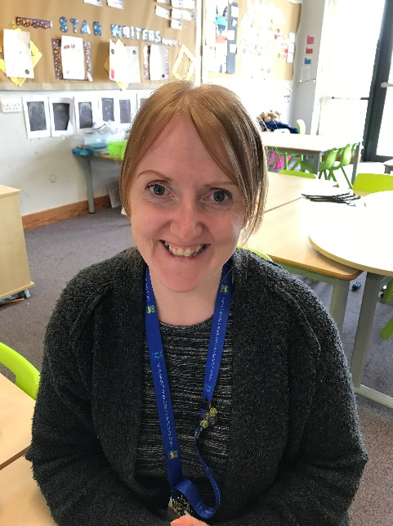
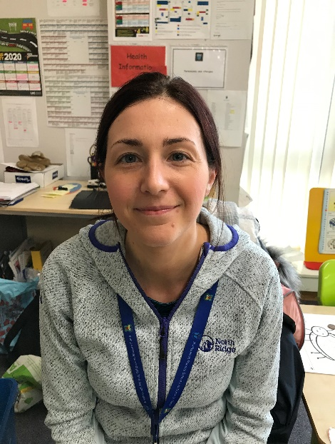
Primary 1 Teaching Team
Ms Michelle Sichi (See-Kee)
Primary 1
Miss Lisa Black
Primary 2/1
Notes:
Mark

Slide 5
Breakfast Club, Breaktimes, and School Lunches
Breakfast Club is available from 8.15am with Mrs White.
Children have 15 minutes for playtime and 45 minutes for lunchtime each day.
For children having a school dinner, the teacher will share the menu in the morning and the children will order their lunch.
Our cafeteria is cashless and you can add money to your child’s account online via Parents Portal.
If your child has food allergies, you will need to complete a form alongside your GP before our catering staff are able to offer your child lunch.
Children can drink water in class throughout the day.
Please do not send your child to school with any nut products or fizzy drinks.
Breakfast club and school dinners are free for all P1 pupils.
Notes:
Jamie

Slide 6
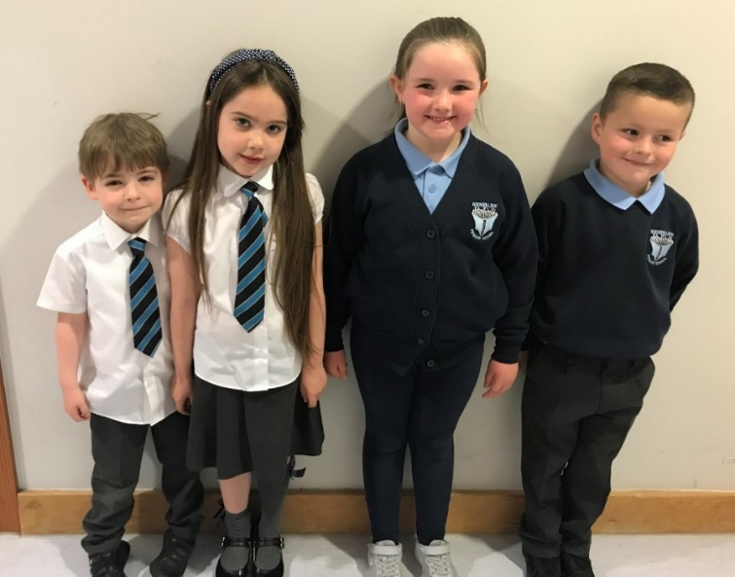
School Uniform
Our school uniform can be purchased online or in store from Scotcrest.
Our children can wear shirts and ties to school, or sweatshirts and polo shirts. In the nicer weather, many of our children wear summer dresses too.
In a recent addition, tartan dresses and skirts are also available.
On gym days, children can come to school dressed in their PE kit (shorts/joggers/leggings and a t-shirt). For outdoor PE, children should wear comfortable clothing which is suitable for the weather. It is important to us that our children feel comfortable and ready to learn.
Notes:
Jamie

Slide 7
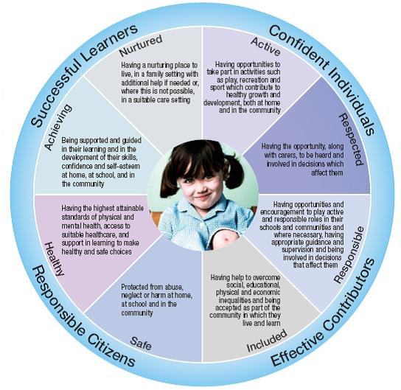
Getting it Right for Every Child (GIRFEC)
Notes:
Mark/Lindsay

Slide 8
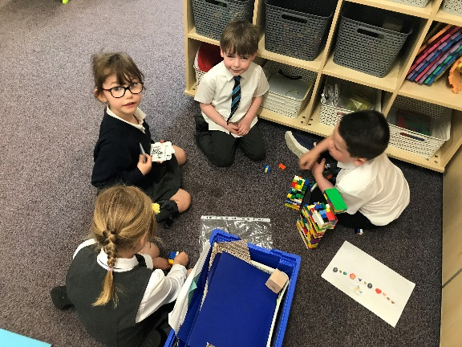
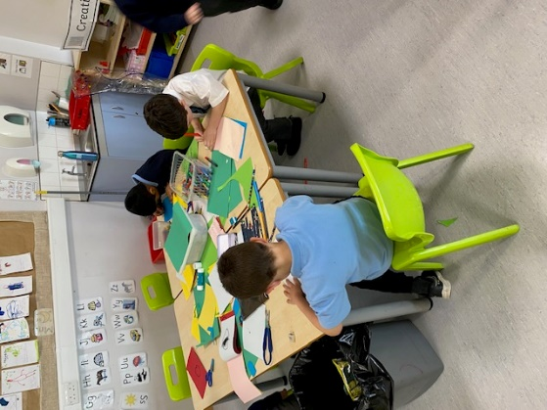
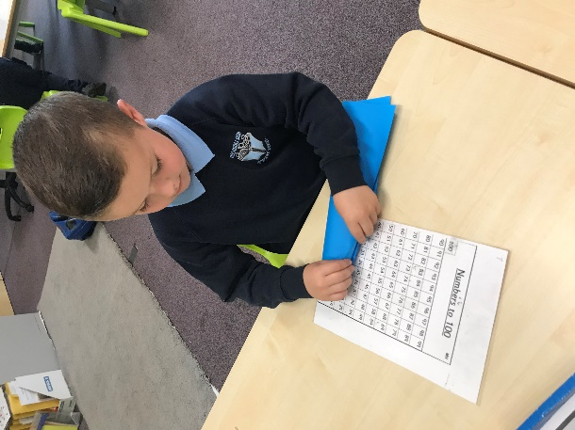
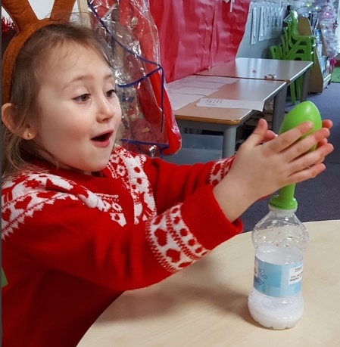
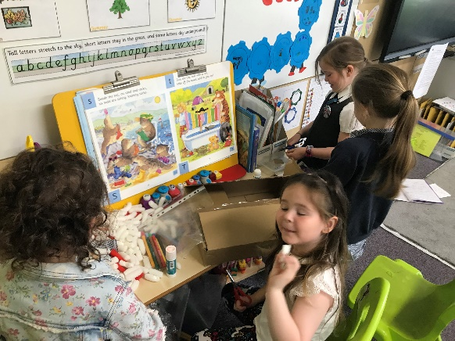
Learning Through Play
We are proud to offer learning experiences for our P1 pupils which are centred around play.
Learning Through Play Sway
Notes:
Lindsay

Slide 9
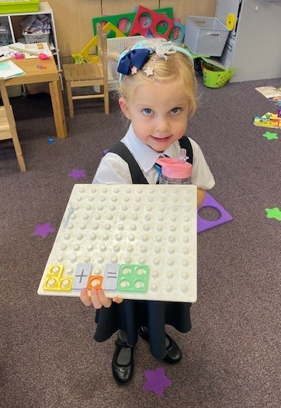
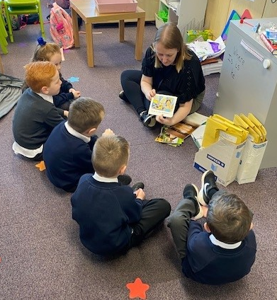
Curricular Workshops
This year, we will be hosting optional workshops to allow you to find out more about how your child is learning at school and how you can support them at home with their Literacy and Numeracy.
Dates for these workshops will be shared with you when they are finalised.
Notes:
Lindsay

Slide 10
Homework
Homework will be given out on a monthly basis, starting from September. In September your child will be given a pack with everything they will need. From then, a monthly grid will be issued which will direct them to the activities they should complete.
Literacy – Reading/Phonics/Common Words
Numeracy
Our homework offer is optional to allow families to balance school life with their other family commitments. Homework will direct you to activities which will support your child with the learning they are doing in class.
Notes:
Lindsay

Slide 11
Keeping in Touch
Xpressions App
Parents Portal
X (Formerly Twitter) @Rochsolloch_Pr
School Website
Rochsolloch Primary YouTube
Newsletters
Progress Meetings
Formal Written Report
Parent Council
Call our office on 01236 794880
Notes:
Mark

Slide 12
Rochsolloch Primary School and Nursery Parent Council
Objectives:
Work in partnership with the school to be welcoming and inclusive
Promote partnership between the school, its pupils and their parents
Develop and engage in activities to support pupils’ education and welfare
Identify and represent the views of parents on matters affecting pupils
Notes:
Between three and twelve parents of pupils – open to all
AGM in October to elect members (2 year term)
Meet at least once per term in person with senior leadership team
Some other Teams/Zoom calls just for PC
Plenty of opportunities to engage beyond being on the PC

Slide 13
RPSPC - Fundraising
Events:
Halloween, Valentines and Shorts & Shades discos for P1-P3 and P4-P7
DJ, dancing (and getting dressed up!)
Summer and Christmas Fayres
Games, raffles, tombola, craft stalls, local businesses, performances from local groups
Social events for parents and children
Fundraisers:
Bonus ball
Easy fundraising
Grants from local authority, businesses etc.
Notes:
Discos – around £2,000 this year
Costume exchange at Halloween
Christmas fayre – £2,500
Summer fayre ???
Totally Taylor – TBC, but likely four figures.
Tesco blue token fund £1,500
North Lan “Community Empowerment grant £1,000

Slide 14
RPSPC - Funding
In the past year:
£2,000 for ICT
£1,500 for loose parts equipment
£800 for corridor display boards
£500 swimming lessons
£500 ties, homework bags and learning journals
£1,000 P7 leavers parties, piper, photographs etc
Notes:
£2k for the school to invest in projector, stage lighting, new laptops, software etc.
£1,500 from Tesco to be spent on kit to stimulate learning and develop skills
£800 to showcase the work done by pupils and groups in the school
Swimming lessons for P6

Slide 15
Helping Your Child Prepare for August
Supporting your child in developing his/her independence can make a big difference to their early school experience.
Teach them how to put on jumpers, shoes, jackets etc.
Encourage them to use the toilet/wash their hands independently.
Labels on clothes, bags, shoes etc. – these often go missing!
Recognisable ribbon or key ring on school jacket.
Encourage your child to look after their property.
If you wish to support your child further with their learning of Literacy and Numeracy skills, there are some simple ideas available on the File Store of our website.
Notes:
Jamie

Slide 16
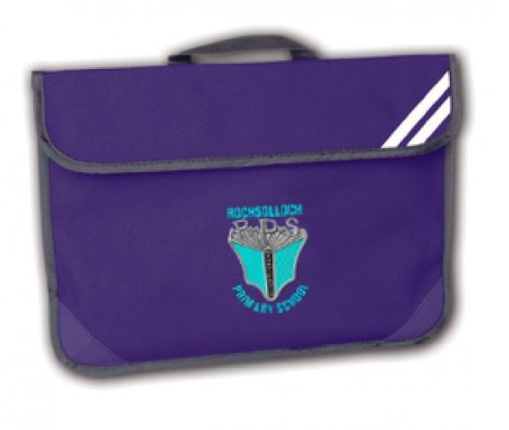
A Gift from our Parent Council
Our Parent Council have bought each of our new P1 pupils a homework folder.
Your child’s folder contains a letter from their class teacher, which you could read at home as you help your child to continue to prepare for the transition to school.
Notes:
Jamie

Slide 17
Day 1 and Day 2
On day 1, our P1 children will arrive at school for 9.30am at the front door.
On day 2, our children will arrive via the playground gate for 9.00am.
We will send you an e-mail reminder of the arrangements on the 12th August ahead of the 14th of August start-date.
Bus Travel
To find out if your child is eligible for the school bus, click here to visit the NLC website.
Aim High! Give it your best try!
Notes:
Jamie

