Slide 1
Welcome to
Induction Information
2021/2022
Notes:
Welcome and Introductions

Slide 2
Introducing Team Rochsolloch
At Rochsolloch Nursery Class we are made up of lots of different individuals who all strive to get it right for your child.
Senior Leadership Team
Mr Mark Wilson Mr Jamie Innes
Head Teacher Depute Head Teacher
Lauren Fox Maureen Orr
Principal Lead Practitioners
Notes:
Explanation of personnel and role.

Slide 3
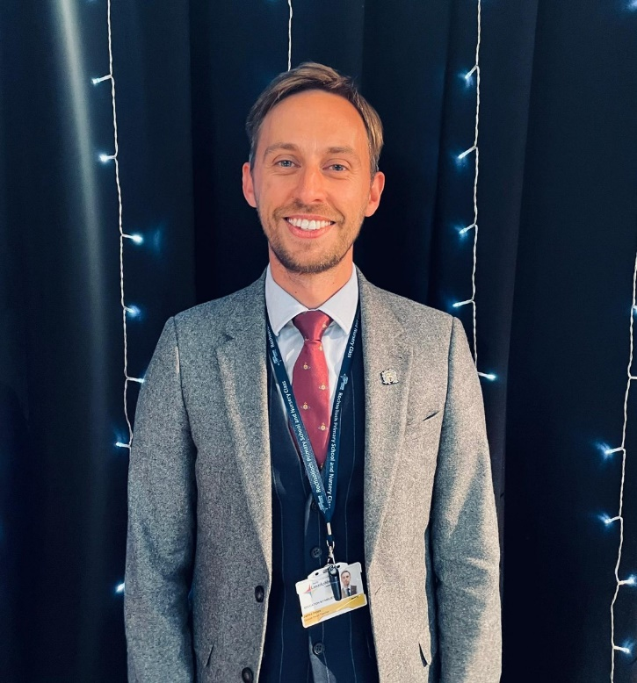
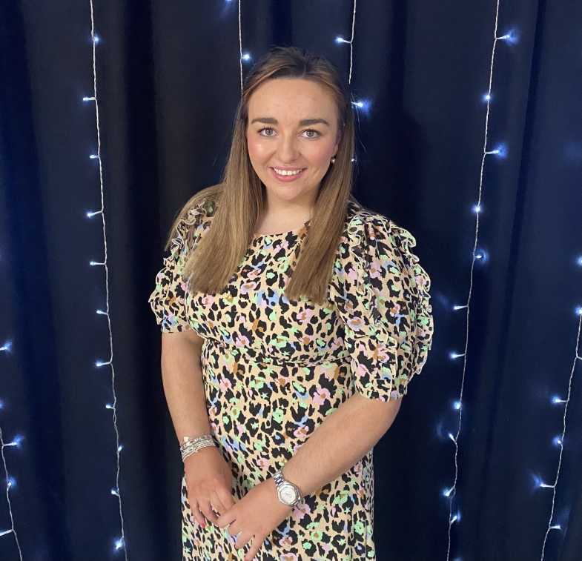
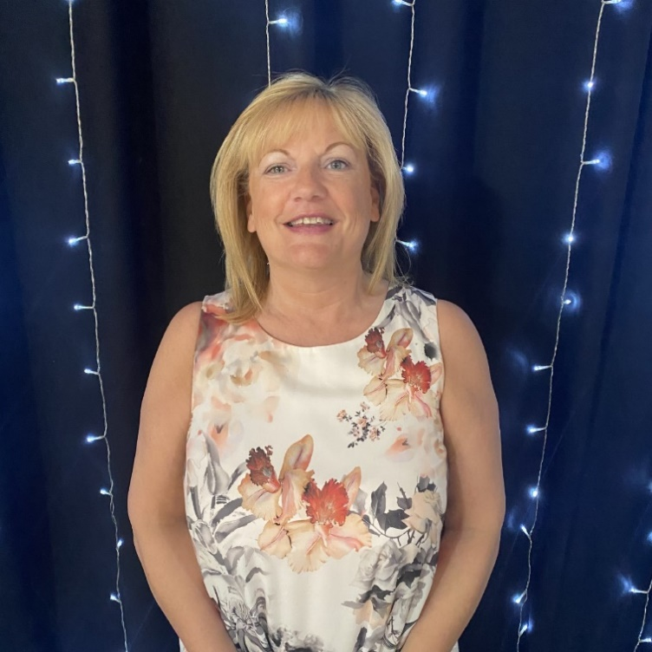
Senior Leadership Team Click on image for introduction
Mr Wilson
Mr Innes
Lauren
Maureen

Slide 4
Rochsolloch Nursery Staff Team
Eileen Moffat Lead Early Learning and Childcare Practitioner
(Term Time) Angela Reilly Early Learning and Childcare Practitioner
(Term Time) Jennifer Murray Early Learning and Childcare Practitioner
(Term Time, Mon/Tue/Wed) Margaret Ann Blair Early Learning and Childcare Practitioner
(Term Time, Wed/Thur/Fri) Louise O’Neill Key Worker (48wks) Rebecca O’Rourke Key Worker (48wks) Laura Morrison Support Worker (Term Time, Wed/Thur/Fri) Jill Duffy Support Worker (48wks) Anne Hayes Support Worker (48wks)

Slide 5
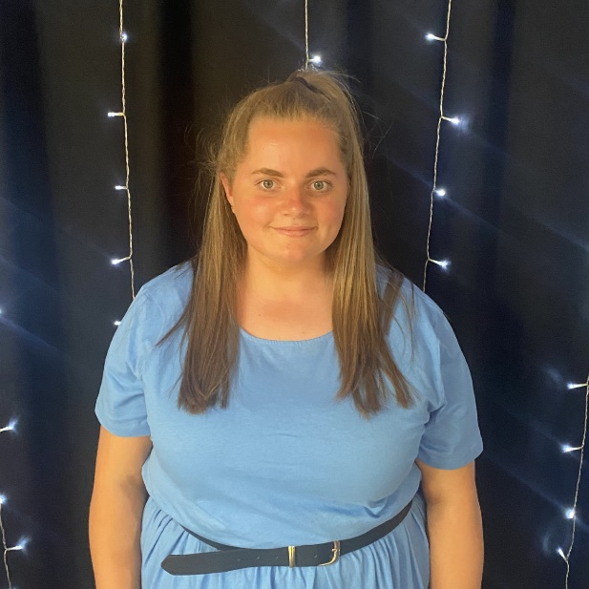
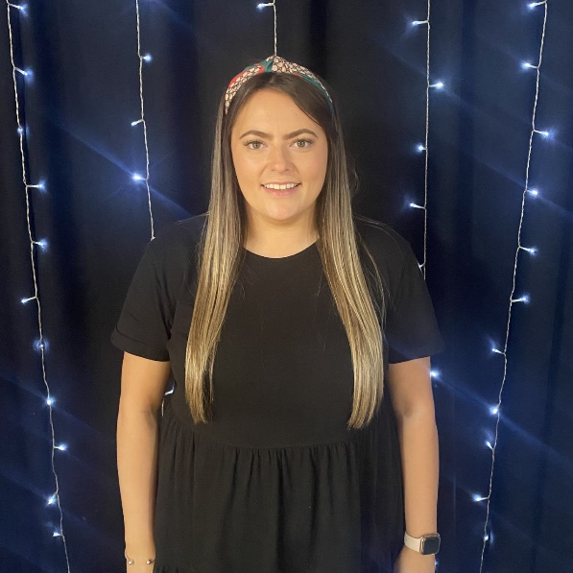
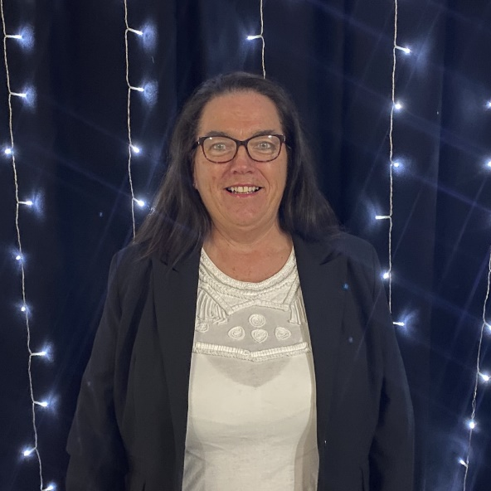
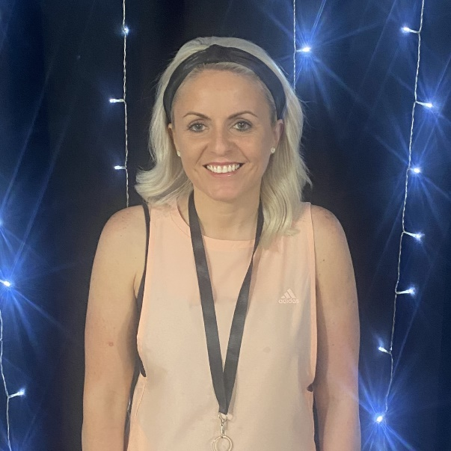
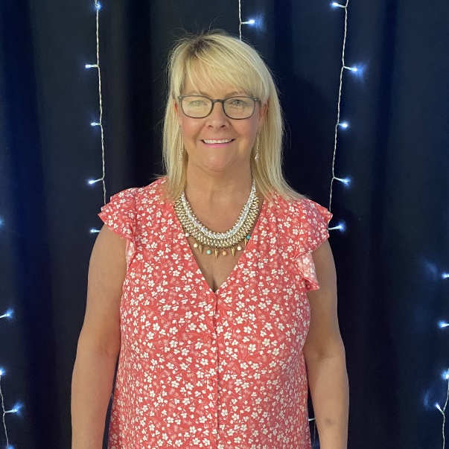
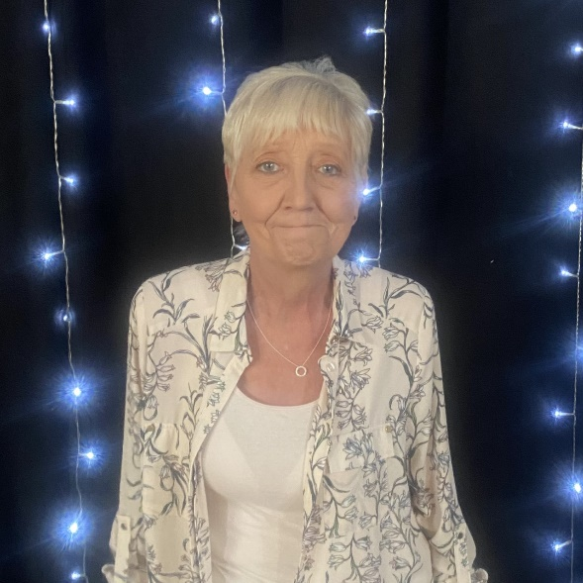
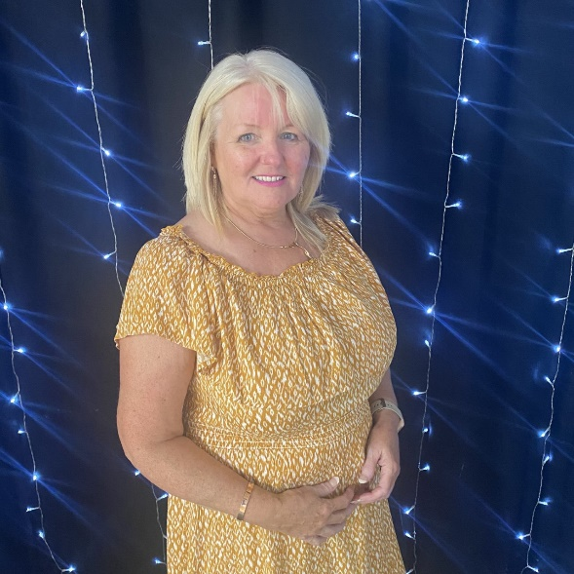
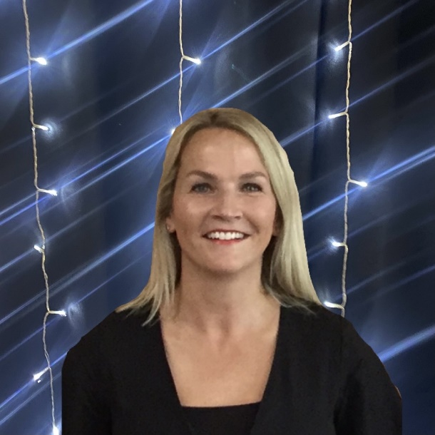
Rochsolloch
Staff Team
Click on each staff member for introduction
Jill
Rebecca
Louise
Margaret Ann
Jen
Angela
Anne
Eileen
Laura

Slide 6
Realising Rochsolloch’s Ambition

Slide 7
Session Times
Term Time
8.45am-2.45pm
Doors open 2.30pm for pick up
Morning 8.00am-12.45pm
Doors open 12.30pm for pick up
Afternoon 1.15pm-6.00pm
Collection for PM is flexible.
(May we please ask that one adult accompanies your child
to and from nursery and a face mask worn at all times when in school grounds).

Slide 8
What will I need when I come to nursery?
Rochsolloch Nursery Uniform- Red sweatshirt
Yellow polo shirt
Joggers/Leggings
Indoor plimsolls
Outdoor clothing
A complete change of clothing, including underwear and socks.
Please label all your child’s belongings.

Slide 9
Our Nursery Models
Uniforms can be purchased from the following supplier:
Scotcrest Uniforms Tel: 01236 768686
62 Clark Street Airdrie
ML6 6AP
Web site: scotcrestschools.co.uk

Slide 10
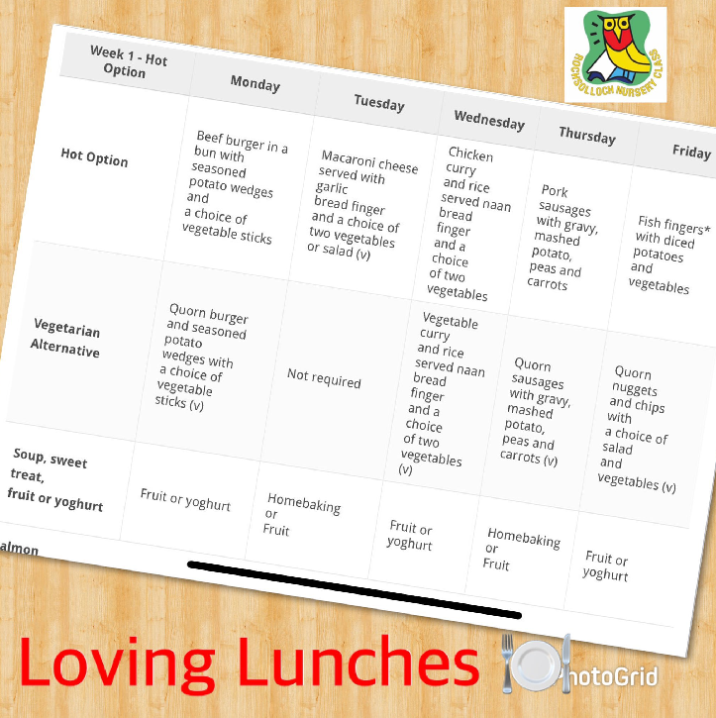
Loving Lunches
Children are served lunch everyday in nursery and enjoy this experience with friends. Menu’s will be posted weekly on Rochsolloch Twitter page. Children are also offered snack throughout the session.
Example of Menu

Slide 11
Communication
Learning Journals
Twitter: @RochsollochN
Group Call

Slide 12
Inductions procedures…
We look forward to welcoming you and your child for a 1 hour visit to the nursery on their start date where you will have the opportunity to meet some of the staff team and explore the nursery environment.
The staff team will share information about the variety of play and learning opportunities that will be provided for your child, both indoors/outdoors and within our local community.
A member of the staff team will invite you to complete the required enrolment paperwork and share information about nursery procedures such as settling in, attendance, absence and the weekly £3 donation which helps to provide additional resources for our children.
Your visit will provide you with the opportunity to share your thoughts and important information you feel we should know about your child.
(Please wear a face covering during your visit).

Slide 13
We look forward to meeting you and your child and supporting your exciting new adventure at
Rochsolloch Nursery Class!
We look forward to welcoming you and your child for a visit before his/her start date!

