Slide 1
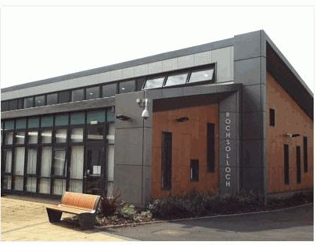
Rochsolloch Primary School
P1 Induction: Information for Parents and Carers
June 2021

Slide 2
This presentation contains audio voiceover recordings from our Senior Leadership Team.
Click on the audio icon on each slide to hear the voiceover.
If you are viewing this presentation on a phone or tablet, we recommend downloading the PowerPoint app for best results.

Slide 3
Everyone Achieves Their Potential
Respect Achievement Happiness
Aims:
Provide the highest quality learning and teaching that gives all learners the knowledge, skills and attitudes to fulfil their potential.
Provide relevant and varied opportunities for wider achievement.
Provide a happy and secure environment where children’s wellbeing is at the centre of all we do.

Slide 4
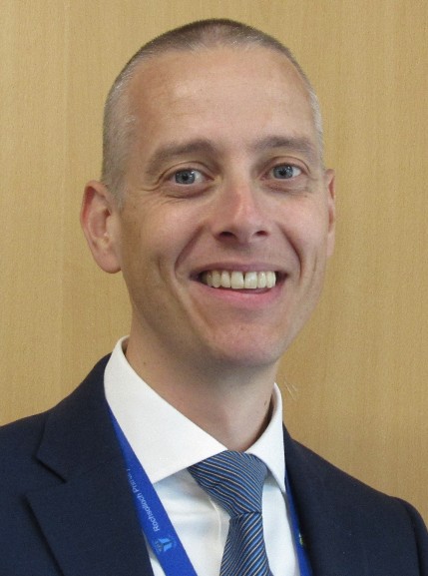
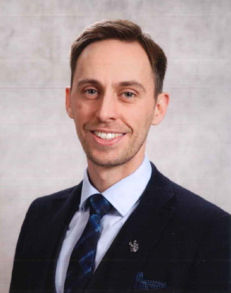
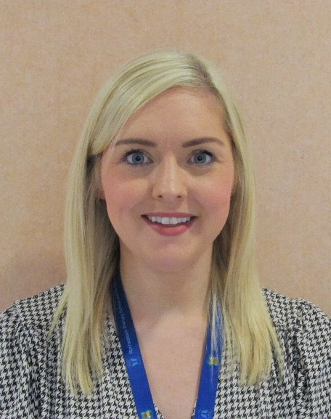
Senior Leadership Team
Mark Wilson
Head Teacher
Jamie Innes
Depute Head Teacher
Lindsay Torley
Principal Teacher

Slide 5
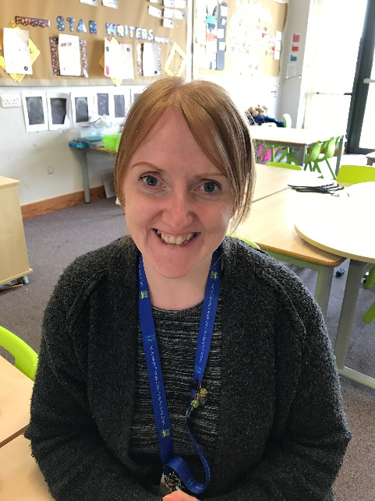
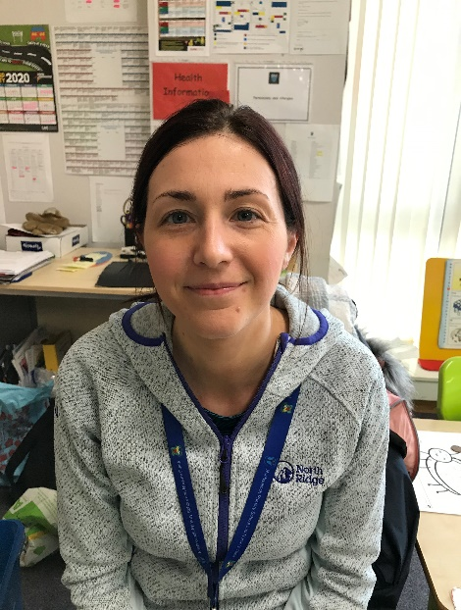
Primary 1 Teaching Team
Ms Michelle Sichi (See-Kee)
Primary 1 Stirling
Miss Lisa Black
Primary 1 Edinburgh

Slide 6
Breakfast Club, Breaktimes, and School Lunches
Breakfast Club is available from 8.15am with Mrs White.
Children have 15 minutes for playtime and 45 minutes for lunchtime each day.
For children having a school dinner, the teacher will share the menu in the morning and the children will order their lunch.
Our cafeteria is cashless and you can add money to your child’s account online via Parents Portal.
If your child has food allergies, you will need to complete a form alongside your GP before our catering staff are able to offer your child lunch.
Children can drink water in class throughout the day.
Please do not send your child to school with any nut products or fizzy drinks.
Breakfast club and school dinners are free for all P1 pupils.

Slide 7
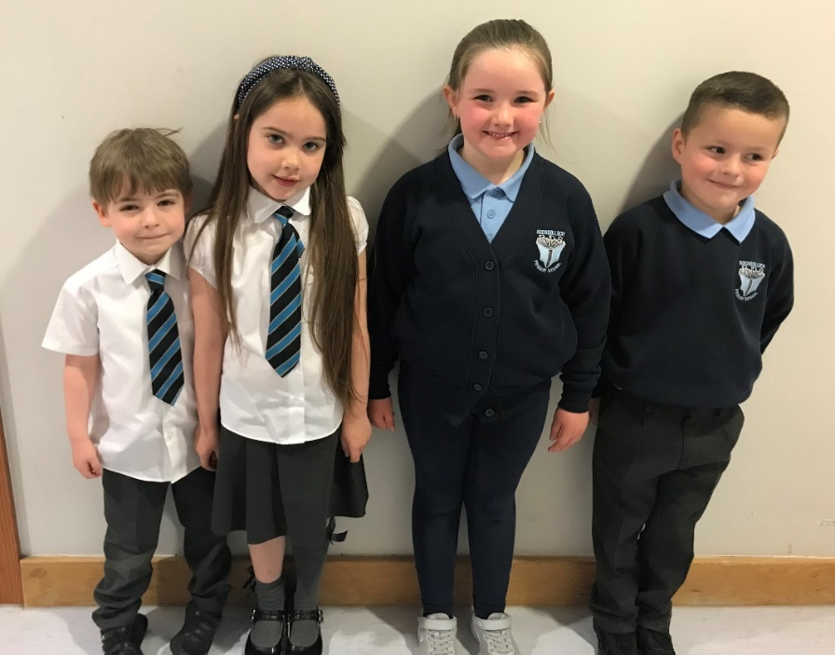
School Uniform
Our school uniform can be purchased online or in store from Scotcrest.
Our children can wear shirts and ties to school, or sweatshirts and polo shirts. In the nicer weather, many of our children wear summer dresses too. It is important to us that our children feel comfortable and ready to learn.

Slide 8
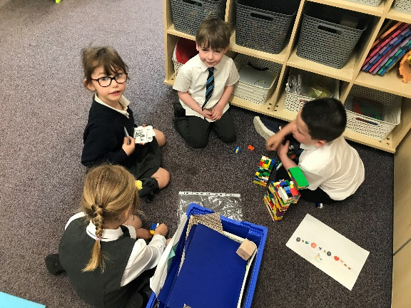
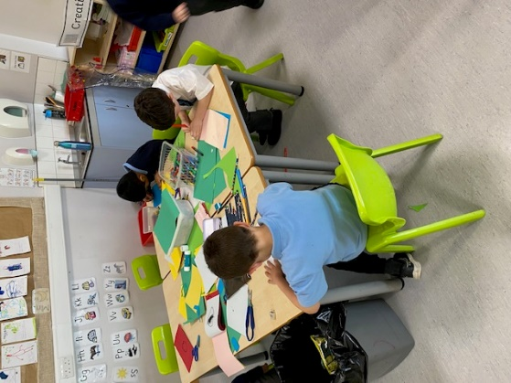
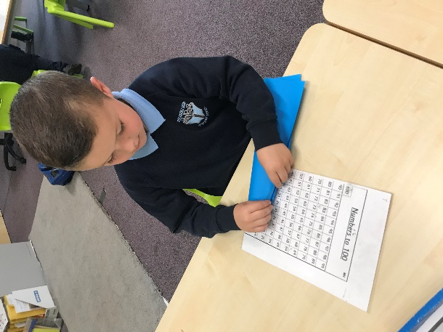
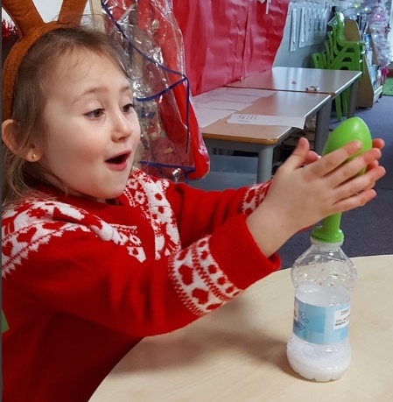
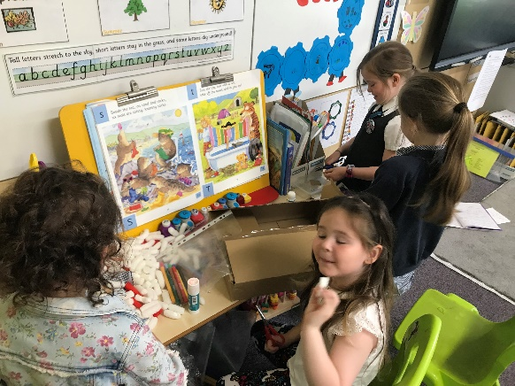
Learning Through Play
We are proud to offer learning experiences for our P1 pupils which are centred around play.

Slide 9
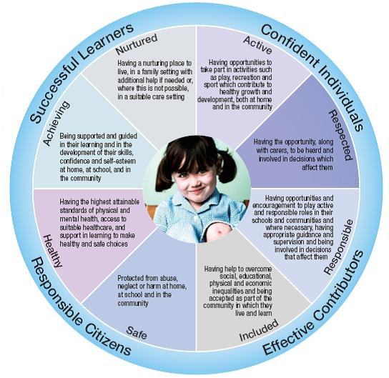
Getting it Right for Every Child (GIRFEC)

Slide 10
Keeping in Touch
Xpressions App
Parents Portal
Twitter @Rochsolloch_Pr
School Website
Rochsolloch Primary YouTube
Newsletters
Progress Meetings
Formal Written Report
Parent Council
Call our office on 01236 794880

Slide 11
Helping Your Child Prepare for August
Supporting your child in developing his/her independence can make a big difference to their early school experience.
Teach them how to put on jumpers, shoes, jackets etc.
Encourage them to use the toilet/wash their hands independently.
Labels on clothes, bags, shoes etc. – these often go missing!
Recognisable ribbon or key ring on school jacket.
Encourage your child to look after their property.
If you wish to support your child further with their learning of Literacy and Numeracy skills, there are some simple ideas available on the File Store of our website.

Slide 12
Day 1 and Day 2
On day 1, our P1 children will arrive at school for 9.30am.
In organising our day 1 and day 2 arrangements, we will be reflecting on the most up-to-date guidance in relation to any COVID19 restrictions which may be in place for August 2021.
In order to give you accurate details of the plan for your child’s first days at school, we will send you an e-mail on the 14th August.
Aim High! Give it your best try!

