Slide 1
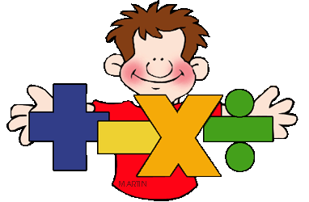
Introduction to Multiplication & Division
1st Level

Slide 2
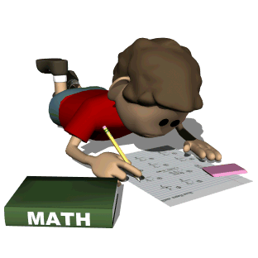
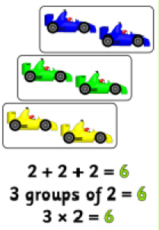
Multiplication
Multiplication can be viewed as repeated addition.
Example: 2+2+2+2+2=10
5X2=10

Slide 3
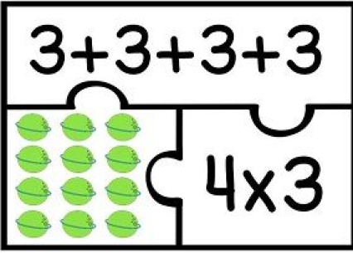
Arrays
Repeated addition
Using arrays is a method used to give a visual representation of multiplication.
E.g. Ben and Susan go to the shop for sweets.
Ben and Susan each buy 3 sweets each.
Repeated addition : 3+3=6
Multiplication: 2 (friends) X 3 (sweets) = 6
Multiplication sum
Array

Slide 4
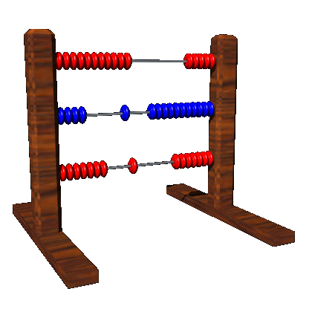
Commutative Laws
Commutative law: when we swap numbers over, in addition or multiplication, we still get the same answers.
2 X 3 = 6
3 X 2 = 6

Slide 5
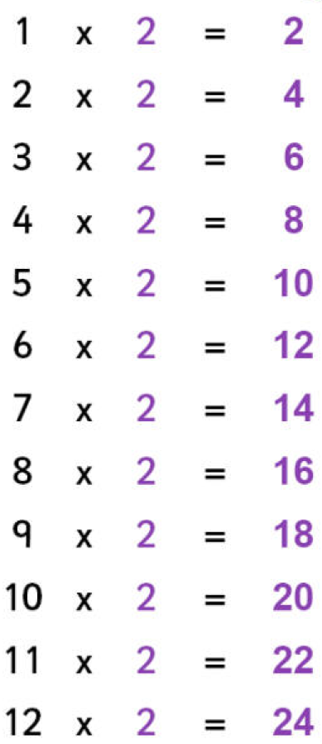
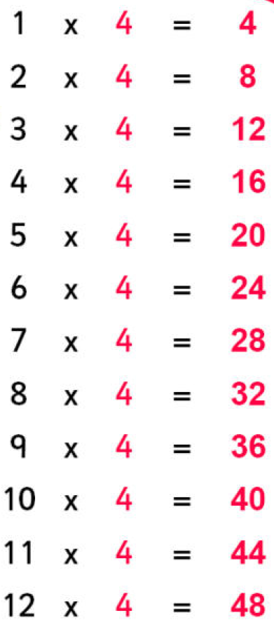
Doubling & Halving
Children are encourage to look for patterns that will help with quicker recall through recognition of doubling and halving.
The 2 and 4 times table can be used for doubling and halving.
e.g. 3 X 2 = 6
3 X 4 = 12
3 & 6 X table
4 & 8 X table
5 & 10 X table
Can all be used to represent and investigate doubling and halving.

Slide 6
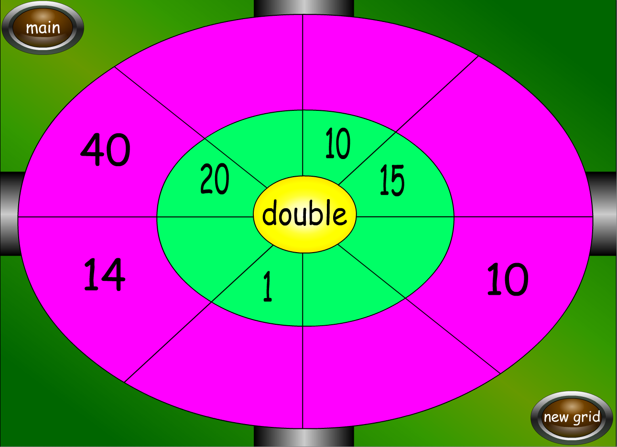
Class Activities

