Slide 1
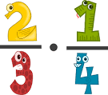
First Level Fractions

Slide 2
Fractions of whole items
Be able to demonstrate an understanding of how a single item can be shared equally
Use the vocabulary associated with fractions
Be able to place simple fractions on a number line

Slide 3
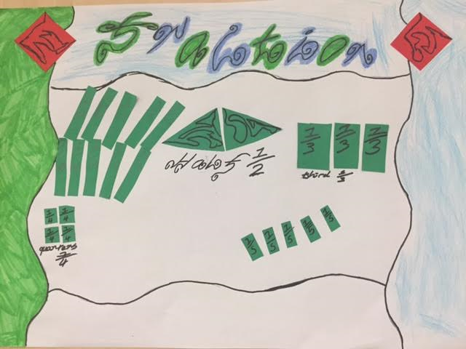
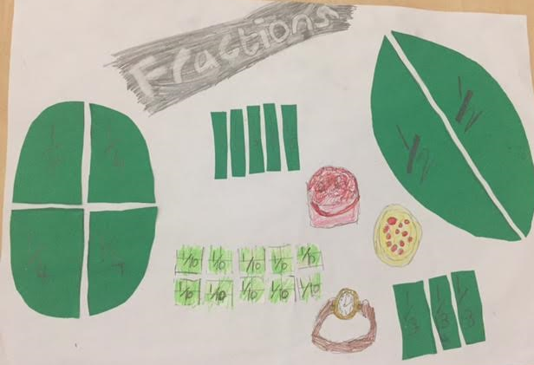
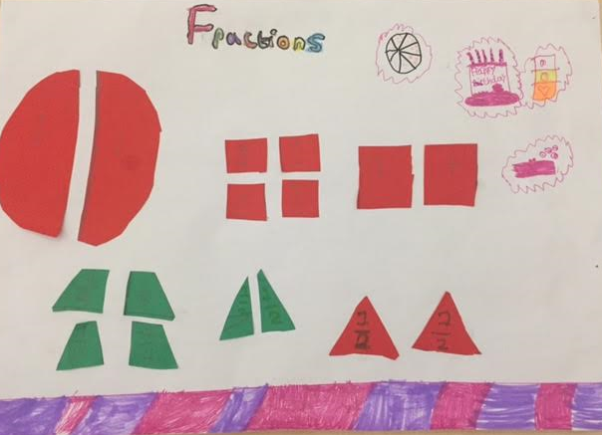
Fraction Posters
Notes:
Pupils are given hands on, practical activities to allow them to experience splitting whole objects and shapes into equal parts.
Pupils are encouraged to come up with their own ways of ensuring that the parts of the fraction are equal – this could be by folding or measuring.
Pupils make links to their real life experiences of using fractions – cutting pizzas or cakes, telling the time or seeing a half price sale in a shop

Slide 4
Number Lines
Notes:
Pupils can experience placing fractions on a number line through folding strips of paper – progressing to placing fractions on an empty number line

Slide 5
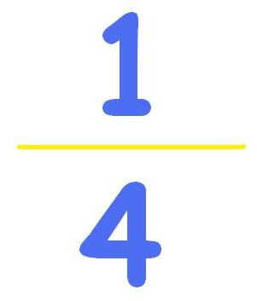
Notation
Numerator
How many pieces we have.
Denominator
(The denominator is downstairs)
How many pieces the item is split into.
Notes:
A fraction is made up of 2 numbers. The top number is called the NUMERATOR and the bottom number is called the DENOMINATOR. In the fraction ¾, 3 is the numerator and 4 is the denominator.
DENOMINATOR
This number shows how many equal ‘pieces’ something has been divided into. In the fraction ¾, 4 is the denominator showing that there are 4 equal pieces making up the whole.
NUMERATOR
This number shows how many of those pieces there are. In the fraction ¾ there are 3 pieces out of the total of 4.

Slide 6
Problem
Colour in $\frac{1}{4}$ of this rectangle.
Notes:
Firstly, pupils should be confident with the meaning of fractions.
They need to understand that finding a fraction in this context deals with splitting an item into equal sized amounts or pieces.
They should develop the vocabulary of fractions and be able to read fractions such as ¼ not only as ‘one quarter’, but perhaps more importantly as ‘1 out of every 4’.
Having this understanding of ¼ as one out of every four, would then translate the question ‘Shade ¼ of this rectangle’ to ‘Shade one out of every four (equal) parts of this rectangle’
Pupils can then be helped to recognise that there are four squares in each row of the diagram, so they need to shade one out of the four in each row.

Slide 7
Fractions of amounts
Through exploring how groups of items can be shared equally, I can find a fraction of an amount by applying my knowledge of division.

Slide 8
Colour in ¼ of the circles

Slide 9
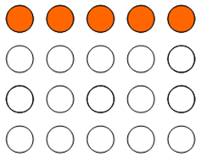
Strategies
Consider though not only shading 1 out of every 4 circles, such as:
Splitting into convenient
groups of 4
Shading 1 then counting and leaving 2,3 and 4 un-shaded.
But also...

Slide 10
Transferring Skills
Jack had 20 sweets. He ate $\frac{1}{5}$of them. How many sweets did he eat?

Slide 11
Second Level Fractions

Slide 12
LI-to calculate a decimal fraction of an amount
Problem 1
How much is 3/4 of 48

Slide 13
Strategy- Visualisation
3/4 of 48

Slide 14
Strategy- Partitioning
First split 48 into quarters using partitioning
48 = 40 + 8
So ¼ of 48 = ¼ 0f 40 + ¼ of 8
40÷4 + 8÷4
10 + 2
12

Slide 15
Strategy-partitoning
Step 2
*Split the pizza into 4 equal parts
*Now share the 48 equally between the 4 slices – 12 on each slice.
*Since the problem asked us to find ¾ we can shade 3 of the 4 slices.
*So 3/4 of 48= 12 + 12 + 12 = 36
12 + 12 + 12 = 3 x 12 = 36
¾ of 48 = 36
12 12
12 12
12 12
12 12

Slide 16
Strategy- Written
3/4 of 48=
Which operation will I use to do this?
+ − × ÷

Slide 17
Strategy- Written
I will use division and multiplication
÷ ×

Slide 18
Strategy- Written
Step 1 48 ÷ 4=
Step 2 4 x ☐ = 48
4 x 12 = 48
¼ of 48 = 12

Slide 19
Strategy- Written
Step 3
¼ of 48 = 12
¾ of 48 = 12 x3
¾ of 48 = 36

Slide 20
LI to find unit fractions of amounts
2/5 of 45= 5/6 of 72=
4/9 of 72= 3/8 0f 64=

