Slide 1
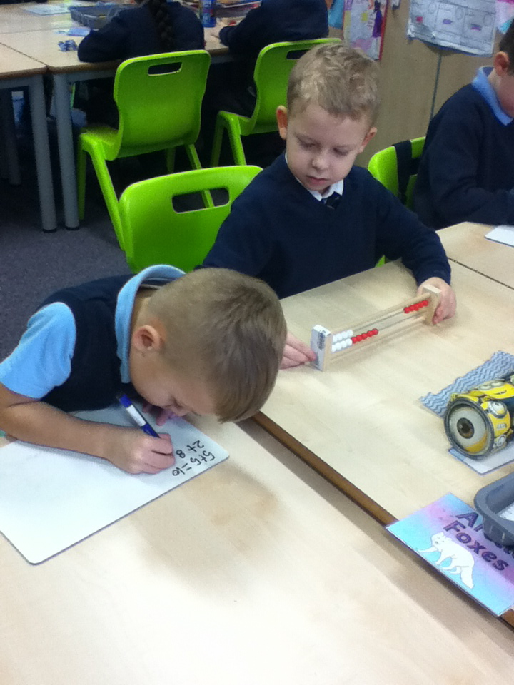
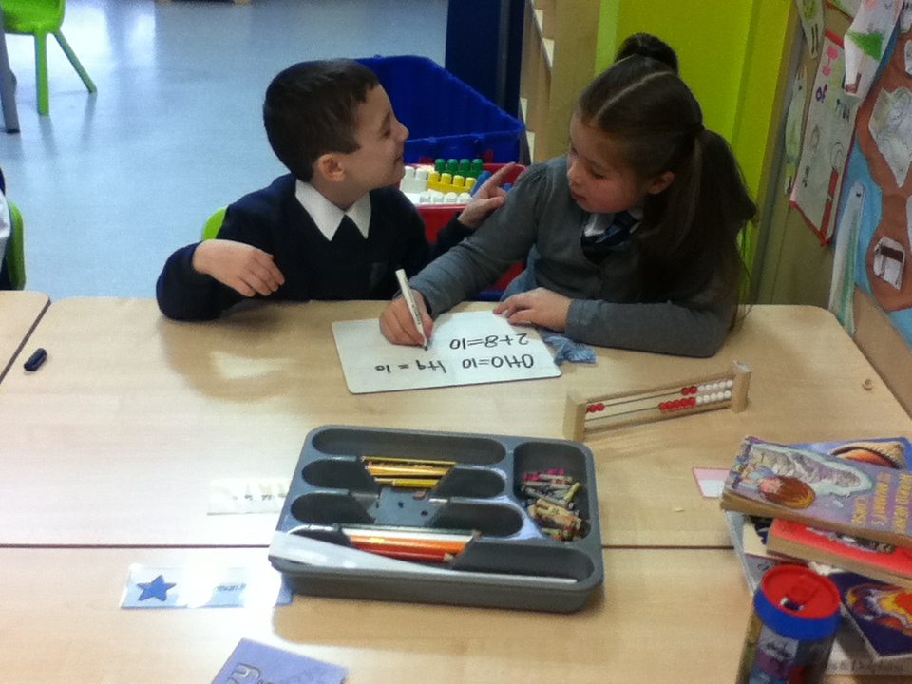
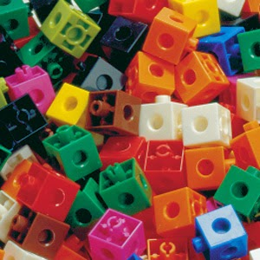
Welcome First Level -Addition and Subtraction Workshop 2
Thursday 18th February 2016
Miss Clerkson

Slide 2
Aims
To focus on partitioning and compensation within addition and subtraction.
To provide a better understanding of each concept.
To provide ideas to help you and your child at home.

Slide 3
Definition of Partitioning
Partitioning – a strategy involving splitting a number into smaller parts to make it easier to work with.

Slide 4
What is partitioning?
Activity 1 – How to partition/split up single digit numbers?
Example: 6 can be split into 5 and 1, 2 and 4 etc.
Look at your chosen number. Can you tell your partner 2 ways that you could split your number?
Examples of Games/Activities to play at home.

Slide 5
Partitioning
Activity 2 – Take another ball from the centre of the table and make a two digit number.
Can you use the digits to make the largest/smallest number?
Partitioning a two digit number:
56= 50+6
Can you do this with your two digit number?
Partitioning a 3 digit number:
345= 300+40+5

Slide 6
Interactive Games
http://www.bbc.co.uk/schools/starship/maths/games/place_the_penguin/big_sound/full.shtml
http://www.ictgames.com/sharknumbers.html
http://www.topmarks.co.uk/place-value/place-value-charts

Slide 7
How to use partitioning in addition and subtraction?
Addition:
42+21=
40+2+20+1=
40+20+2+1=
60+3
=63

Slide 8
Subtraction:
75-53=
75-50-3
75-50=25
25-3=
22

Slide 9
Definition of Compensation
Compensation – adjusting both parts of the sum knowing that the answer will still be the same.

Slide 10
Compensation
Activity 1: Recall doubles.
1+1
2+2
3+3
….
10+10

Slide 11
Addition and Subtraction –Using a Rekenrek
Activity 2: Using a Rekenrek (calculating frame).
http://www.ictgames.com/brilliant_beadstring_with_colour.html

Slide 12
Thank you for listening! ☺

