Slide 1

18 days of Christmas joy
By the captains

Slide 2

Day 1

Slide 3

You need to give 10 people a high five

Slide 4
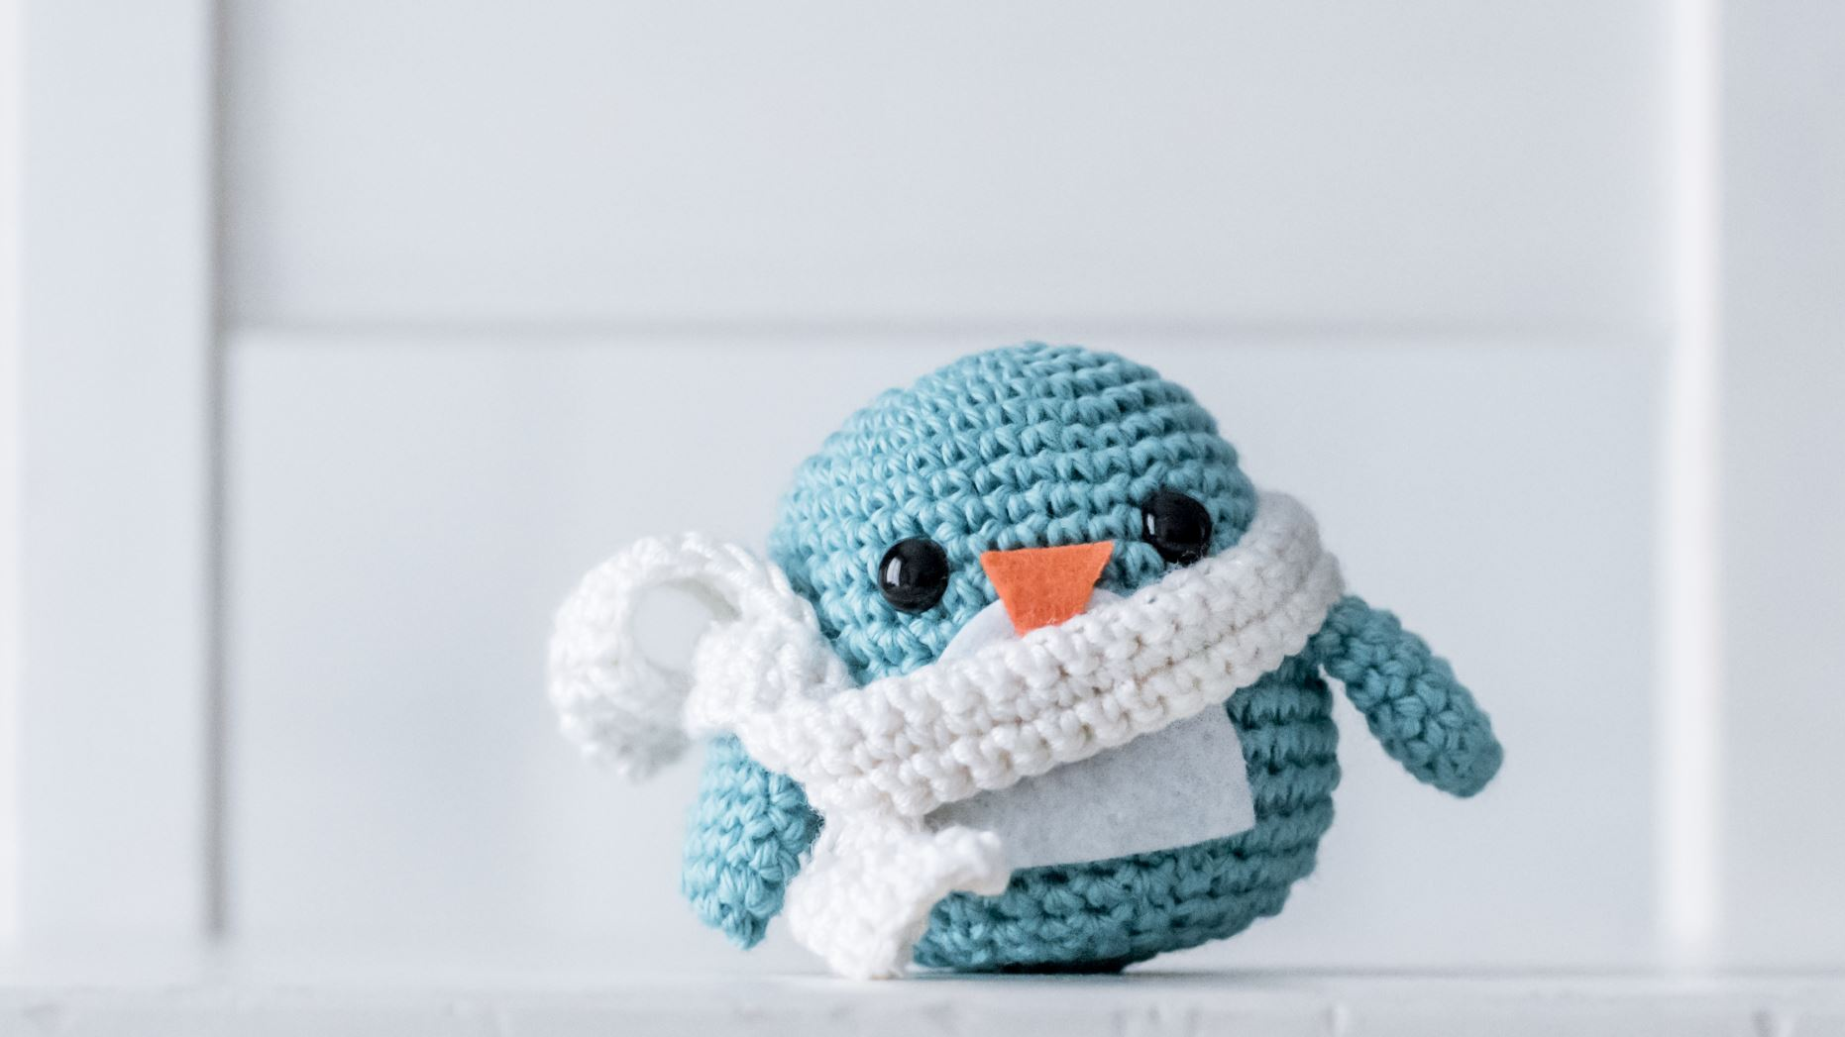
Day 2

Slide 5
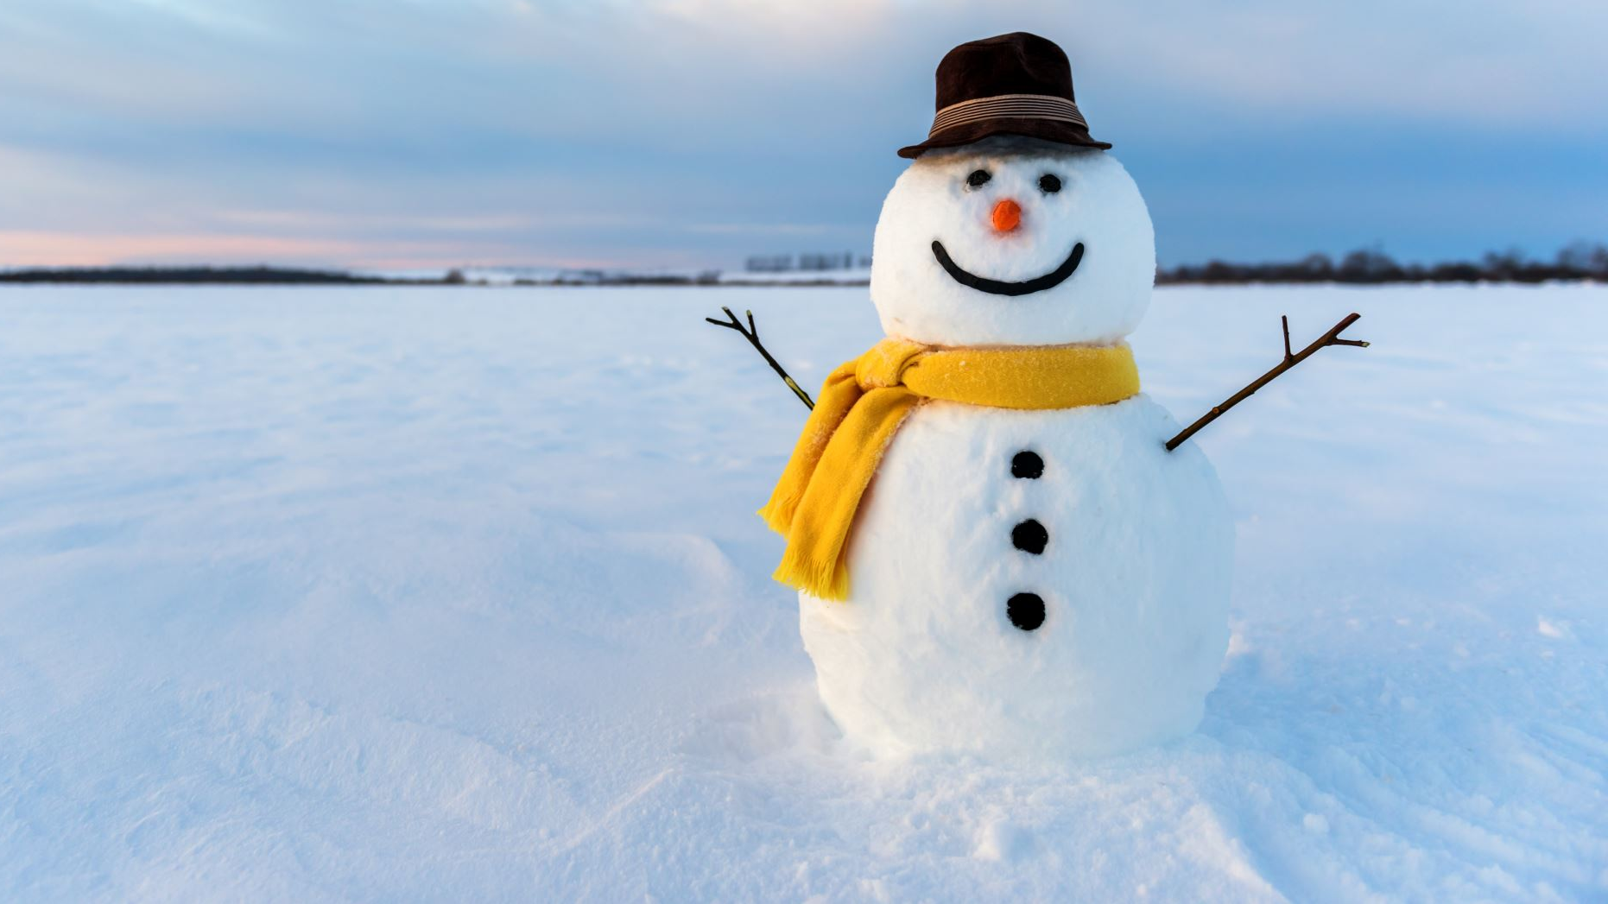
Give 2 people a compliment

Slide 6

Day 3

Slide 7

Invite someone to play a game with you

Slide 8

Day 4

Slide 9

Hold the door for someone

Slide 10

Day 5

Slide 11

Tidy up at least 5 things at tidy up time

Slide 12

Day 6

Slide 13

Help an adult.

Slide 14

Day 7

Slide 15

Give 3 people a fist bump

Slide 16
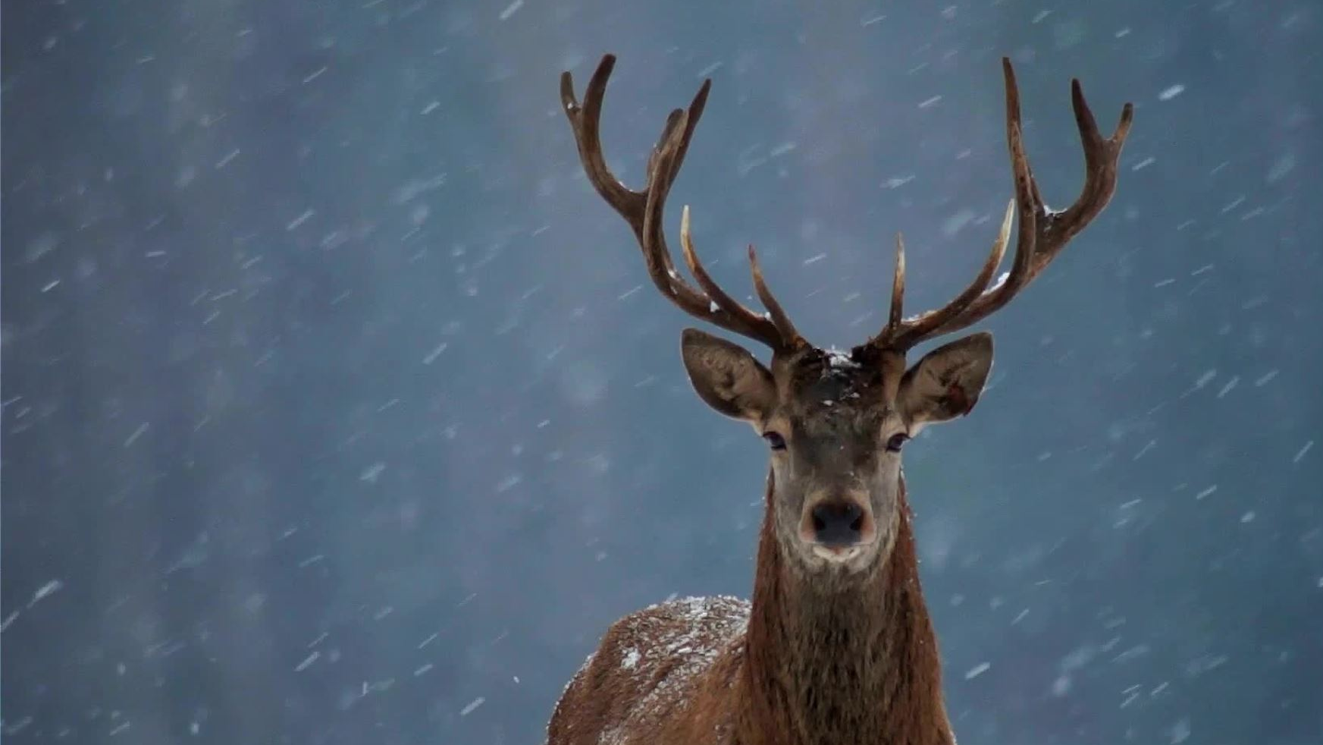
Day 8

Slide 17

You need to say good morning to an adult

Slide 18
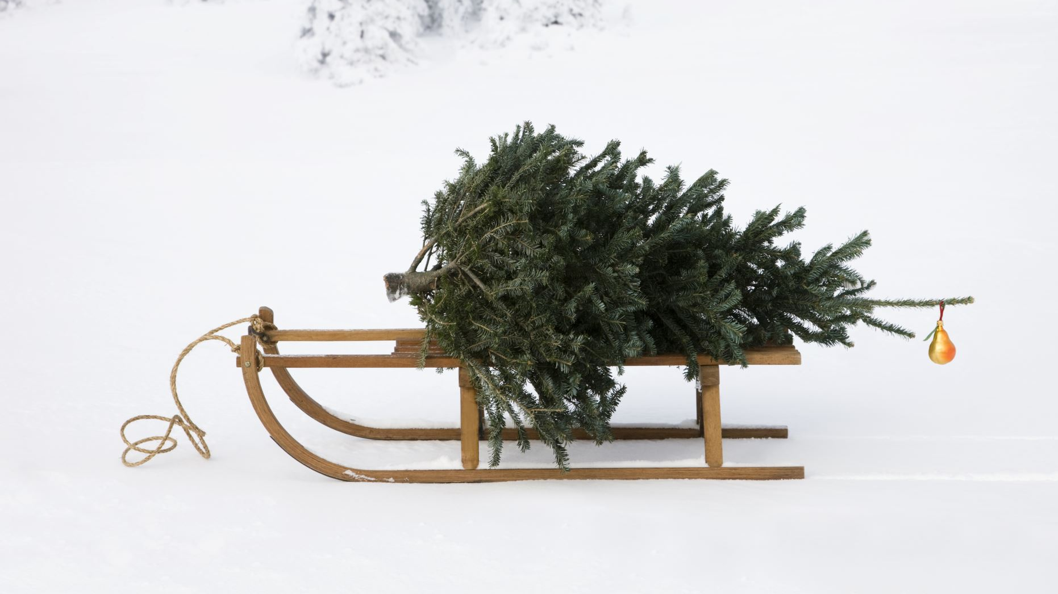
Day 9

Slide 19
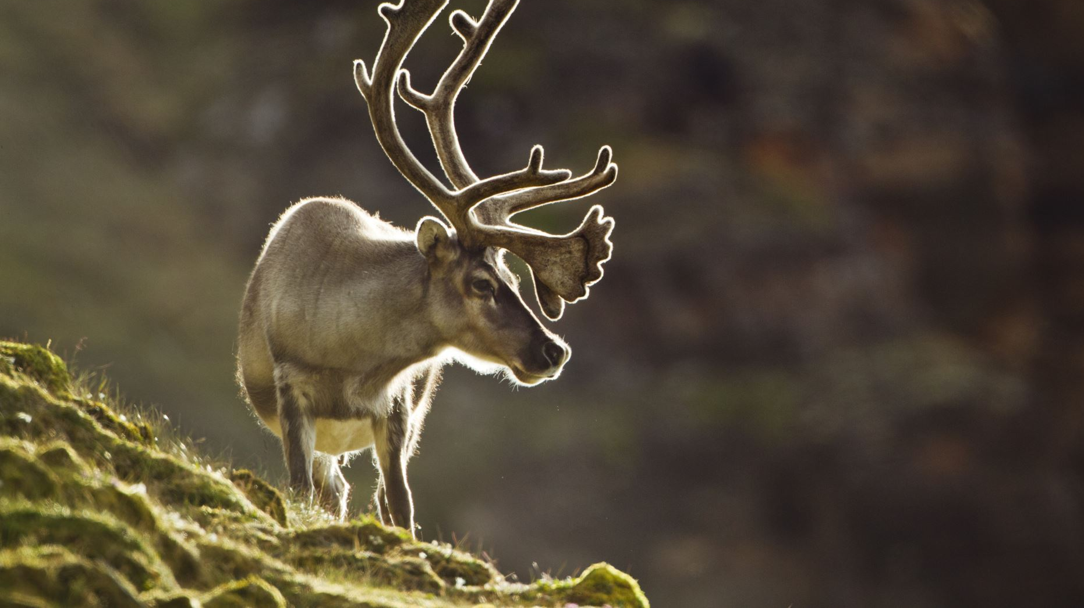
You need to clean up your lunch in the dinner hall.

Slide 20

Day 10

Slide 21

You have to hang your jacket up properly after break and lunch.

Slide 22

Day 11

Slide 23
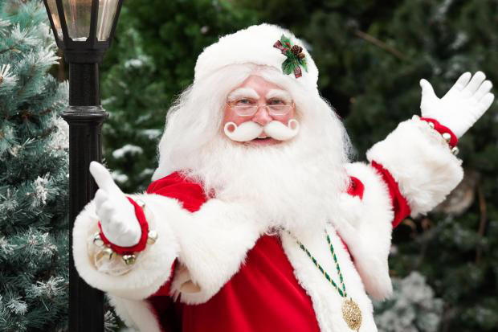
Offer to litter pick

Slide 24

Day 12

Slide 25

Use your manners

Slide 26

Day 13

Slide 27

tuck in your chair at the end of the day

Slide 28
Day 14

Slide 29
Make someone smile :)

Slide 30

Day 15

Slide 31

Help somebody in need

Slide 32
Day 16

Slide 33

Listen to your teachers

Slide 34
Day 17

Slide 35

Give someone in your family a cuddle<3

Slide 36

Day 18

Slide 37
Tell your family you love them

Slide 38

Hope you had so much fun!
Have a great Christmas!!!

