Slide 1

Play Pedagogy in NLC
Session 5
High Quality Learning, Teaching and Assessment through Play
Fiona Kirk (ESO- Play & Enquiry) kirkfiona@northlan.gov.uk
Lisa Lettis (ESO- Play & Enquiry) lettislisa@northlan.gov.uk

Slide 2
Agenda
9.30am: Welcome and Overview of today’s session
9.30am-10.45am: What Does Highly Effective Play Pedagogy Look Like?
10.45am-11.00am: Break
11.00am-11.30am: Guest Speaker: Donna Kennedy, Principal Teacher at Drumpark Primary- Implementing Play Pedagogy with children with ASN
11.30am-12.15pm: Planning
12.15pm-12.30pm: Reflection
12.30pm-1.20pm: Lunch
1.20pm- 1.45pm: Guest Speakers- Leona McGinley, Pedagogy Team St Ignatius Primary Journey with Play Pedagogy and use of Floor Books
1.45pm-2.30pm: Assessment and Observation
2.30pm-3.00pm: Key Takeaways and Evaluation

Slide 3
Session 5 Aims:
Examine - what does highly effective play pedagogy look like?
Explore how the LTA Cycle is exemplified through play pedagogy
Understand planning and assessment for play pedagogy and the use of observation

Slide 4
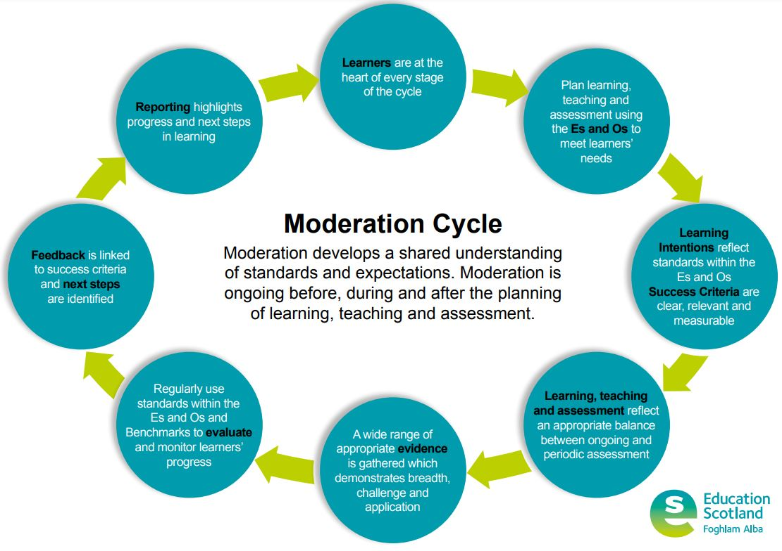
How is the LTA cycle exemplified through Play Pedagogy?
Are there any sections easier or more difficult that traditional teaching to exemplify through Play Pedagogy?
Learning, Teaching and Assessment (Moderation) Cycle

Slide 5
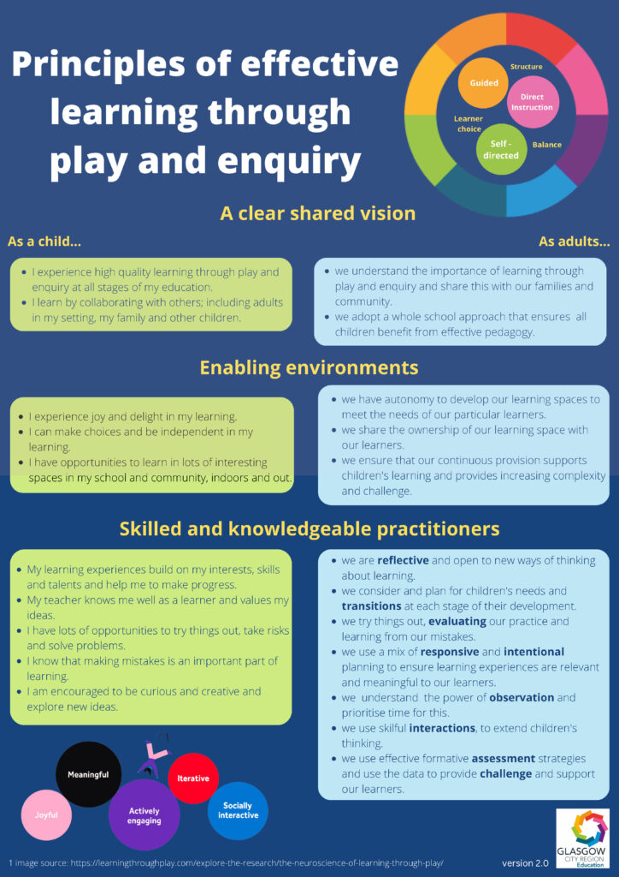

Slide 6
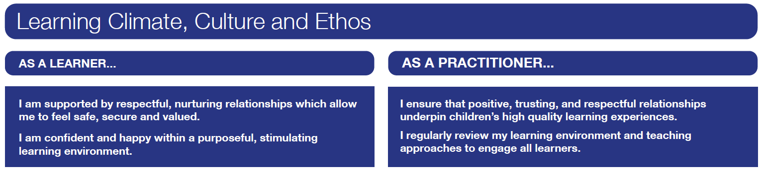
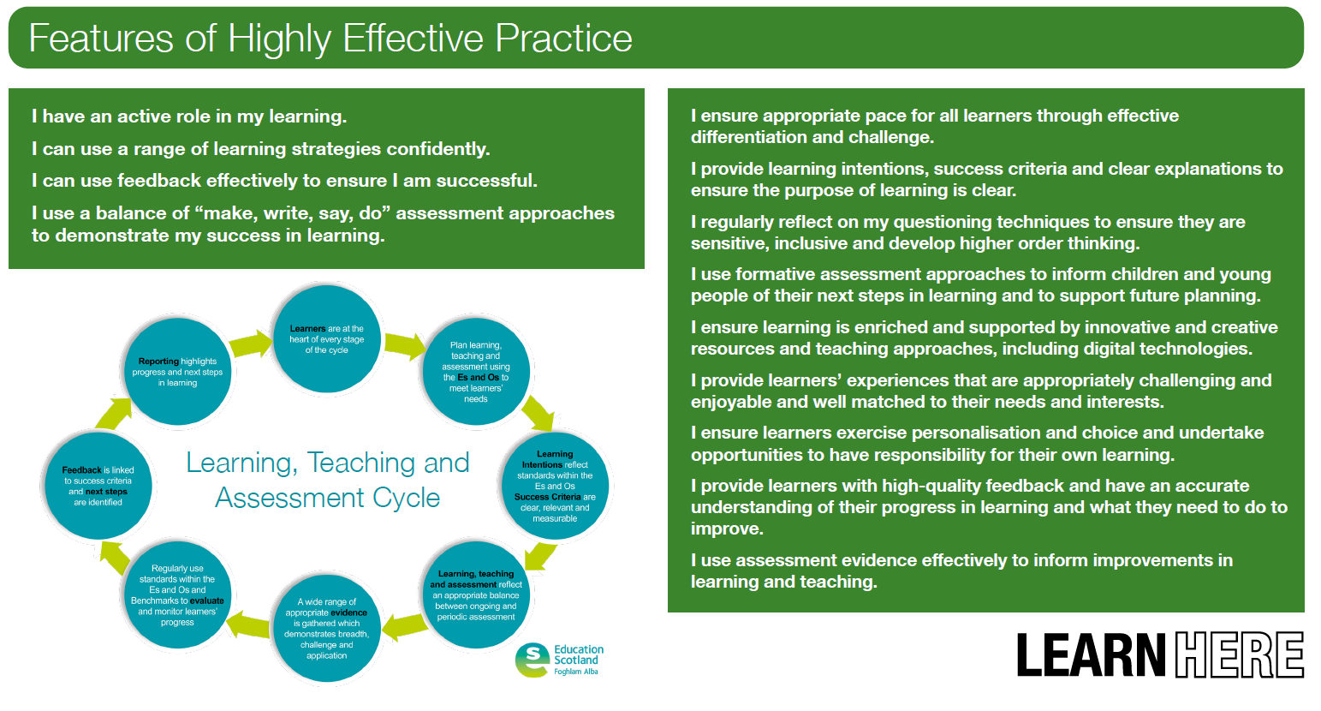
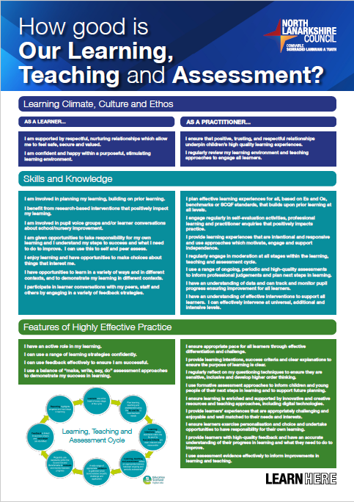
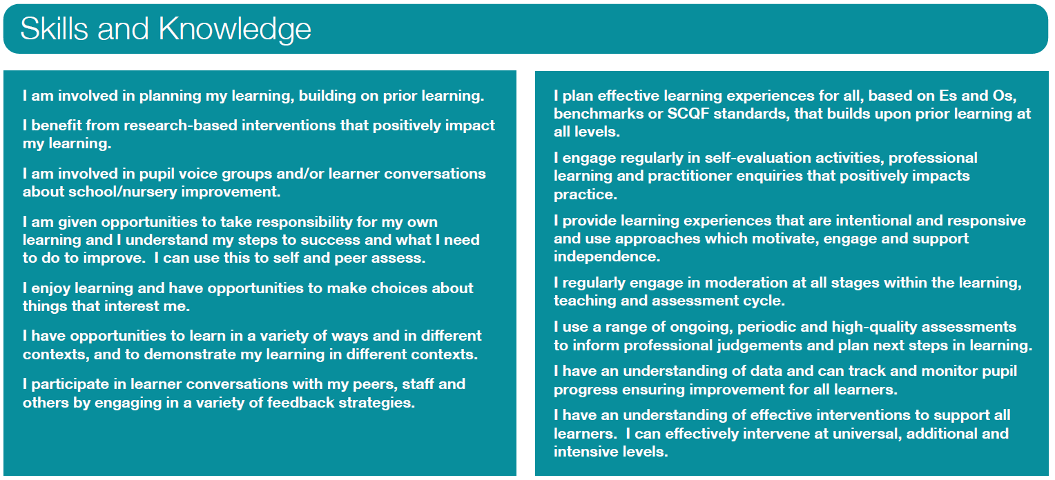
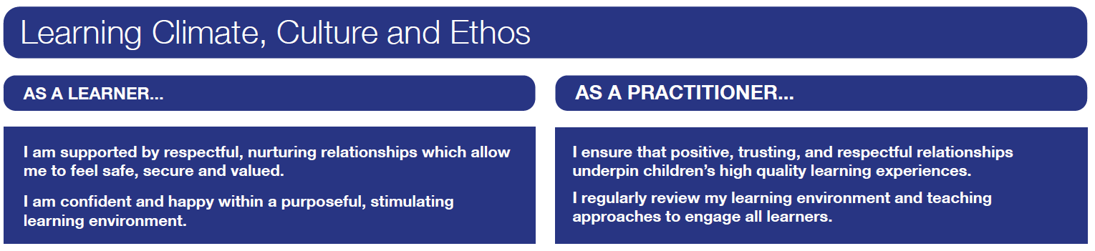

Slide 7

Examples of Effective Practice
Notes:
Share examples of effective practice from your own experiences- pick out couple of these examples to share with wider group

Slide 8
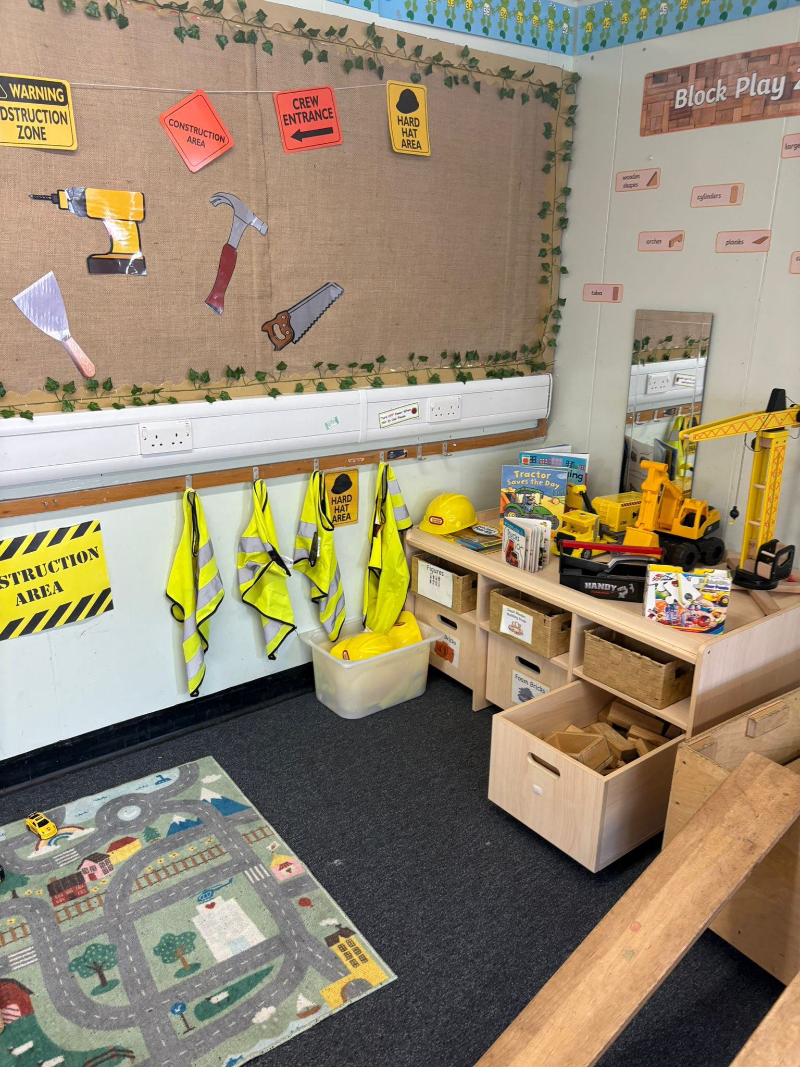
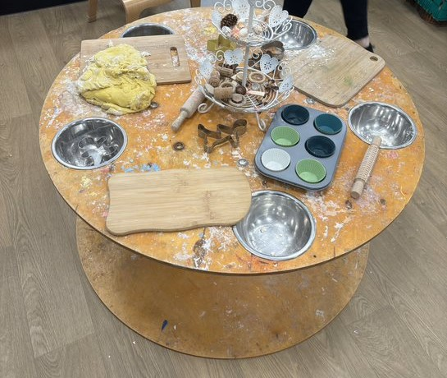
Notes:
Discuss- what skills development/learning could be happening here? Could anything be added to this to enhance provision e.g. reading- Gingerbread man, Characters in story, Tea Party, Birthday Party, patterns, fine motor, role play (set up pizzerias), sensory, etc.
Construction- adding ramps- spark curiosity, angles, forces, different motions (different objects)

Slide 9

Guest Speaker: Donna Kennedy (PT, Drumpark)
https://sway.cloud.microsoft/zyzhoxc0lPLR97pK?ref=Link (Link to Sway Presentation)

Slide 10

Potential Difficulties/Advantages with Planning, Monitoring and Tracking with Play Pedagogy
“The important role for the practitioner is to determine what the young child could learn through their own interests, balanced with learning across the areas of the curriculum. Supporting this in a quality learning environment with high quality interactions will enable the young child to support and extend their learning, deepen thinking and make progress.” RTA pg. 21

Slide 11
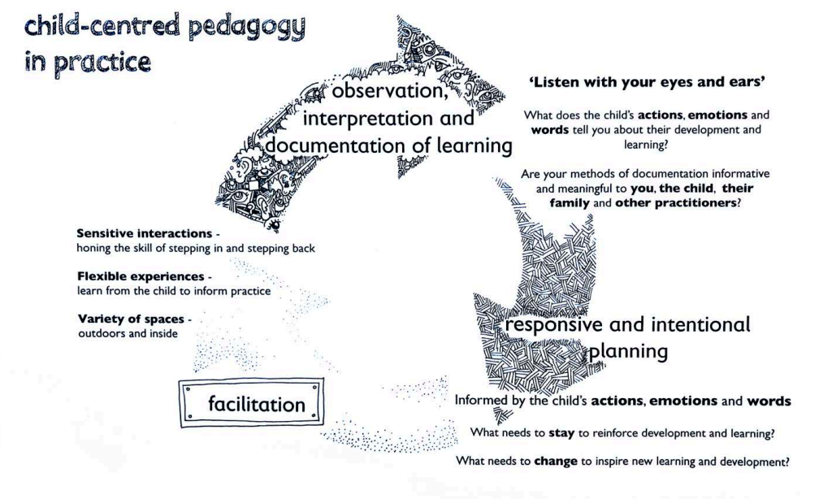

Slide 12
“All planning must focus directly on enhancing the learning journey.”
Education Scotland August 2016
“It is important that we recognise that planning and assessment is a process not an end result, that it is neither limited nor driven by paperwork, but is part of an ethos of ensuring quality experiences and environments for children in order that they develop into successful learners, confident individuals, effective contributors and responsible citizens.”
Curriculum for Excellence, 2007

Slide 13
Planning Across the Year
Long-term
Medium-term
Short-term
Outline the structure of the year.
Shouldn’t limit your flexibility to respond to children’s needs, interests or progression.
Ensure coverage of Es and Os (achievement of Early Level).
Plan across the four contexts of learning?
Forward plan
Short and focused on the main learning activities and experiences developed from Es and Os
Termly
Following children’s ideas and interests e.g. IDL theme
Linked to observations.
Daily/Weekly
Blend of adult-led, adult-initiated and child-led
Working document
Links made to medium and long-term plans
Are children involved in planning their next steps
Possible lines of development established and reflected in zones (observations)?

Slide 14
The next part of the planning cycle involves the ‘what do we do next?’ – the planning, assessing and evaluation. “Informed by the child’s actions, emotions and words – what needs to stay to reinforce learning and development – and what needs to change to inspire new learning and development?” RTA Pg 66
It is important then that practitioners and teachers provide, through responsive and intentional planning, a blend of child-initiated and adult-initiated learning experiences. The emphasis should be on child-centred play pedagogy to ensure continuity in children’s curriculum experiences. RTA Pg 52
Quality settings understand the learning possibilities afforded by the interactions, experiences and spaces we facilitate for the children so that their learning can be both responsively and intentionally planned for, supported and extended. RTA Pg 83
A balance of responsive planning and intentional planning is essential in providing suitable experiences that connect with and extend children’s interests and motivations. RTA Pg 63
Planning
Learning should be facilitated through a cyclical process of responsive and intentional planning, which includes observations, interpretation and documentation of learning, responsive and intentional planning and facilitation. RTA Pg 47
Has both intentional and responsive planning for continuity and progression using Curriculum for Excellence Early Level been considered? RTA Pg 46

Slide 15
Intentional Planning
Adult initiates learning experience using knowledge of learner and curriculum and progression pathways
Helps to ensure coverage of CfE Es and Os/Benchmarks
7 principles of curriculum design should be evident
Can plan experiences across the four contexts of learning
Plan opportunities for skills development
Responsive Planning
Take account of learners’ interests
May involve helping with a new discovery, providing guidance and support or seizing an opportunity to develop a new skill
Starts with an observation/’noticing’
May lead to intentional planning
Brief
Be ready to adapt intentional planning if necessary- be sensitive to children’s needs

Slide 16
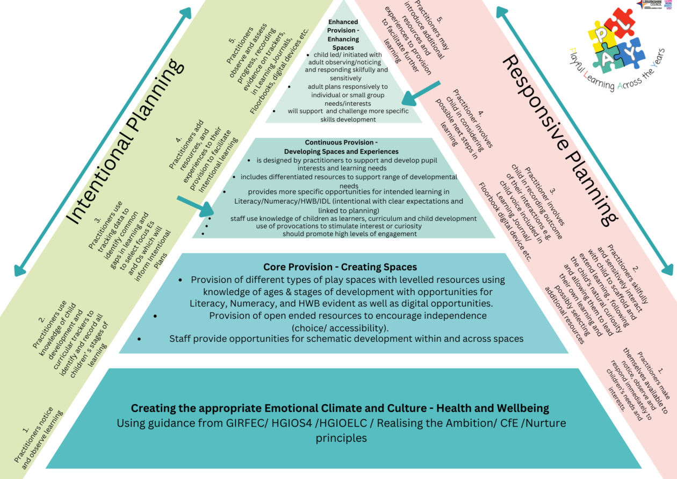

Slide 17
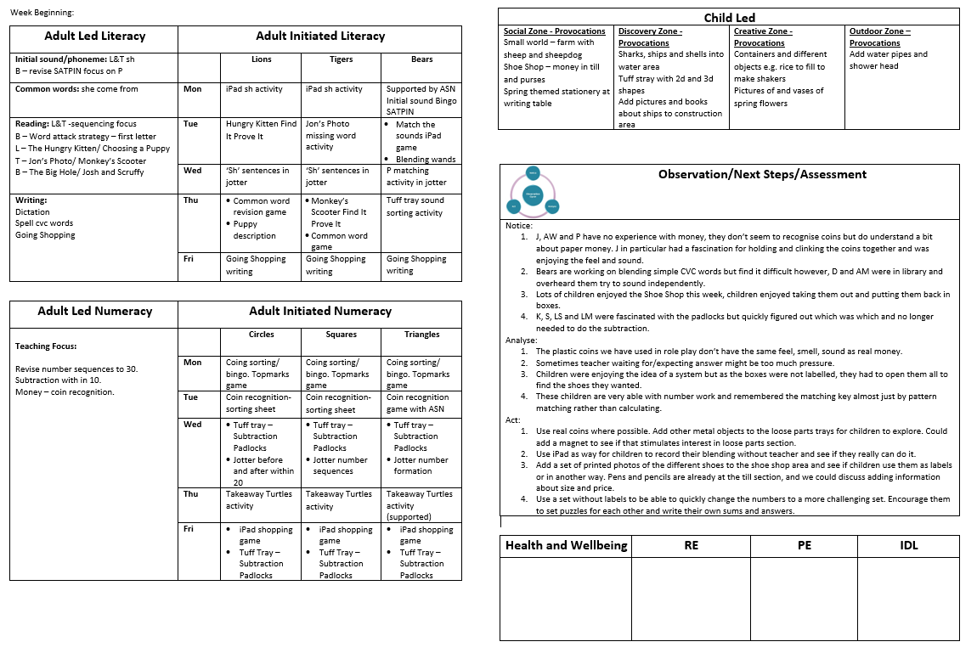
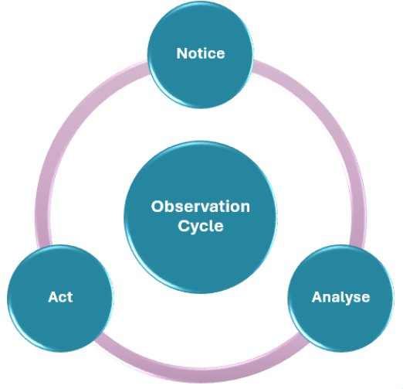

What did I notice?
Planning for potential learning and opportunities for children to build on teaching but open ended enough that children can lead where they choose. This is also responsive planning as depending on observations and interests can be adapted throughout the week.
Adult Initiated activities can be active activities or traditional jotter activities depending on what is needed.
What will I do now? What will the child do now?
What does this tell me? What does this mean?
Intentional Planning linked to Es and Os and with appropriate LI and SC. Some of it may be responsive planning coming from observational assessments
Will be added to as week progresses. Important that is not just a description of a task. What will you learn from or do about this observation? Responsive planning comes from observations.

Slide 18

Guest Speakers: Leona McGinely (Pedagogy Team)

Slide 19
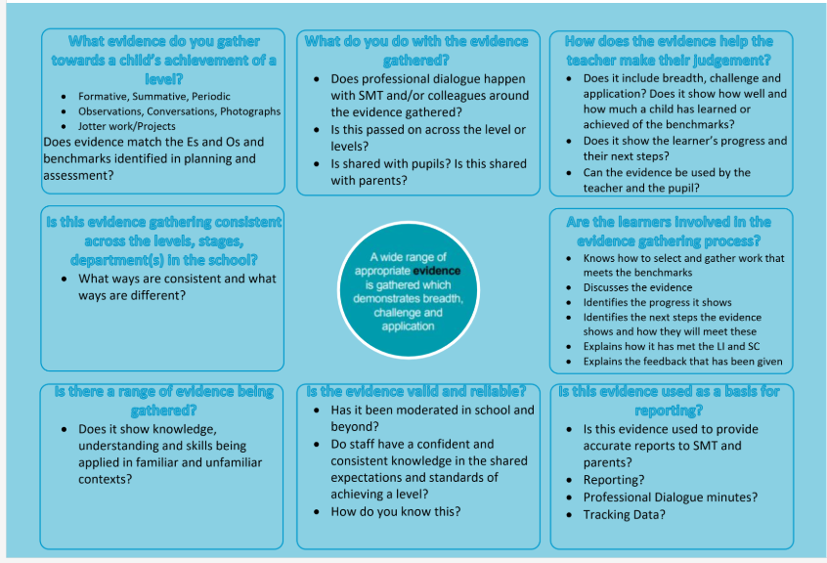
Assessment
“Assessment is integral to the planning of learning and teaching. A variety of assessment approaches can be used to allow children and young people to demonstrate knowledge and understanding, skills, attributes and capabilities in different contexts across the curriculum.” (Assessment in the BGE Update 2020/2021)

Slide 20
What types of evidence do you collect to inform your planning and to capture a child’s knowledge, skills and capabilities (make the learning visible)?
Are your methods of documentation meaningful and informative- for you, the child, their family and other practitioners?
Notes:
On flipchart paper

Slide 21
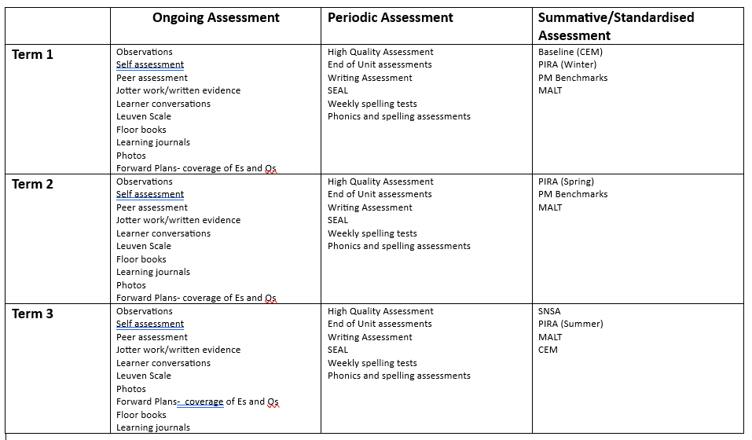
Evidence/Documentation Across the Year
Notes:
A range of formative assessment and summative assessment should be collected throughout the year to determine children’s progress in learning and this should then be used to provide appropriate experiences

Slide 22

Observation
“Observation can be seen as noticing and trying to interpret what the child’s actions, emotions and words mean in terms of what they are learning. We can observe what they are mastering and what they still need help, guidance and practice with. Our role includes noticing what the child does and how this might be changing over time.” (RtA 2020:65)
Why? Purpose?
When do you observe and how often?
“Listen with your
eyes and ears”.
What do you observe?
How do you observe?
Notes:
Consider the questions?
Skilled practitioners observe all the time, use them to make accurate judgements about how to further support children’s learning e.g. Kerry Anne (fine motor skills)
Continually carry out informal observations. Notice the subtleties of what children are doing and saying. Most observations are not recorded
Observation is crucial- supports us to facilitate interactions and experiences in appropriate spaces to enhance learning and development

Slide 23
Observation Types
Narrative Methods
Narrative Observation
Magic Moments
Learning Stories
Running Records
Photographs/Videos
Sampling Methods
Time Sampling
Event Sampling
Rating Scales e.g Leuven Scale
Work Samples
Sociograms
Notes:
Different purpose and tell us different things. Narrative methods- tell a story, form majority of obs
Narrative Obs- Most common- factual account- tell us about children’s skills, interest, abilities and needs
Magic Moments- capture fleeting moments of learning, in the moment- rely on deep understanding of curriculum, learning pathways- leave them as moments/link them together to show how particular child is progressing
Learning Story- written to child, show child’s progress over time, includes child’s voice, family and practitioner- showing links
Running Record- very detailed description of event/behaviour recorded as it happens, factual, written in present tense and include times (commentary)- look closely what child is doing and understand strengths and areas of support
Photos/Videos- usually sit alongside written obs, tell 1000 words
Sampling methods- Time sampling-recording what a child is doing at diff points in day, could be used for quiet child, child who plays in certain area, focus on selected behaviours
Event sampling- obs behaviour and consequences e.g. how child is portraying type of behaviour
Rating scales- graded levels od response- checklists, Leuven scale (5 point scale- engagement and involvement)
Work Samples- things children make/create, e.g. can sample same thing at different points in year to show progression
Sociograms- how children communicate and socialise with each other

Slide 24
Observations in Practice
What? Key learning Key skills Something you didn’t already know Wow moments | When? Constantly observing Before tidy up Schedule a time Adapt timetable | How? Floor books Paper Template QWIQR Book Creator One Note
How often? As and when Stars of the week Ensure equality | Why? Understand strengths Understand interests and where they like to learn- enhance environment? Understand learning dispositions Recognise stages of development Assess knowledge and progress | What it shouldn’t be? Overly time consuming- record significant events Done for the sake of it A description of a task/activity
Notes:
Missed opportunity- tapping into PROCESS of how a child learns/thinks over end product

Slide 25

Notes:
Teachers are in the children’s spaces capturing their learning

Slide 26
What did I notice?
What does this tell me? What does this mean?
What will I do now? What will the child do now?
Notes:
Notice- focus on strengths, factual, non-biased and non-judgemental. Most important part of cycle is arguably thinking about what we’ve seen, making sense of it, insight into what and how a child is learning- what will our actions be?
Task- work in groups to look at the example- go through the observation cycle.

Slide 27
Tools to Support Judgements
Curriculum for Excellence Experiences and Outcomes
Curriculum for Excellence Benchmarks
Progression Frameworks
Developmental Milestones
Stages of Play
Schematic Play

Slide 28
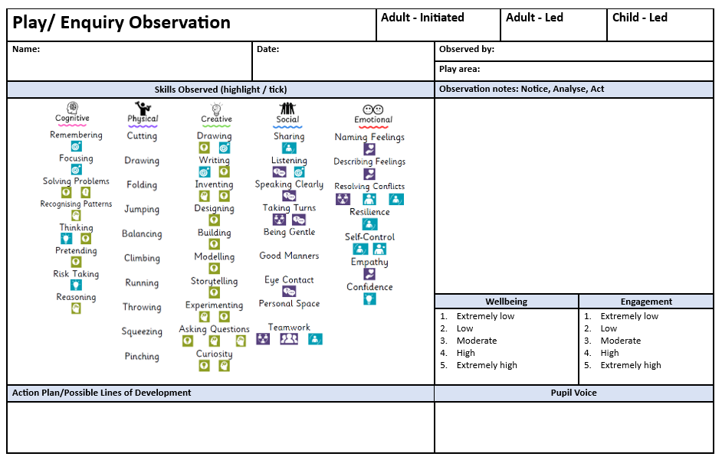
Notes:
Example- recording an observation

Slide 29
Suggested Reading/Support
Portmoak Sketchnote - Learning is better when children talk about their learning
Education Scotland (2018)
Woodmuir Primary - Involving children in planning and assessing their own learning
Education Scotland (2018)
Education Scotland video Pondering Pedagogy- https://youtu.be/9KCp6OYYz2o?si=AuxRVWhGGNUFfWS3
Louis, S. (2022). Observing young children — A Froebelian approach. Froebel Trust. Observing young children
Scottish Government. (2020). Realising the ambition: Being me. Scottish Government.

Slide 30
