Slide 1

Play Pedagogy in NLC
Session 4
Play Pedagogy in Practice: Creating High-quality Learning Experiences
Fiona Kirk (ESO- Play & Enquiry) kirkfiona@northlan.gov.uk
Lisa Lettis (ESO- Play & Enquiry) lettislisa@northlan.gov.uk

Slide 2
Agenda
9.30am-10:15am: Types of Play
10:15-10.45am: Reflect on key messages from National Guidance
10:45am- 11:00am: Break 11:00-11:30am: Creativity in the Classroom (Deborah McArthur: Arts Development and Engagement Manager)
11.30am-12.00pm: STEM (Colin Dorman: ESO)
12:00pm-12.30pm: How to incorporate Literacy and Numeracy Experiences into all areas of provision
12.30pm-1.20pm: Lunch
1.30pm-2.00pm: Block Play (Shannon Smith: ELC Development Officer)
2:00pm-2.30pm: Enhancing Creativity
2.30pm-3.00pm: Reflection and Evaluation

Slide 3
Session 4 Aims:
To consider and recognise the different types of play.
To reflect on National Guidance and examine high-quality learning experiences that are intentional, responsive, and flexible.
To consider practical examples and examine how the experiences we provide for children can encompass the three learning contexts and assess where these would fit on the Continuum of Play.
To explore how to incorporate Literacy and Numeracy into all areas of provision.

Slide 4
“To support cognitive development the learning environment should be rich in opportunities for children to engage with concepts and foster skills for learning, such as reasoning, creativity and problem solving. The choice of experiences on offer should reflect an environment of open-ended possibilities in which children can feel intrinsically motivated to explore and investigate through play- including taking calculated risks and learning from mistakes.”
(Realising the Ambition, 2020:47)

Slide 5

Types of Play
What are the different types of play that children experience in your classroom and outdoors?

Slide 6
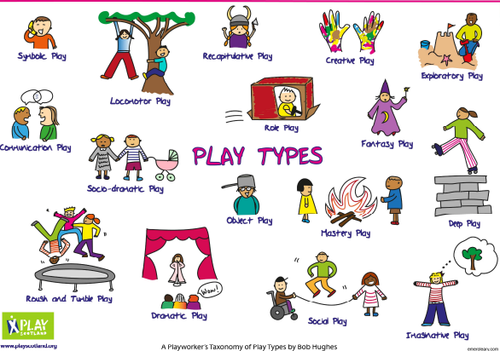
Why is recognising play types important?
To understand the power and benefits of different kinds of play.
To monitor the types of play already happening.
To support and extend different kinds of play so all children have high-quality play experiences as engaging in each play type is necessary for a child’s healthy development.
“…engaging in each one is a necessary corollary for a child’s healthy development”.
(Hughes, 2006)
Bob Hughes (2006): 16 types of play
Notes:
Helps us to categorise some of these types of play

Slide 7
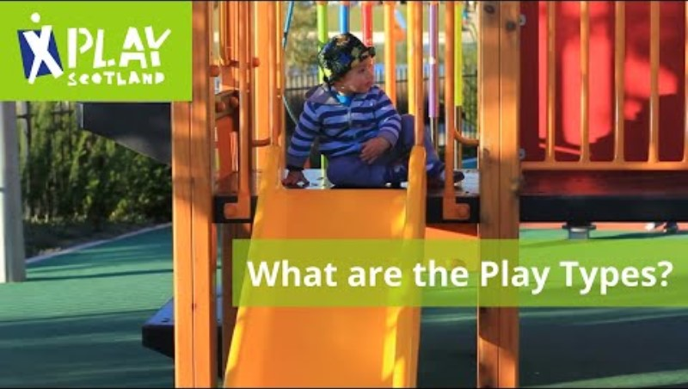
Notes:
Link to play types toolkit in suggested reading

Slide 8
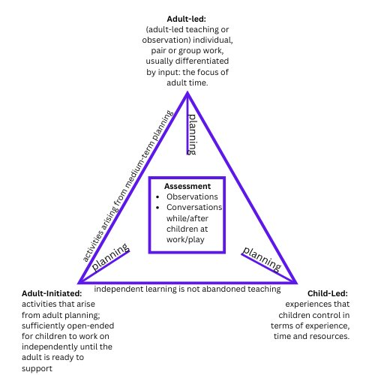
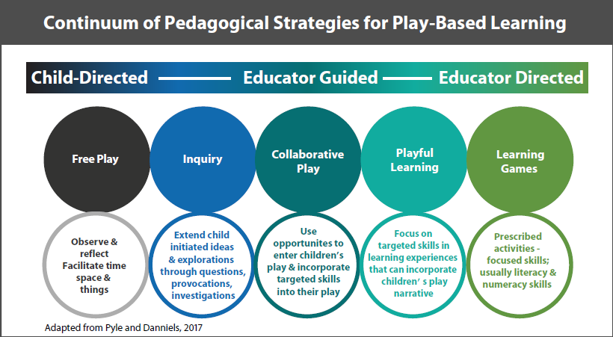
By using examples from your own practice consider:
What learning experiences are provided for children in your class? Are they weighted more towards one learning context?
What do you think children get out of these experiences?
How could you provide experiences across all three learning contexts?

Slide 9

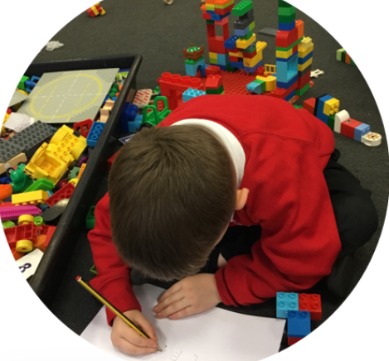
Reflective Questions (RtA)
Do you start with the child and consider their abilities and needs?
Do you provide flexible experiences?
Are the experiences built on children’s prior learning?
Are children afforded opportunities in the outdoor environment? (often contains more opportunity and stimulates children’s curiosity and wonder for learning)
Do you value the importance of the process more than the “end products” at this stage?
Do you provide open-ended experiences and materials to allow more exploration? (Often lead to deeper and more creative learning as there is no “wrong way”).
Is there a balance of responsive and intentional planning to provide suitable experiences that connect with and extend children’s interests and motivations?
What opportunities are available for children to engage with concepts and foster skills for learning such as reasoning, creativity and problem solving?
Notes:
Link to what has been discussed at other sessions- Environment (spaces), interactions- to facilitate child-centred pedagogy-

Slide 10

Guest Speaker: Deborah McArthur (Arts Development and Engagement Manager)
Notes:
Creativity in the Classroom

Slide 11

Guest Speaker: Colin Dorman (ESO)

Slide 12

Literacy and Play Pedagogy (RtA)
Literacy is everywhere in the environment and can be attached to everyday learning opportunities and experiences.
Literacy experiences should weave, build and grow children’s interests, vocabulary and knowledge.
Literacy learning should encourage children to see themselves as readers and writers, through purposeful experiences which build on the way children use literacy.
Opportunities to notice patterns, similarities and differences in sounds and words
Opportunities to develop gross motor skills
Investigating and experimenting with words, rhymes, songs and musical instruments
Role play- builds on life experiences and interests
Exploring a range of stories e.g. picture books, fiction and non-fiction texts, a variety of media (Reciprocal storytelling)
Experiences
Role modelling
Exploring mark making and print
Opportunities to develop fine motor skills e.g. manipulating clay, using peg boards, jigsaws, sewing
Having fun with stories through tactile and sensory experiences
Opportunities for social interaction and communication
Notes:
Discussion- what literacy experiences do you provide for children just now?

Slide 13
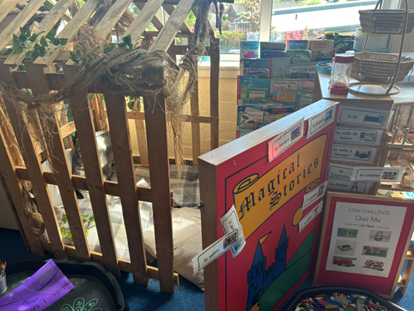
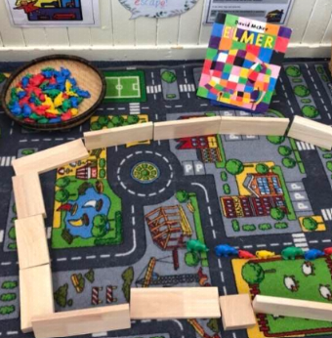
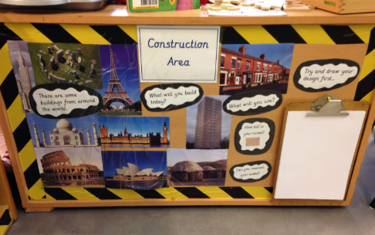
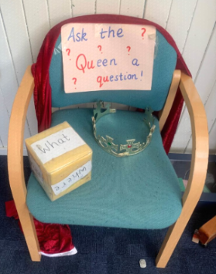
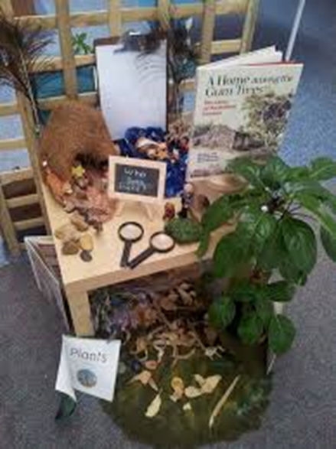
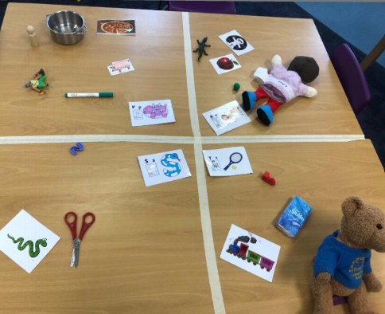
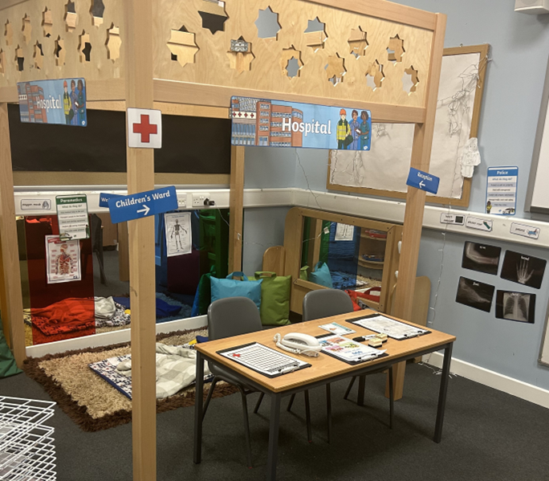
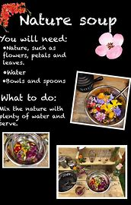
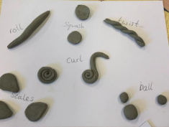
Literacy Experiences

Slide 14

Numeracy & Mathematical Thinking and Play Pedagogy (RtA)
Numeracy and mathematical thinking encompasses many different elements- recognising numerical symbols, verbalising numbers, recognising patterns and shapes.
It involves a variety of skills such as understanding numbers, counting, problem solving, measuring, sorting and patterning.
Applying skills in all areas of life therefore should be embedded in the environment and throughout the curriculum with a variety of materials being used to encourage exploration, enquiry and problem solving.
Story books that illustrate representations of number, shape and pattern
Number recognition in the environment- notice that numbers have a purpose
Role play, board games, digital technologies and programmable toys to support positional language
A range of materials to encourage reasoning through experimentation, trial and error and prediction
Identify and explore shape and symmetry within natural contexts and environments
Experiences
Opportunities to sing and rhyme with visual representations of numbers that involve counting, ordering and recognising number
Investigate and experiment with quantity- compare and contrast a variety of objects using more than, less than, same as
Water and sand play to explore, experiment, test and extend ideas- pouring, measuring, volume and capacity
Create patterns and sets of objects, identifying and discussing their characteristics
Daily outdoor play to explore size and perspective through movement and seeing familiar objects from a different angle, height or distance
Notes:
What numeracy experiences do you provide for children just now?
Both responsive and intentional in design

Slide 15
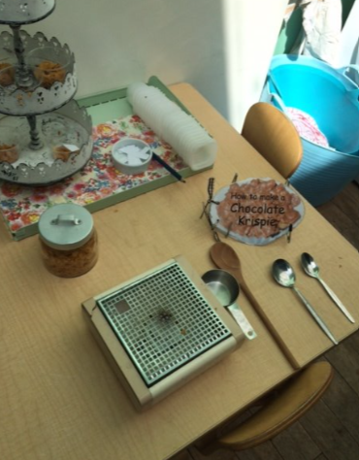
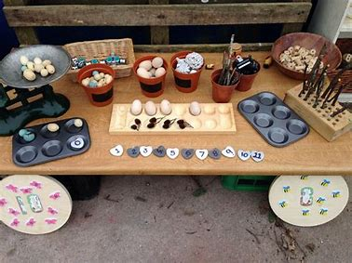
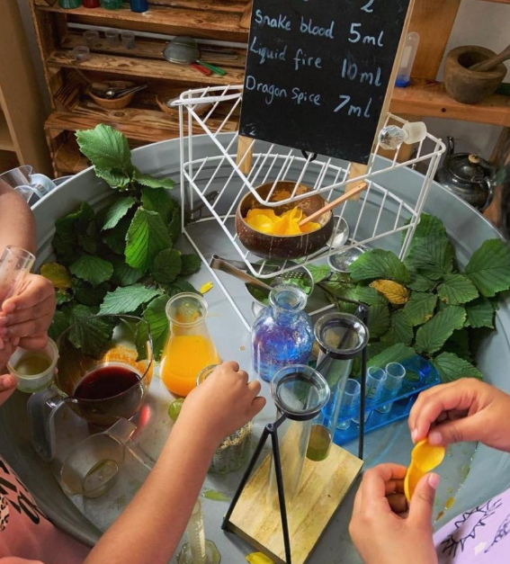
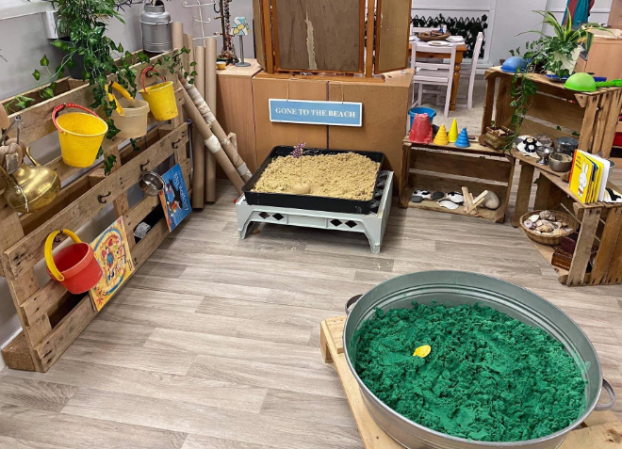
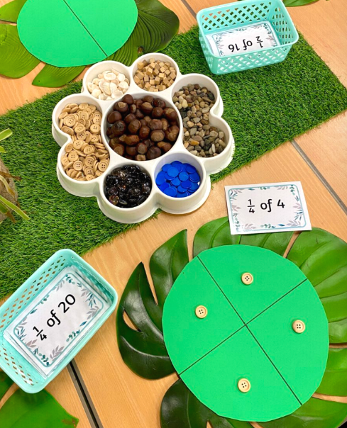
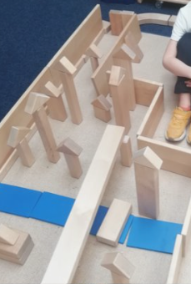
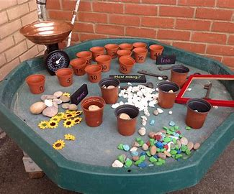
Numeracy Experiences

Slide 16





Task
Notes:
What Literacy and Numeracy experiences do you already provide or could be provided in each zone? A3 sheet of paper- Lisa add to flipchart (take pics of it for reference/take back to schools)

Slide 17
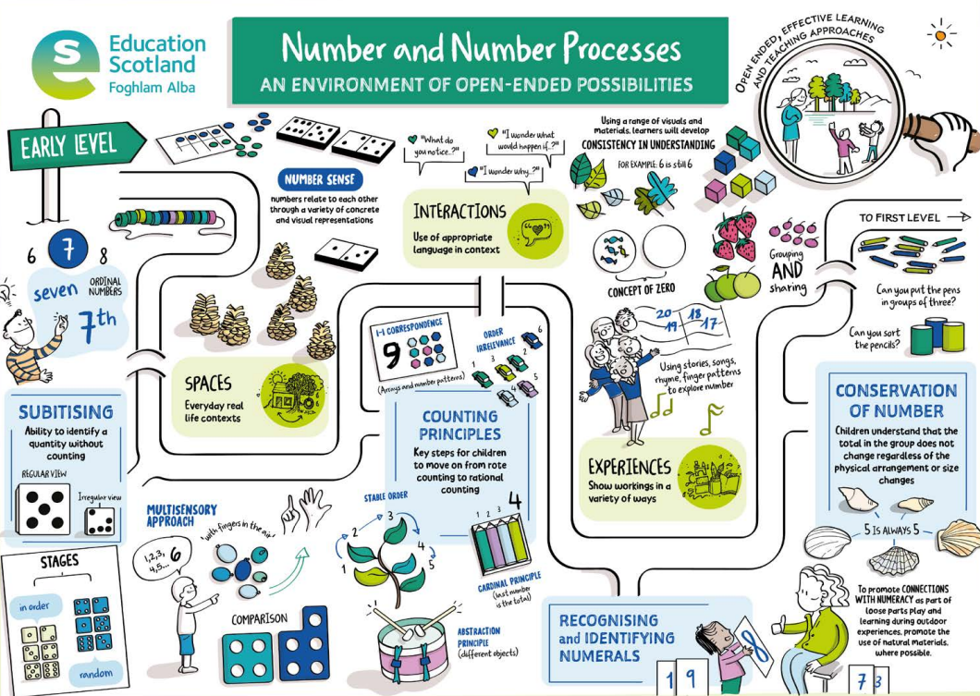
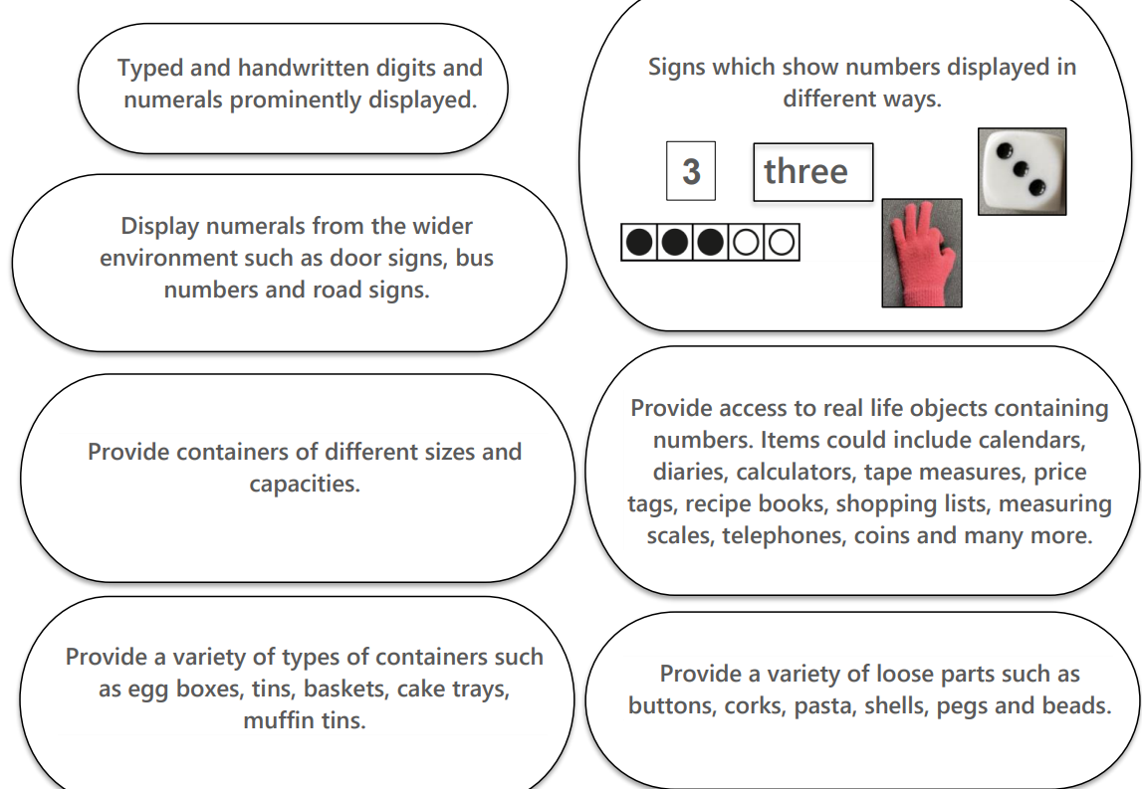
Notes:
Professional learning resource for Numeracy- on Education Scotland website (in suggested reading list)

Slide 18
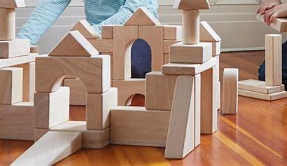
Guest Speaker: Shannon Smith (ELC Development Officer)
Notes:
Block Play

Slide 19


Slide 20
Creative Process - involves investigating a problem or issue, exploring multiple viewpoints and options, generating and testing out ideas, developing, refining and communicating solutions and evaluating whether or not they have worked.
Creative Learning - describes the range of activities and approaches undertaken by an individual which supports the development of creativity and other skills.
Creativity Skills – those skills which contribute to an individual’s capacity to understand and apply a creative process
Creative Teaching describes approaches and activities, developed and delivered by those who lead learning, which are usually exciting, innovative and often use unexpected techniques to engage learners.

Slide 21





Slide 22
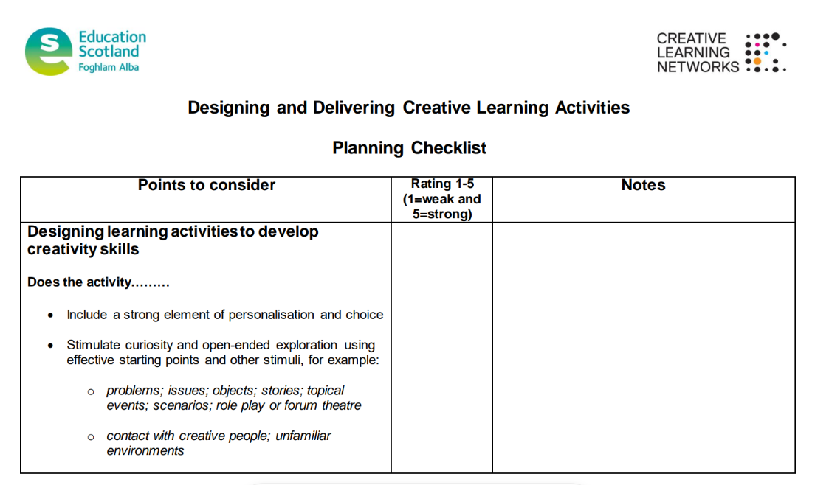

Slide 23
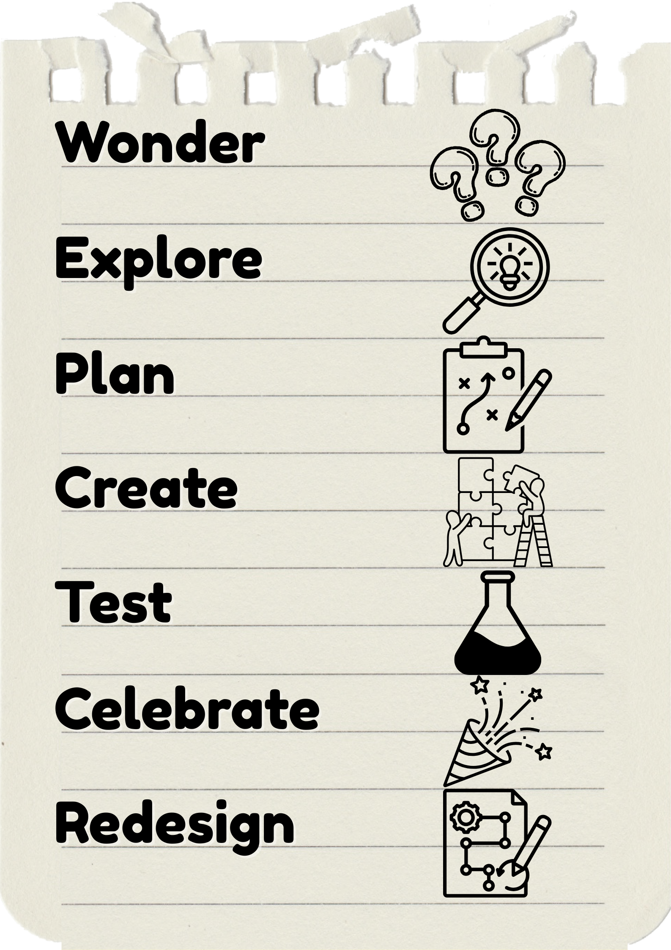

Slide 24

Reflection
Notes:
Looking at highly effective Play Pedagogy next session- bring something along that showcases highly effective Play Pedagogy- photo, learning conversation, piece of work, etc. (just to share and have a discussion at your table).
Site Visits

Slide 25
Suggested Reading
Education Scotland. (2020) Realising the Ambition
Numeracy Professional Learning Resources | Resources | Education Scotland (Numeracy examples linked to high quality interactions, experiences and spaces)
Hughes, B. (2006) Play Types. Speculations and Possibilities. London: The London Centre for Playwork Education and Training.
Pyle, A. & Danniels, E. (2017) A Continuum of Play-Based Learning: The Role of the Teacher in Play-Based Pedagogy and the Fear of Hijacking Play, Early Education and Development, 28:3, 274-289, DOI:10.1080/10409289.2016.1220771
Play-Scotland-Play-Types-Tooolkit-bringing-more-play-into-the-school-day.pdf- Play Types Toolkit

Slide 26
