Slide 1

Play Pedagogy in NLC
Group A Session 3
Play Pedagogy in Practice: Balance and Structure of the Day
Fiona Kirk (ESO- Play & Enquiry) kirkfiona@northlan.gov.uk
Lisa Lettis (ESO- Play & Enquiry) lettislisa@northlan.gov.uk

Slide 2
Agenda
9.30am: Welcome and Overview of today’s session
9.30am-10.45am: The Balance of the Day and the Role of the Adult
10.45am-11.00am: Break
11.00am-11.20am: Guest Speaker – Lorraine Meechan
11.20am-12.30pm: Stages of Play
12.30pm-1.30pm: Lunch
1.30pm-2.00pm: Play Schemas
2:00pm-2.50pm: Guest speakers Mhairi Stevenson/Nicola Devlin
2.50pm-3.00pm: Questions and Evaluation

Slide 3
Session 3 Aims:
To examine the balance of the learning contexts (adult-led, adult-initiated, child-led)
To explore quality interactions and the role of the adult
To explore practical examples of structuring the learning
To explore stages of play and play schemas

Slide 4
“There is no contest between child-led and adult-led learning. It is the one without the other that gives young children an impoverished experience.” Julie Fisher
“The important role for the practitioner is to determine what the young child could learn through their own interests, balanced with learning across the areas of the curriculum. Supporting this in a quality learning environment with high quality interactions will enable the young child to support and extend their learning, deepen thinking and make progress.” RTA pg. 21

Slide 5
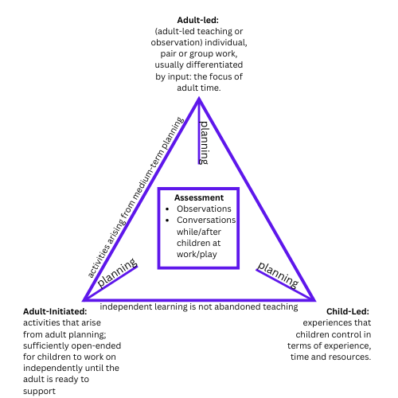

Slide 6


Task –
What is the role of the adult in each of the contexts for learning?

Slide 7
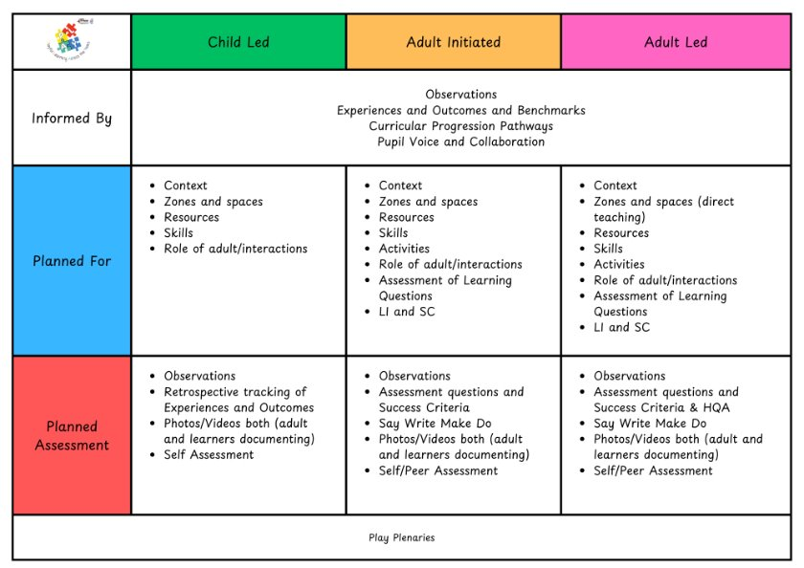

Slide 8
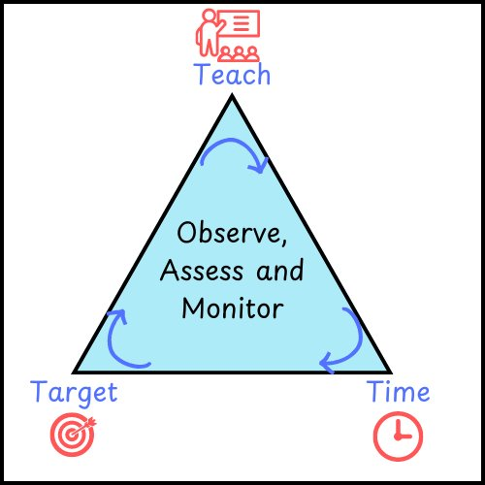
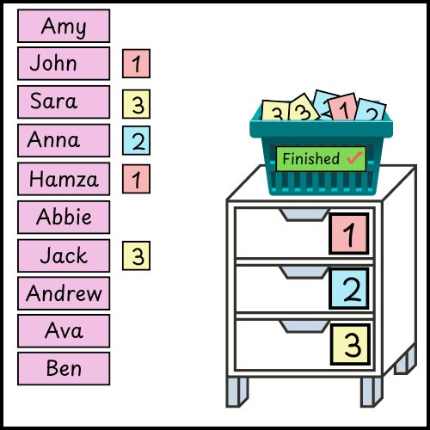
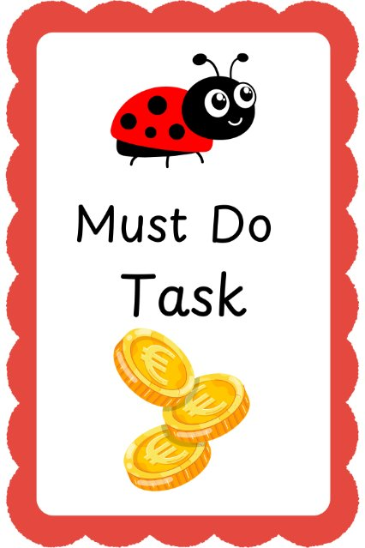
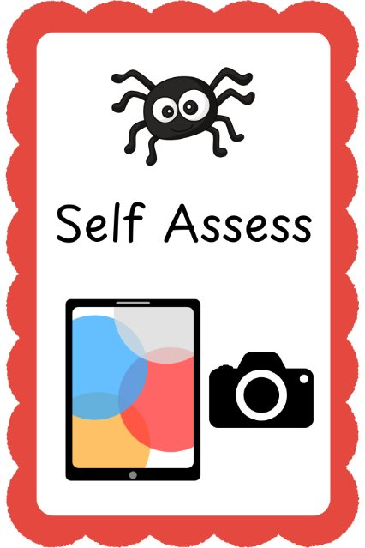
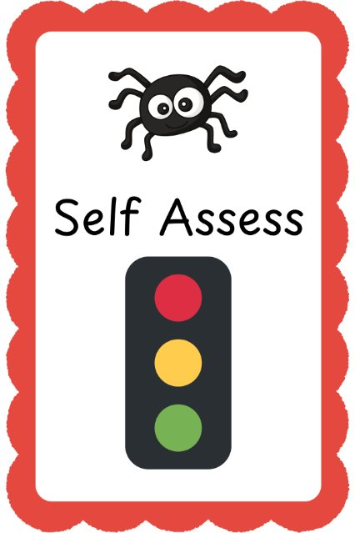

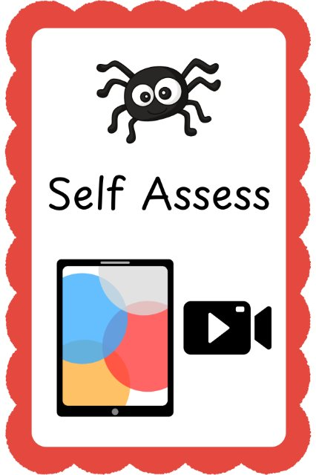

Slide 9
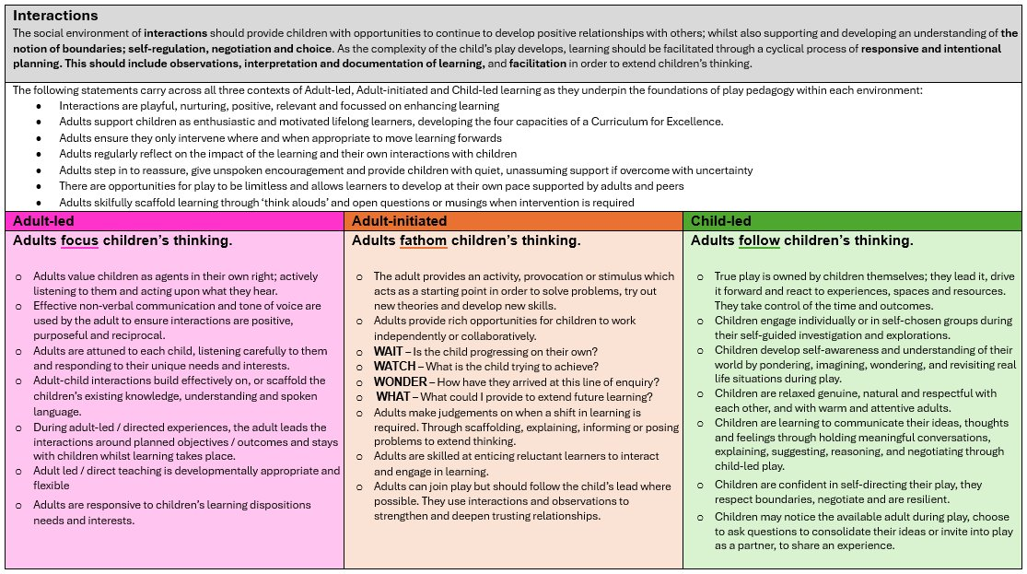
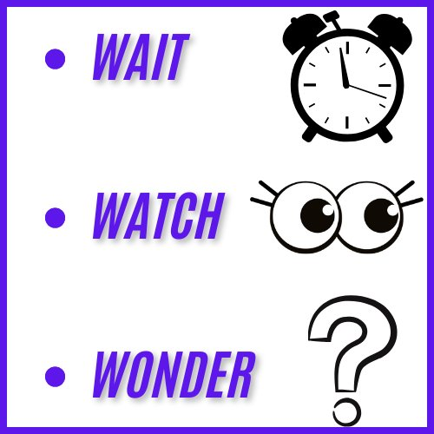

Slide 10
Task –
What needs to be in place for quality interactions to happen?
Ways to interact without just asking questions?

Slide 11
Thinking Aloud | Verbalising Feelings | Modelling
Non-verbal Communication | Commenting | Noticing
Imagining | Making Connections | Providing Thinking Time
Posing Problems | Giving Control | Staying Quiet
Echoing back with new/correct vocabulary | Visual Props/ Communication aids | Open-ended questions
Praise and Attention | Naming Skills/ Processes

Slide 12
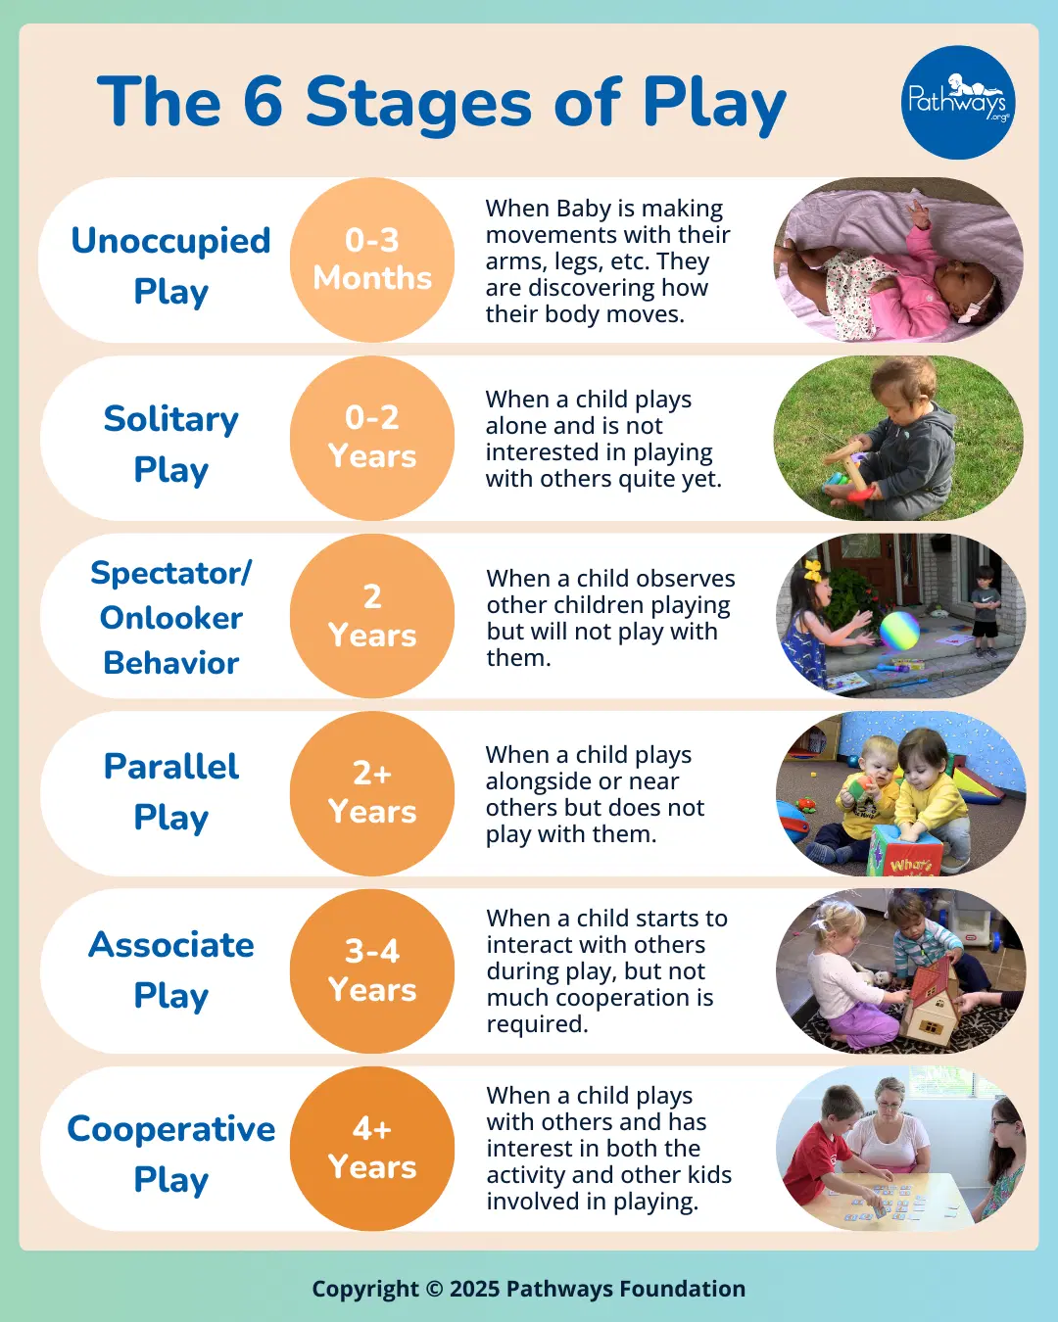
Notes:
Parten 1930s- Child Development- helps us to tailor experiences/activities to developmental level of children. Engage all children when designing a curriculum suited to their stages of play. How can we support next steps?

Slide 13
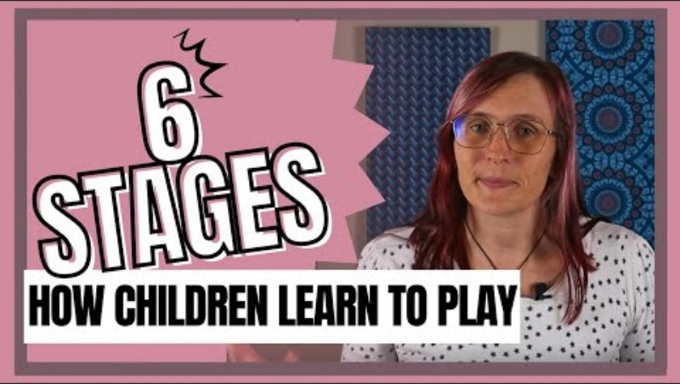

Slide 14
Task –
Are there any children in your class who you think are at a different stage of play than their numerical age?

Slide 15
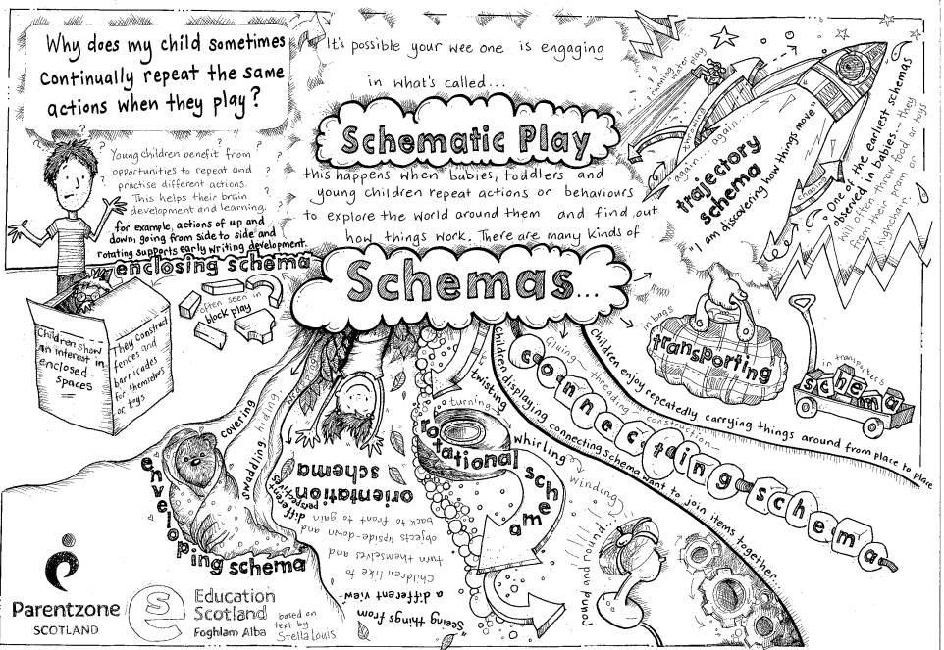
Notes:
Really important to understand schematic play- helps them explore world around them, discover how things work. Help children develop their understanding of the world and build foundational skills for holistic development. Ensure environment rich in opportunities for exploration and play. Repeating and practising different actions helps support brain development and learning. Strengthens connections in brain.
Recognise and extend patterns of behaviour and thinking- plan challenging and exciting learning experiences to support children’s learning and development.
Children have predominant schema.

Slide 16
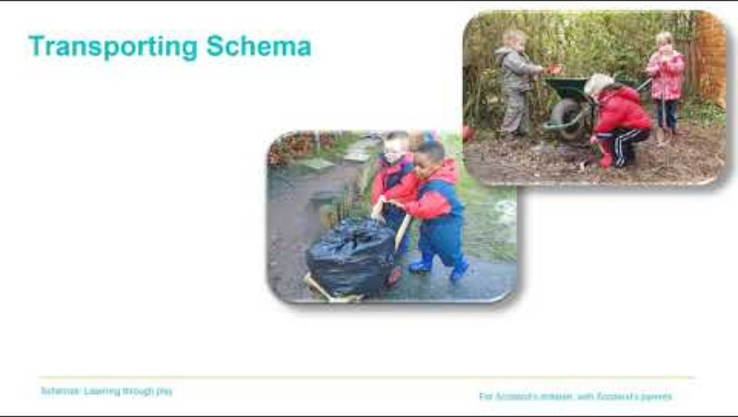
Notes:
2.11 play video

Slide 17
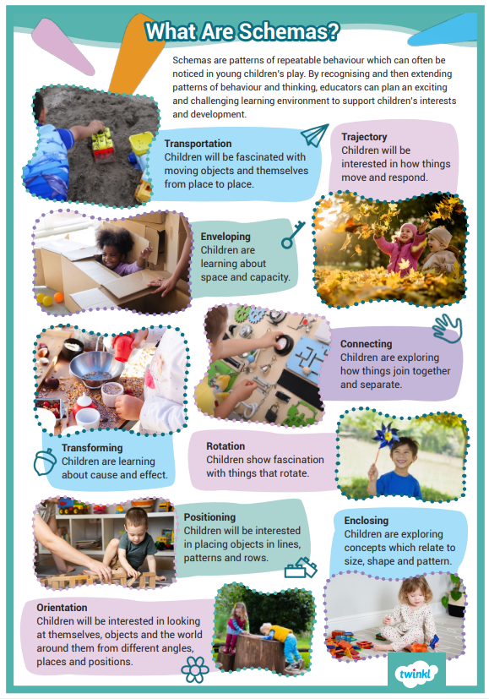
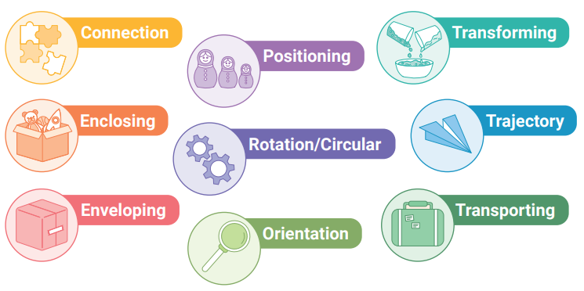

Slide 18
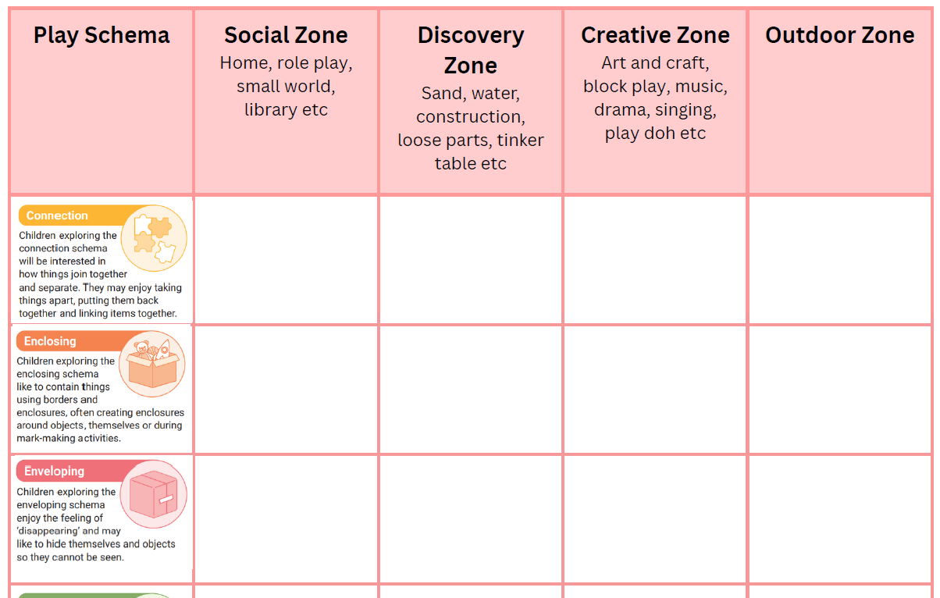
Task –
How can our continuous provision support these schema?

Slide 19

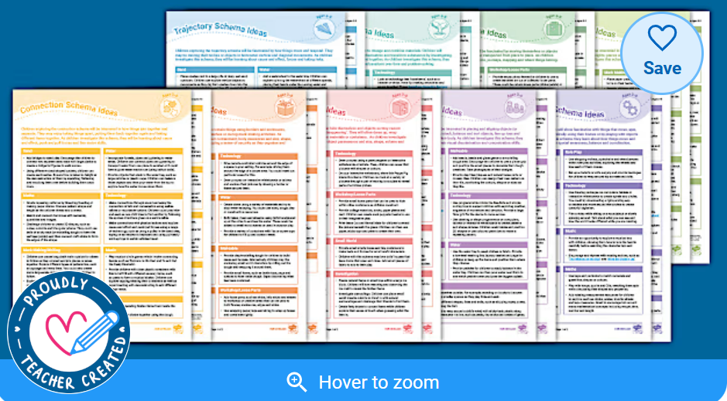

Slide 20
Suggested Reading/Further Support
Starting From the Child: Julie Fisher
Interacting or Interfering: Julie Fisher
Stages of Play: 6 different ways your child will play - BBC Tiny Happy People
Pathways.org | How Kids Learn to Play: 6 Stages of Play Development
What are the stages of play? Jean Piaget’s Theory of Play! - Play. Learn. Thrive.
How Many Play Schemas Are There? (Solved!) - Early Impact Learning
A Guide to Play Schemas in Early Childhood Education — My Teaching Cupboard

Slide 21


