Slide 1

Play Pedagogy in NLC
Group A Session 2
Play Pedagogy in Practice: Creating a High-quality Learning Environment
Fiona Kirk (ESO- Play & Enquiry) kirkfiona@northlan.gov.uk
Lisa Lettis (ESO- Play & Enquiry) lettislisa@northlan.gov.uk

Slide 2
Agenda
9.30am: Welcome and Overview of today’s session
9.30am-10.45am: Key Components of a High-quality Learning Environment (the What)
10.45am-11.00am: Break
11.00am-11.20am: Guest Speaker Joanna Lander (Tollbrae Primary School)- Practical examples of learning spaces with a focus on loose parts and outdoor learning
11.20am-12.30pm: How to a Create a High-quality Learning Environment- Learning Zones & Resources
12.30pm-1.30pm: Lunch
1.30pm-2.30pm: Reflection
2:30pm-2.50pm: Guest Speaker Kerry Anne Kane (Holytown Primary School)- Setting up the environment, resources and practical examples
2.50pm-3.00pm: Questions and Evaluation

Slide 3
Session 2 Aims:
To reflect on National Guidance to understand the key components of a high-quality learning environment in P1 (P2, P3).​
To review National Guidance and practical examples to help consider the key components of high-quality spaces.
To evaluate your indoor and outdoor spaces, considering their strengths and areas for development.​

Slide 4
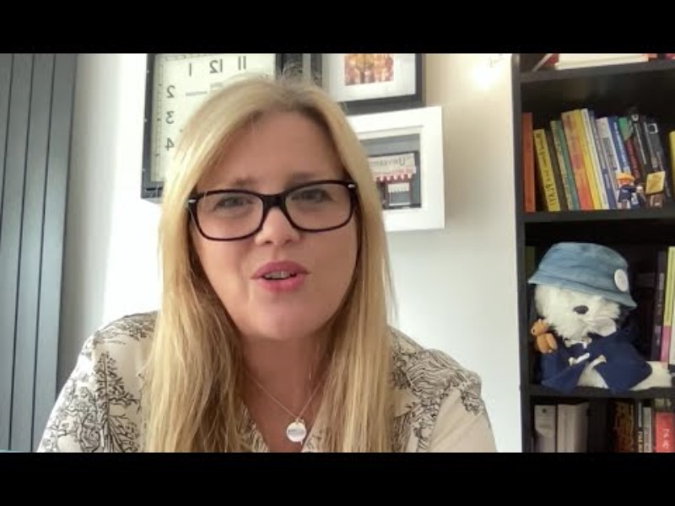

Slide 5

Task
Draw/write words or phrases that describe your physical environment:
Look/sound/feel?
Continuities/discontinuities with an ELC setting?
What message(s) does it give to your children?
Children’s voice? Choice?
Notes:
Split paper in half- Now and Changes like to make (come back to this part at end)

Slide 6
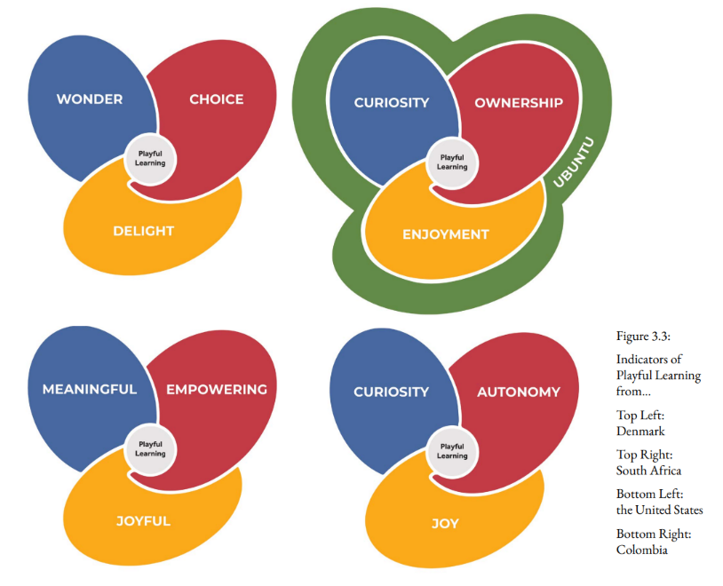
Using the sheets to help you, what would you want the Indicators of Playful Learning to be in your classroom?
Notes:
Cross-cultural indicators of Playful Learning (what it looks like and feels like across all contexts)- when all three indicators are present, playful learning is likely occurring: leading their learning, finding joy and exploring the unknown (Harvard University Research)

Slide 7
Environment as ‘Third Teacher’
(Malaguzzi)
Environment should be as good as another adult in the stimulation, support and provocation it provides (Fisher, 2013).
In early stages of primary, it should not look or feel starkly different from a motivating ELC environment (Realising the Ambition, 2020).
Conducive to learning through play.
Physical spaces, both indoors and outdoors, should be constantly reviewed to incorporate a wide range of responsive, familiar and exciting new play opportunities.
Spaces provide experiences that are joyful, meaningful, actively engaging, socially interactive, and iterative (Lego Foundation, 2017).
Co-create the learning environment with the children.

Slide 8
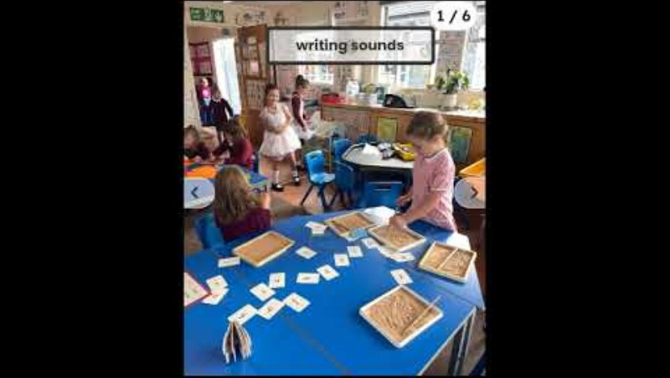
Key Components of a High Quality Spaces
https://youtu.be/KTJ6KeSFvh0?si=liSkPcoWlVaTZcLK
Notes:
Watch the video clips and note down what you think are some key components/’must-haves’ of high-quality spaces
Discussion: Anything resonate with you? Worry you? Reassure you? Might use? (coloured post its to come up and share what you discussed)

Slide 9
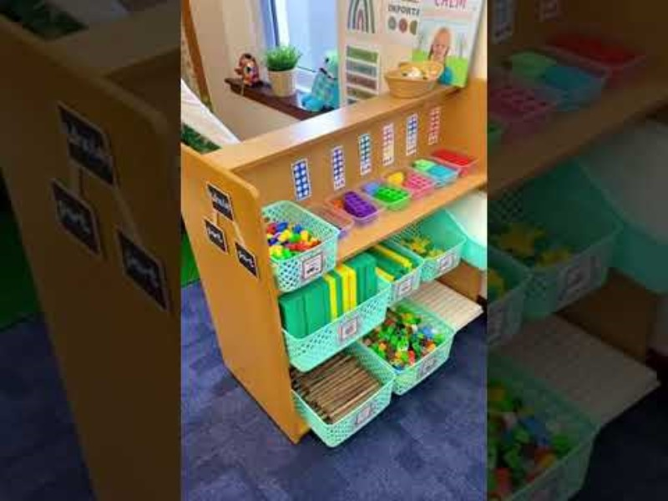
Notes:
Review video choices

Slide 10


Slide 11
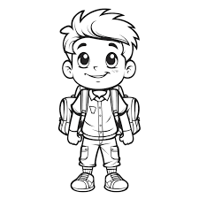
Spaces that develop children’s learning (RtA, 2020)
are adaptive and responsive to my emotions, interests and needs (indoors and outdoors).
encourage and values play, fun, exploration, enquiry and movement.
I need spaces that:
promote interesting opportunities for developing literacy, numeracy and other curricular areas beyond designated ‘areas’- encouraging me to connect and reinforce my learning.
offer independence, choice and opportunities for me to extend my learning with other children and adults.
provide regular access to the natural world, enabling experiences, conversations and interactions that promote my creativity and curiosity.
rich in relevant environmental print showing meaningful connections to the way we use words and numbers in our everyday lives.
encourage a sense of safety and security, yet enabling appropriate risky play, which enables me to be playful in my learning.

Slide 12

Guest Speaker: Joanna Lander

Slide 13
How Good are Our Spaces?
Zones/Areas
Resources
  Are they clearly labelled?
  How are they defined? Do they have literacy, numeracy and digital throughout? Investigation areas?
  Are they used by the children? Purposeful? Include choice?
  Do they promote creativity, curiosity, enhance learning in literacy, numeracy or other curricular areas? Do they help to build strong relationships?
  Are they accessible for the children?
  Responsive to children’s interests?
  Provide balance of experiences that foster shared thinking, problem solving, exploration, experimentation?
  Provocations?
  Sustainable? Reuse, Recycle and Repurpose?
  Multi-functional? Loose parts? Flexible?
  Open-ended materials? Explore and problem solve as they develop creative and critical thinking skills
  Opportunities for children to explore and investigate?
  Labelled and well organised?
  Interesting things to hook the children and engage them in learning- see, smell, touch?
Notes:
Too wordy- might want to change?

Slide 14




Possible Zones/Areas
Notes:
Activity- on the A3 paper what would you put in each zone (can rename zones as just a suggestion)? Prompts to sort/own ideas

Slide 15
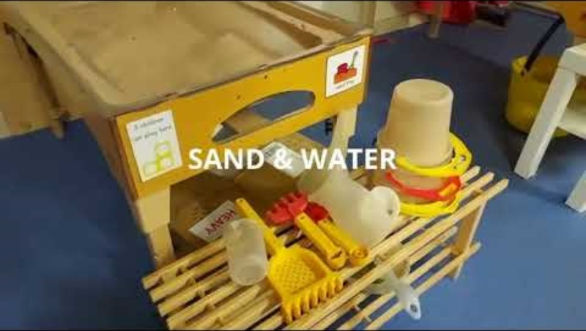

Slide 16
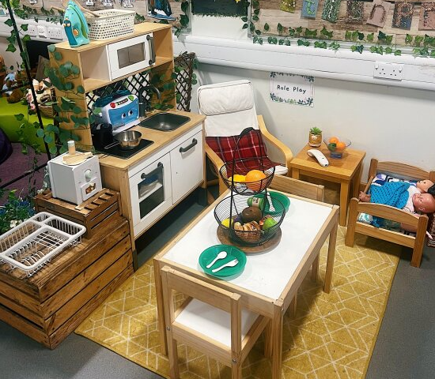
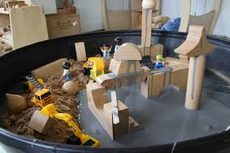
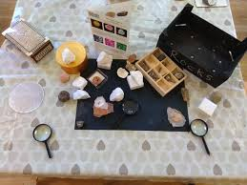
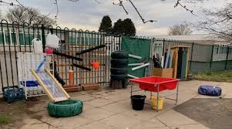
Zones/Areas: Possible Examples
Story Corner- books, magazines, reference materials, audio books, etc.
Home Corner
Table-top games
Calm space
Puppets- storytelling
Role play
Small world
Communication tools e.g telephone
Writing materials e.g. picture cards, paper, pens ,notebooks
Art & Craft e.g. junk modelling, painting, drawing, cutting and sticking
Woodwork
Music
Space for movement and dance
Mark making and Writing
Block play and construction
Tinker table e.g. nuts, bolts, screws, wires, parts of machines e.g. old computers
Sand and water
Play doh
Nature/Science/STEM area
Tinkering
Digital technology
Loose parts- pebbles, sand, twigs, acorns, feathers, stones, beads, bottle tops, spoons, etc
Construction materials e.g. Lego, Kapla, K’nex
Sensory Area
Reference books and resources
Large loose parts e.g. tree blocks, wooden blocks, half pipes, tarpaulin
Garden equipment e.g. gloves, digging materials
Water play area with resources
Mud kitchen
Risky play equipment e.g. climbing, swinging, balancing
Sports and physical equipment e.g. balls, scooters
STEM and exploration materials e.g. magnifying glass

Slide 17

Think, Feel, Steal?
Notes:
Go back to drawing/words about used to describe your environment- anything take away/change

Slide 18

By KerryAnne Kane
Play-Based Environment

Slide 19
Introduction
About Me
My name is KerryAnne Kane
Teaching within NLC for 17 years
P.1 teacher for 8 years
Started in a very traditional classroom

Slide 20
My Traditional Classroom Environment
Fixed seating- table and chair for every child
Bright walls
Printed displays
Uniform standardised displays of children’s work
Some toys- mainly plastic with fixed purpose at back
Outcome driven
Open area with more toys but only used at timetabled times and teacher controlled
Play often used as a reward

Slide 21
Changing the Environment
Removed all furniture
Created learning zones (meeting area, teacher table, library, writing area, maths area, creative area, construction area, messy play area, ICT area and role play area)
Furnished using old nursery furniture and large loose parts (reuse, recycle, repurpose)
Resourced using open ended resources (including natural materials)
Tables and chairs put in open area so children could complete targeted tasks
Introduced natural walls and colours
Used lights and mirrors
Introduced interactive displays and more pupil voice
Introduced ‘Speedy Skills’ and ‘Top Tasks’
Started to use provocations
Greater use of outdoor spaces

Slide 22
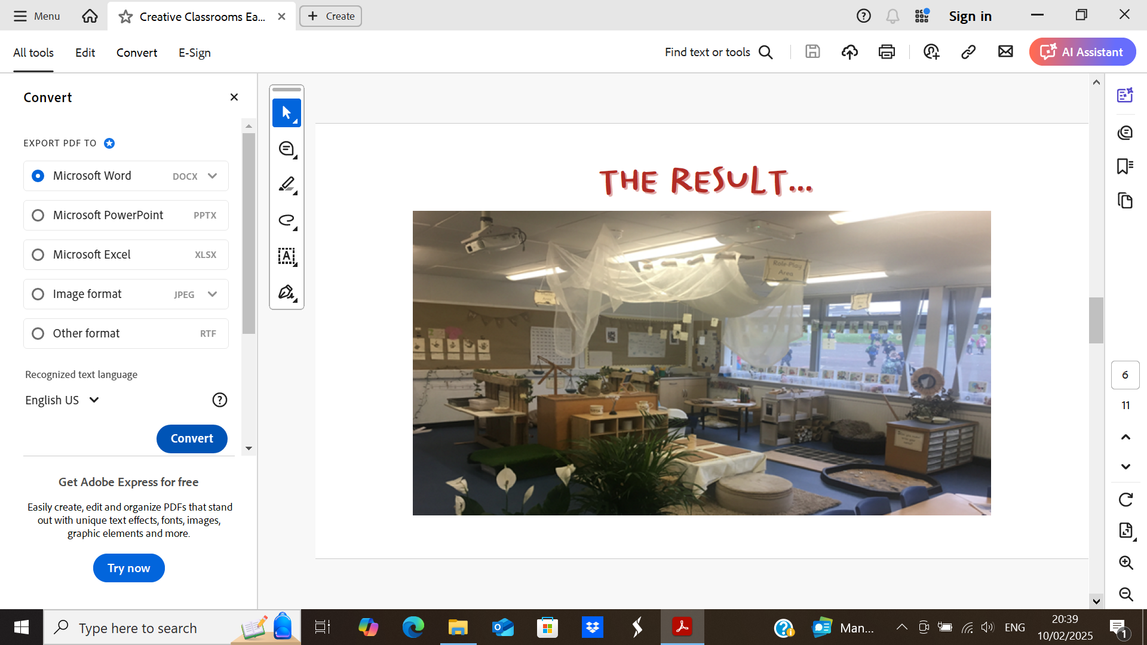
The result…
Lights and Mirrors
Storage Units and Baskets/ Tubs
Writing Table
Loose Parts/ Open Ended Materials
Teacher Table and Chairs
Natural Materials/ Resources
Soft Furnishings
Key Furniture/ Resources

Slide 23
Key Elements of Environment
The environment must be set up to give children space, time, and autonomy to engage in activities and interact with resources that are meaningful and interesting to them
Resources should be freely accessible
Learning areas/ zones should not create boundaries to learning
Maths and literacy should be evident in all areas
Provocations (invitations to play) should be evident within the space
Observations should inform the environment and provocations
Spaces should be responsive and ever changing
The environment/ provocations should focus on the process rather than outcome
The outdoors should be used often as an extension of the classroom

Slide 24
Challenges | Ways we have Minimised
Finding a balance between structure and freedom | Use of weekly planners highlighting direct teaching, teacher-initiated learning and child led Focusing on individual children’s needs Observations
Attainment | Emphasis on play as what is developmentally appropriate for children Use of formative and summative assessments and observations A range of evidence of learning Quality direct teaching
Coverage of Curriculum | Retrospective recording using outcome map Use of provocations (curiosity case)
Space | Removal of unnecessary furniture Use of outdoors
Safety | Risk assessments
Lack of resources/ funding | Asking for donations Reusing, recycling and repurposing Thinking creatively
Mess/ noise levels | One big tidy at the end of the day Use of ‘Top Tasks’ Changing the environment

Slide 25
Measuring Success
Engagement
Social interaction
Growth and development
Flexibility and adaptability

Slide 26
Suggested Reading/Further Support
Bottrill, G. (2022) Can I Go and Play Now? (second edition). London: SAGE ​
Education Scotland. (2020) Realising the Ambition ​
Fisher, J. (2013) Starting with the Child: Teaching and learning in the Foundation Stage (fourth edition). Wiltshire: Open University Press.
Project Zero (2023). A Pedagogy of Play: Supporting Playful Learning in Classrooms and Schools. Cambridge USA: Harvard University Press ​
Building a better future – Spaces (Pictures of spaces from schools and Early Years settings in Moray Council
Early Level Play Pedagogy Toolkit | Resources | National Improvement Hub (Play Pedagogy in Practice Section with practical examples)
elc35_reggioaug06.pdf (Reggio Emilia Approach to Early Years Education- Environment as Third Teacher)
education.gov.scot/media/3bjpr3wa/realisingtheambition.pdf
thecuriosityapproach.com/blog/what-is-the-curiosity-approach

Slide 27
