Slide 1
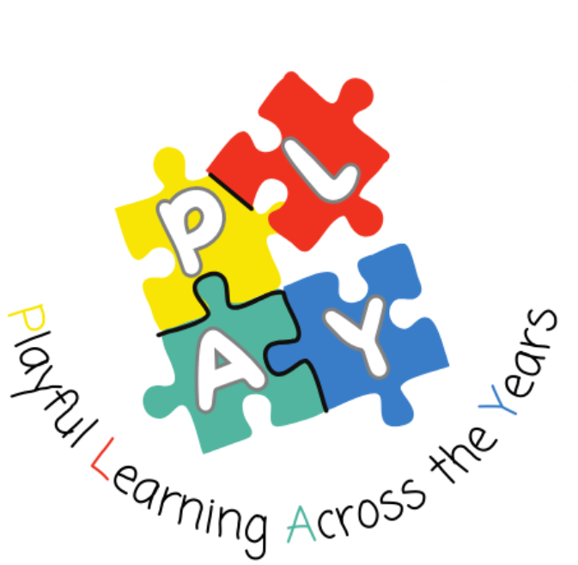
Play Pedagogy in NLC
Session 1
Play Pedagogy in Practice: Understanding the Rationale
Fiona Kirk (ESO- Play & Enquiry) kirkfiona@northlan.gov.uk
Lisa Lettis (ESO- Play & Enquiry) lettislisa@northlan.gov.uk

Slide 2


Slide 3
Overarching Aims:
To build a network of colleagues exploring Play Pedagogy
To develop consistent practice across NLC in Play Pedagogy
To ensure that a child-centred, systematic approach is used as a vehicle to support high quality learning and teaching in schools.
All stakeholders will have a clear rationale and understanding of the value of play.
We will have a shared language and understanding of how to support learning and teaching that nurtures the holistic development of children’s cognitive, social, emotional and physical capacities.
Ensure our classrooms reflect a pedagogy that is enabling for all children.

Slide 4
Session 1 Aims:
To understand the core programme and expectations
To discuss and explore our journey to this session
To explore the policies and research which underpin Play Pedagogy
To understand key aspects of child development
To explore a definition of play

Slide 5

Your Journey

Slide 6
A Rationale for Play Pedagogy in Schools
Our Why?
Early childhood is defined as the period from birth to age eight. It is a time of significant growth with brain development at its peak (UNESCO, 2017). During these years, the development of emotional wellbeing, cognitive skills, social competence and sound mental and physical health build a strong foundation for success into adult years (UNICEF, 2018).
32.4% of children and young people in NLC have additional support need status (January 2025).
Public Health Scotland Statistics show at age 4-5 assessment the number of children in SIMD 1 with a developmental concern was 24% compared with 11% of children in SIMD 5 (32.5% of children in NLC living in Q1).

Slide 7
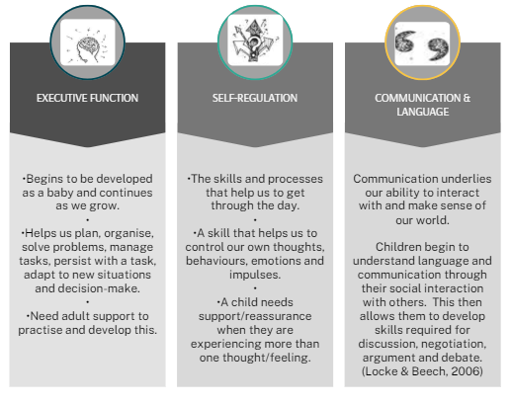
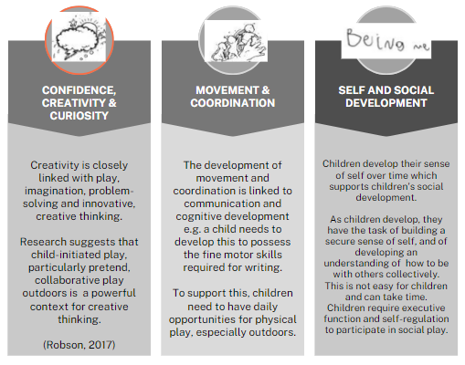
There are 6 core dimensions of child development that are central to learning, surviving and flourishing:
Play helps develop these naturally and in a developmentally appropriate way.

Slide 8
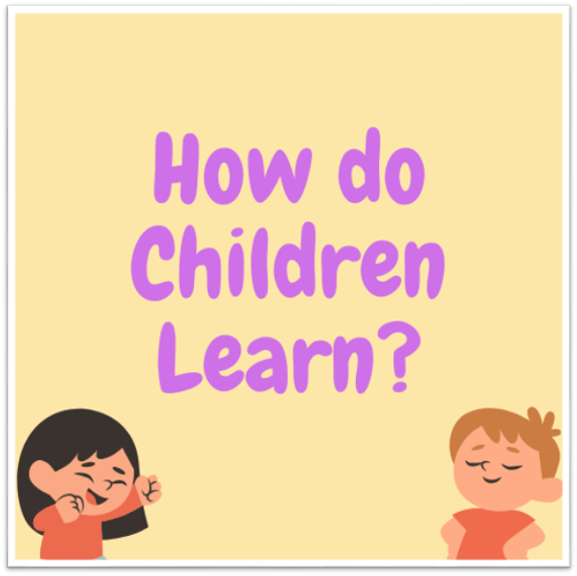

Slide 9
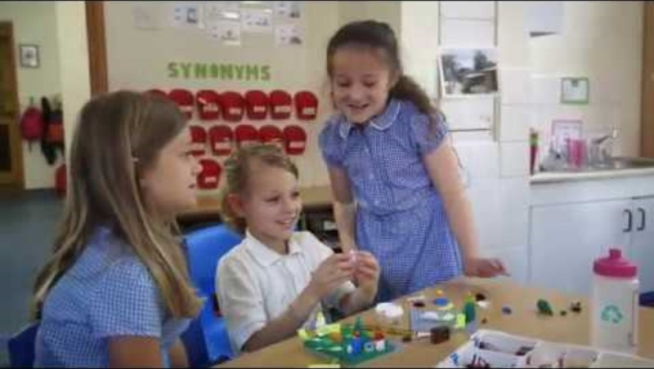
Notes:
5 characteristics of learning through play- to apply their learning and support the development of future skills e.g. for jobs that haven’t been created
Actively engaging, iterative, joy, meaningful, socially interactive

Slide 10
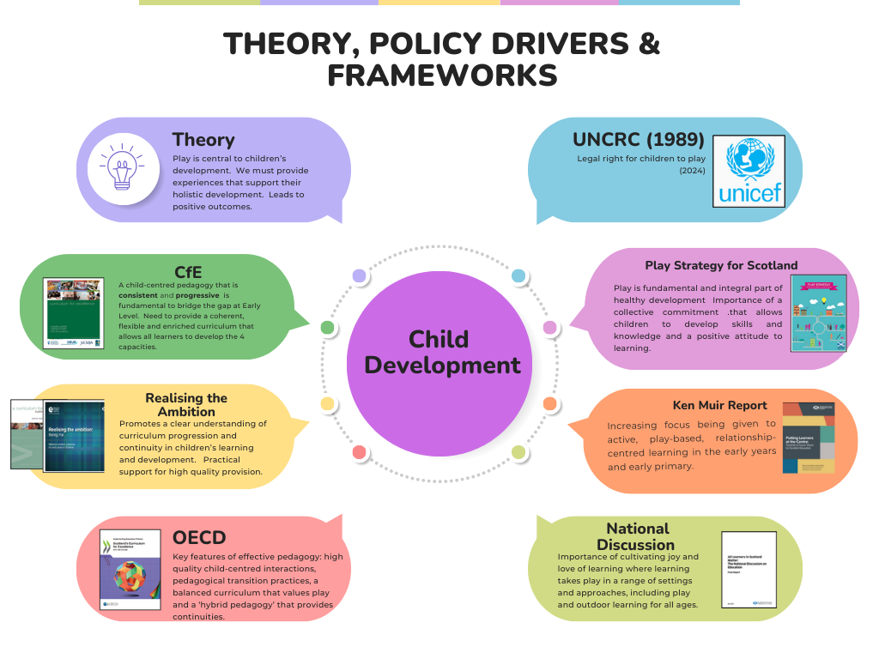
Notes:
Theory- Froebel, Vygotsky, Fabian
PP supports children’s rights- right to play, right to be heard, right to share thoughts
CfE- consistent and progressive, bridge the gap, flexible and enriched curriculum
Realising the Ambition- clear understanding of curriculum progression, continuity. Offers practical support for high quality provision.
OECD- high quality child-centred interactions- continuity
Play Strategy- play is fundamental and integral part of healthy development
Ken Muir & National Discussion- cultivation of joy and love of learning- Bristol research

Slide 11
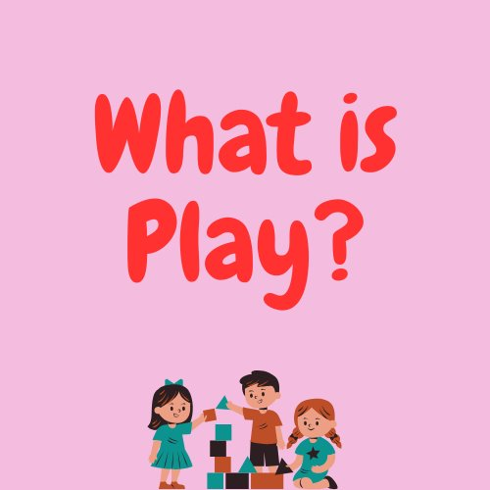
Look at or read the description of the activities.
Sort the activities into categories. What categories have you chosen and why?

Slide 12
Play encompasses children’s behaviour which is freely chosen, personally directed and intrinsically motivated. It is performed for no external goal or reward and is a fundamental and integral part of healthy development which seeks to improve play experiences for all children. (RtAp45)

Slide 13
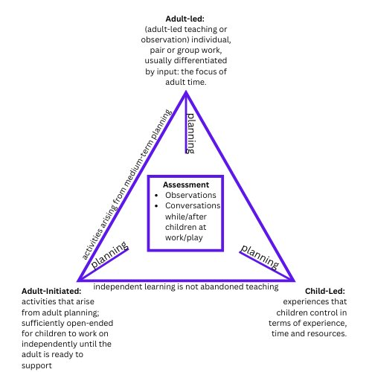

Slide 14
What is Play Pedagogy?
A systematic and child-centred approach that helps to support high quality learning and teaching in schools. It helps schools to develop a shared language and understanding of how to support learning and teaching that nurtures the holistic development of children’s social, emotional, physical and cognitive capacities.

Slide 15
What is Play Pedagogy?
What play pedagogy is? | What play pedagogy is not?
A child-centred , developmentally-appropriate approach that enables children to develop their cognitive, physical, social and emotional capacities | An intervention
An approach that supports high-quality learning, teaching and assessment through thoughtful interactions, experiences and spaces | An easy alternative for teachers
Links to the curriculum i.e. the curriculum is what children learn and play is a vehicle for how children learn | A quick fix for dealing with additional support needs/behavioural issues
Play IS learning | Play is not separate from learning
Implementation of Curriculum for Excellence supported by Realising the Ambition guidance | Play does not replace teaching of specific skills e.g. phonics

Slide 16
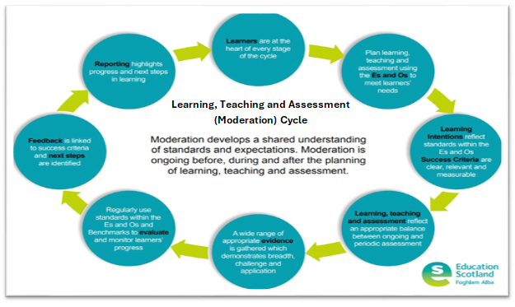
What does highly effective practice in Primary 1 look like?
Environment “does not look starkly different” from Early Years setting- Learning zones integrated into the classroom where possible and use of outdoor spaces
High quality learning and teaching that features thoughtful interactions, experiences and outcomes for all children- opportunities to deepen their learning and explore new learning and develop skills
A continuum of adult-directed learning (direct teaching of specific knowledge and skills), adult-initiated learning and child-led learning- clear understanding of the role of the adult
Skilled and knowledgeable practitioners- flexible and evolve their practice to meet the needs of their learners and ensure progression across Early Level through ongoing and periodic assessment
A variety of approaches used to plan, manage and assess learning e.g. observations, standardised assessments, responsive and intentional planning to ensure high levels of attainment
High quality resources available that are purposeful, flexible, open-ended and that stimulate curiosity and creativity. ​
Children’s voice is central e.g. planning, assessing, the environment leading their learning
High levels of engagement and involvement
Environment is calm, regularly reviewed- provision is refreshed to ensure it stimulates children

Slide 17
Voices from Practice: Play Pedagogy in NLC
We have introduced EPIC time (Everyone Playing in Class), which must be self-chosen and self-directed, intrinsically reinforcing and self-motivating, always structured and well planned and always imaginative. This has created a lovely environment where children and teachers play alongside each other. By focusing on play schemas and being actively involved in EPIC time, it has allowed staff to show more of an understanding of the learning and type of play taking place.
Play Pedagogy has allowed a more seamless transition from nursery to Primary 1. Children have more choice in their learning and there is no ceiling put on what they learn making it easier to extend and challenge. As a practitioner, I have never known my children better, which enables me to adapt my teaching to meet the individual needs of all children. Play Pedagogy allows for easier differentiation and allows children who are not ready to access the curriculum, regular opportunities to engage in learning in a way and at a pace that suits them.
Play Pedagogy truly allows practitioners to teach with a child centred approach. Play allows for a freedom to teach in a way that Curriculum for Excellence intended. Play Pedagogy allows teachers to examine the experiences and outcomes and think how can my learners best complete this learning? Furthermore, I have never known for children to develop more in the four capacities than what play has facilitated. Play has provided an enhanced transition from nursery supporting and extending children where appropriate. Play has enhanced my pedagogy by enhancing my knowledge of each individual and how best they learn. The opportunities for learners to access a continuous provision, that is meaningful, planned and challenging has allowed learners to have breadth and depth to their learning. Every cohort is different but so far, our data for attainment has been strong showing that Play Pedagogy can improve teaching and learning in a child centred way. Learners are intrinsically motivated, more resilient and cooperative in tasks.
“A balance of teacher directed, child initiated, teacher initiated are all used to provide challenge and enjoyment within the principles of the curriculum design”.
“Children’s level of confidence in regard to sharing thoughts and opinions around their interests have grown considerably”.
“Pupil choice/voice allows children to lead their learning, direct their learning, choose a focus, and become intrinsically motivated. This allows the teacher to plan responsively and allows for more curriculum coverage”.
“We never look at play as a reward, we firmly believe it is a crucial part of the learning process of the child”.

Slide 18
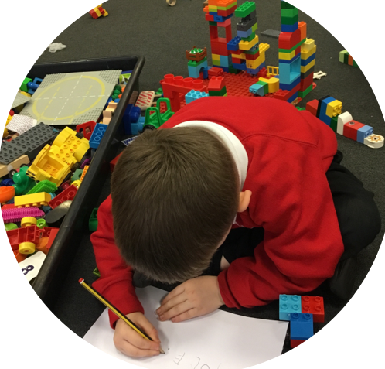
Children’s Voice: Play Pedagogy
Play is when you get to use your imagination. It’s learning in a fun way.
You get to learn other things through play.
Play is fun because you get to move around instead of sitting in class all day.
Play is happiness.
I enjoy creating and building and using my cutting skills.
I enjoy using design skills to build.

Slide 19
Suggested Reading
Bottrill, G. (2022) Can I Go and Play Now? (second edition). London: SAGE
Education Scotland. (2020) Realising the Ambition education.gov.scot/media/3bjpr3wa/realisingtheambition.pdf
Fisher, J. (2013) Starting with the Child: Teaching and learning in the Foundation Stage (fourth edition). Wiltshire: Open University Press.
Palmer, S. (2020) Play is the Way: Child development, Early Years and the Future of Scottish Education. Thirsty Press.
Project Zero (2023). A Pedagogy of Play: Supporting Playful Learning in Classrooms and Schools. Cambridge USA: Harvard University Press

Slide 20
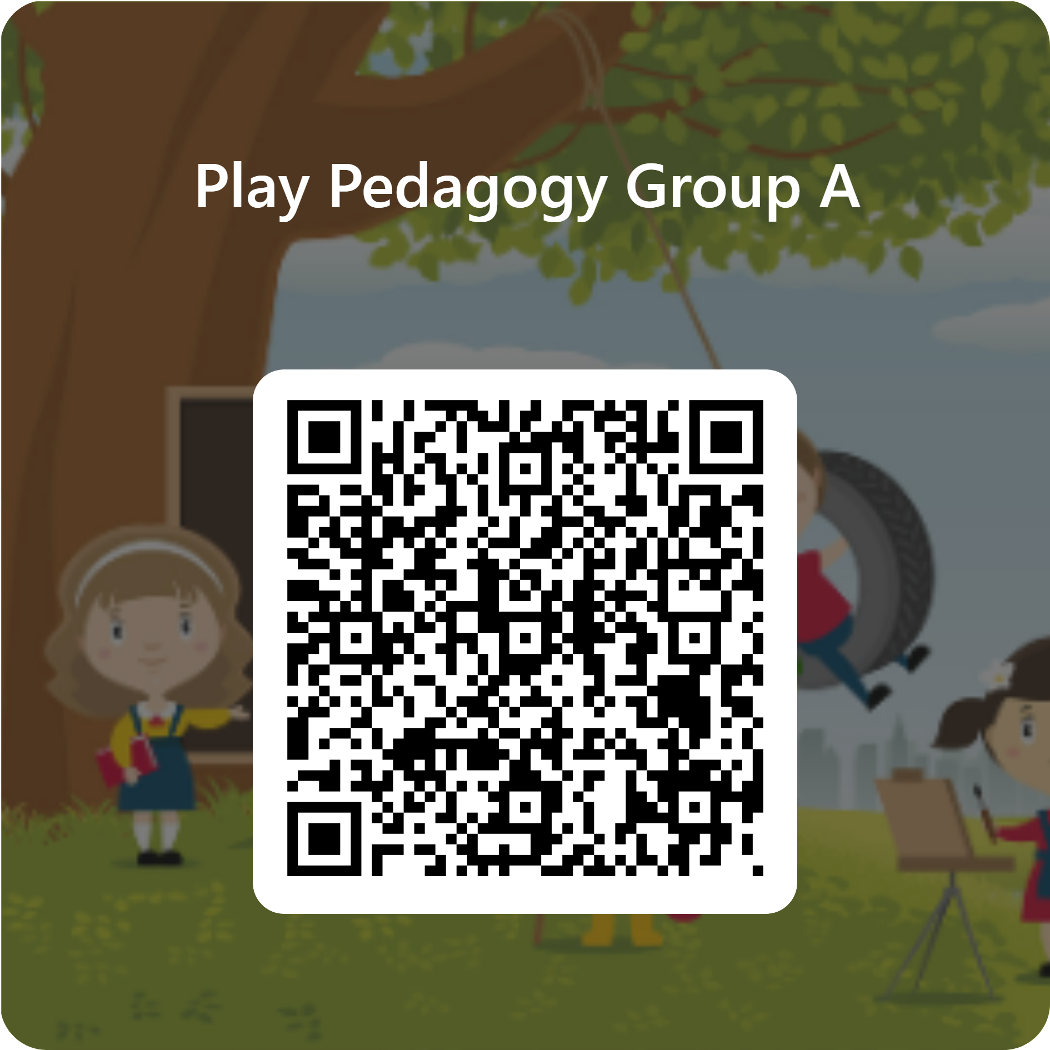
Notes:
Questions

