Slide 2
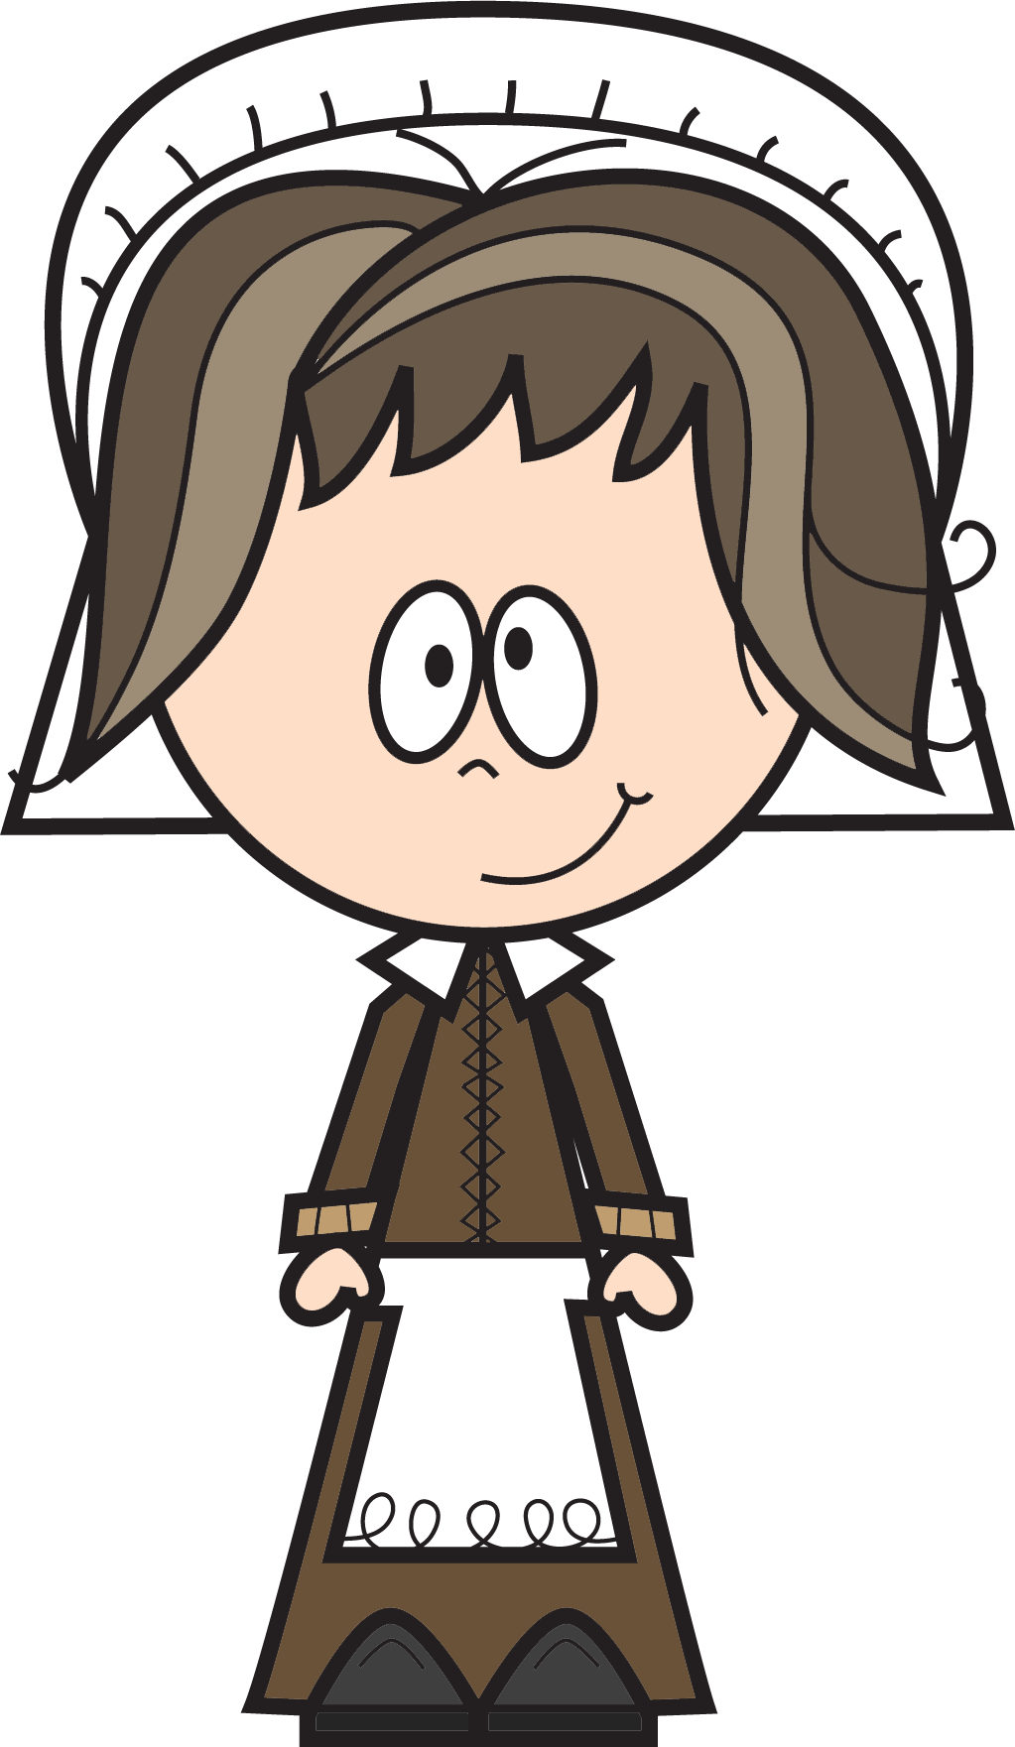
International Nurses Day is celebrated every year on the 12th May. This takes place on the anniversary of Florence Nightingale’s birth. She is a very famous nurse and this year is a special celebration as it is 200 years since Florence Nightingale was born! This year’s celebration is also very significant as our nurses face the very difficult job of nursing people back to full health, both physically and mentally, during the Covid-19 pandemic. We are very grateful to the fantastic, selfless job that they do along with all the other medical and key workers.
To celebrate, we are going to learn more about Florence Nightingale. Go to https://www.twinkl.co.uk/go and use the pin UA0195 to complete one or two interactive activities of your choice at a level that suits you! (Click on my lessons and then Primary 7 Florence Nightingale Lesson to access the activities)
Once you are all clued up on your facts select at least one activity from our choice board. I would love to see some examples of your work on our Microsoft Teams feed.

Slide 3
YOU GOT SKILLS Create a job advertisement for a nurse. What skills do you think you may need to have? How would you persuade someone to take the job? | SAY CHEESE If a family member is a nurse ask them if they are allowed to take a photo together with their nurse work colleagues and post on Twitter mentioning @LadywellPrimary to allow everyone to say thank you. | RESEARCH Learn about the different colours and types of uniforms nurses wear. How do these compare to other countries in the world?
FIRST AID Click HERE to watch a short video revising basic first aid. Comment something you learned. | CELEBRATE Find out about some famous nurses from the past and create a TOP 5 facts poster about one of them. | DEAR DIARY... Pretend you are Florence Nightingale and create a diary entry. Click to the next slide for some handy hints...

Slide 4
Can you answer these questions in your diary?
What was the hospital like?
How were you feeling?
What was happening around you? What could you see, hear and feel?
What treatments did Florence give to injured soldiers?
Florence would walk around with her lamp, writing letters to the injured soldiers and spend time talking to them. What might she have written or talked about?

