Slide 1
Year 4 - Summer - Block 2
Money

Slide 2
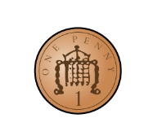
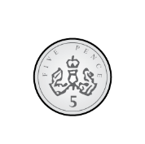
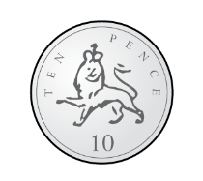
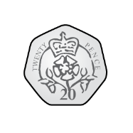
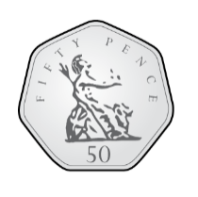
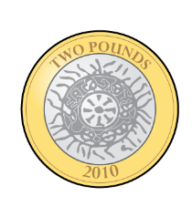
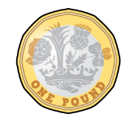
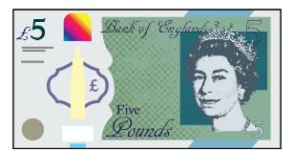
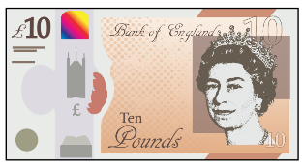
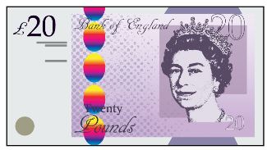
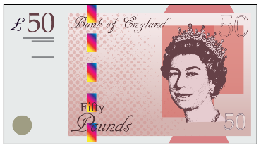
Some children are converting 1206 p into pounds.
Who is correct?
Whitney
Rosie
Teddy
What have the others done wrong?
Explain your answer.
1206 p $=$ £12.6
1206 p $=$ £12.06
1206 p $=$ £120.6

Slide 3
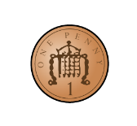
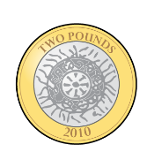
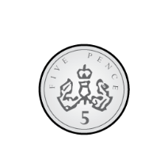
Eva has these coins:
She picks three coins at a time.
Decide whether the statements will be always, sometimes or never true.
She can make a total which ends in 2
She can make an odd amount.
She can make an amount greater than £6
She can make a total which is a multiple of 5 pence
Can you think of your own always, sometimes, never statements?

Slide 4
Teddy, Dora and Jack are buying toys.
Teddy
Dora
Jack
How much money could Jack have?
Is there only one answer?
I have £5.43
I have 534p
I have more money than Dora but less than Teddy.

Slide 5
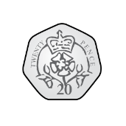
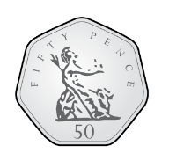
What would you rather have, five 50p coins or twelve 20p coins?
Explain your answer fully.

Slide 6
Amir has these digits cards.
He uses them to fill the frame below:
He makes a total that is more than three pounds but less than six pounds.
How many amounts can he make?
Order your amounts in ascending order.
4
6
3
2
£ .

Slide 7
£5.45
Three children buy toys.
Can you work out who buys what?
-Tommy buys a toy which rounds to £5 but gets change from £5
-Amir buys two toys which total approximately £25
-Eva’s toy costs 5 p more than the number the cost rounds to.
If you had £30, what combinations could you buy and what change would you approximately get?
£19.83
£3.05
£4.65

Slide 8
Mo buys some socks and gloves.
He estimates how much
he’ll spend.
£4 $+$ £5 $=$ £9
What could the actual price of the socks and gloves have been?
Mo has £12
He says he has enough money to buy three pairs of socks.
Do you agree?
Explain why.

Slide 9
A class has £100 to spend on books.
How many books could they buy for £100?
How many different ways can this be done?
Book Prices
Hardback $=$ £8
Paperback $=$ £4

Slide 10
Dexter buys a teddy bear for £6.00, a board game for £4.00, a CD for £5.50 and a box of chocolates for £2.50
He has some discount vouchers.
He can either get £10.00 off or pay half price for his items.
Which voucher would save him more?
Explain your thinking.

Slide 11
Here is Dora’s receipt.
Use the information to complete the receipt:
The sandwich costs £2.15 more than the crisps.
The orange juice is the same price as the crisps and banana together.
The banana is half the price of the crisps.
Receipt
Sandwich
Orange Juice
Crisps | 60p
Banana
TOTAL

