Slide 1
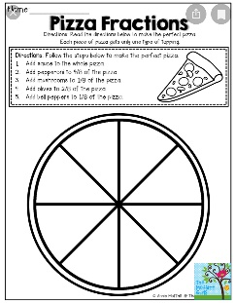
Spelling
Purple Group after face faint crafty magnificent traffic daffodil difficult raffle staff graph telephone elephant phantom photograph | Orange Group quack quiet quiz queen quit quite are dad not
Write your words 3 times (handwriting practice) Partner spell Jumbled spell
Reading
With the book you’ve chosen at home complete the following tasks…. Design a new front cover Illustrate your favourite part of the book Create a comic strip of your favourite part
Maths
Quick 10 https://www.topmarks.co.uk/maths-games/daily10 (choose Level 2, Multiplication, Mixed Tables)
Number Talks Remember to talk about how you solved these chilli challenges – if you can others to join in you can teach them the hand signals.
https://www.bbc.co.uk/bitesize/topics/z3rbg82/articles/zq2yfrd Have a look at the short clip & quiz – have fun! Can you complete your own Fractions Pizza……..
38+20 38+26 38+30 38+33 | 45+30 45+38 45+40 45+46 | 57+10 57+14 57+30 57+36
French
https://www.bbc.co.uk/teach/supermovers/ks1--ks2-mfl-french-greetings-with-ben-shires/zdpdvk7 Watch & practise having a short conversation to say hi!
RME
Please complete the ‘Eid-al-Fitr’ flip book posted on the class blog. https://blogs.glowscotland.org.uk/nl/public/p42020/uploads/sites/39479/2020/03/19132720/t-re-367-eid-alfitr-flapbook.pdf
Handwriting
Please complete one of the Handwriting sheets previously posted on the class blog. https://blogs.glowscotland.org.uk/nl/p42020/2020/03/19/handwriting/
Music
Listen to your favourite music and tell me on ‘Teams’ your favourite song to dance to!
Remember I will also be posting Daily Challenges on the Glow P4 Team, our Class Blog on the school website and on Twitter (@MrsSteel_LWell). If you have any questions please email me AlisonSteel@ladywell.n-lanark.sch.uk

