Slide 1
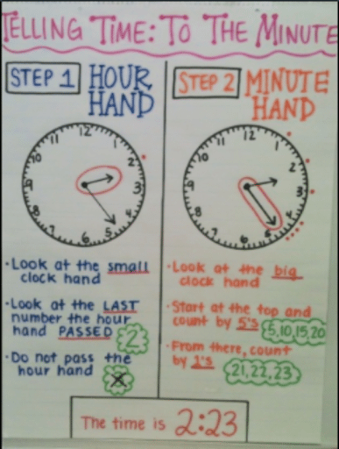
Hi Primary 4! Here are some task for you to do this week! If you can, post them so I can see all your hard work! Miss Stewart ☺
Maths
Health and Wellbeing
Who has been joining Joe Wicks every morning for some fitness?
LI:To understand how to look after your body now and in the future.
Discuss what ‘being healthy’ means – what it looks like, feels and sounds like.
Activity
Children could try to illustrate their ideas. Select images from magazines of what they think ‘being healthy’ looks like and create a poster – children could write captions explaining their choice of picture.
Writing
Who are they?
Look through either a magazine or a newspaper. Choose three people who you would like to write about and cut them out.
Write about who the people are, what their lives are like, and how they might know each other.
A variation of this would be go out for a walk. Pick some people who you may pass and make some quick notes about them- how did they look, what were they wearing. Then write a story about them when you get home.
This week their will be a focus on time.
With an adult at home go over the sheet above and practise telling the time to the nearest minute.
Useful interactive website:
https://www.topmarks.co.uk/time/teaching-clock

